Slide 1
The Darwin VAAC Volcanic Ash Workstation
R Potts, M Manickam, A Tupper and J Davey
Bureau of Meteorology, Australia
Volcanic ash – aviation hazard mitigation arrangements
Science / Operational issues
VAWS
Future directions

Slide 2
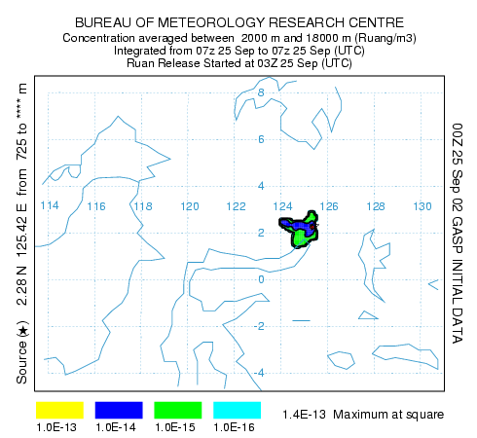
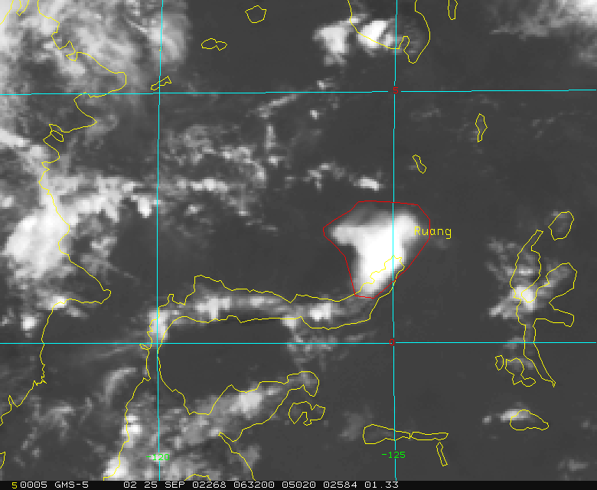
Warnings for volcanic ash
Advice for aviation on eruptions and the presence of volcanic ash is based on detection or notification of an eruption, satellite data and dispersion model output.
The text based advice provides information on the current position of the ash cloud and forecast positions for +6h, +12h and +18h.

Slide 3
Warnings for volcanic ash
VAAC service requirement – the process
Timely advice / detection of eruption
Delineation of analysed threat area or ash boundary
Delineation of forecast threat area
Timely preparation and issue of Volcanic Ash Advisory (corresponding graphical product)

Slide 4
Warnings for volcanic ash
Science issues
Timely detection of eruption / ash cloud
Satellite data
  Detection of ash (height, boundary)
  Discrimination of ash from water/ice clouds
  Vis / IR data – GOES9, NOAA AVHRR

Slide 5
Warnings for volcanic ash
Science issues … cont
Dispersion model
  Underlying NWP model
  Source term
  Dispersion model
  Utilization / visualization of output
What ash concentration is a hazard to aircraft

Slide 6
Warnings for volcanic ash
Operational / Service issues
Timely advice of eruption / ash cloud
Delineation of analysed threat area
Delineation of forecast threat area
Timely issue of volcanic ash warnings
  Process manually intensive
  Staff resources limited
  Risk of delays / errors

Slide 7
Warnings for volcanic ash
Operational / Service issues … cont
Need for graphical product consistent with text VAA
Training & Education

Slide 8
Warnings for volcanic ash
Service requirement
…
Delineation of analysed threat area
  (height, perimeter, multiple layers)
Delineation of forecast threat area
  (height, perimeter, multiple layers)
…

Slide 9
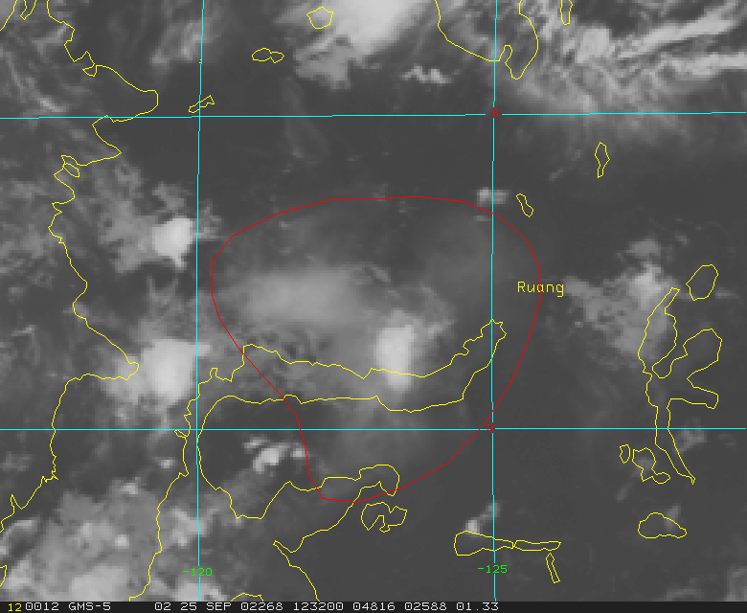
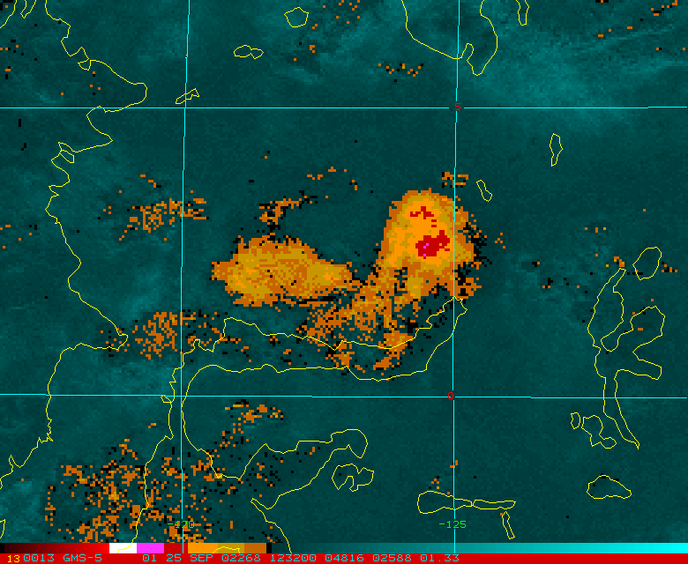
Ruang volcano - 25 September 2002, 0345 UTC
GMS5 satellite data, 25 Sept 2002, 1230 UTC

Slide 10
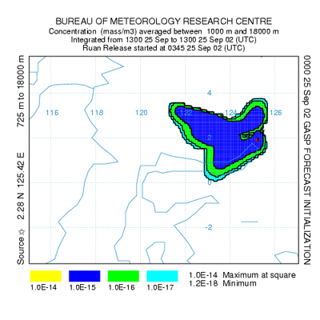
Ruang volcano - 25 September 2002, 0345 UTC
Hysplit dispersion model forecast
25 Sept, 1300 UTC
GMS5, 25 Sept 2002, 1230 UTC

Slide 11
Volcanic ash warning service
Service requirement
…
Timely preparation of Volcanic Ash Advisory (and corresponding graphical product)

Slide 12
Volcanic Ash Warning Preparation System (VAWS)
Interactive user interface to streamline preparation of warning
Integrated display environment (satellite, NWP data, dispersion model)
Text + graphical product
Stable framework for implementation of improved analysis and forecast methodologies
Responsive graphical interface
Platform independence

Slide 13
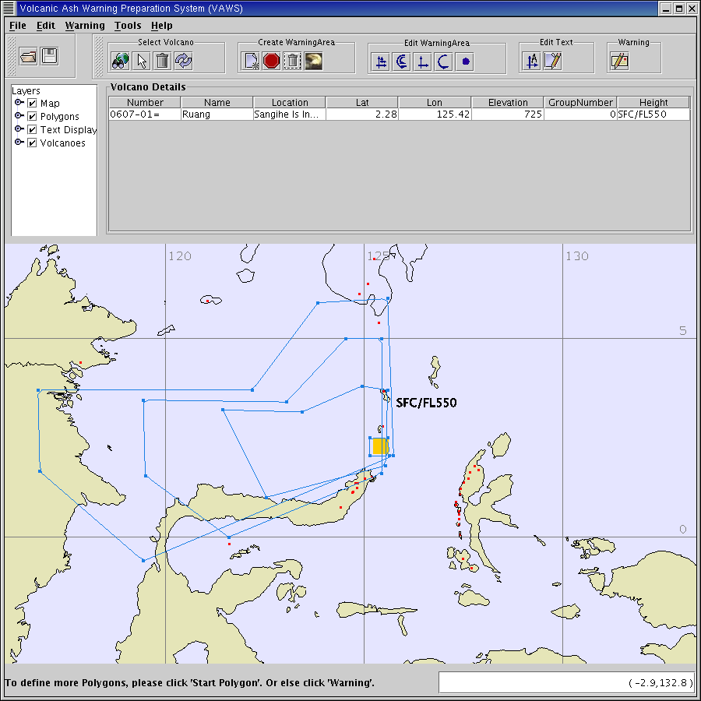
Volcanic Ash Warning Preparation System (VAWS)
Graphical interface
Select volcano
Define height and delineate analysed and forecast threat areas

Slide 14
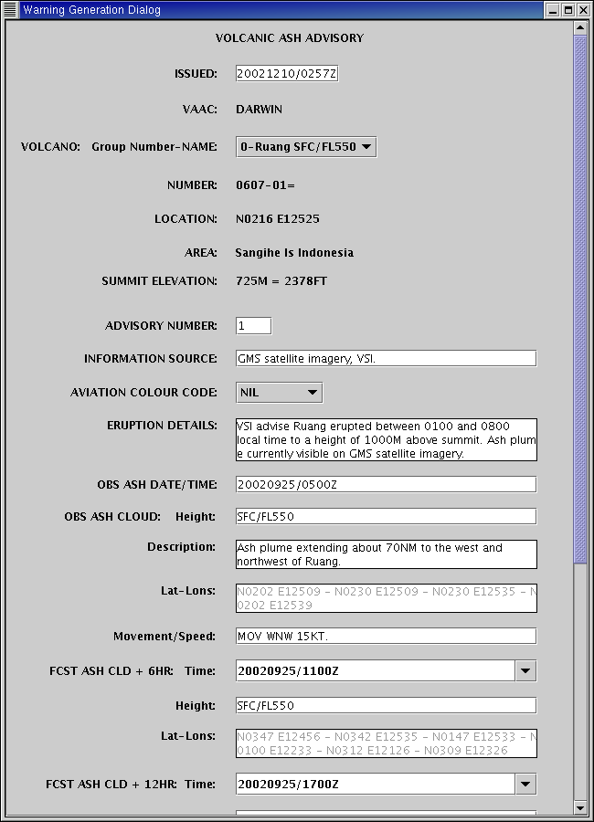
Text interface
Input manual elements of Advisory message
Preview output
Submit

Slide 15
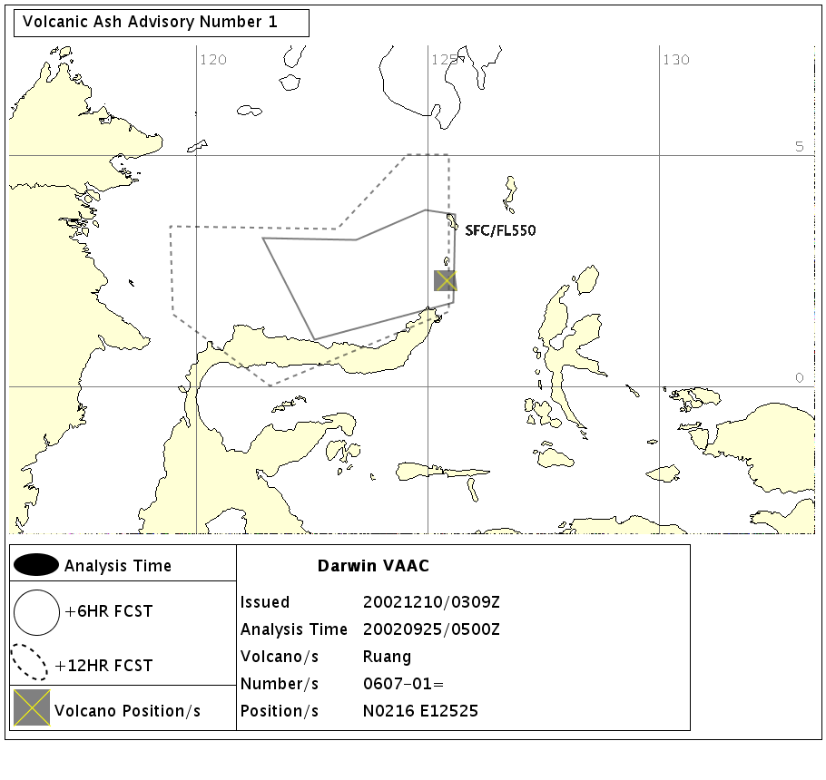
Output graphical product

Slide 16
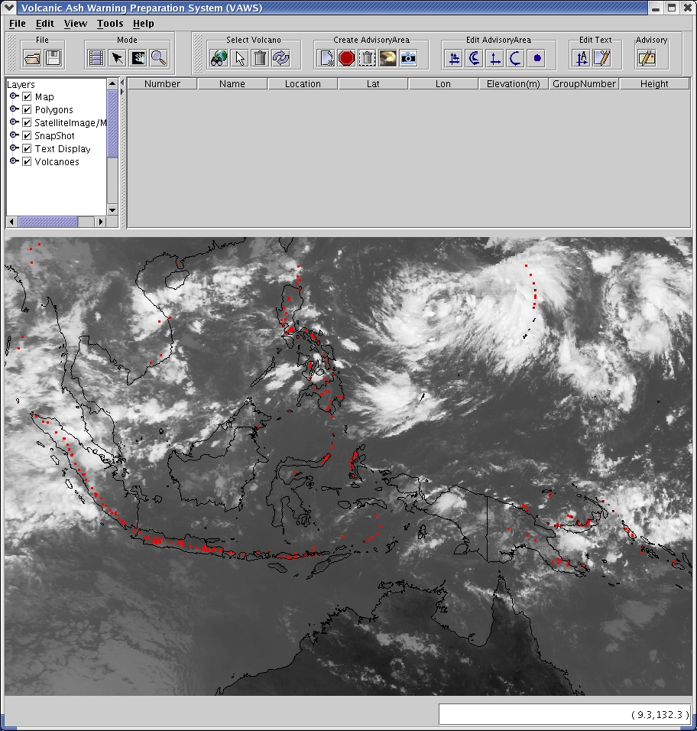
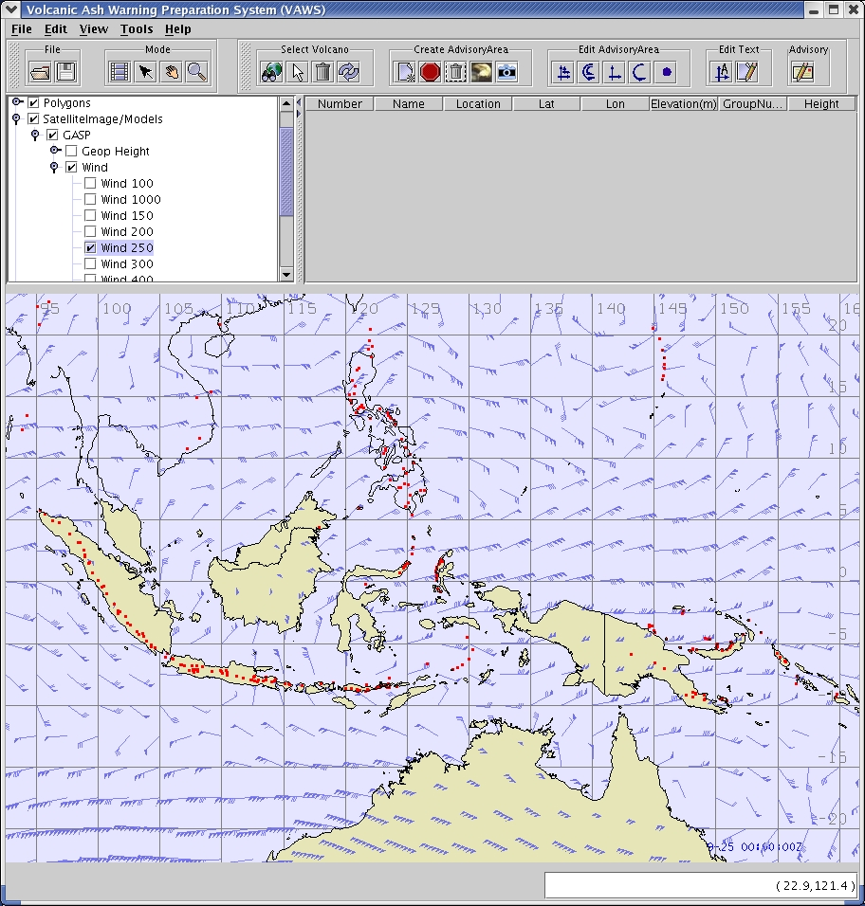
The next step –
Implement display of satellite data, NWP data, dispersion model output

Slide 17
Operational experience
Operational use since 2 Dec 2003
  200+ VAA messages up to 1 June 2004
  www.bom.gov.au/info/vaac/advisories.shtml
Forecasters generally satisfied
  Streamlines preparation of VAA
  Upgrades (look and feel, operations)
Aviation industry satisfied with graphical product
  Consistent with text product
  Clear, simple, concise

Slide 18
Future directions
Further development of VAWS
  dispersion model
Detection of volcanic eruptions
Improve detection and analysis of volcanic ash plumes - MTSAT-R, MODIS, GIFTS
Improve utilisation of ash dispersion model output

Slide 19
The End

