Slide 1
Rapid Detection of
Bio-Terrorist Attacks
Galit Shmueli
Smith School of Business
University of Maryland, College Park, MD
Collaboration with Stephen E. Fienberg and Anna Goldenberg
Center for Automated Learning and Discovery
Carnegie Mellon University
Dunja Mladenic
J.Stefan Institute, Ljubljana, Slovenia Rich Caruana
Cornell University

Slide 2
Overview
Requirements for timely detection
Data sources used for detection
  Traditional vs. non-traditional
  Potential for early detection
Outbreak detection using grocery sales data
  Single series vs. basket-level data
  Characteristics
  Design of statistical framework
Combining data sources
  Benefits
  Challenges

Slide 3
Requirements for a Timely Detection System
Frequent collection of data.
Fast transfer of data (electronic reporting).
Immediate analysis of incoming data.
Immediate output.
Additional requirements:
  Sufficient amount of data.
  Data need to be local, not nationwide.
  Data must include early signature of outbreak!
Notes:
Restricted geographical region
Powerful system
Local data vs. enough data

Slide 4
Data Traditionally Used for Outbreak Detection
COLLECT
TRANSFER
ANALYZE
DECIDE
DATA:
  FREQ.
  RICH
  LOCAL
  EARLY SIGNATURE
Emergency medical services
Sentinel practices
Laboratory & mortality data
School absence records
Veterinary reports
911 calls & ambulance dispatch
Notes:
ICD9 codes
NY, Baltimore, Seattle, Western Pennsylvania. (http://www.cbsnews.com/stories/2002/11/01/attack/main527736.shtml)
Baltimore: cat & dog deaths

Slide 5





Non-Traditional Data Sources
Idea: Carry very early signature of outbreak
  Prescription drugs and over-the-counter medication at pharmacies
  OTC medications and grocery sales
  Web browsing at medical websites
  Automatic body tracking devices
Notes:
Prescriptions – traditional data source?
Tracking NY pharmacy data: NYC Dept. of Health
Verispan: claims from Rx + Doctors

Slide 6
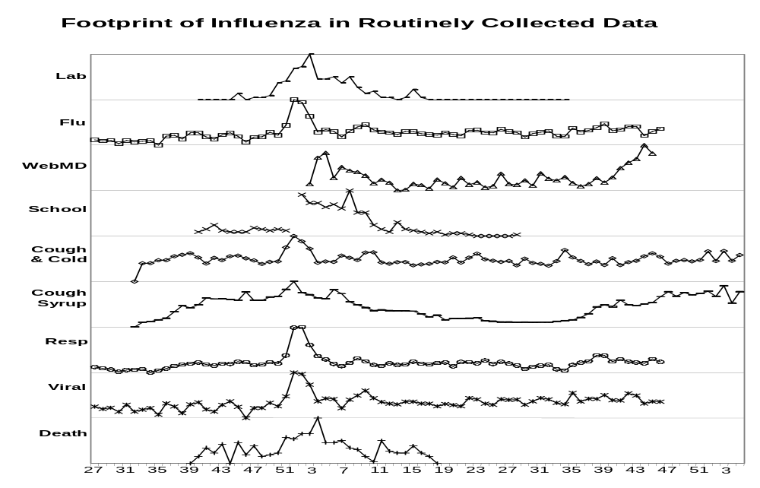
Lab cultures
Sentinel Physicians
WebMD queries
School absence
Cough&Cold sales
Cough syrup sales
ER Resp complaints
ER Viral complaints
Deaths
weeks
Notes:
Flu, Resp, Viral are ICD9 codes.
Throat is subgroup of Cough & Cold

Slide 7
Grocery and OTC Data
Recent efforts to examine hospital admissions data (Reis et al., PNAS 2003) suggest that important signals can be found from aggregated information across multiple days.
Scanner data are, in principle, available in real-time so the issue is what frequency is most relevant.
NY health dept collects daily Pharmacy data (R_{x} & OTC), but no analytic methods yet.
We used daily data in our initial work.
Notes:
Daily data available, not popular in marketing.

Slide 8

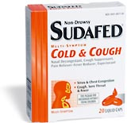
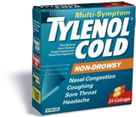

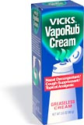
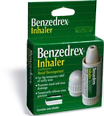
Grocery Sales Data: Daily Sales
Daily sales of several OTC medication groups for 541 days between 8/8/1999 - 1/31/2001
Concentrated on cough & cold medication (inhalational symptoms):
  Cough medication
  Tabs & Caps
  Nasal medication
Notes:
Store zipcode?

Slide 9
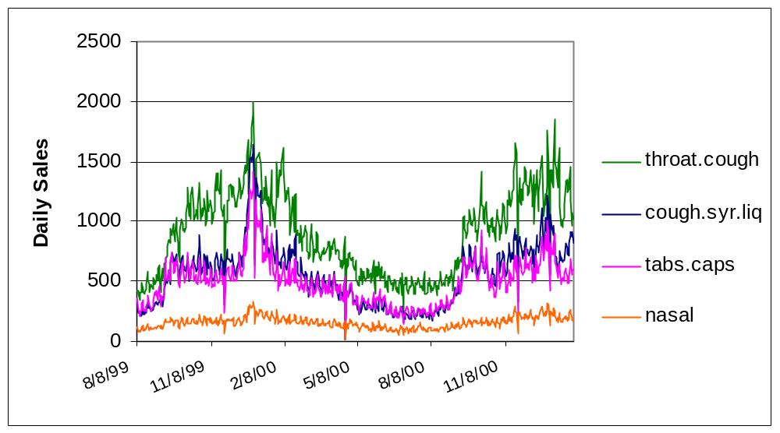
Features of Grocery Sales Data
Very noisy
Non-stationary
Seasonal
Correlate with total sales
  Stores closed on certain days
  Weekday/Weekend

Slide 10
Existing Analysis Methods for Single Series
CDC:
  QC: p-charts, Cusum, moving average, etc.
  Regression type Serfling method, account for cycles
  Problem: assumes independence
Time Series
  ARIMA (for annual data) and ARIMA-type
  Problem: assumes stationarity
Scan statistic
  Monitors reported spatial or space-time disease clusters
  Developed by Martin Kulldorff (http://srab.cancer.gov/satscan/)
  Assumes Poisson/Bernoulli dist of number of events in an area
Notes:
Serfling (standard in CDC): y_t = a + b t + cos(t/365.25 + d) + e_t

Slide 11
The Challenge:
Design a Statistical Framework
Model “no-outbreak” baseline of sales
  Use preliminary data
  Account for total sales, marketing efforts
  “Get rid” of noise (smooth, model)
  Any actual outbreaks during baseline period?
  Blackbox vs. tractable methods
Establish threshold to declare outliers
  Distinguish real increase from random noise
Notes:
Pharmacy data collected by NY Health dept but no analysis method.

Slide 12
The Challenge: Design a Statistical Framework – cont.
Develop role-forward algorithm
  Online vs. offline data & analysis
  Assess every new data point
  Efficient (fast, computationally cheap)
Test system for real & false alarms
  Simulate footprint of outbreak in sales, with team of experts (public health, medicine, marketing)

Slide 13
Constraints and Requirements
Automated system
  Computationally efficient tools
  Not too customized to specific dataset
  Flexible for handling different outbreaks types
User friendly
  Tractable methods
  Software availability
  Informative output
Ability to integrate with other data sources
  The importance of multiple sources (Wagner, 2002)
  Wagner & Moore attempt to integrate medical & public health data
Notes:
Wagner & Moore’s goal to integrate datasets (PH + med)

Slide 14
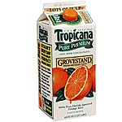
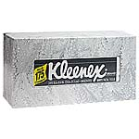



The Complete Grocery Data:
Basket-Level Data
The Data
  The footprint as a collection of symptoms!
  Much larger dataset: millions of baskets weekly.
  Only baskets with one or more of 50 pre-selected products: 200,000-500,000 baskets a week.
  Track freq of combinations of medications/groceries.
  Look for unusually high-freq combinations in baskets.

Slide 15
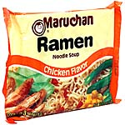

Preliminary Analysis & Results
Data-Mining methods
  Look for combinations that occur in more than 0.1% of baskets that contain at least one selected item
    Confidence (% baskets containing X which also contain Y)
    Support (% of baskets that contain both X,Y)
  Further reduction: only rules that have high ranking
Results (unexpectedly high frequency):
  Cough + Throat + Tabs & Caps
  + +
“Ramen Noodle”
“Condensed”
“Ready to eat”
Notes:
Soup triplet is most stable and repeats over time (higher frequency items than health-related items!)
Different classification (more detailed); variety seeking of soups vs. laxatives

Slide 16
Design a Statistical Framework
Use arrays of data on co-purchases.
Define “combined-baseline” frequency.
Test divergence from baseline using statistical testing.
  Independence: Naïve Bayes.
  Quasi-independence: Log-linear model (Larntz & Weisberg, JASA 1976).
Develop visualization tools for displaying combinations over time.
Notes:
Co-purchases: groups of items within single baskets. joint or multiple sets.. UNIQUE
Naïve Bayes: looks at counts (one-way marginal) across baskets. independence assumption incorrect, but empirical success (Langley, Iba, Thompson, 1992)
Quasi independence: Look at joint distributions.

Slide 17
Combining Data Sources
Examples of sources w. identifiers:
  Grocery and Pharmacy data: Over 80% of grocery data can be linked to families through affinity cards.
  Hospital admissions and ER records.
  Other non-traditional non-public-health data such as school absences.
Record linkage methods for producing linked data files
  Traditional methods (e.g., Fellegi & Sunter) are based only on merging two lists of records.
  Need extensions to multiple lists and allow for missing identifiers in some lists.
Notes:
Aggregates don’t have identifiers, but sources do.
Administrative records in schools can BECOME PH sources
Early version of Logistic regression for matching records

Slide 18
Using Combined Data Sources
Track the different sources simultaneously.
Signals from early systems trigger further data collection (launch active data collection).
  U of Utah: Signal from influenza electronic reporting system -> take lab cultures.
Signals from early systems alert later ones
  Our project: Signal from grocery + OTC sales triggers alertness of public health and medical surveillance systems.
Multivariate models?

Slide 19

Privacy
January 27, 2003
Health Data Monitored for Bioterror Warning
By WILLIAM J. BROAD and JUDITH MILLER
o secure early warning of a bioterror attack, the government is building a computerized network that will collect and analyze health data of people in eight major cities, administration officials say.
The Centers for Disease Control and Prevention is to lead the multimillion-dollar surveillance effort, which officials expect to become the cornerstone of a national network to spot disease outbreaks by tracking data like doctor reports, emergency room visits and sales of flu medicine. "Our goal is to have a model that any city could pick up and apply," a senior administration official said of the plan.
…
Privacy, though a goal, is apparently not yet guaranteed. A Pentagon planning document on the surveillance effort for fiscal 2002 and 2003 said the Defense Department was working to develop "enhanced automated privacy protection methods" that will "assure the anonymity of records accessed by the data monitoring software."
Experts say that privacy can, in theory, be violated when connections are made between disparate databases — for instance, between those of physician payment and disease diagnosis, or health and law enforcement. They also say the potential for personal identification increases as the surveillance becomes a two-way street in which not only are problems detected but physicians are notified about potential problems involving individual patients.
…
Notes:
GE privacy issues.

Slide 20
Privacy & Confidentiality Issues
Each data system has separate rules and restrictions on access.
Record linkage methods require useful “identifiers” but merged records do not.
Challenges:
  How to gain access to separate confidential files without creating privacy problems?
    Role for neutral “statistical” record linkage broker?
  Creating merged file that won’t allow for re-identification and linkage by “owners” of individual data systems.
Notes:
GE privacy issues.

Slide 21
Summary
Non-traditional real-time data can be useful for timely detection of an outbreak, if collected and used in an adequate statistical framework.
Monitoring grocery and OTC sales requires advanced statistical and data-mining methods.
Using basket-level data for detecting unusually high frequencies of certain combinations.
Combining multiple sources of data is essential for timely detection, but poses technical challenges and privacy issues.

