Slide 1

Diagnostic Assays for the Detection of West Nile Virus Infection
What’s Available - - - - What’s New

Slide 2
Serological Assays
Virus Detection
Assays
human serum/csf
equine serum
avian (chicken)
mosquito pools
tissues
csf
IgM ELISA
IgG ELISA
PRNT
Competative ELISA
HI
IFA
Dipsticks
virus isolation
TaqMan RT-PCR
RT-PCR
NASBA
Ag capture ELISA
Dipsticks

Slide 3
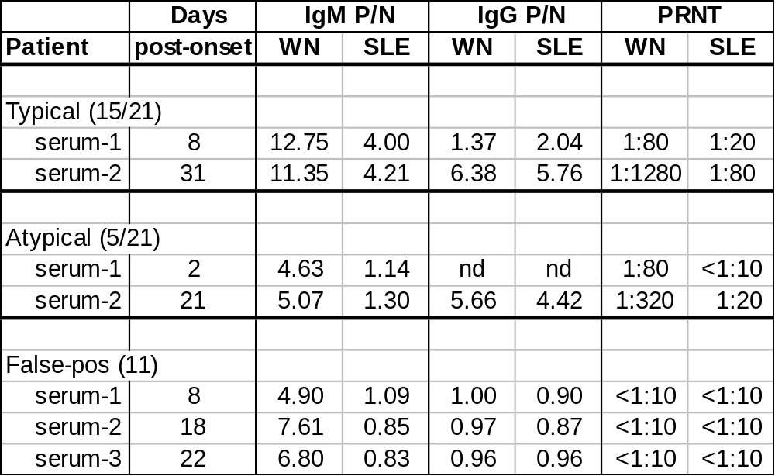
Serological Data from 2000
21 human cases - 2000
pos = P/N >3

Slide 4
Antigen Capture ELISA for WN Virus
Flavi-McAb
6B6C-1 HRP
WN virus
WN McAb
3.91D

Slide 5
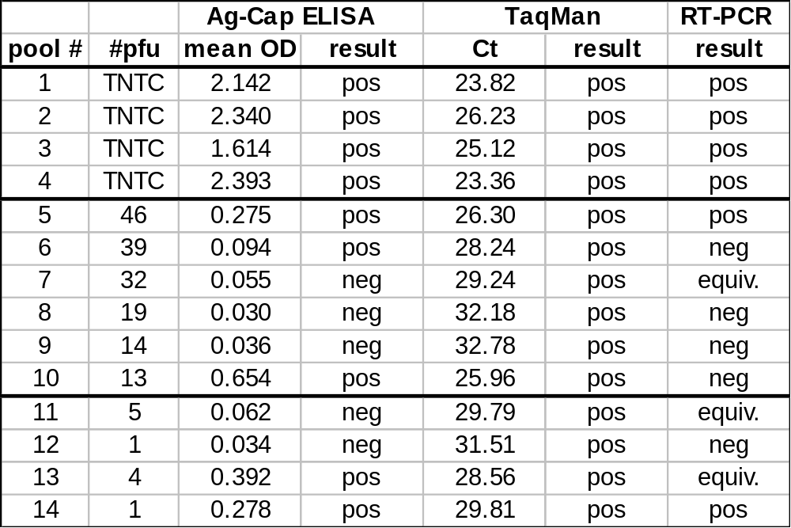
Testing of Mosquito Pools by Antigen
Capture ELISA & RT-PCR

Slide 6
Nucleic Acid Amplification Assays
1.
RNA extraction from:
serum, csf, tissue, & mosquito pools
RNA Extraction
2.
Standard
RT-PCR
TaqMan
RT-PCR
LightCycler
RT-PCR
NASBA
Amplification
3.
Agarose gel
TaqMan probe
PE7700/5700
iCycler
Smart Cycler
LightCycler
FRET probes
SYBR green
melting curve
NucliSensTM
Reader/ECL
Molecular
beacons
Detection
NA sequencing;
S. blot

Slide 7
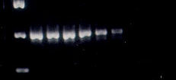
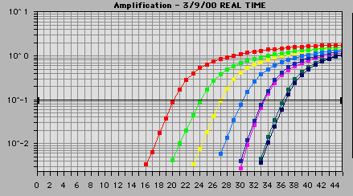
10k 1k 100 10 1 1 0.1 0.1
400 bp
Rn
10,000
1000
100
10
1
0.1
10k 1k 100 10 1 0.1
Cycle

Slide 8
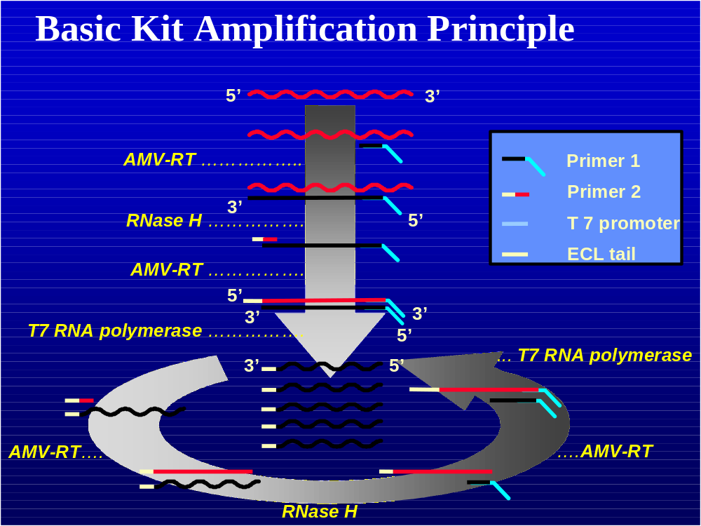

Slide 9
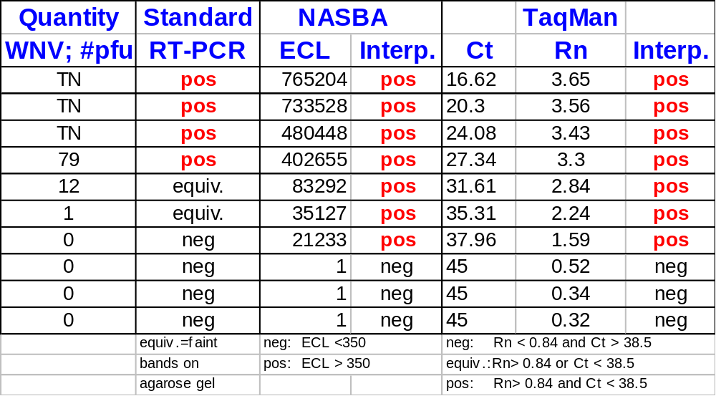
Sensitivity of WNV NASBA & TaqMan Assays
WNV NY99 virus seed

Slide 10
Nucleic Acid Amplification Assays for Arthropod-borne Viruses
Target | RT-PCR | TaqMan | NASBA
alphavirus-all | YES
alphavirus-domestic | YES |  | In progress
eastern equine encephalitis | YES | YES | YES
western equine encephalitis | YES | YES | In progress
Venezuelan equine encephalitis | YES | YES
flavivirus | YES
St. Louis encephalitis | YES | YES | YES
West Nile | YES | YES | YES
Powassan | YES | In progress | In progress
dengue | YES |  | YES
yellow fever | YES
California/Bunyamwera | YES
Lacrosse | YES | YES | YES

Slide 11
Comparison of RT-PCR TaqMan & NASBA
 | Traditional RT-PCR | TaqMan PCR | NASBA
Time | 24-48 hours | 4 hours | 4 hours
Throughput | 40 | 96 | 50
Sensitivity | 10 pfu | 0.1 pfu | 0.1 pfu
Interpretation | Subjective | Semi-Automated | Automated
Start-up cost | $10K - $15K | $50K - $100K | $1K - $20K
Cost per test | $7 | $10 | $10 - $12

