Slide 1
U.S. Geological Survey
China’s Growing Appetite for Minerals
by David Menzie, Pui-Kwan Tse, Mike Fenton, John Jorgenson, and Hendrik van Oss

Slide 2
China in 2004
Rapid economic growth for past 15 years
Growth “spreading” to other countries, such as India
Remaking world order (bipolar, unipolar, multipolar)
Development primarily influenced by—
  Infrastructure projects
  Demand for capital goods and consumer goods
Notes:
Economic growth has exceeded 5% per year (doubling rate of 12 years) for x of the last 4 years for the following 10 of the 20 most populous countries: China (4), India (3), Russia (3), Bangladesh (2), Nigeria (2), Vietnam (4), Turkey (3), Iran (3), Ethiopia (2), and Thailand (2).
(2) For a discussion the effect of economic growth in Asia see Zakaria, Fareed, 2004, America’s Big Challenge: Asia; Washington Post, 19 October, p. A23.

Slide 3
Minerals Information and Development
Minerals information will be central to—
  Accommodating growth
  Adjusting to changed world, especially in areas of—
    Economy (markets)
    National security
USGS research on minerals in development cycle—
  Based on 1929 work of USGS geologist Foster Hewitt
  Main goal is to develop benchmarks to—
    Identify position in cycle
    Anticipate emerging issues

Slide 4
Economic Development Summary
Mineral consumption increases exponentially in early stages of development
Consumption of commodities increases in logical order related to stage of development—
  Infrastructure (indicated by use of cement and construction materials)
  Light manufacture (indicated by use of copper)
  Heavy manufacture (indicated by use of aluminum and steel)
  Consumer goods (indicated by use of industrial minerals)
  Services (static rates of consumption)
Based on experience in the Republic of Korea—
  Stages take about 20 years each and begin at 5-year intervals
  Entire cycle takes 30 to 40 years
China appears to be about 20% to 30% through light manufacture stage (based on its consumption of copper)
Notes:
(1) This talk examines recent consumption of cement, copper, aluminum, iron ore, pig iron, steel, steel scrap, oil, and gas.
(2) In China, the infrastructure phase began about 1990, the light manufacturing phase in 1995, and heavy manufacturing in 2000.

Slide 5
Effect of Development in China
China’s importation of some minerals is rising rapidly
Minerals prices are rising worldwide (but fluctuation could be larger in the future)
China’s exportation of some metals is declining (rare-earth elements, tin, and tungsten)
Foreign investment is increasing (minerals, infrastructure, aid)
Environmental residuals from production could rise
Notes:
(1) Wall Street Journal article (9Sept04, p. C1 Commodities Enter Investment Mainstream) cites 10 to 15 years of under investment in commodity production and increasing Chinese consumption as leading to high commodity prices into the first part of the next decade.
(2) Foreign investment in China is increasing, but foreign investment by China in mineral-resource projects is also increasing.
(3) Some example commodity price changes (Sept04/Jan03) Au (119%), Cu (181%), Pt (146%), Pd (90%), and Sn (219%)
(4) China share of world production is 85% of rare earths, 32% of tin, and 83% of tungsten.

Slide 6
Background

Slide 7
China and the United States in 2003
 | China | United States
Area | 9,596,960 km² | 9,629,091 km²
Population | 1.29 billion | 293 million
Gross Domestic Product (GDP) | $6.45 trillion | $10.99 trillion
GDP/capita | $5,000 | $37,500
Economic growth rate | 9.1% | 3.1%
Trade (total) | $851 billion | $2.59 trillion
Exports | $438 billion | $1.05 trillion
Imports | $413 billion | $1.54 trillion
Trade between China and the United States | $126 billion | $181 billion
Exports | $92 billion (to U.S.) | $28 billion (to China)
Imports | $34 billion (from U.S.) | $152 billion (from China)
Ownership of companies | Some state-owned | Private
Direct foreign investment | $54 billion | $30 billion
Notes:
GDP and GDP per capita are expressed in purchasing power equivalent.
China’s economy doubles every 8 to 10 years, depending upon the growth rate, which averages 7 to 9 percent.
Note the difference between the Chinese estimate of its exports to the US versus the US estimate of imports from China--the difference is largely due to re-exports of Chinese goods to the US by third-party countries. Such differences in trade accounting will be sources of difference in trade policy negotiations.

Slide 8
China’s Share of World Mineral Production in 2003
Commodity | Percentage | Rank
Fuels:
Coal | 45 | 1
Oil | 4.7 | 6
Industrial minerals:
Cement | 42 | 1
Fluorspar | 55 | 1
Rare earths | 85 | 1
Metals:
Aluminum | 18 | 1
Antimony | 89 | 1
Copper | 12 | 2
Gold | 8 | 4
Lead | 18 | 2
Magnesium | 45 | 1
Molybdenum | 24 | 3
Silver | 12 | 3
Steel, crude | 23 | 1
Tin | 32 | 1
Tungsten | 83 | 1
Zinc | 22 | 1
Notes:
China became the leading producer of lead in 2004.
As China’s economy grows, domestic production will take a larger share of the production of these minerals.

Slide 9
Infrastructure
Cement

Slide 10
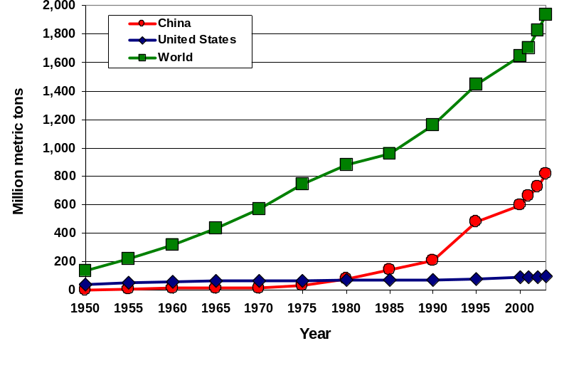
Production of Hydraulic Cement—1950–2003
Notes:
The rapid increase in Chinese cement production began about 1990.
China accounts for more than 1/3 of world cement production.

Slide 11
Cement
 | China | United States
Production (2003): | 813.2 Mt | 95.9 Mt
Percentage of world (1.94 Gt) | 42% | 5%
World ranking | Largest | 3d largest
Consumption (total) | ~ 810 Mt | ~ 115 Mt
Per capita consumption | 630 kg | 378 kg
Imports | 1 - 4 Mt/yr | 25 Mt/yr
Exports | 5 - 6 Mt/yr | <1 Mt/yr
Number of plants | ~ 5,000 | 116
Technology | vertical shaft (VSK), some rotary kilns | 100% rotary kilns
Capacity:
Clinker^{e} | 730 Mt | 105 Mt
Cement^{e} | 850 Mt (vast majority are village-scale VSK) | 110 Mt
Average output per plant | <200,000 t | 850,000 t
Environment | +750 Mt/yr CO₂ (dust capture/suppression) | 83 Mt/yr CO₂ (dust disposal)
Notes:
Chinese per capita consumption is large by world standards, but not as large as Korean consumption was in 1995 (1.2 t/person) near the end of its material development cycle.
(2) Vertical shaft kilns are old technology. New Chinese kilns are large rotary shaft kilns.
(3) Note that China imports less than 1% of its cement consumption. The United States imports more than 20% of its cement consumption.

Slide 12
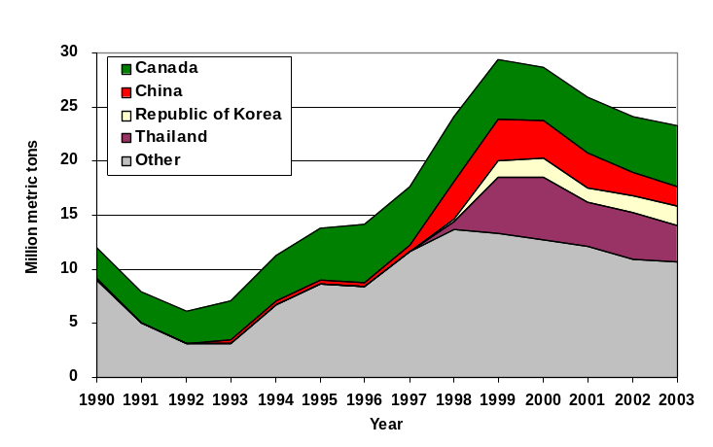
U.S. Imports of Hydraulic Cement and Clinker
Asian Crisis 1997
Notes:
(1) The increase in U.S. imports of cement from Asia during the Asian economic crisis that began in 1997 could foreshadow increased U.S. imports of other commodities during future economic downturns in Asia. Similar increases in steel imports in 2000 and 2001 led to the U.S. applying tariffs on some steel imports and to trade disputes between the U.S. and some of its trading partners.

Slide 13
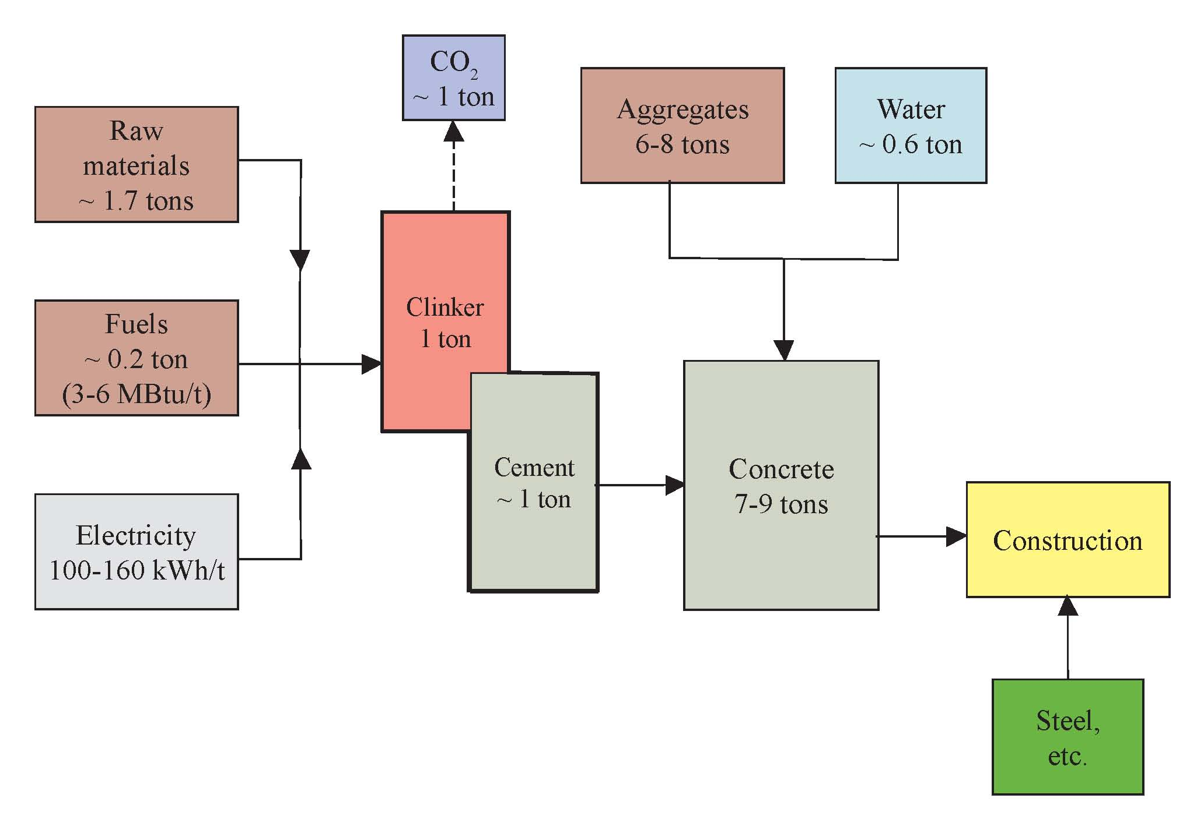
Production Flow for Cement
Notes:
(1) The production of one ton of cement clinker results in the release of approximately one ton of carbon dioxide to the atmosphere.

Slide 14
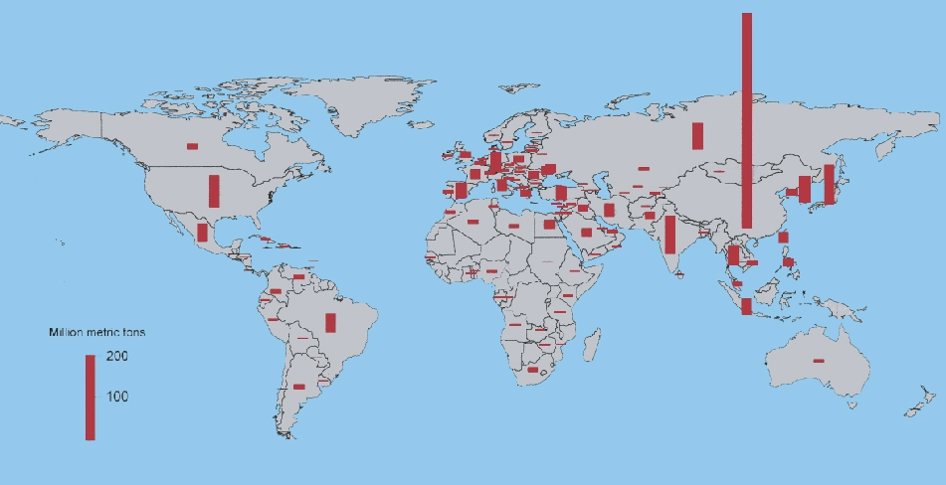
Country-Level Output Capacity for Clinker or CO₂ Emissions
750M tons
Source: van Oss, H.G., and Padovani, A.C., 2003, Journal of Industrial Ecology.
Notes:
Hendrik van Oss is the USGS cement commodity specialist.
(2) China and India are the countries with the largest capacities to generate cement clinker and carbon dioxide from cement manufacture. China generates about 750 million tons of carbon dioxide emissions annually at full production of cement.

Slide 15
Light Manufacture
Copper

Slide 16
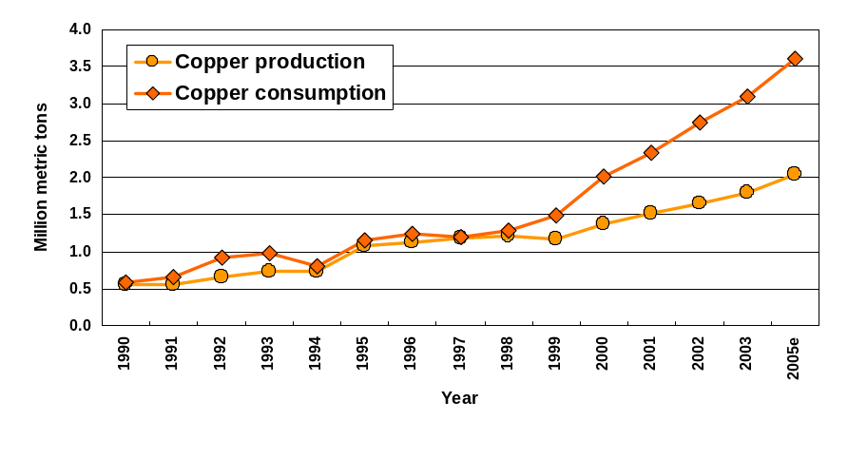
China’s Production and Consumption of Copper
Production
supplemented by imports
Notes:
During the early stages of economic development, copper is used to wire assembly plants used in light manufacturing.
(2) China is discussing joint development of Chilean copper resources with CODELCO, the Chilean state-owned mining company (London Mining Journal, 2 July 04) and Jiangxi Copper Company has reached agreement with Ivanhoe Minerals concerning the development of the large Turquoise Hill deposit in Mongolia.
(3) The China Geological Survey has been actively involved in the USGS Global Mineral Resource Assessment Project’s assessment of world copper resources, and has shown considerable interest in USGS mineral-resource assessment methodology.
(4) Data are for 1990 – 2003. Data for 2005 are estimated.

Slide 17
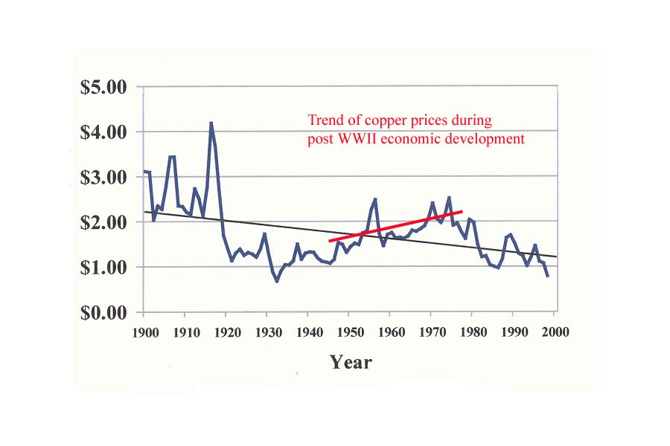
Price of Copper 1900-2000
(in constant 1997 dollars)
Dollars per pound
Notes:
Real price of copper rose throughout the post-WWII period through 1975. This period marked the redevelopment of the Japanese and West German economies.

Slide 18
China recently surpassed the United States in the amount of copper consumed
During 2004, several Chinese copper smelters were forced to close temporarily due to an inability to obtain concentrate
Notes:
Indian copper smelters also had difficulty obtaining concentrate (London Mining Journal, 6Feb04).

Slide 19
Heavy Manufacture
Aluminum, Iron Ore, and Steel

Slide 20
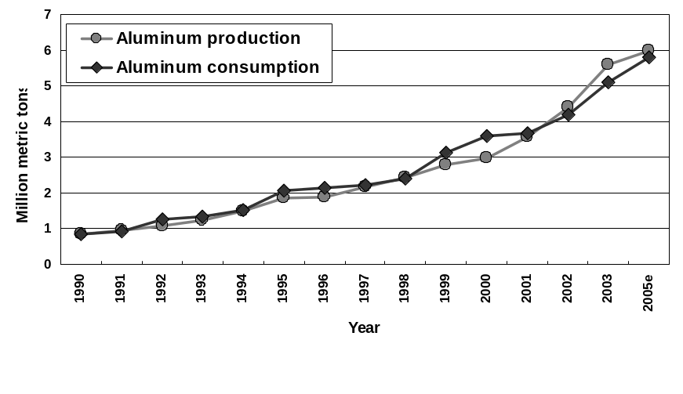
Production and Consumption of Aluminum
Aluminum mainly produced
from imported bauxite and
alumina
Notes:
State-owned Minmetals bought 51% of the Sherwin, Texas alumina refinery (London Mining Journal, 30Apr04). Minmetals has recently made an offer to buy Noranda. State-owned companies such as Minmetals could have an advantage over non state-owned companies in bidding for the assets of public companies because they could obtain necessary financing from their government owner.
Data for 1990 – 2003. Data for 2005 is estimated.

Slide 21
Iron Ore in China—Driving Forces
Consumption more than 400 Mt
Low-grade domestic ores (average 32% Fe content)
  Most mines small to medium size
  High levels of impurities in ores
Imports more than one-half of Fe needs
Major import sources—Australia and Brazil
  Three companies (about 70% of world’s exports)
  Australia’s shipping costs far lower
Plan to increase ownership in overseas joint-venture mines—
  To 50% from 12%
Notes:
What are the “driving forces” and what is the direction of the Chinese iron ore industry?
China’s requirements of iron ore have risen strongly since 2000 to reach 409 Mt in 2003.
Chinese production at 261 Mt consists mainly of low-grade ores with an average grade of 33% (compared to their import grades of over 60%). Their domestic ores come from small to medium size mines and have high levels of impurities.
They currently import 36% in terms of the domestic requirements for gross tonnage. But when considering the Fe content of this import tonnage, imports represents greater than 1/2 of the domestic iron ore requirements.
Most of China’s ore comes from the big three exporters – CVRD, BHP-Billiton, and Rio Tinto, who control about 70% of the world’s export iron ore market.
Currently, they have either joint venture ownership or full ownership of mines in several countries – Shougang in Peru (100%), United Taconite in the United States (30%), and Portman’s Koolyanobbing in Australia. It is China’s stated objective to obtain 50% of their iron ore from their ownership portion of joint venture mines.

Slide 22
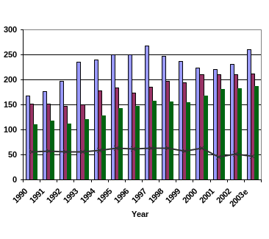
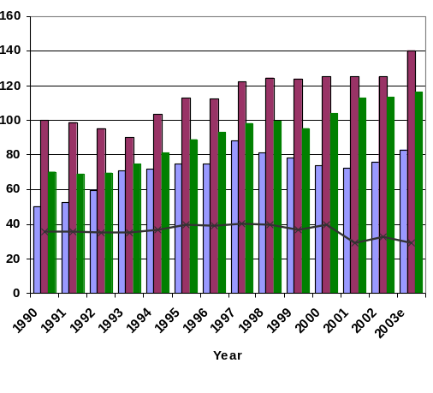

Major Producers of Iron Ore
Fe content
Gross weight
Million metric tons
Source: U.S. Geological Survey Minerals Yearbook.
Notes:
On the right, we consider the world’s major producers of iron ore are China, Brazil, and Australia, in that order on a gross tonnage basis.
On the left, considering iron content, the order then becomes Brazil and Australia, followed by China. The gap between Brazil and Australia can be seen to be narrowing and taking into account Australia’s proximity to China, they may soon surpass Brazil as the number one iron-ore-producing country in the world.
The U.S. production is shown both in terms of gross tonnage and iron content for comparison.
Source: Kirk, W.S., 2004, U.S. Geological Survey Minerals Yearbook 2002.

Slide 23
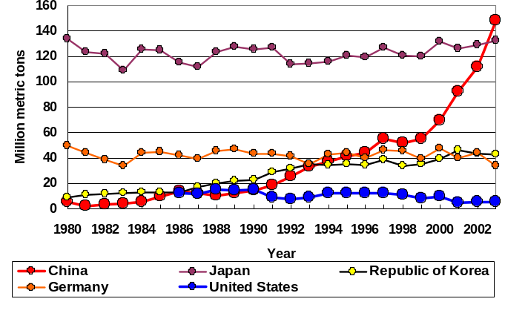
Leading Importers of Iron Ore—1980–2003
Sources: U.S. Geological Survey Minerals Yearbook; United Nations Conference on Trade and Development.
Notes:
This graph shows iron ore imports from 1980 through 2003 for the four major importing nations – Japan, China, the Republic of Korea, and Germany.
It shows a more or less steady level of imports by Japan and Germany, a steady increase by the Republic of Korea, and China, a steady increase followed by a steep increase beginning in 2000.
Two major items can be observed in 2003. China surpassed Japan as the No. 1 importer of iron ore, and in Germany, the largest consumer in the European Union, imports reached the lowest levels in over 20 years.
U.S. imports in 2003 were 12.6 Mt, while exports were 6.8 Mt for net imports of 5.8 Mt. In 1990, Chinese expansion became evident, while U.S. production decreased slightly.

Slide 24
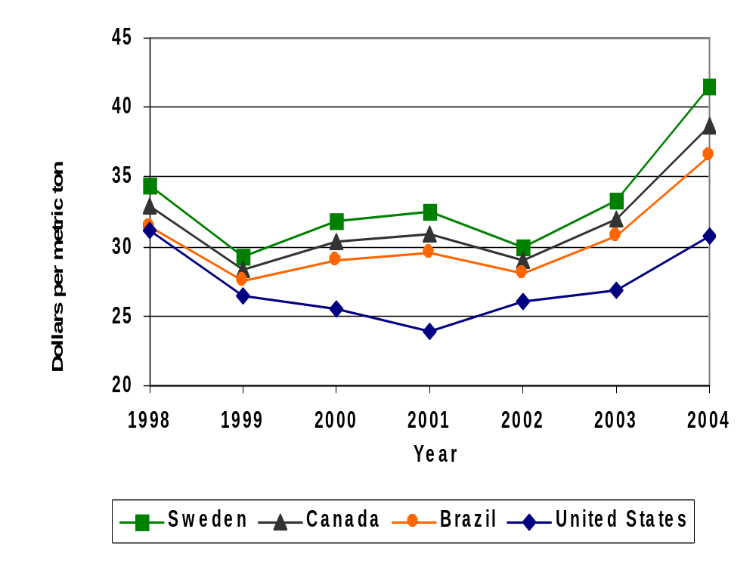
Comparative Pellet Prices—1998–2004
Note: Prices for Brazil, Canada, and Sweden are based on an assumed 60% iron content.
Sources: U.S. Geological Survey Minerals Yearbook; United Nations Conference on Trade and Development, The iron ore market 2003-2005.
Notes:
This slide is not an exact representation of world iron ore pellet prices, since in Brazil, Canada, and Sweden are based on a cents-per-metric-ton formula that is dependent on the percentage of iron contained in the pellets (this has been assumed to be 60%).
This does show a delayed tendency for U.S. prices to follow world prices, but the domestic steel industry also has an important influence on domestic pricing structure. The 2004 iron ore price for the United States is an estimate based on mid-year prices.

Slide 25
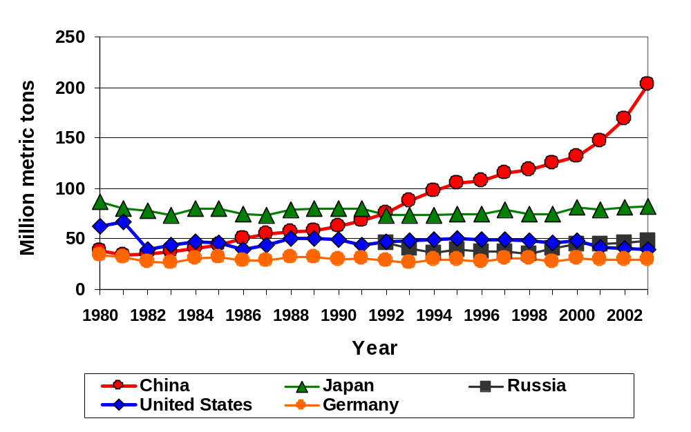
Major Producers of Pig Iron
Sources: United Nations Conference on Trade and Development; International Iron and Steel Institute.
Notes:
Pig iron production has always been considered a key indicator of iron ore consumption.
This slide clearly indicates China has been strongly increasing its lead as the major pig iron producer in the world. Their production has reached over 200 million metric tons in 2003.
Japan’s, the closest competitor at slightly over 80 million metric tons, and Germany’s production have remained constant at about 35 to 40 million metric tons.
The United States production has declined slightly in recent years and Russian production has increased slightly.

Slide 26
Effects on World and U.S. Trade
China will dominate the international iron ore industry in the future
Iron-ore exporting countries with joint-venture companies are increasingly dependent on China for iron ore demand—
  Brazil, Australia, and Peru
U.S. iron ore industry somewhat isolated from the “China syndrome”
  U.S. mines primarily affected by changes in U.S. steel industry
  Recently, China purchased 30% of one U.S. iron ore mine
U.S. prices track foreign prices to some extent
Prices expected to rise in 2004
Notes:
From these slides on production, importing, and pig iron production, one can clearly see that the international iron ore industry is dependent on China.
We hear about new joint ventures being launched every year between China and producing countries. China’s goal, as mentioned earlier, is to have 50% of their imported iron ore come from their share of joint venture mines.
The United States iron ore industry has always been somewhat isolated from world trade in iron ore. The mines located in Minnesota and Michigan provide raw materials mainly to the domestic steel industry. In an exception to this statement of our independence from China in world trade, the Laiwu Group has purchased 30% ownership in United Taconite Company, a 4.3-million-long-ton-capacity mine in Minnesota. They accept pellets in trade from Cleveland Cliffs Canadian operations in exchange for their portion of production.

Slide 27
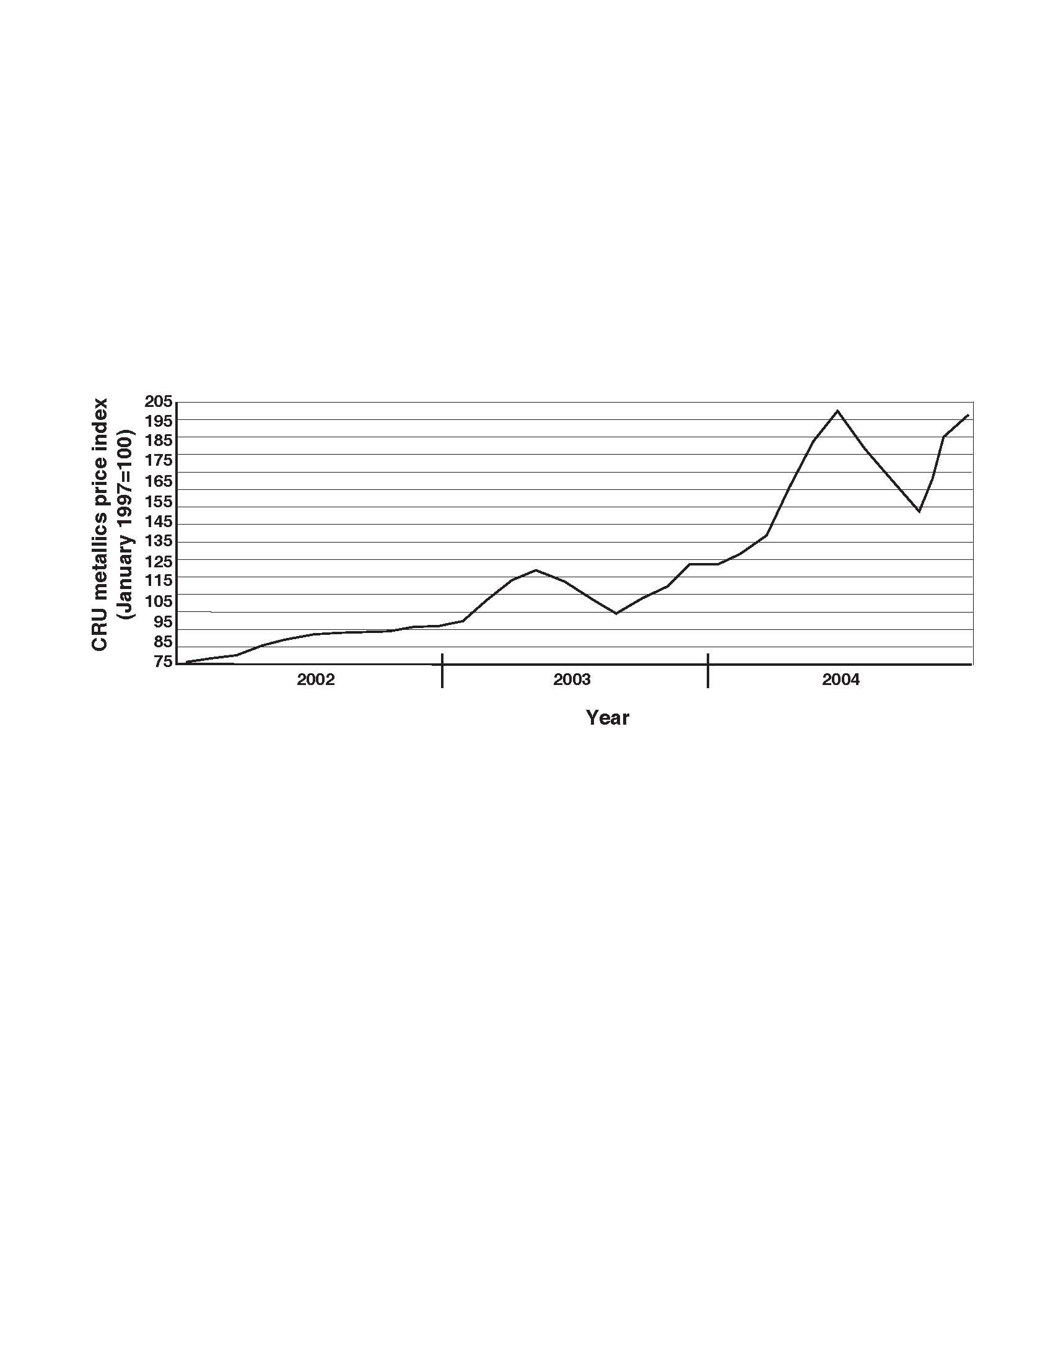
Raw Material Price
Direct-reduced/hot briqueted iron and pig iron in Western Europe, Asia, and North America
Source: CRU International Ltd.
Notes:
Pig iron and direct-reduced hot briqueted iron are primary raw material inputs to production of steel by blast furnace methods. The price of these inputs has risen since 2002.

Slide 28
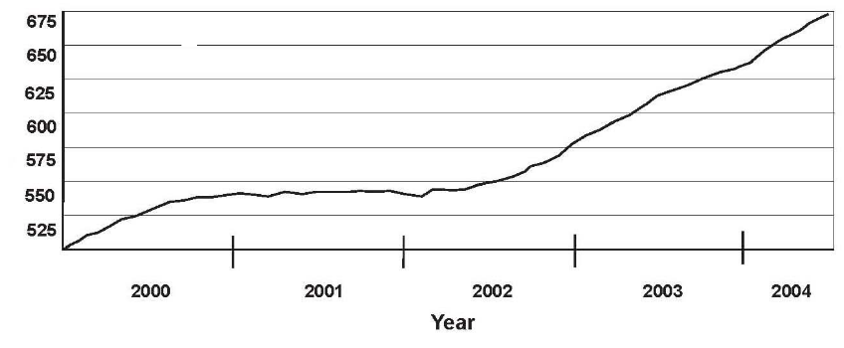
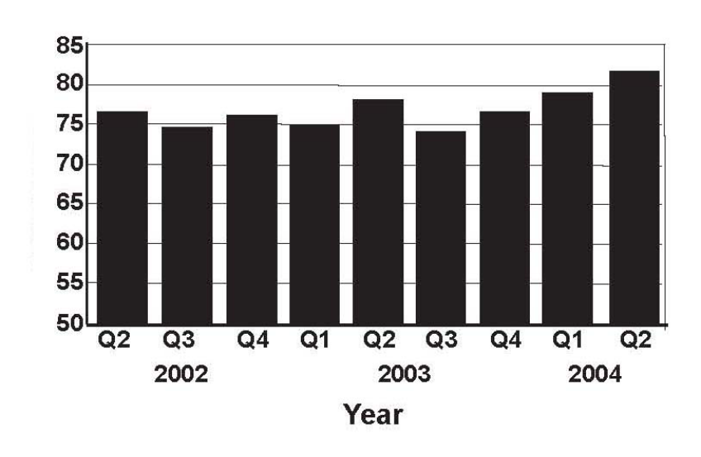
World Steel Production
Blast furnace hot metal output
Million metric tons
Source: International Iron and Steel Institute.
Electric arc furnace steel production
Million metric tons
Source: International Iron and Steel Institute.
Notes:
Steel production from integrated steel mills (blast furnaces above) has risen since 2002. Production from electric arc furnaces has also risen but at a slower rate. Integrated furnaces typically use pig iron to produce steel while electric arc furnaces use scrap as a feed source. This has reversed a long-term trend in which steel production from electric arc furnaces increased at a faster rate than production from integrated production facilities.

Slide 29
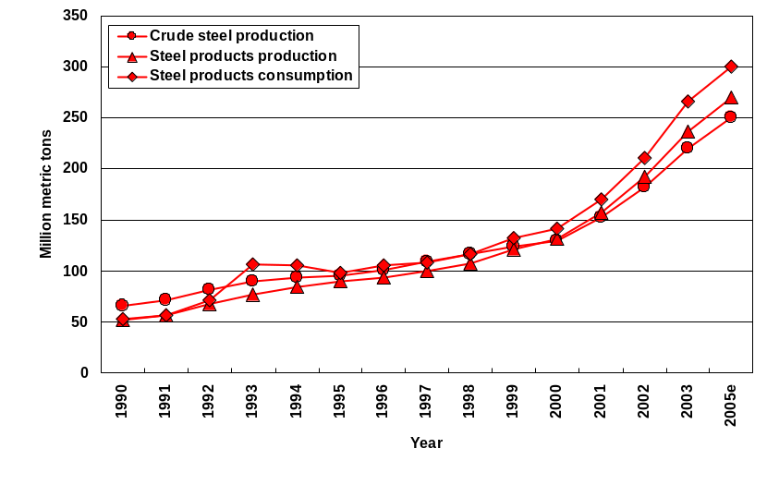
China’s Production and Consumption of Steel
Notes:
In 2005, China’s crude steel production is estimated to be more than the United States and Japan’s crude steel production combined.
(2) China is importing both crude steel and steel products.
(3) China’s rapid increase in steel production and consumption began in 2000 the beginning of the heavy manufacturing stage.
(4) Data for 1990 – 2003. Data for 2005 is estimated.

Slide 30
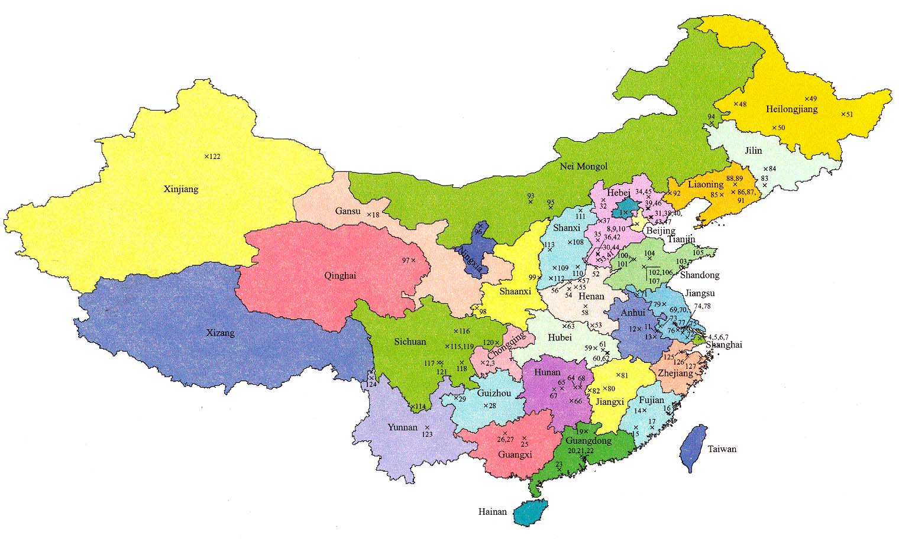
Major Iron and Steel Plants in China
Notes:
China’s steel capacity has more than doubled since 1995. Most of the capacity was added at already existing plants.
(2) The map shows the location of 122 iron and steel plants. The USGS has table contain information on the ownership and capacity of the plants.
(3) The majority of the plants are located in the eastern part of China.

Slide 31
Steel Production
China’s Government predicted that raw steel production for 2003 would be 210 Mt, a record high for the country
Actual production for 2003 was 220 Mt, which was 23% of total world production and a 15.3% increase from 2002
China’s demand for steel increased differently depending upon end use—
End use | 2003 compared with 2002 | First half of 2004 compared with first half of 2003
Car production | 36.7% | 16.2%
Home appliances | 35.2% | 30.0%
Ship building | 13.5% | 12.0%
Notes:
Note that construction use is not covered in this table.

Slide 32
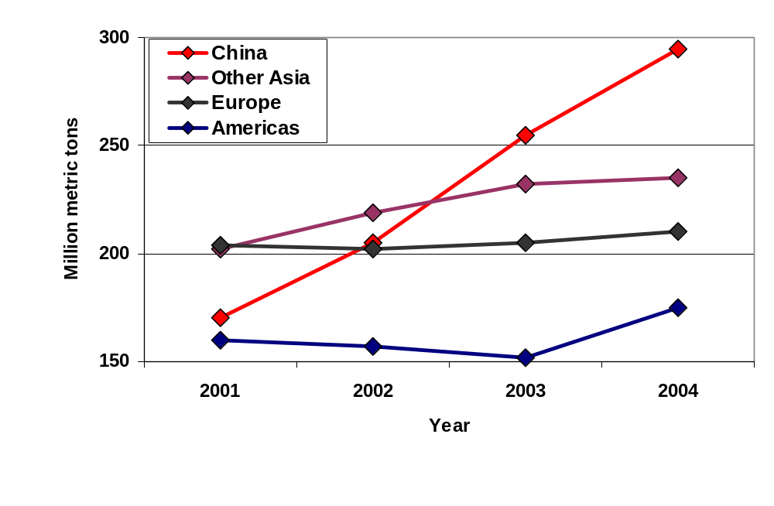
Trends in Demand for Steel
Source: International Iron and Steel Institute.
Notes:
World demand for steel has increased dramatically in China since 2001. Demand in other Asian countries, Europe, and the Americas has increased but at a much slower rate.

Slide 33
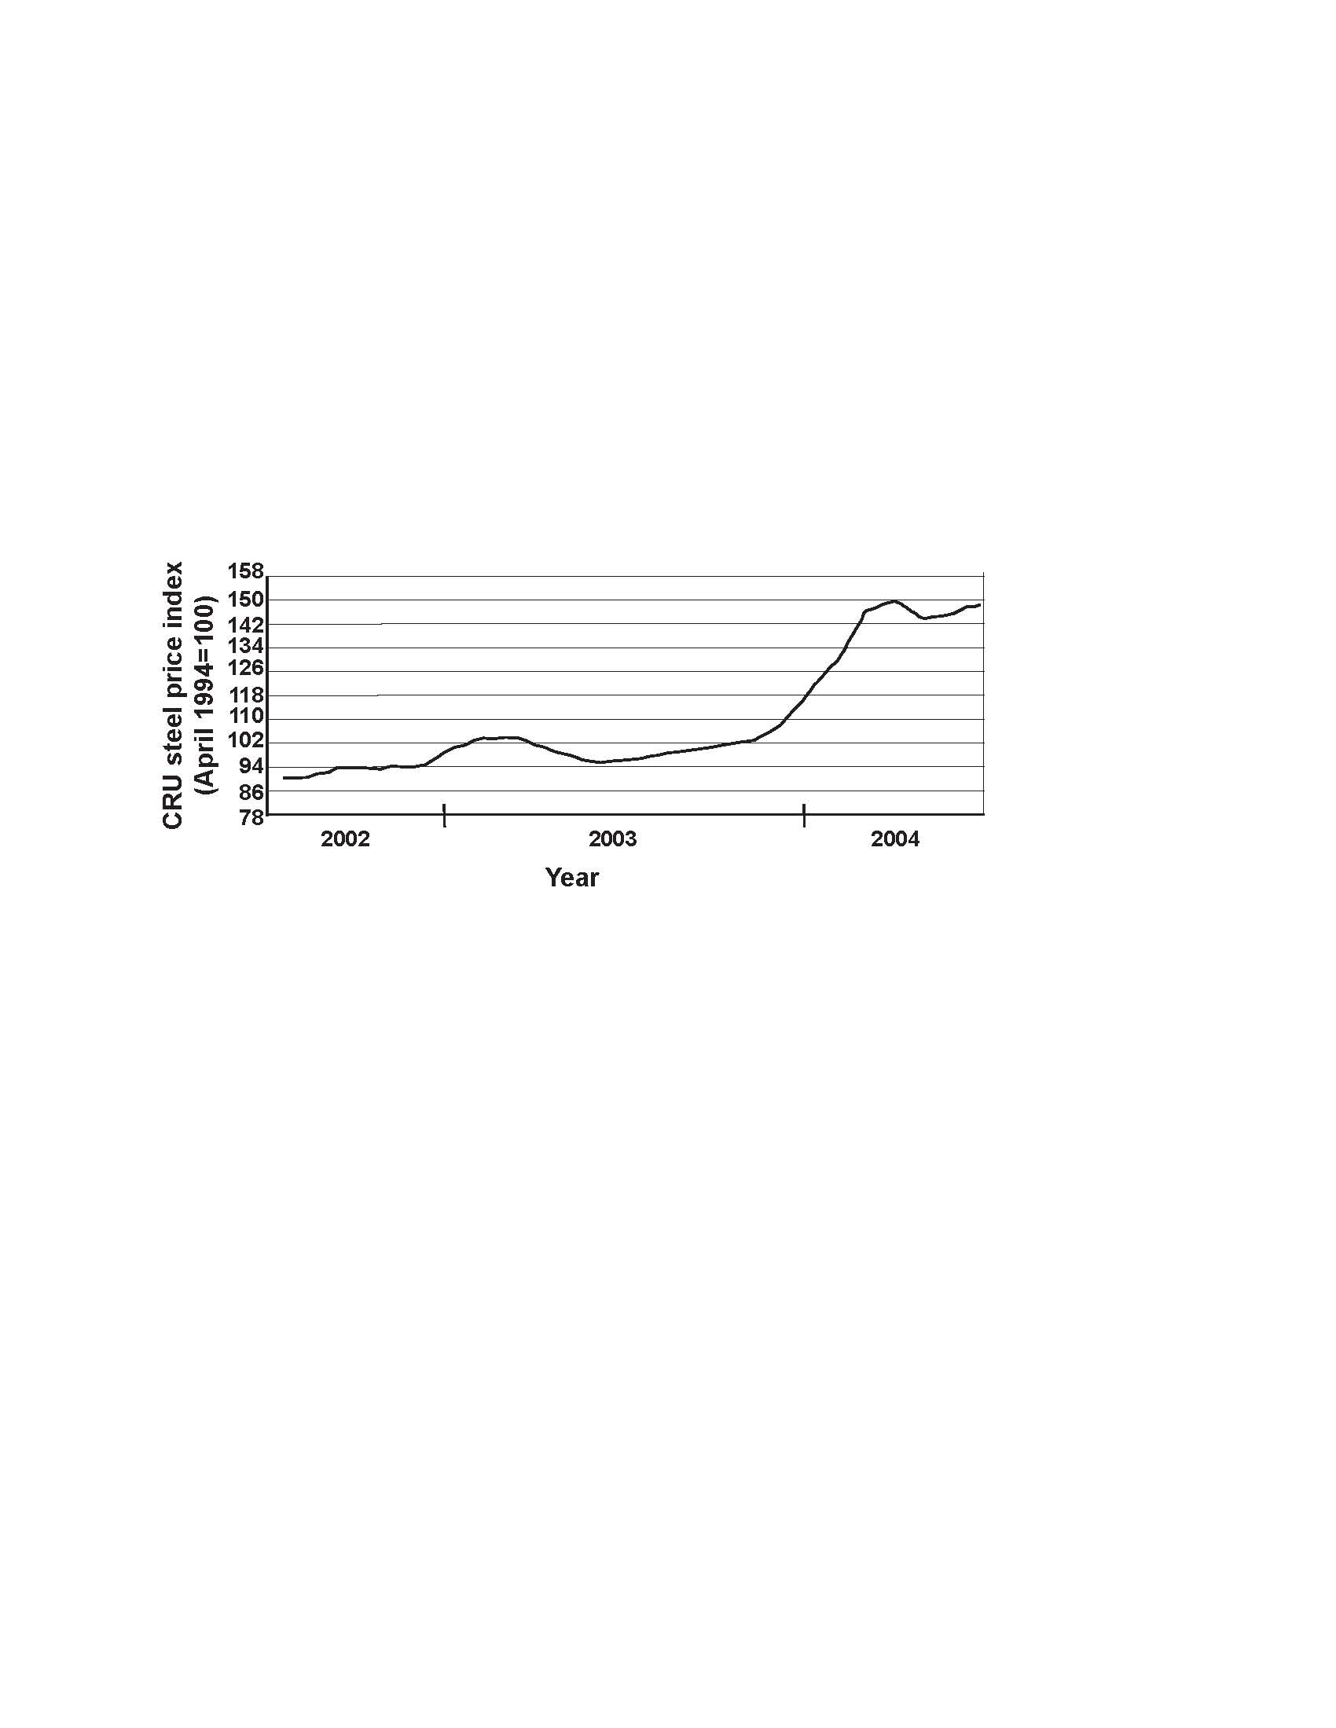
Steel Prices
Product | Percentage change
 | May 2003 to May 2004 | Year to date
Hot-rolled sheet | 129% | 75%
Cold-rolled sheet | 83% | 43%
HD galvanized sheet | 74% | 36%
Coiled plate | 132% | 68%
Cold-finished bar | 36% | 31%
Wide-flange beams | 73% | 60%
Wire rod/low carbon | 64% | 45%
Rebar | 64% | 44%
Average spot price | 77% | 48%
Stainless sheet 304 | 109% | 91%
OCTG seamless tube | 59% | 26%
Scrap | 69% | 83%
Global steel prices
Source: CRU International Ltd.
Notes:
Prices of steel products have increased differentially.

Slide 34
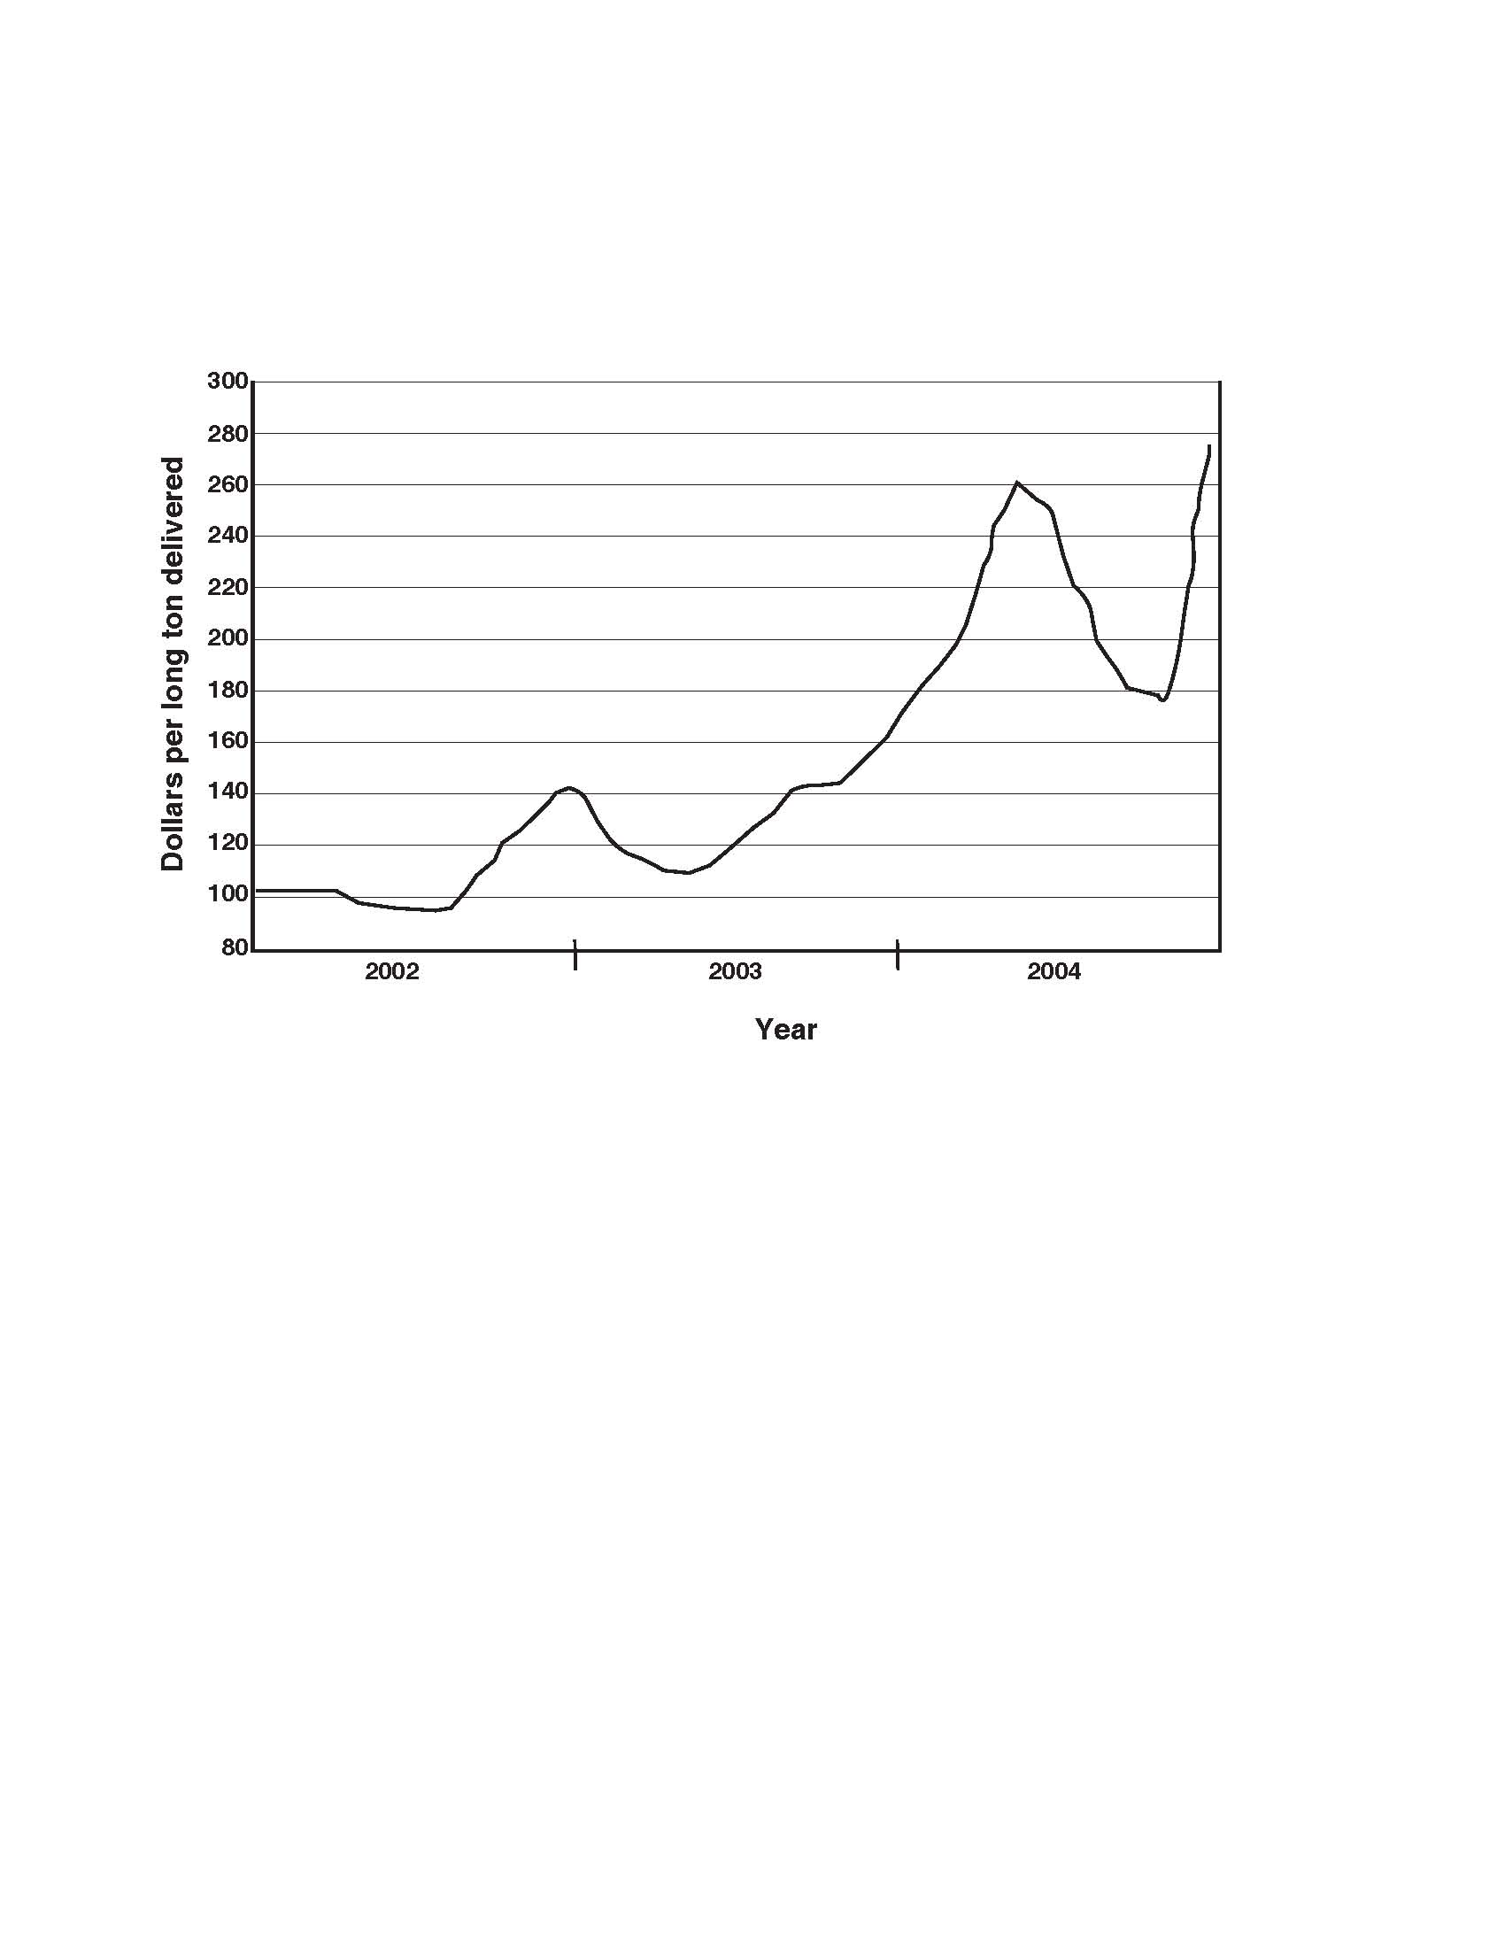
Price of Scrap
U.S. shredded scrap (Philadelphia, PA)
Source: CRU International Ltd.
Notes:
Scrap is primarily used in Electric Arc Furnaces. A discussion of the behavior of the price of scrap and the effects of the pig iron and scrap price increases on the U.S. steel industry follows in the next four slides.

Slide 35
Scrap Prices in the United States
Scrap prices increased until February 2004 owing to—
  Increased global steel production
  China’s great demand for scrap
  Scarcity of coke by blast furnaces (leading to more scrap use)
  Scrap deliveries slow (owing to shortage of railroad cars)
  Brazil’s depleted pig iron supply
Scrap prices decreased from February through June 2004 because—
  China, Japan, and the Republic of Korea left market to avoid high prices
  China’s Government reduced credit incentives to steelmakers and the construction sector

Slide 36
Scrap Prices in the United States—Continued
Prices currently rising in the United States because—
  Increasing demand for steel products and scrap by China,
  the Commonwealth of Independent States, and other Asian countries
  United States is major supplier of scrap to China (causing shortage in United States)
  Increasing shipping costs (owing to shortage of bulk ocean carriers)
  Global shortage of scrap
  Weaker U.S. dollar

Slide 37
Effects of Rising Prices to U.S. Steel Mills
Georgetown Steel in South Carolina closed its 900,000-short-ton-per-year minimill and went into bankruptcy; blamed increasingly high cost of raw materials
Nucor Steel—
  Bought idled American Iron Reduction DRI plant in Convent, LA
  Became major partner with Rio Tinto plc, Shougang Corp., and others to open an 800,000-t/yr HIsmelt plant in Western Australia to produce pig iron
  Reported 61% decline in net income during 2003 despite a 30% increase in sales

Slide 38
Effects of Rising Prices to U.S. Steel Mills—Continued
AK Steel posted profit in second quarter of 2004 (compared with loss a year earlier)
Steel Dynamics reported profit more than tenfold compared with previous year
Timkin Co. reported record second-quarter sales and more than 500% increase in net income
U.S. Steel reported a second-quarter profit as a result of global price increases

Slide 39
Consumer Goods
Autos and Fuels

Slide 40
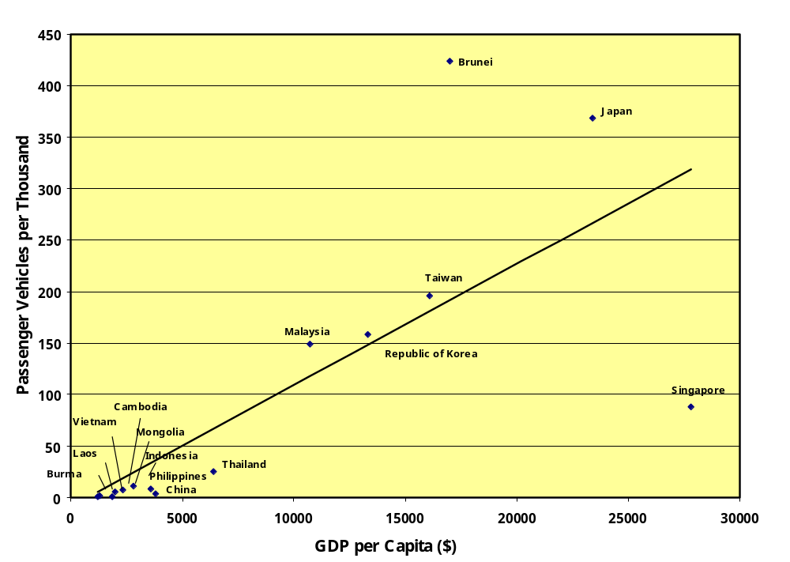
GDP and Passenger Vehicles per Capita in East and Southeast Asia in 2002
Notes:
China’s GDP per capita is now at $5,000 on a purchasing power basis. Per capita GDPs of other countries are also on a purchasing power basis.
(2) In 8 to 10 years, China will have a GDP per capita of $10,000 and could use about 100 autos per thousand people or more than 120 million vehicles. The United States currently uses about 200 million vehicles.

Slide 41
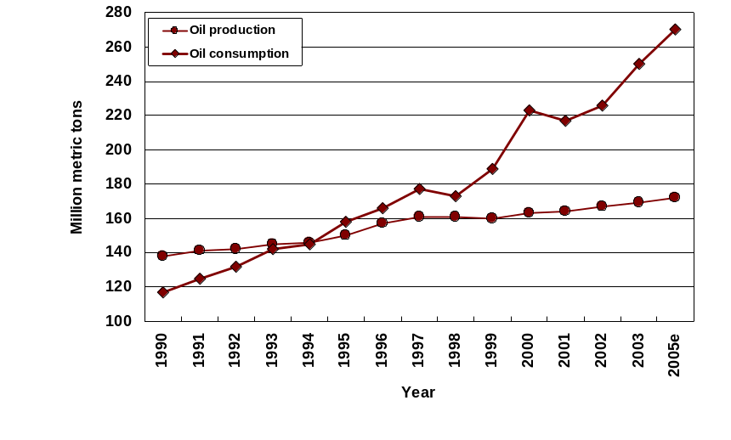
China’s Production and Consumption of Oil
Import Gap
Notes:
The graph shows the production of crude oil from 1990 - 2003. Data for 2005 are estimated. China’s growing economy and increasing per capita GDP China’s imports of crude oil can be expected to increase dramatically in the future.

Slide 42
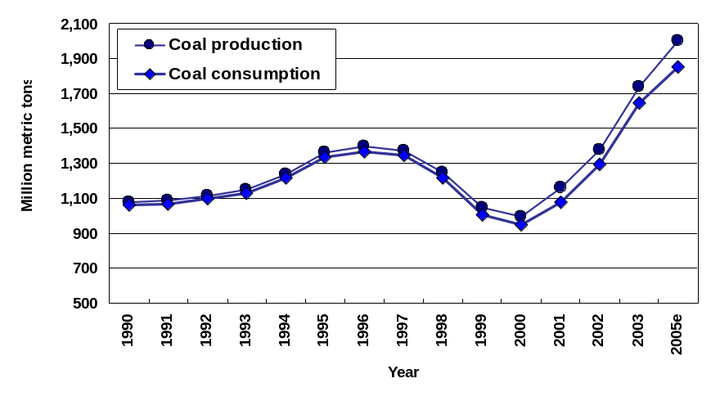
China’s Production and Consumption of Coal
China’s coal consumption results
in 5.5B tons CO2 emissions annually
Notes:
Data for 1990 – 2003. Data for 2005 is estimated.
Carbon dioxide emissions from coal consumption are more than 7 times those of cement consumption. While carbon dioxide emissions are one of the most examined environmental residuals from mineral production and use, increased production and use will result in large increases in other environmental residuals such as overburden, tailings, and smelter and mineral processing wastes.
(2) China currently exports a small percentage of its coal production, mostly to Asian countries. Japan now imports coal from China; previously Japan imported coal from the United States.

Slide 43
Conclusions

Slide 44
Implications
  Increased consumption of minerals and minerals information (world copper consumption could reach 24 Mt by 2020 with China using about 5.6 Mt; world production in 2003 was estimated to be about 13.9 Mt)
  Higher prices and possibly more volatility
  Increased competition for minerals
  Continued trade disputes
  Pressure on manufacturers in developed countries and need for
  new material strategies
  Increased environmental residuals
Notes:
New material strategies could include re-engineering materials for easier disassembly and the use of information technology such as radio chips and robotics to decrease the cost of sorting used materials to increase reuse, remanufacture, and recycling and thus to control material costs.

