Slide 1
Inter-Professional Diabetes Care: Research and Operational Issues of Group Appointments
Susan Kirsh, MD
David Edelman, MD, MPH
Hank Wu, M.D.

Slide 2
Overview of Group Medical Appointments in Diabetes
Hank Wu, M.D.
Providence VA Medical Center
Assistant Professor of Medicine
Alpert Medical School, Brown University

Slide 3
Impact of Diabetes Mellitus
23.6 Million with diabetes (7.8%) in the US
  Health care costs surpassed $92 billion
  65% die from cardiovascular disease
Prevalence of DM among veterans is 12%
  Performance measures are not being met nationwide
VA Diabetes Performance Measures | VA | VISN-1 | Goal
HgbA1c > 9% or not done (Lower is Better) | 16% | 16% | 15%
LDL-Cholesterol < 100 | 68% | 68% | 67%
Blood Pressure < 140/90 | 78% | 81% | 79%
Notes:
Diabetes is a progressive illness that requires continuous modification of medication by the provider, and patients will require multi-factorial interventions such as education and counseling, in addition to pharmacotherapy
65% of DM pts will die of CV disease, so other cardiovascular risk factors such as hypertension, hyperlipidemia and tobacco use also had to be addressed to diminish micro and macro vascular events
However, multi-factorial, multi-targeted interventions is difficult to accomplish in traditional care settings and costly

Slide 4
CV Risk Factor Control in Diabetes
Fewer than half of adults with diabetes achieve
treatment goals for CV risk factors
NHANES III (n = 1204)
60
NHANES 1999-2000 (n = 370)
50
44.3
48.2
40
37.0
35.8
33.9
Adults (%)
29.0
30
20
10
5.2
7.3
0
A1C Level
<7%
Blood Pressure
<130/80 mm Hg
Total Cholesterol*
<200 mg/dL
Achieved all 3 treatment goals
*LDL-C and TG not evaluated.
Saydah SH, et al. JAMA. 2004;291:335-342.

Slide 5
Chronic Care Model
System Redesign
Electronic Medical Record
Organization Commitment to Quality
Provider Decision Support
VA Standard
Notes:
Diabetes is a chronic progressive illness that requires continuous modification of medication by the provider, and patients will require multi-factorial interventions such as education and counseling, in addition to pharmacotherapy
Concomitant cardiovascular risk factors such as hypertension, hyperlipidemia and tobacco use also had to be addressed to diminish micro and macro vascular events
However, multi-factorial, multi-targeted interventions is difficult to accomplish in traditional care settings and costly
Application of the chronic care model for system redesign is necessary. There are some elements of the CCM that are VA standards.

Slide 6
Chronic Care Model
Shared Medical Appointments
Care Delivery Redesign
Group visits
Alternative providers: Clinical Pharmacists, Nurses
Group education
Equipment
Self Management
Link to Resources
Case Management
Notes:
Group Medical Visits completed the remaining components of the CCM for multifactorial management of DM

Slide 7
Group Medical Appointments (GMA)
“Group visits through which several patients meet with the same provider(s) at the same time” (Weinger)
Other terms:
  “Group medical visits”
  “Shared medical appointments”
Targeted to a common problem for efficiency and peer support:
  HTN, DM, Lipids
  Smoking Cessation
  Mental illness, e.g. bipolar disorder, PTSD
  Heart failure
  Frail elderly
Notes:
Group medical visits have been proposed to be an efficient method to achieve cardiovascular risk reduction and guideline implementation in diabetes mellitus, through efficient resource use, improvement of access to care, and promotion of behavioral change through group support.(7, 8) However, these treatment models require intensive physician involvement to show clinical efficacy, which may reduce the potential cost savings expected from this intervention.(9-11)

Slide 8
Types of Group Visits
 | Education | Behavioral modification | Pharmaco-therapy | Case Management
Education-Behavioral
Shared Medical Appt
Dropped-in Medical Appt
Education / Pharmaco-therapy
Indiv.
Indiv.
Group / Indiv.
Notes:
There are many ways to classify GMA. The current classification is based on whether a pharmacotherapy component is present or not and whether this occurred in an individual or group setting.

Slide 9
Education-Behavioral Intervention
 | Education | Behavioral modification |  | Pharmacotherapy | Case Management
Nutritionist
MD | sometimes
Pharm D | sometimes
RN /NP |  |  |  |  | sometimes
DSME groups
  In most VAMCs
  Modest improvement in glycemia
    HbA1C ↓ 0.32% to 0.43% at 12 months
    Best with face-to-face delivery, cognitive reframing, exercise intervention
Notes:
Education-based clustered visits, which usually consists of group visits with a multidisciplinary team led by a nurse educator and may include a dietitian, a pharmacist, and a behavioral therapist. Education-based group visits showed only modest improvements in glycemia.
Multi-disciplinary providers: at least a nurse and a nutritionist
Focus on:
Self-management education
Behavioral modification, at different intensities
No pharmacotherapy

Slide 10
Shared Medical Appointment
Group Education with Individual Pharmacotherapy
- Structured Appointments -
 | Education | Behavioral modification | Pharmaco therapy | Case Management
Nutritionist |  | sometimes
MD | sometimes |  | Individual
Pharm D |  |  | Individual
RN /NP |  |  | Individual
Notes:
Targeted pharmacotherapy may occur before, during or after the group education component
With pre-established appointment
Chronic Care Clinics
Group Medical Visits
Without pre-established appointment
Drop-in group medical appointments
Advantages: avoids interruption of the group dynamics with individualized pharmacotherapy
some patients may prefer to discuss their medications in a more private setting
Problems: more provider time or need for more providers, which affects cost
Dedicated multidisciplinary team (not patient’s regular PCP)
Group education with individual pharmacotherapy intervention during or after the group sessions
Contains a education - behavioral component
Knowledge about the disease
Self-management skills
Behavioral Modification
Usually formed by a multi-disciplinary team
Nurse, pharmacists, psychologists, nutritionist, and/or physical therapist
Direct or indirect physician participation
VA and non-VA setting
HbA1c levels improved 1.3 – 1.4% at approximately 6 months
Chronic-care clinics, which consist of individual (NOT group) appointments with the primary care physician, nurse, and clinical pharmacist, followed by group education and support by nurse. and a group education/ support meeting
Non-VA HMO setting, west coast
After 2 years, this model may improve quality of life, DM knowledge and reduce specialty and emergency room visits, but did not improve HbA1C levels compared to controls (worsened from 7.4% to 7.9% in both groups).
WE think that the main reason for the difference in A1c results derived from intervention provided by their regular PCP’s (CHC model) vs. a dedicated team (GMV), since not every provider is suitable to run groups

Slide 11
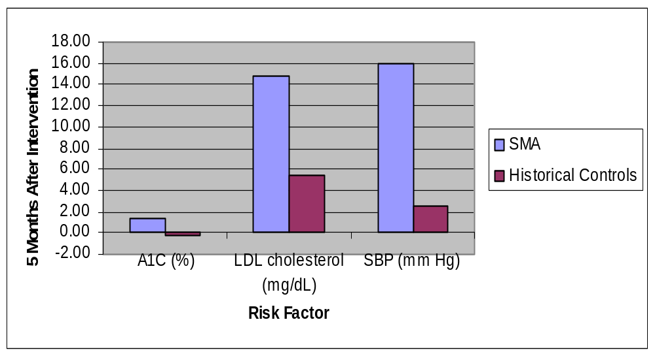
Cleveland VAMC
Shared Medical Appointment
p = 0.29
p < 0.05
p < 0.05
1.4 vs. -0.3
Notes:
Target : A1c>9%, SBP >160 mm Hg, or LDL cholesterol >130 mg /dL
Appointment of 1-2 h

Slide 12
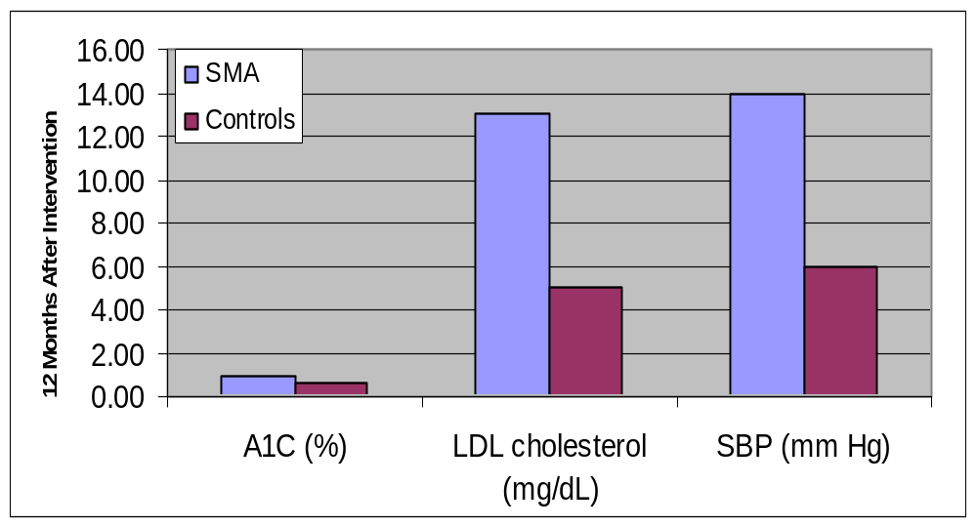
Durham and Richmond VAMC’s
Shared Medical Appointment
P = 0.08
P = 0.03
P = 0.38
Notes:
While the MD is the theoretical leader, there is no true lead; the nurse (not an NP, RN only) runs the education session, and the MD and PharmD make the med changes
Pharmacotherapy is on an individual basis. All pateints get a 5-10'
breakout after group.
3. MD and Pharm D jointly decide the pharmacotherapy; either then may represent that decision and negotiate it with the patient.

Slide 13
Drop-in Group Medical Appointment
-No Structured Appointment-
 | Education | Behavioral modification | Pharmaco therapy | Case Management
Nutritionist
MD
Pharm D
RN /NP
Notes:
Providence VAMC – Pharmacist-led Insulin Initiation program
Target population: DM patients that needs insulin initiation
Known time and place – without previous appointment
Group education and behavioral modification
Individualized visits for pharmacotherapy during group sessions with another provider
Improves access for episodic medical needs
Concerns are often psychosocial
Can be led by physician or clinical pharmacist
Behaviorist in the team is helpful
Specific population is given access to the clinic
Patients were told when and where to show up
Not formally evaluated in RCT’s
Improves patient flow
May improve clinical outcomes
Present in VA and non-VA setting
Start patient on insulin
Smoking cessation counseling

Slide 14
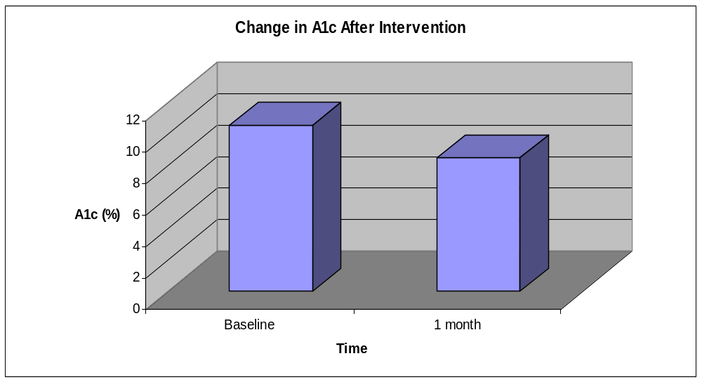
Providence VAMC
Pharmacist-led Insulin Initiation Program
p < 0.01
10.6%
8.5%
Notes:
Target : DM patients who need insulin initiation
Set time and place – no appointment necessary
Pharm D led group education
Individualized pharmacotherapy during group sessions w/ other provider

Slide 15
Group Education and Pharmacotherapy
 | Education | Behavioral modification | Pharmaco therapy | Case Management
Nutritionist
MD
Pharm D
RN /NP
Notes:
Education, pharmacotherapy and case management ALL in the group setting
Multidisciplinary team that provides education
Case managers or group leaders that provides pharmacotherapy: physician or clinical pharmacists or nurses
Efficacy shown in short-duration RCT’s
Several ongoing RCT’s to assess cost-effectiveness

Slide 16
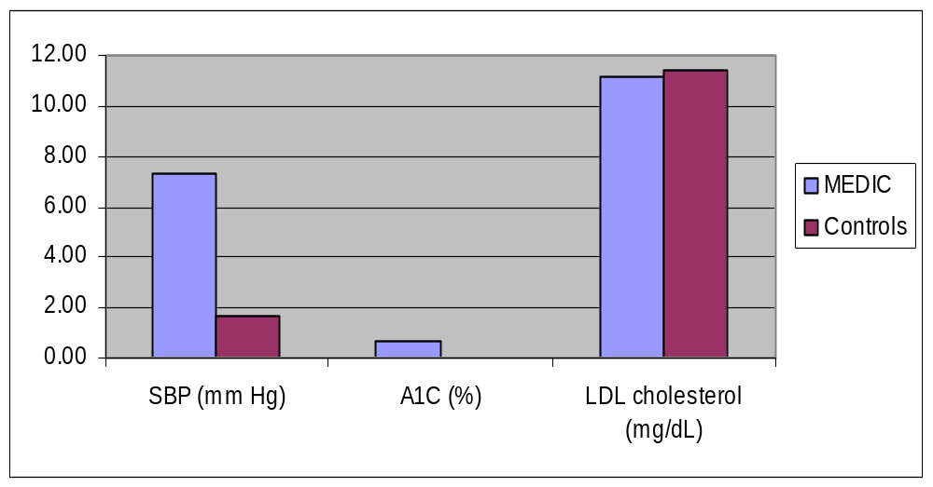
Multidisciplinary Education in Diabetes & Intervention for Cardiac Risk Reduction (MEDIC)
Providence VAMC
3 month follow up
p =NS
p < 0.05
p < 0.05
0.7 vs. 0.0
Notes:
6-8 participants per class
2-hr sessions weekly x 4 wks
2 Components
Multidisciplinary education
Pharmacist-led behavioral & pharmacological intervention
Pilot RCT to plan larger trial
n = 58, MEDIC
n = 51, control
3 month follow-up

Slide 17
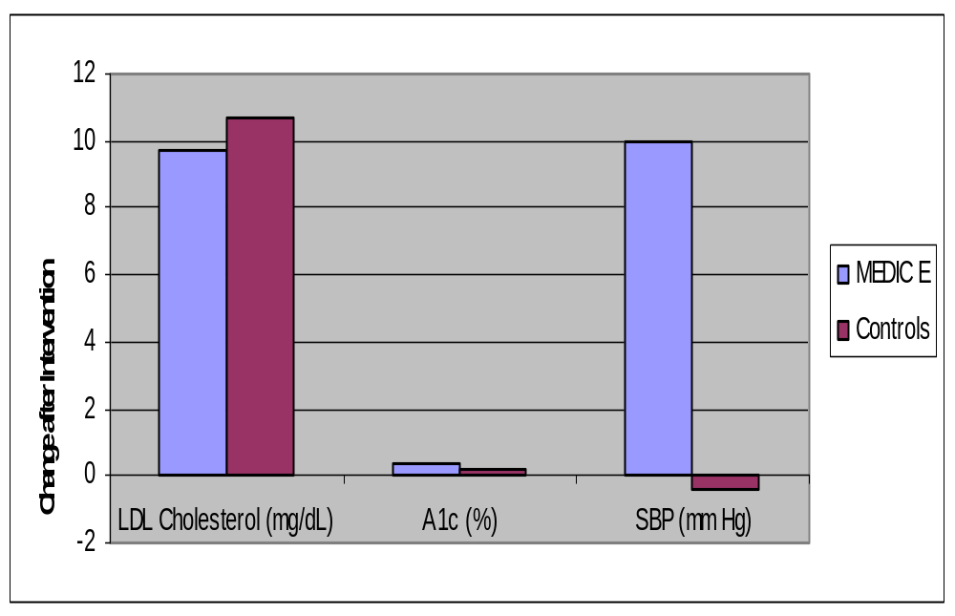
Are the Results Sustainable?
MEDIC-Extended (MEDIC-E)
P = NS
p < 0.05
P = NS between groups,
P < 0.05, for MEDIC-E compared to baseline
6 month follow up
Notes:
MEDIC plus monthly 90 min. booster sessions for 5 mos.
Pilot RCT
MEDIC-E = 47
Control = 47
6 mo. follow-up

Slide 18
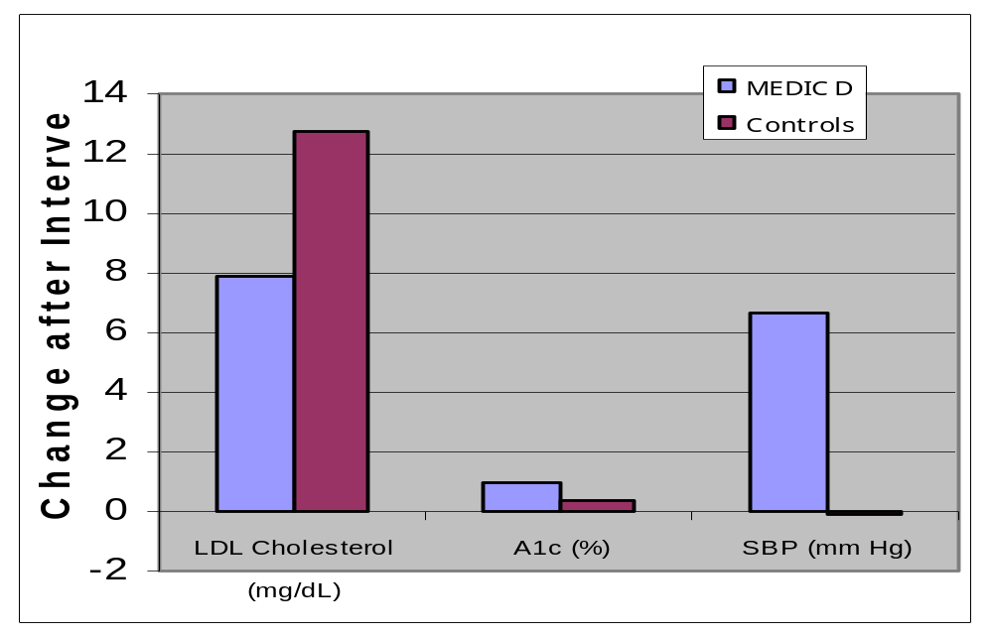
Targeting in Diabetes with Depression (MEDIC-D)
P = NS
P = NS between groups,
P < 0.05, for MEDIC-D compared to baseline
P = NS
6 month follow up
Notes:
6-8 participants per class
Modified MEDIC-E:
2-hour sessions weekly x 4 weeks, then monthly booster x 5 months
2 Components
Multidisciplinary education
Pharmacist-led behavioral & pharmacological intervention
Pilot RCT
n = 28, MEDIC-D
n = 22, control

Slide 19
Group Leader / Case Manager
Need for a consistent group leader / case manager to provide continuity of care
Content expert
Medication case management
Effectively control group dynamics
Examples: Physician, Clinical Pharmacist, Nurse
Notes:
A content expert is needed, so someone who knows how to manage and educate pts on diabetes, this could be a physician, pharmacist or a nurse
You need a team member who can prescribe medications, physician, clinical pharmacist, nurse practitioner
And integral to program is have a facilitator who can effectively manage group dynamic b/c having one over talkative patient can kill any program

Slide 20
Potential Benefits vs. Usual Care
Better access to care
Peer support
Multi-faceted intervention
  Stronger education – behavioral component
Fits well in Integrated Health Care Systems
Cost-benefit

Slide 21
Potential Obstacles
Great variability in care delivery models, with consequences in:
  Efficacy
  Cost
  Access to care
Institutional infrastructure and commitment a “must”
Turf issues versus teamwork
Billing, in the private sector
Notes:
Multidisciplinary team is costly. It may be more efficient to have less personnel that is capable of several functions, e.g. a clinical pharmacist who is a diabetes educator and can prescribe medications

Slide 22


Continuum of Quality Improvement and Research:
Rigor vs. Relevance
Operations
“Relevant”
Context-Dependent
Problem Solving
Quantitative >, <, or =
Qualitative
Pre-test post-test or
quasiexperimental designs
Tends to be NON-LINEAR
Research
“Rigorous”
Identify generalizable
knowledge, i.e.,
Eliminate Context
Publishable
Quantitative>Qualitative
RCTs
Tends to be LINEAR
Potential Synergy
Continuum not a dichotomy
Goal is relevance moving as close to rigor as one can

Slide 23
*** Danger ***
Linear Fallacy of Research and QI: Widely-held assumption that social and biological systems can be largely understood by dissecting out micro-components and analyzing them in isolation.
A
P
Complexity
DATA
S
D
D
S
P
A
A
S
P
The journey up the ramp of complexity is NOT linear.
D
A
P
S
D
Time

Slide 24
Revised Conceptual Model of Rapid Cycle Change
Tomolo, Lawrence, and Aron, QSHC, in press.
Complexity
Challenges
P
D
D
P
D
P
A
S
A
S
A
S
P
D
S
A
P
D
P
S
D
P
P
S
D
Opportunities
Time
Legend:
P=Plan D= Do = Barrier = Direct flow of impact
S=Study A=Act = Lingering background impact Arrowhead = Feedback or feedforward
Different Sizes of letters and cycles and bolding of letters = denotes differences in importance/impact

Slide 25
Why? In short, the issue is CONTEXT
Target of the interventions – the context - cannot as easily be controlled, randomized or matched in the same way as can patients
Quality programs usually cannot be controlled or standardized
The context of the intervention is constantly changing
Project is fixed
Context must adapt
Research
Context is fixed
Project must adapt
T. Greenhalgh
Practice

Slide 26
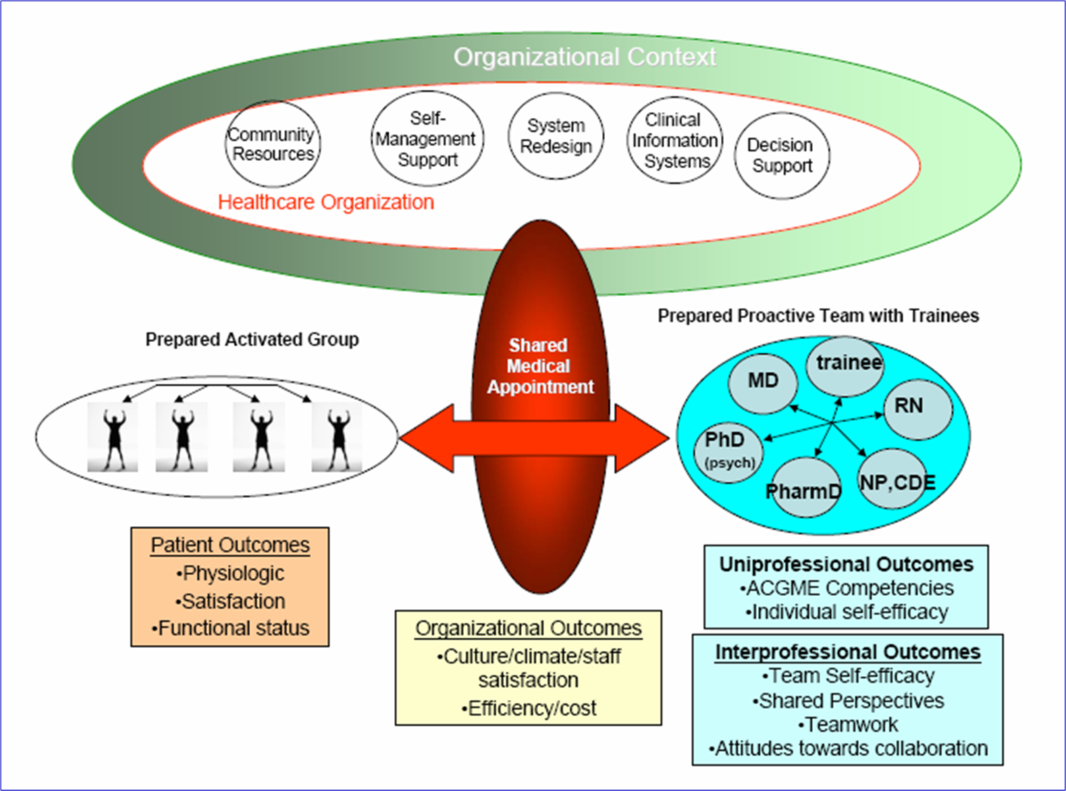
Cleveland VAMC

Slide 27
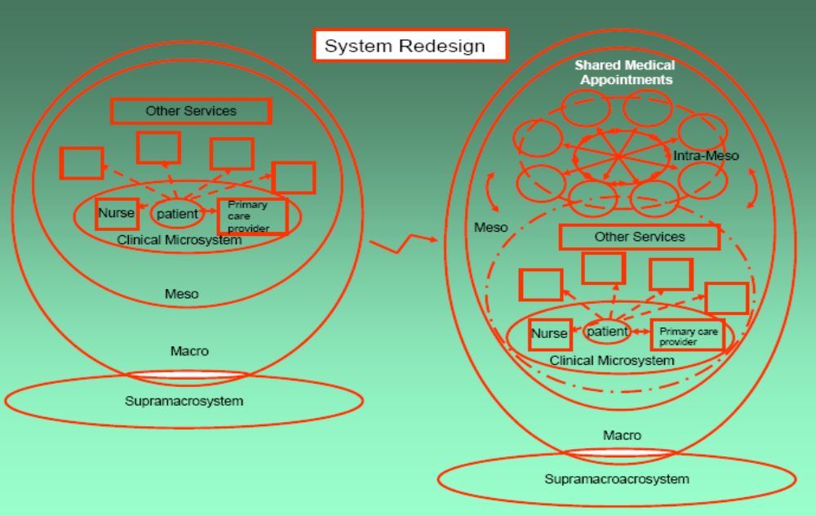
Kirsh SR, Lawrence R, Aron DC. Tailoring an Intervention to the Context and System Redesign Related to the Intervention:Case Study of Implementing Shared Medical Appointments for Diabetes; Implementation Science 2008

Slide 28
Characteristic of Innovation ~ Degree of which innovation provides or is:
Relative advantage or utility over existing or other methods
Trialability, reversibility without risk if doesn’t work
Compatibility with existing norms and values
Visibility, observability of results by other people
Complexity of explaining, understanding
Centrality of impact on daily working routine
Divisibility
Costs relative to benefits and level of investment
Pervasiveness, scope
Risks
Magnitude, disruptiveness
Flexibility, adaptability to situation/needs of local context/target group
Duration for when innovation/change must take place
Involvement of target group in development
Form, physical properties of innovation

Slide 29
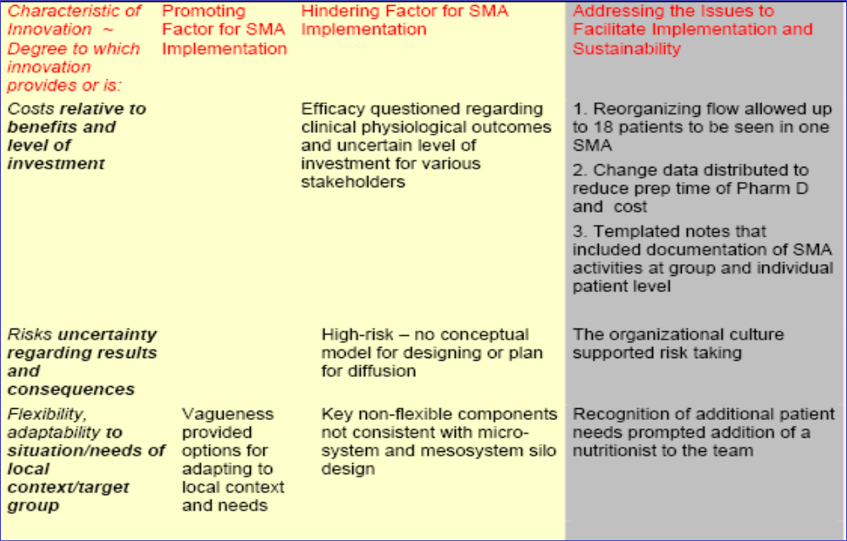
Grol R, Bosch M, Hulscher M, Eccles M, Wensing M. Planning and studying improvement in patient care: the use of theoretical perspectives. Milbank Q. 2007;85:93-138.

Slide 30
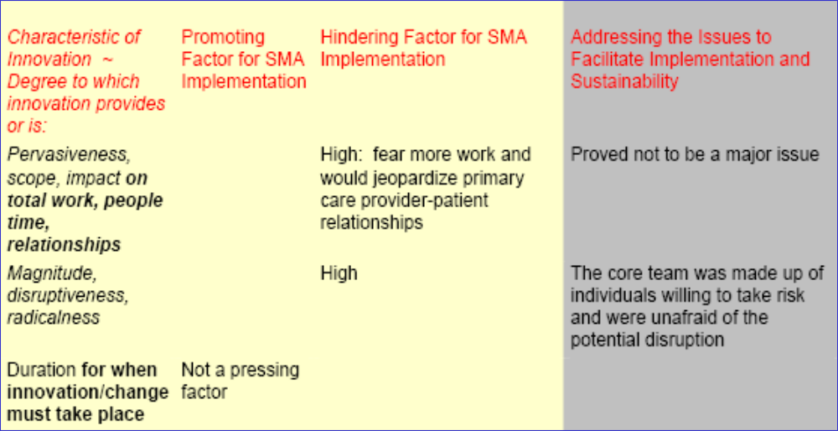
Characteristics continued
Leadership of the Clinic Director and strong team support critical promoting factors

Slide 31
For Improvement and Sustainability
SMAs require complex changes that impact on multiple levels of the organization
Reconfiguration involved the primary care clinic itself and other services from which the patients and the team were derived.
Relationships among different parts of the system were altered.

Slide 32
Conclusions/Lessons Learned
Tailoring the intervention alone will not ensure sustainability; system adjustments are required.
Qualitative work adds another dimension that makes quantitative data more meaningful

Slide 33

SQUIRE guidelines
For writing up quality improvement work to add rigor
Largely incorporates contextual factors
Use of SOME signposts of SQUIRE, but not all applicable

Slide 34
Why Do Shared Medical Appointments Work?
Who do they work for?
When you have a hammer, everything looks like a nail……
Targeting patients to different
interventions

Slide 35
Short Answer–
We don’t know.

Slide 36
Possible Mechanisms of Action
Patient-to-provider interactions
Patient-to-patient interaction
  Self-management groups, with an educator only, have a well-documented modest effect
  Not discussed further here
Other?

Slide 37
Patient-to-Provider Interactions
Multidisciplinary Approach
  Having a doc, a pharmacist, and a nurse is better than usual, MD-based care
Group leader may function as a “specialist”
  Having someone really interested in (eg) diabetes may be better than usual primary care
Lack of distractions
  Care of only (eg) diabetes may be better diabetes care than the ADHD environment of primary care
More is better
  Just having more care for a chronic illness may be better care for that chronic illness

Slide 38
Multidisciplinary Approach
Theory– each provider brings a special expertise, increasing chance that each patient’s best approach to improvement may be available
At least one small RCT assessed this
Intervention 1.5% better A1c compared to control
Other studies involving subspecialty MDs are similar in results
It’s plausible that this is part of the effect

Slide 39
“Specialty Referral”
Theory– a provider interested enough to run a group might be a better provider for that disease than the usual PCP
Untested theory to my knowledge
Many group interventions rotate providers or have patients see their own PCPs
My guess is that this is not a big part of the effect

Slide 40
Care Focus
Theory– without the distractions of usual primary care (acute issues, meeting quality guidelines, etc.) it is easier to improve a single target
Not much literature on this
May come out in qualitative evaluations of group processes
Plausible, but hard to really know

Slide 41
“More is Better”
Theory– what you really need to manage chronic illness is more patient-provider contact, ANY contact.
A wide variety of diabetes structural interventions have worked in RCTs (eg case management, pharmacist clinics)
More probably is better, to a point
Point of diminishing returns unknown

Slide 42
Summary
Probably a number of factors add up to provide the effects of shared medical clinics
Some of these are probably independent of patient interactions within groups
From a cost perspective, would be nice to know what pieces are the most “bang for the buck”
Future study should focus on this

Slide 43
How do you answer this question?
Quantitative measurement
  Measure patients’ perception of care and see what changes
  Or, develop predictive models in an effort to match patients with intervention (SMA, case-management, pharmacist)
Qualitative measurement
  If you want to know what’s working for the patients, just ask them
Don’t bother
  “Just Do It,” treat groups as a “black box” intervention

