Slide 1

International Assoc. of Emergency Managers Region XII Survey Report:
Present Status and Future Trends
Brad Wilson
Region XII Vice-President

Slide 2

About the Survey
130 Question Survey
  Covered a variety of topics
Intended for Undergraduate and Graduate Level Students
Hosted online at SurveyMonkey.com
Changes from Last Year

Slide 3
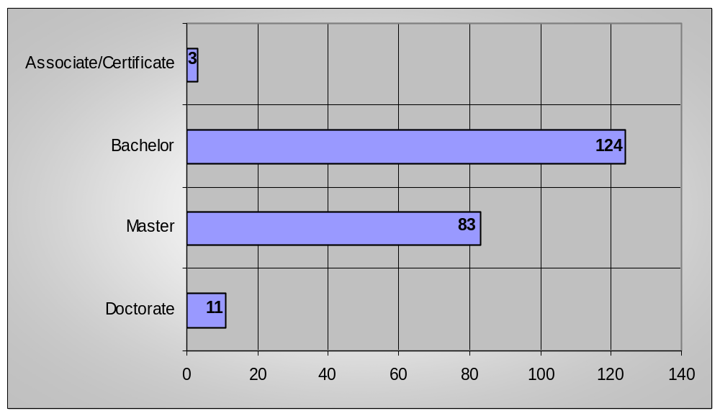
Who Responded
Students who are actively enrolled in Emergency
Management or related degree programs
Bachelor
Master
Doctorate
Associate/Other
Total Number
= 54 %
= 36 %
= 5 %
= 1 %
228

Slide 4

Who are the Students?
Age
25< = 36 %
26-30 = 18 %
31-33 = 8 %
34> = 37 %
Gender
Male = 60%
Female = 40%

Slide 5


Who are the Students?
Marriage Status
Single = 56 %
Married = 36 %
Divorced = 8 %
Ethnicity
White/Non-Hispanic = 83.5 %
American Indian/Alaskan = .09 %
Black = 5.7 %
Hispanic = 5.7 %
Asian/Pacific Islander = 1.9 %
Other = 2.4 %

Slide 6
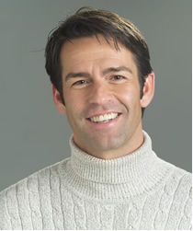
The Emergency Management Student
The Emergency Management student is:
  31 years old
  Single without children
  White/Non-Hispanic
  Male
  Lives off-campus
  United States Citizen
  First time college student who has worked in a previous career
  Belongs to an Emergency Management Student Group (IE. IEMSA, Public Admin.)

Slide 7
What Students Think About Their Program
68 % rate their program “very good/excellent”
  “Could have included more hands-on functions”
  “The idea of an educational EOC or more hands on practice would be excellent for this program”
  “The […] program does well in the fact that it is so interdisciplinary”
  “I think it [is] great to have the chance to take these courses online for working adult students”

Slide 8
What Students Think About Their Professors
  78 % rate their professors as “very good/excellent”
  “Professors are very passionate about the field and it makes me want to learn more”
  “The faculty, also, is top-notch and very accessible. However; it is a little too easy to walk away with a 4.0 in the core classes”
  “There are a lot of things we learn that need a more hands on approach”
  “Best. Teaching staff. Ever.”

Slide 9
Emergency Management Courses
Students have an overall positive view of their courses
  “Needs to be less about policy/theory and more about applying actual tools to the field of emergency management”
  “Although EM readings and curricula do exist, there still seems to be a lack of consensus on what defines EM doctrine”
  “When compared with degrees in law or medicine, the field of EM lacks discipline and consistent application of the lexicon”

Slide 10

Internships
Held an internship while in school
  Yes – 27%
  No – 73%
Held a paid or unpaid internship
  Paid – 45%
  Unpaid – 55%
Felt that the internship gave them adequate training
  Yes – 80%
  No – 20%

Slide 11
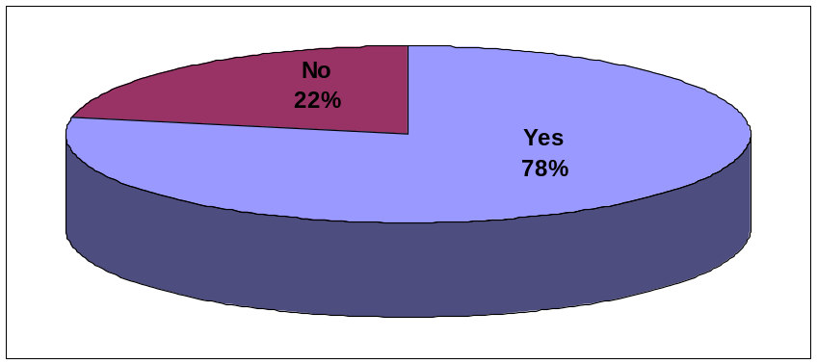
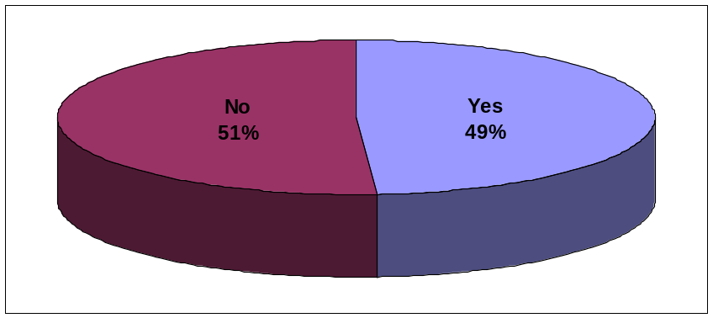
Research, Conference and Publications
61% of graduate students have conducted independent research
93% of students have not published one or more research papers
49% of students have attended a professional conference
Conference Attendance Comparison
05-06 Year
06-07 Year

Slide 12

Lack of Participation – Research and Publications
Lack of funding opportunities
More full-time students participate versus part-time students
Have not had the opportunity for research
“Sometimes it's obvious that all your doing is research for the prof's next book”

Slide 13
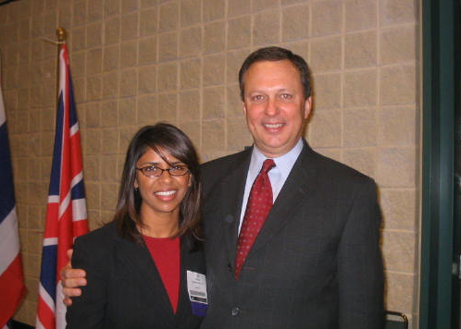

Lack of Participation – Conferences
Lack of funding
University related conflicts (tests, projects, etc)
Private life will not allow it (work, spouses, children)

Slide 14
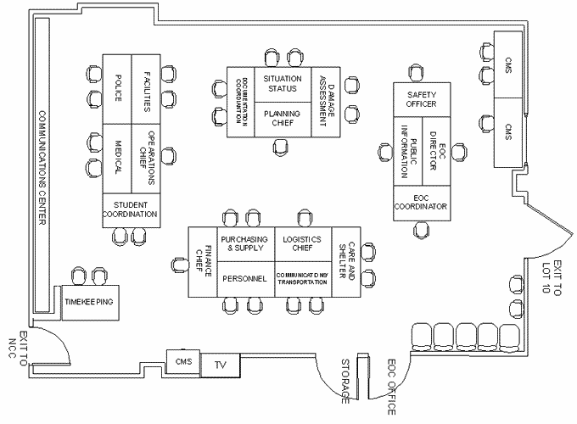
What Would You Change?
Program
  “I would like to see more integration with international programs”
  “Classes offered in the morning and early afternoon”
  “A better idea of what an Emergency Manager ACTUALLY does”
  “Functioning EOC”

Slide 15

What Would You Change? (cont.)
  “More networking events with the industry”
  “More cohesion between the faculty, students, and alumni”
  “Raise entrance standards (IE. Weed out of those who are getting the degree and don’t care about it)”
  “More experienced faculty”

Slide 16
What Would You Keep the Same?
  “The passion the professors have for the subjects they teach”
  “The ability to discuss current events as real-life applications of what is being learned in the classroom”
  “How the course work is divided up in classes”
  “The idea of a required internship is good so that we make up for the hands on experience that may not can be accomplished in the classroom”
  “Small class size”

Slide 17
If they were here to address you:
  “Keep on exploring new ways to promote these types of degrees”
  “Need to incorporate more real-world exercises into the curriculum, such as table-tops, etc..”
  “They need to consider what happens to students after the program is over, especially if the student has no prior emergency management experience. They should design the program with post graduation in mind.”
  “Make it harder on us; the real world does not give extra credit”

Slide 18
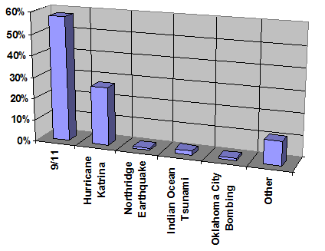
In Your Opinion:
What single event has had the most effect on the policies and direction of Emergency Management?
  9/11
  Hurricane Katrina
  Northridge Earthquake
  Indian Ocean Tsunami
  Oklahoma City Bombing
  Other
  “9/11 did in the U.S. because it changed the focus from natural hazards to terrorism. Putting FEMA under the umbrella of DHS and cutting preparedness and mitigation programs made the country more susceptible to natural hazards and the disasters they will generate”

Slide 19


In Your Opinion:
Do you feel that the Department of Homeland Security is detracting from Emergency Management?
  Yes – 44%
  No – 26%
  Uncertain – 30%
  “While issues in EM and the DHS overlap, I think FEMA, as an example, functioned better and had a better public image before it was brought under the guise of the DHS”
  “DHS is detracting because they are more interested in terrorist activities and other similar types of threats. They seem to ignore the need for education and mitigation from natural hazards and other man-generated threats (such as riots, and technological failures and accidents). They also seem to miss the boat somewhat on the social aspects of disasters as well.”

Slide 20
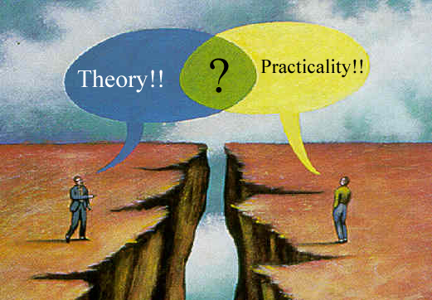
In Your Opinion:
Do you feel there’s a gap between research and practice?
  Yes – 71%
  No – 29%
  “Emergency management in academia is a fairly new topic outside of the traditional military or emergency responder training/academy. Although there is a great deal of research taking place, how is this being integrated into real-life solutions? I think that those doing the research often have difficulty bridging the divide with those that actually face these issues daily.”
  “Emergency Managers do not apply the research”

Slide 21
Observations
  15% increase in students 25 years old or younger entering into EM related degree programs
  More and more students are starting the program as Freshmen
  Vast majority of students have a positive view of their programs, courses, and professors
  Very little diversity
  More and more students are joining Emergency Management related student groups

Slide 22
My Challenge
  Continue to fight for what you want in your programs
  Listen to your student’s opinions, praises and concerns
  Work closely with local EM offices for exercises, plan revisions, etc..
  Work for greater diversity in the student populace
  Bridge the gap between research and practice
  Keep up the good work, we enjoy going to class and listening!
  Challenge Us.

Slide 23


Brad Wilson
Bradwilsonem@msn.com
Vice-President, IAEM Region XII
  www.iaem.com
Past President, UNT IEMSA
  www.untiemsa.org
University of North Texas EADP Graduate, 2007
  www.unt.edu/eadp

