Slide 1
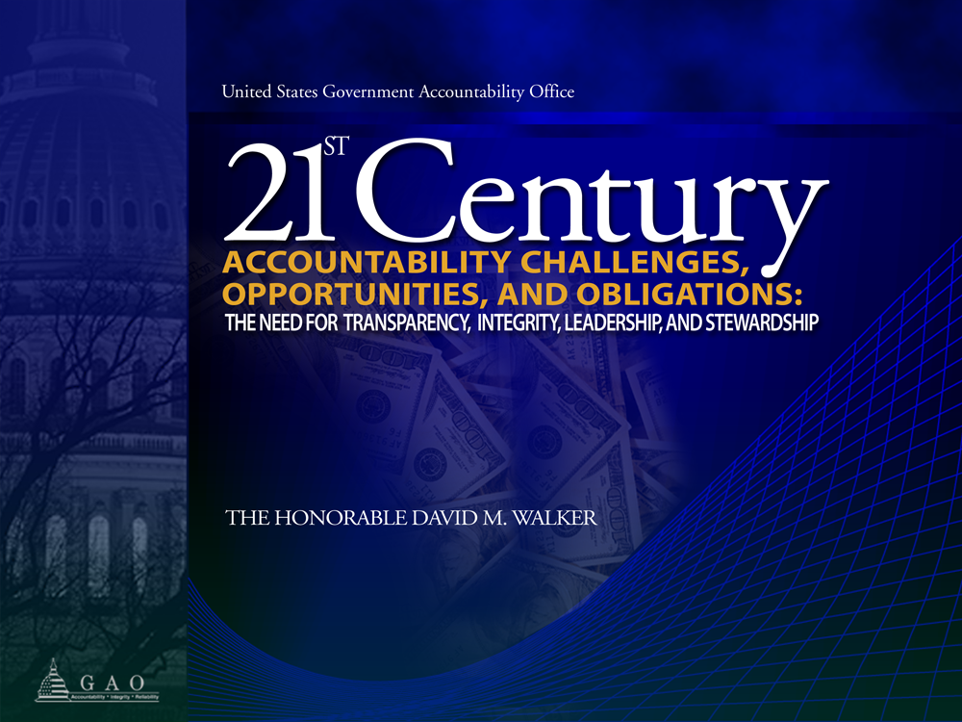
Comptroller General of the United States
Federal Financial Management Conference
March 10, 2006

Slide 2

The Case for Change
Government is on a “burning platform,” and the status quo way of doing business is unacceptable for a variety of reasons, including:
  Past fiscal trends and significant long-range challenges
  Rising public expectations for demonstrable results and enhanced responsiveness
  Selected trends and challenges having no boundaries
  Additional resource demands due to recent terrorism
  events in the United States
  Government performance/accountability and high risk challenges, including the lack of effective human capital strategies

Slide 3
FY2005 GAO Audit Report –
Emphasis of a Matter
“…the U.S. government’s total reported liabilities, net social insurance commitments, and other fiscal exposures continue to grow…Given these and other factors, it seems clear that the nation’s current fiscal path is unsustainable and that tough choices by the President and the Congress are necessary in order to address the nation’s large and growing long-term fiscal imbalance.”

Slide 4
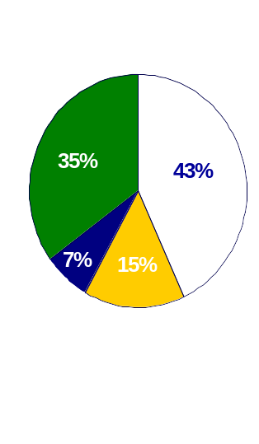
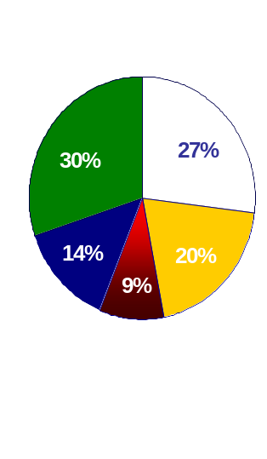
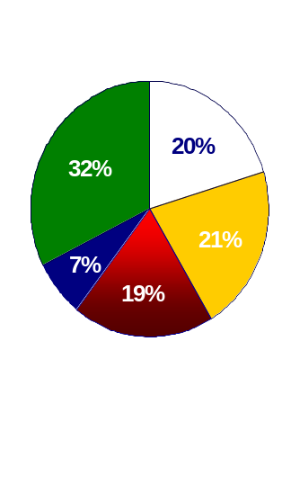
Composition of Federal Spending
1965
1985
2005
Defense
Social Security
Medicare & Medicaid
Net interest
All other spending
Source: Office of Management and Budget.

Slide 5
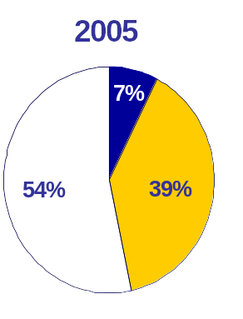
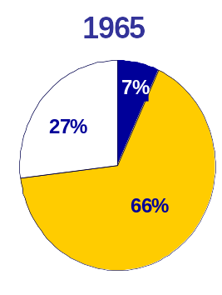
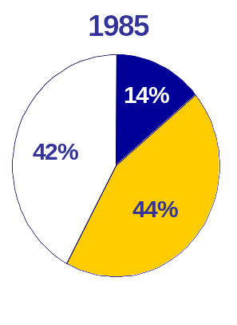
Federal Spending for Mandatory and Discretionary Programs
Net Interest
Discretionary
Mandatory
Source: Office of Management and Budget.

Slide 6
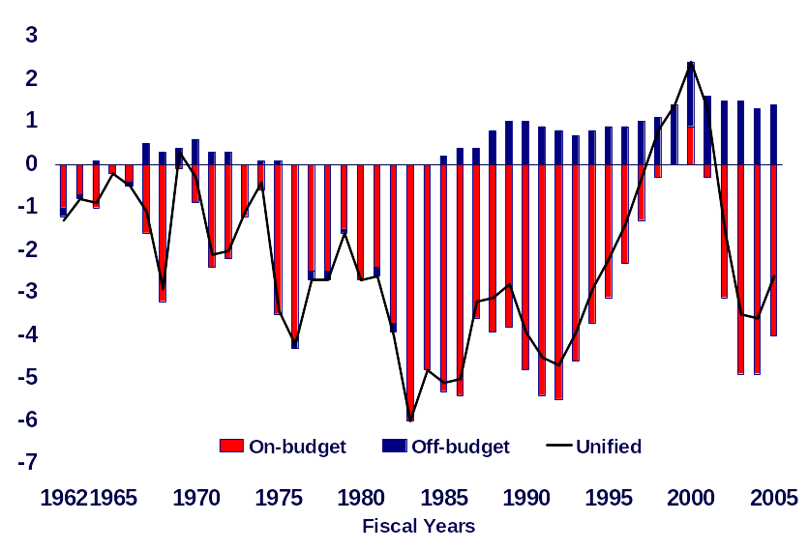
Surplus or Deficit as a Share of GDP
Fiscal Years 1962-2005
Percent of GDP
Source: Office of Management and Budget

Slide 7
Fiscal Year 2004 and 2005
Deficits and Net Operating Costs
 | Fiscal Year 2004 |  | Fiscal Year 2005
 | ($ Billion)
On-Budget Deficit | (568) |  | (494)
Off-Budget Surplus* | 155 |  | 175
Unified Deficit | (413) |  | (319)
Net Operating Cost | (616) |  | (760)
*Includes $151 billion in fiscal year 2004 and $173 billion in fiscal year 2005 in Social Security surpluses and $4 billion in fiscal year 2004 and $2 billion in fiscal year 2005 in Postal Service surpluses.
Source: The Office of Management and Budget and the Department of the Treasury.

Slide 8
Estimated Fiscal Exposures
($ trillions)
 | 2000 | 2005
Explicit liabilities | $6.9 | $9.9
Publicly held debt Military & civilian pensions & retiree health Other
Commitments & contingencies | 0.5 | 0.9
E.g., PBGC, undelivered orders
Implicit exposures | 13.0 | 35.6
Future Social Security benefits | 3.8 | 5.7
Future Medicare Part A benefits | 2.7 | 8.8
Future Medicare Part B benefits | 6.5 | 12.4
Future Medicare Part D benefits | -- | 8.7
Total | $20.4 | $46.4
Source: U.S. government’s consolidated financial statements (CFS).
Note: Estimates for Social Security and Medicare are at present value as of January 1 of each year as reported in the CFS and all other data are as of September 30.

Slide 9
How Big is Our
Growing Fiscal Burden?
 | 2000 |  | 2005
Total Fiscal Exposures | $20.4 trillion |  | $46.4 trillion
Burden
Per Person |  | $72,000 | $156,000
Per Full-time Worker |  | $165,000 | $375,000
Per Household |  | $189,000 | $411,000
Sources: GAO analysis.

Slide 10
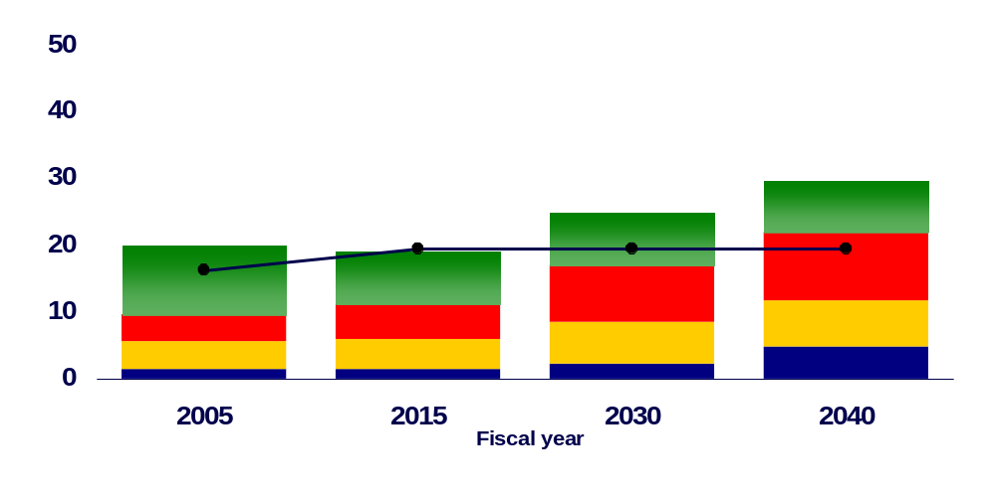
Composition of Spending as a Share of GDP
Under Baseline Extended
Percent of GDP
Revenue
Net Interest
Medicare & Medicaid
Social Security
All other spending
Notes: In addition to the expiration of tax cuts, revenue as a share of GDP increases through 2016 due to (1) real bracket creep, (2) more taxpayers becoming subject to the AMT, and (3) increased revenue from tax-deferred retirement accounts. After 2016, revenue as a share of GDP is held constant.
Source: GAO’s January 2006 analysis.

Slide 11
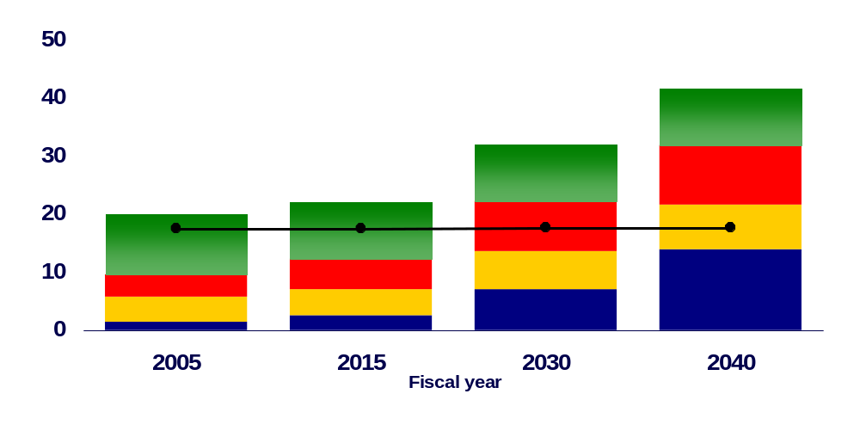
Composition of Spending as a Share of GDP
Assuming Discretionary Spending Grows with GDP after 2006 and All Expiring Tax Provisions are Extended
Percent of GDP
Revenue
Net Interest
Medicare & Medicaid
Social Security
All other spending
Note: This includes certain tax provisions that expired at the end of 2005, such as the increased AMT exemption amount.
Source: GAO’s January 2006 analysis.

Slide 12
Current Fiscal Policy Is Unsustainable
The “Status Quo” is Not an Option
  We face large and growing structural deficits largely due to known demographic trends and rising health care costs.
  GAO’s simulations show that balancing the budget in 2040 could require actions as large as
    Cutting total federal spending by 60 percent or
    Raising federal taxes to 2 times today's level
Faster Economic Growth Can Help, but It Cannot Solve the Problem
  Closing the current long-term fiscal gap based on reasonable assumptions would require real average annual economic growth in the double digit range every year for the next 75 years.
  During the 1990s, the economy grew at an average 3.2 percent per year.
  As a result, we cannot simply grow our way out of this problem. Tough choices will be required.

Slide 13
The Way Forward:
Three Pronged Approach
Re-impose Budget Controls
  Discretionary spending caps
  PAYGO rules on both sides of the ledger
  Mandatory spending triggers
Improve Accounting and Reporting and Metrics:
  Enhanced financial statement presentation
  Automatic present value disclosures for legislative debate on major tax and spending bills
  Develop key national (outcome-based) indicators
Re-examine Policies and Programs:
  Restructure existing entitlement programs
  Reexamine the base of all other spending programs
  Review and revise existing tax policy, including tax preferences and enforcement programs
  Expand scrutiny of proposed new programs, policies, or activities

Slide 14
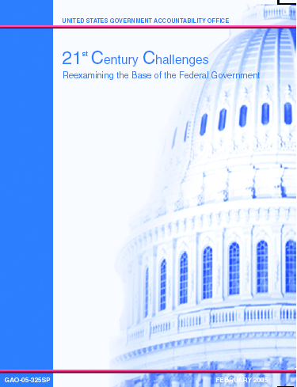
21st Century Challenges Report
Provides background, framework, and questions to assist in reexamining the base
Covers entitlements & other mandatory spending, discretionary spending, and tax policies and programs
Based on GAO’s work for the Congress

Slide 15
Twelve Reexamination Areas
MISSION AREAS
International Affairs
Natural Resources,
Energy & Environment
Retirement & Disability
Science & Technology
Transportation
Defense
Education & Employment
Financial Regulation &
Housing
Health Care
Homeland Security
CROSSCUTTING AREAS
Reexamining the Tax System
Improving Governance

Slide 16
Generic Reexamination Criteria and Sample Questions
Relevance of purpose and the federal role
Why did the federal government initiate this program and what was the government trying to accomplish?
Have there been significant changes in the country or the world that relate to the reason for initiating it?
Measuring success
Are there outcome-based measures? If not, why?
If there are outcome-based measures, how successful is it based on these measures?
Targeting benefits
Is it well targeted to those with the greatest needs and the least capacity to meet those needs?
Affordability and cost effectiveness
Is it using the most cost-effective or net beneficial approaches when compared to other tools and program designs?
Best practices
Is the responsible entity employing prevailing best practices to discharge its responsibilities and achieve its mission?

Slide 17
Key National Indicators
WHAT: A portfolio of economic, social, and environmental outcome-based measures that could be used to help assess the nation’s and other governmental jurisdictions’ position and progress
WHO: Many countries and several states, regions, and localities have already undertaken related initiatives (e.g., Australia, New Zealand, Canada, United Kingdom, Oregon, Silicon Valley (California) and Boston).
WHY: Development of such a portfolio of indicators could have a number of possible benefits, including
    Serving as a framework for related strategic planning efforts
    Enhancing performance and accountability reporting
    Informing public policy decisions, including much needed baseline reviews of existing government policies, programs, functions, and activities
    Facilitating public education and debate as well as an informed electorate
WAY FORWARD: Consortium of key players housed by the National Academies domestically and related efforts by the OECD and others internationally.

Slide 18
Audit Results for 24 CFO Act Agencies
 | 2005⁽¹⁾ |  | 2000 |  | 1996
Unqualified | 19 |  | 18 |  | 6
Qualified | 0 |  | 3 |  | 4
Mixed Disclaimed | 1 4 |  | 0 3 |  | 0 14
Total | 24 |  | 24 |  | 24
(1) 2005 includes the Department of Homeland Security (DHS), which became a CFO Act agency in FY 2005. FEMA, which became part of DHS, is included in prior years.

Slide 19
2005 Audit Results for 24 CFO Act Agencies
Unqualified
19 agencies
Qualified
None
Mixed
1 agency (GSA)
Disclaimed
4 agencies (DOD, DHS, NASA, DOE)
Approx. $848 billion (58%) of reported total assets at September 30, 2005
Approx. $751 billion (25%) of net costs as of September 30, 2005
Restatements
7 agencies (USAID, DOD, DHS, HUD, Justice, State, DOT)

Slide 20
Selected Accountability Issues
Leading by Example
Definition of success in financial management
  Clean opinion on financial statements
  No material internal control weaknesses
  No significant compliance issues
  Systems that produce timely, accurate, and useful financial and management information
Opinions on internal control
Additional issues
  Accelerated and enhanced financial reporting (all agencies)
  Audit/financial management committees (selected agencies)

Slide 21
Selected Reporting Challenges
Financial and Performance Reporting
  DOD assets, liabilities, and contingencies - DOD
  restatements - certain agencies
  performance reporting - all agencies
  “trust funds” (e.g., restricted vs. unrestricted revenues, intra-governmental obligations) - OMB
  long-range fiscal challenges (e.g., per capita burden, sustainability, intergenerational impact) - GAO
  summary annual report - Treasury

Slide 22
The Federal Financial Audit Environment
The federal financial audit environment is evolving:
  Closer to an opinion on the consolidated financial statements of the U.S. government (CFS), but DOD is the key challenge
  GAO, as the auditor of the CFS, needs to be able to use the work of the auditors of the agency financial statements
  Agencies need to meet accelerated due dates, maintain unqualified opinions, and address their internal control and financial management system deficiencies
  More timely financial and performance reporting should not come at the price of less reliable reporting

Slide 23
GAO’s Work to Modernize the Accountability Profession
GAO is actively working to modernize and transform the accountability profession, both inside the government and in the private sector, and to lead by example in this area:
  Definition of success in financial management: clean opinion, no major weaknesses in controls or compliance, and financial systems that produce timely, accurate and useful information for management
  Acceleration of financial reporting and related other reports
  Opinion on system of internal control
  2003 revision of Government Auditing Standards (2006 revision is in process)
  Creation of the U.S Auditing Standards Coordinating Forum (i.e., GAO, PCAOB, ASB)
  Coordination with accountability organizations around the world (e.g., INTOSAI)
  Modernization of the accounting/reporting and audit models (e.g. IFAC, IAASB, FASB, GASB, FASAB, etc. )
  Assure appropriate treatment of restatements by auditors and others
  Monitor implementation of the Sarbanes-Oxley Act, including providing suggestions for possible actions by the PCAOB and the SEC in connection with the internal control reporting requirements under Section 404
  Consider whether reform elements similar to those in Sarbanes-Oxley make sense for the federal government
  Explore additional opportunities for employing more frequent reporting and continuous auditing approaches
  Explore revised approaches to quality assurance programs, including internal inspections and peer reviews
Notes:
GAO also had a large role in supporting and assisting the Congress in the development of the Sarbanes-Oxley Act

Slide 24
Financial Statement Audit Peer Review
Performed by a large, international accounting firm (KPMG LLP) in accordance with AICPA peer review standards and Government Auditing Standards
Clean opinion – fourth straight time
Reviewers cited numerous good practices:
  Major issues and significant consultations well documented
  Internal inspection and peer review taken seriously
  Comprehensive sampling plans used
  Good use of tracking sheets and routing slips
Reviewers also suggested clarifying policies and procedures for documenting references to prior year testing and the assessment of management’s internal control evaluation process

Slide 25
International Peer Review Team
Australia
Mexico
Norway
South Africa
Canada
Netherlands
Sweden

Slide 26
Performance Audit Peer Review
Clean Opinion
Global Good Practices
  Strategic planning process
  Audit risk assessment
  Agency Protocols
  Use of experts
  E.A.G.L.E
  Report design
Other Observations
  Distinguishing between audit and non-audit services
  Reporting additional details on sources of critical information and methodological choices
  Reviewing the quality assurance system for further efficiencies
  Streamlining the documentation requirements
  Making the inspection program more efficient
Report Has Been Made Public

Slide 27
How Do We Move Forward?
Good governance, transparency, and accountability are critical
  in the private sector to promote efficiency and effectiveness in the capital and credit markets, and overall economic growth, both domestically and internationally
  in the public sector for the effective and credible functioning of a healthy democracy, and in fulfilling the government’s responsibility to citizens and taxpayers
  in both sectors to support a healthy economy that provides economic opportunities and benefits to citizens
Sorting out the needs and effective and appropriate governance and accountability mechanisms for different sectors and types of organizations and on an international scale will be critical

Slide 28
Key Ingredients Needed for These Challenging and Changing Times
Courage
Integrity
Creativity
Stewardship

Slide 29
Comptroller General of the United States
Federal Financial Management Conference
March 10, 2006

