Slide 1
Flow dependent background error for GSI
Still under construction
Core module well tested (raflib.f90)
Many features of anisotropic filter implemented
Near term goal (implementation by March)
- anisotropic option installed
- aspect tensor options
isotropic inhomogeneous (current)
coupling to background gradient

Slide 2
Flow dependent background error for GSI
Several options tested in eta 3dvar to gain experience while waiting to use in GSI (Pondeca)
raflib being used in high resolution test version of sst analysis (Katz, Gemmill)
Used recently by Haixia Liu for 3D OSSE experiment with GPS data

Slide 3
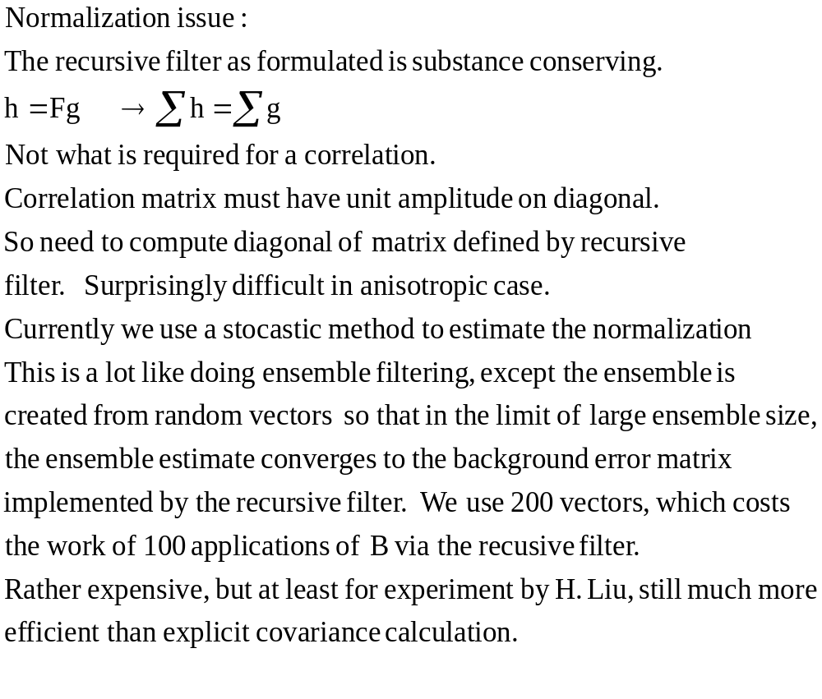

Slide 4
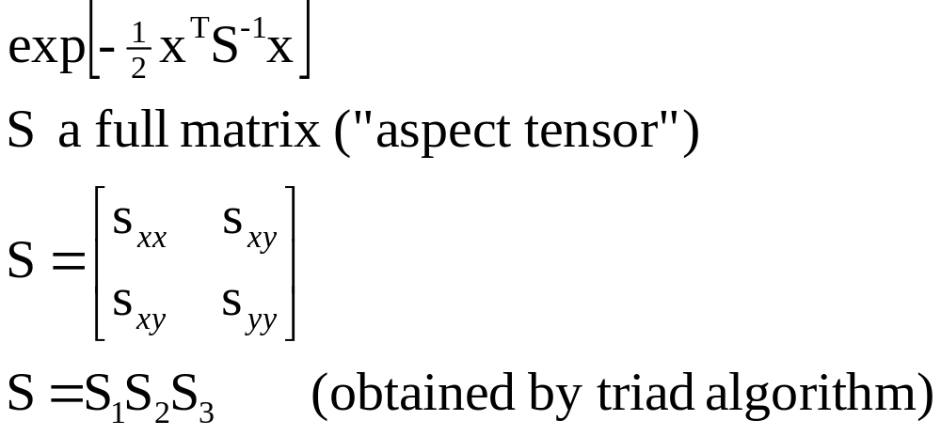

Anisotropic background error
s₃
s₂
s₁

Slide 5
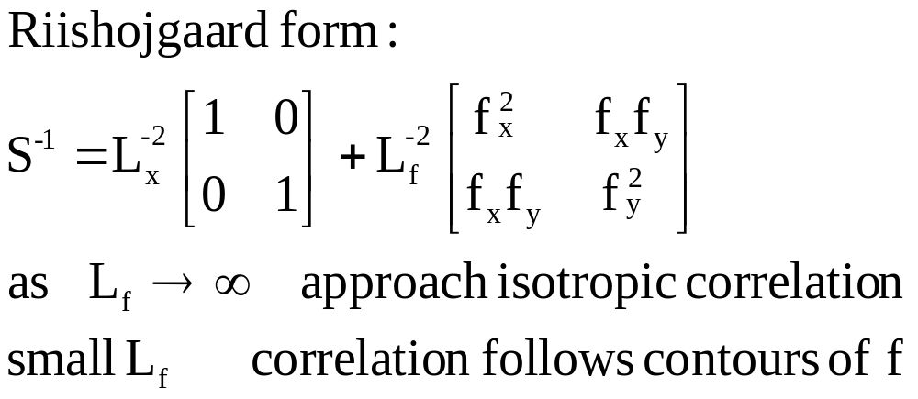
Anisotropic background error

Slide 6
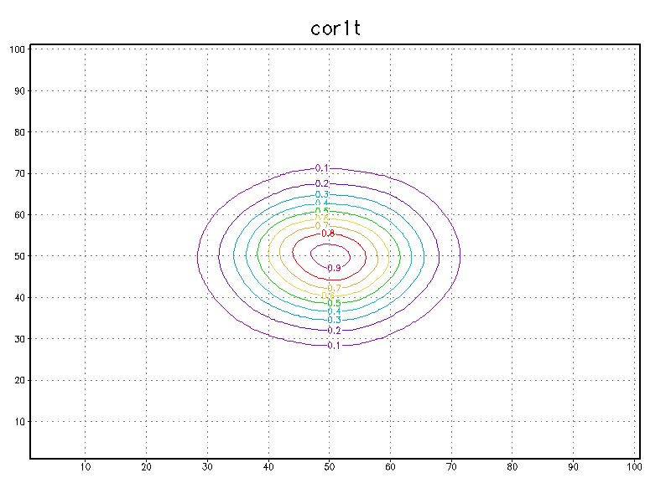
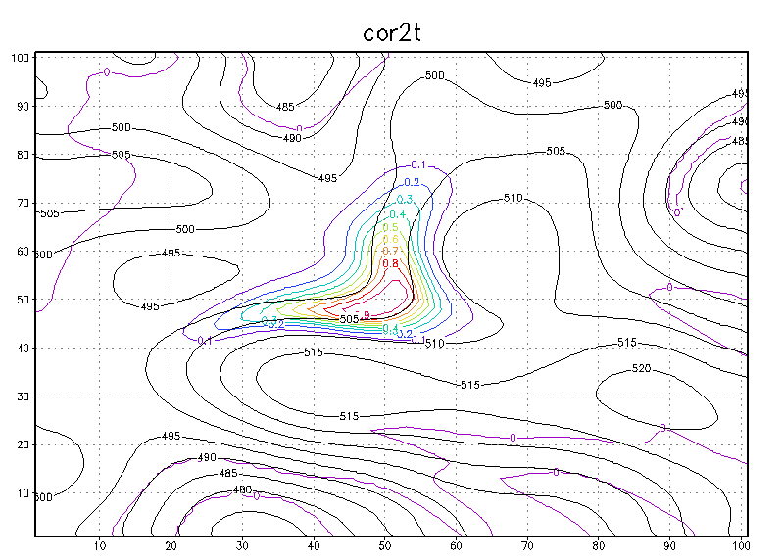

Slide 7
Some implementation details
Additional parameters to estimate
Return to factored form of B, B=CC^{T}
Factored form increases size of control vector for sum of gaussians
Interpolate to coarser grid when applying filter (resolution determined by shortest correlation lengths)
Try baseball grid when running in global mode to solve pole and periodicity problems (code provided by Purser, already tested)
Cut cost of filter in half with latest refinement (Purser)
Consider replacing or augmenting NMC method for parameter estimation with estimates from innovations (simplified approximations to maximum likelyhood or least squares fitting, Purser)

