Slide 1

Endogenous Market Transitions
Insights from Modeling Alternative and Hydrogen Fuels and Vehicles
(TAFV and HyTrans)
Paul Leiby
Oak Ridge National Laboratory
April 21, 2006
Washington, DC
Presented at the DOE/EPA Workshop
Modeling the Oil Transition

Slide 2
Market Tensions & Tradeoffs During Transition to Alternative Motor Fuel
Speed of introduction
Scale economies of fuel production plant
Offering fuel to a wide region and market
Variety and diversification of fuel/ vehicle techs produced
Diversity of vehicle-models
offered within tech
Retail fuel availability
Vs.
Slow capital turnover, adj. costs
Investment risk Distance to market (distributed?)
Initially targeting high demand-density markets
Learning and Tech progress in given tech
Vehicle-plant scale econ
Station size or utilization rate, delivery network
Vs.
Vs.
Vs.
Vs.
Vs.

Slide 3
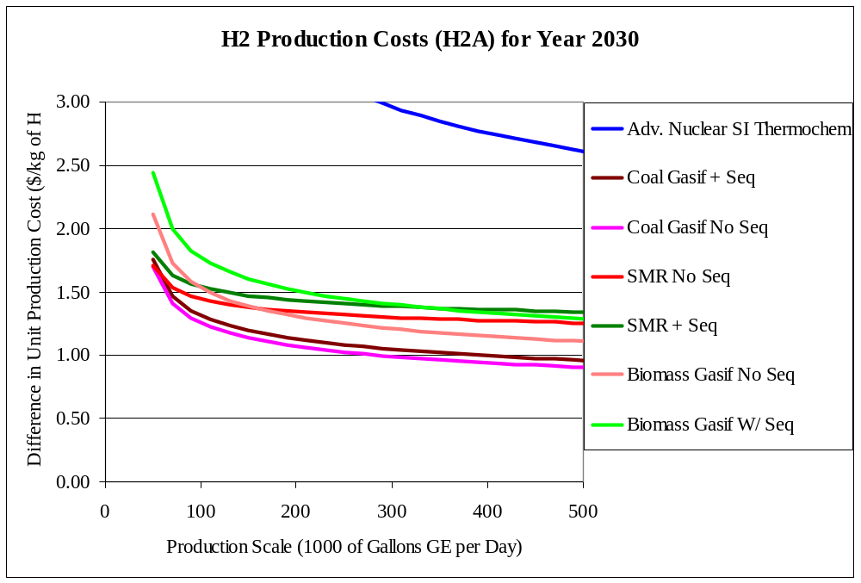
Market Tensions & Tradeoffs During Transition to Alternative Motor Fuel
Speed of introduction
Scale economies of fuel production plant
Offering fuel to a wide region and market
Variety and diversification of fuel/ vehicle techs produced
Diversity of vehicle-models
offered within tech
Retail fuel availability
Vs.
Slow capital turnover, adj. costs
Investment risk Distance to market (distributed?)
Initially targeting high demand-density markets
Learning and Tech progress in given tech
Vehicle-plant scale econ
Station size or utilization rate, delivery network
Vs.
Vs.
Vs.
Vs.
Vs.

Slide 4
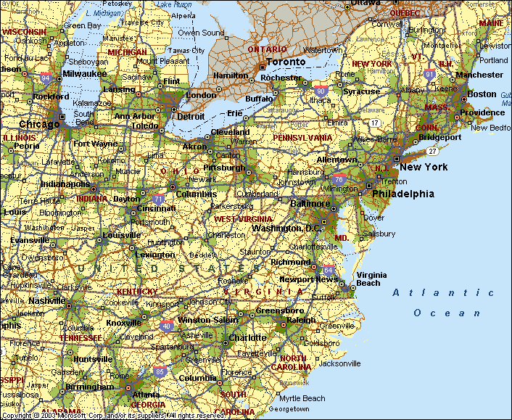
Market Tensions & Tradeoffs During Transition to Alternative Motor Fuel
Speed of introduction
Scale economies of fuel production plant
Offering fuel to a wide region and market
Variety and diversification of fuel/ vehicle techs produced
Diversity of vehicle-models
offered within tech
Retail fuel availability
Vs.
Slow capital turnover, adj. costs
Investment risk Distance to market (distributed?)
Initially targeting high demand-density markets
Learning and Tech progress in given tech
Vehicle-plant scale econ
Station size or utilization rate, delivery network
Vs.
Vs.
Vs.
Vs.
2/3 of LDV fuel is used in <10% of the land area (EPA data)
Vs.

Slide 5
Market Tensions & Tradeoffs During Transition to Alternative Motor Fuel
Speed of introduction
Scale economies of fuel production plant
Offering fuel to a wide region and market
Variety and diversification of fuel/ vehicle techs produced
Diversity of vehicle-models
offered within tech
Retail fuel availability
Vs.
Slow capital turnover, adj. costs
Investment risk Distance to market (distributed?)
Initially targeting high demand-density markets
Learning and Tech progress in given tech
Vehicle-plant scale econ
Station size or utilization rate, delivery network
Vs.
Vs.
Vs.
Vs.
Vs.

Slide 6
Market Tensions & Tradeoffs During Transition to Alternative Motor Fuel
Speed of introduction
Scale economies of fuel production plant
Offering fuel to a wide region and market
Variety and diversification of fuel/ vehicle techs produced
Diversity of vehicle-models
offered within tech
Retail fuel availability
Vs.
Slow capital turnover, adj. costs
Investment risk Distance to market (distributed?)
Initially targeting high demand-density markets
Learning and Tech progress in given tech
Vehicle-plant scale econ
Station size or utilization rate, delivery network
Vs.
Vs.
Vs.
Vs.
Vs.

Slide 7
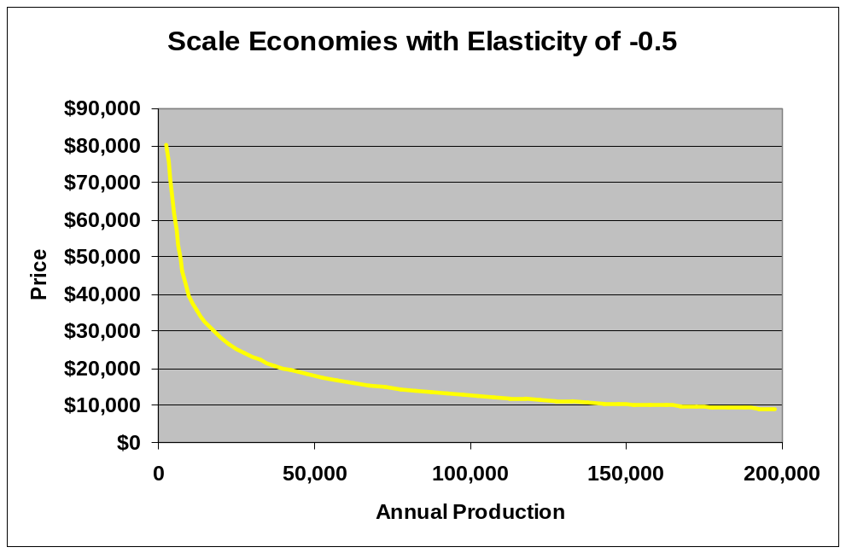
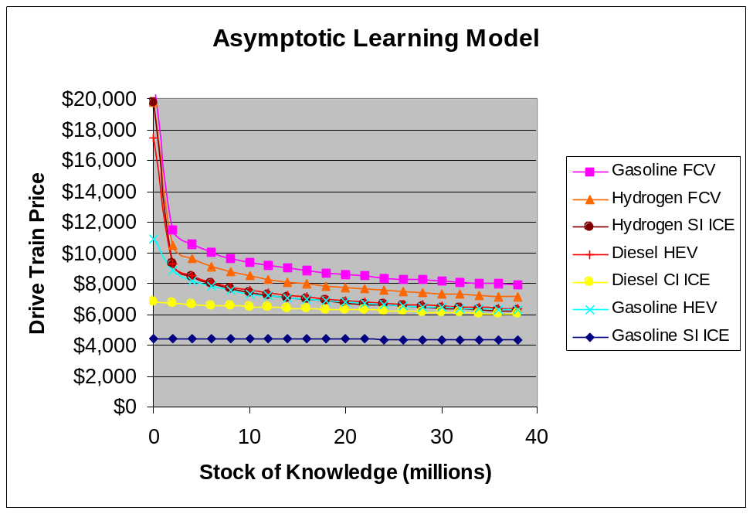
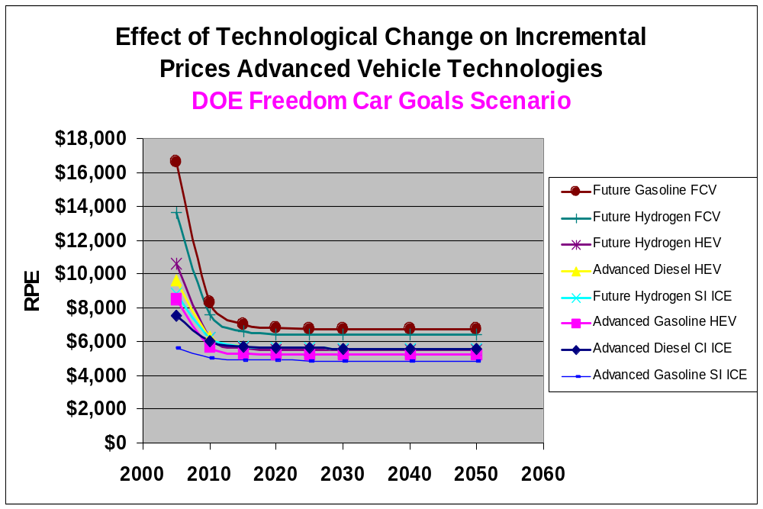
Technological Cost Reduction for New Vehicles
Vehicle technologies improve by 3 mechanisms:
Retail Price =
Scale × Learning × Tech Change
× Scenario Ref Price
Scale w/ Annual Production/Plant
Future FCV
Gasoline SI ICE
Learning & Unlearning w/ Stock on Road
Tech Change w/ Passage of Time (Yr)
Notes:
On vehicle technology side. Currently we represent technology as a drivetrain.
Thanks to advice we have received, we are changing that to a component based model.
Unstead of drive train, there are stacks, batteries, motors. In this way the technologies interact with one another.
Curves that we have derived from information from Phil Patterson, showing rapid technological progress.
Learning and scale
Model does have these dynamic effects that the more you produce, the cheaper the vehicle, large scale cheaper the vehicle.
======
Tech progress occurs strictly as a function of time.
Tech change curves are for large scale advance level of learning.
Cheaper to produce later, all else equal.
Learning and unlearning curve.
Done as a function of stock on the road.
Q: What are elasticities related to?
Q: [Santini] Can you mark where you are on Scale and Learning curves with X’s

Slide 8
Market Tensions & Tradeoffs During Transition to Alternative Motor Fuel
Speed of introduction
Scale economies of fuel production plant
Offering fuel to a wide region and market
Variety and diversification of fuel/ vehicle techs produced
Diversity of vehicle-models
offered within tech
Retail fuel availability
Vs.
Slow capital turnover, adj. costs
Investment risk Distance to market (distributed?)
Initially targeting high demand-density markets
Learning and Tech progress in given tech
Vehicle-plant scale econ
Station size economies, utiliza-tion rates, delivery network
Vs.
Vs.
Vs.
Vs.
Vs.

Slide 9
PSAT ASCM
Vehicle
Attributes
Vehicle
Choice
Model
Vehicle
Supply Model
Tech. Change
Learning
Scale Econ.
H2A H₂
Production
Models
Make & Model
Diversity
Hydrogen
Infrastructure
Investment
Vehicle
Sales by
Technology
H2A Hydrogen
Delivery
Models
Price of
Hydrogen
Hydrogen
Availability
Vehicle
Stock &
Fuel Use
LDV
Sales
Non-Transport
Hydrogen Use
Hydrogen
Use
GHG
Emissions
AEO Energy
Scenarios
HYTRANS MODEL STRUCTURE
H₂ Feedstock
Supply Curves
Notes:
A schematic of the model, does not have all the arrows. Point I’d like to make is that we derive inputs from other models.
In process of incorporating the HDSAM models.
Draw on many of the other analytic efforts going on that are sponsored by the Dept of Energy, and use them in our model.

Slide 10
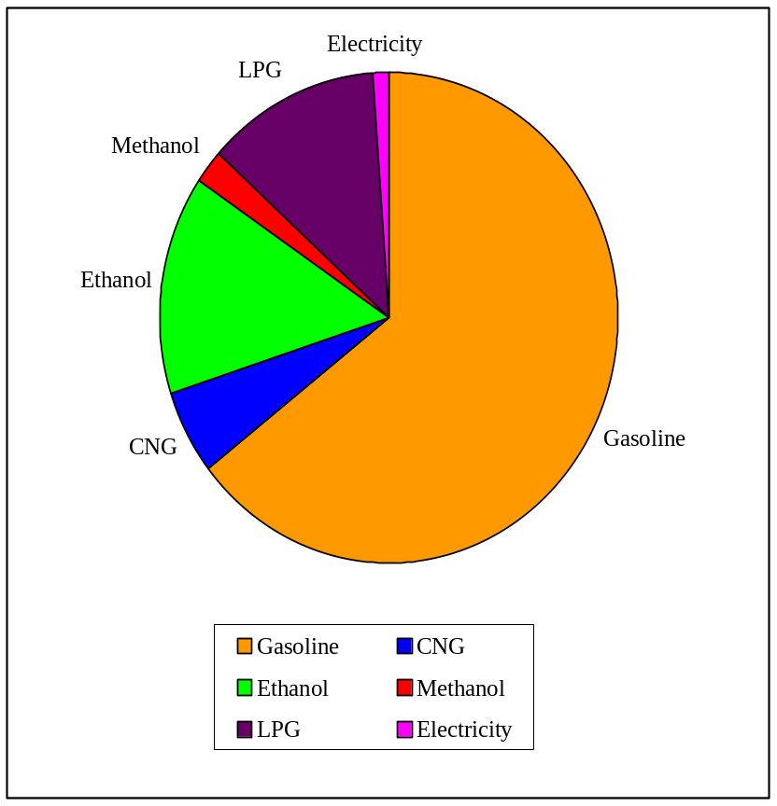
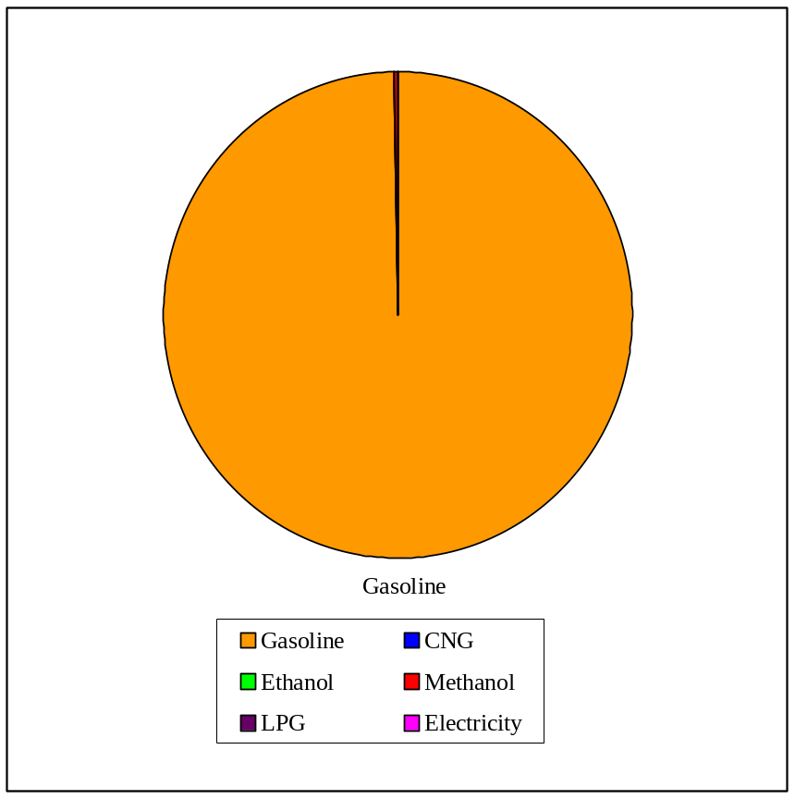
Lesson: Transitional barriers matter
“Market barriers to significant alternative fuel and vehicle use are substantial” (Leiby and Rubin 2000, Greene, Leiby, Bowman and Tworek 2005)
2010 Alternative Fuel Demand Shares, Base Case, No New Policies
No Transitional Barriers
Transitional Analysis With Barriers
Source: Leiby, P.N. Leiby, D.L. Greene and Harry Vidas. 1996.*
“Market Potential and Impacts of Alternative Fuel Use in Light Duty Vehicles: A 2000/2010 Analysis, DOE/PO‑0042, Office of Policy Analysis, U.S. Department of Energy, Washington, DC, January, 1996.
TAFV Model, Leiby, Rubin, Greene 2000

Slide 11
Lessons from Transition Modeling of Alternative and Hydrogen Motor Fuels (TAFV and HyTrans)
Barriers particularly large for
  Fuels requiring distinct, costly vehicle technology
  Gaseous fuels
    (storage and delivery issues)
  Fuels/vehicles in early technological stage

Slide 12
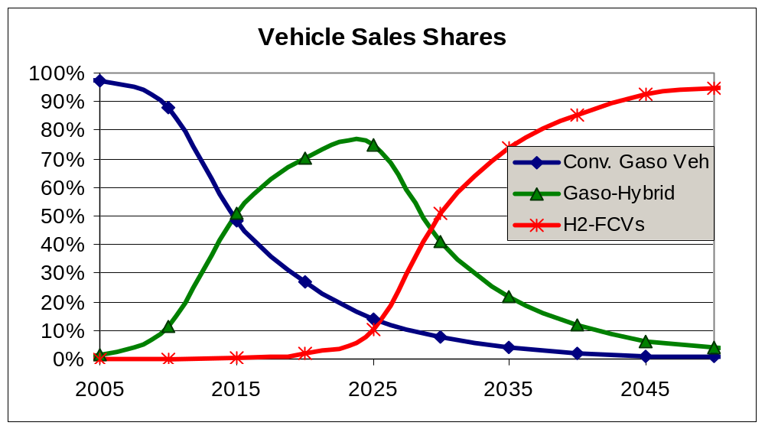
Find Can achieve transitions with
Marked technological progress
Targeted, temporary transitional policy and
Sustained higher oil prices or carbon/security incentives
H2-FCV
Gaso-HEV
Gaso-conventional
HyTrans Case of H2-FCV Introduction Program 3, Followed by $1.5K Subsidy for FCVs. Greene, Leiby, Bowman Tworek 2006

Slide 13
Contribution of Market Equilibrium Transition Modeling Approach
Full problem too rich (hard) for any single model/approach
  Each has purpose, insights
Least-cost Market balancing approach
  Provides consistent, theory-based discipline for integrating components and tradeoffs,
  Must be augmented with represent key transitional considerations
  Endogenous prices and quantities over time
  Allows normative analysis: estimates net benefits

Slide 14
Continued Modeling of Transition – Challenges
Uncertainty
Expectations/foresight
Positive-reinforcing factors
  Lock-in/lock-out
  More than one equilibrium
Long-range (> 50 yr) planning, discounting

