Slide 1
KNOWLEDGE NETWORKING
Key to Success in a Global Environment
Michael Salkind
B.MET.E. – RPI 1959
Ph.D. – RPI 1962
President, OAI
Rensselaer Polytechnic Institute
September 17, 2001

Slide 2


Knowledge Management
“If only Hewlett-Packard knew what
Hewlett-Packard knows we could
be 3 times more profitable”
Hewlett-Packard CEO

Slide 3
KM Pays Off
Buchman Labs - sales up 50%, revenue up 10%
Texas Instruments - $1.5 billion cost avoidance
Dow Chemical - $40 million annual savings
CIGNA - went from $250 million loss to $90 million profit
Skaudia - started up in 7 months, not 7 years
Chevron - $650 million annual savings
USAA - customer phone service increased from 30 to 70%
O’Dell and Grayson, if only we knew what we know
An Investment in Knowledge Pays the Best Interest
Benjamin Franklin

Slide 4

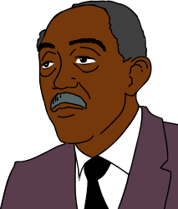
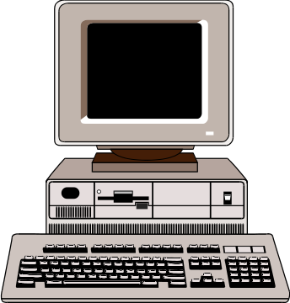

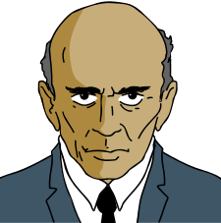


Knowledge Management
Does Not Work
Even With Incentives
Chevron, Bechtel

Slide 5
Knowledge Networking
Networking
And Face to Face
Ford, E&Y, BP Amoco
Team Mates, Peer Assistance, Best Practice

Slide 6
KM Myths
Build it and they will come
Technology can replace face-to-face
First you have to create a learning culture
N. Dixon, Common Knowledge

Slide 7
BP Amoco KM Experience
1997 saved $20M, 1998 saved $700M
Applied to: restructuring, building retail sites, refineries, oil wells
How: “Learn Before Doing”
Web-based folders of artifacts, videoclips, checklists, and hyperlinks to people
- desk top video, multi-media email, real-time shared whiteboard
Most important: Hyperlinks to people with stories to tell
- BP Amoco has a voluntary intranet yellow pages: 30,000+ listings
Peer assist: Team comes to site to advise on planning
- Ask specific questions, not “tell me everything you know”
After action review (US Army): 15 minutes
- What was supposed to happen? What actually happened?
- Why is there a difference? What can we learn and do?
Spin off KM in 1999 as Knowledge Transformation, Int.
CONNECTION, NOT COLLECTION
Telling Tales at BP Amoco, Fortune , May 1999

Slide 8
Knowledge Is:
Information with
Sufficient context to
Provide meaning to the user in
Doing work that is
Important to the enterprise
Knowledge is
In people’s heads
In conversations
On paper
In digital form (audio, video, other)
Arian Ward, Work Frontiers Int.

Slide 9


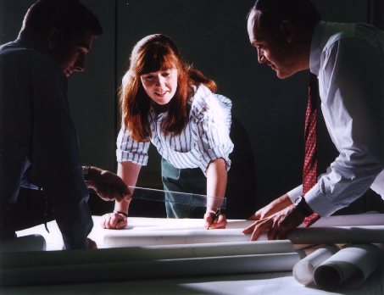

What’s Different About
Knowledge?
Data
“1840KL0617”
Information
“The KLM flight leaves Detroit at 1840”
Knowledge
“That’s not a good flight; often busy and delayed”
Relationships and trust are required
for knowledge transfer and re-use
©2000 Knowledge Transformation TM International, Inc. , all rights reserved

Slide 10





Knowledge Pyramid
(People, Documentation, Software)
Business
Goals
Application & Learning
Capture
Wisdom
Interpreted knowledge for effective
business decisions
Business
Processes
Insight
Stock of experiences + values
+ rules + contextual information
Knowledge
Experience
Message;
useful groupings of data
Engineering
Processes
Information
Record of
transaction
Analysis
Data
©2000 Knowledge Transformation TM International, Inc. , all rights reserved

Slide 11
Knowledge Pyramid
(People, Documentation, Software)
Business
Goals
Application & Learning
Capture
Wisdom
Purposeful integration of knowledge
for effective business decisions
Business
Processes
Insight
Purposeful integration of information
through experiences, values, rules
Knowledge
Learning
Experience
Purposeful integration of data
through analysis
Engineering
Processes
Information
Record of
transaction
Analysis
Data
©2000 Knowledge Transformation TM International, Inc. , all rights reserved

Slide 12
What is
knowledge management?
Making maximum use of what your organisation and ‘networks’ know
Doing this systematically and continuously
Never making the same mistake twice
Right decisions, first time, every time
Cutting the learning curve
No unlearning curve
“anyone in the organization who is not directly accountable for making a profit should be involved in creating and distributing knowledge that the company can use to make a profit. ”
John Browne, BP Amoco
©2000 Knowledge Transformation TM International, Inc. , all rights reserved

Slide 13
Why Now?
‘‘To make knowledge work productive will be the great management task of this century, just as to make manual work productive was the great management task of the last century’’
- Peter Drucker
The marketplace is going global
Changing ever more rapidly
Cheap, networked computing
Drowning in information, starved for knowledge
Engineering focus on task in era of networking (need to turn ‘nerds into nodes’)
No choice…
©2000 Knowledge Transformation TM International, Inc. , all rights reserved

Slide 14

An Emerging Business Imperative
Currency
Product
Knowledge
Craftsmen
Cottages
Labor
Capital
People
Technology
Pre-Industrial
Model
Industrial
Model
Information Age
Model
Source: Adapted from Peter Drucker and Karl Albrecht
©2000 Knowledge Transformation TM International, Inc. , all rights reserved

Slide 15
Implications for behavior
Industrial Era Post-Industrial Era
Structure Deep Hierarchy Flat and Networked
Focus Inside the Silo Virtual Enterprise
Style Command & Control Trust, Empowerment
Driver The Boss The Customer
Technology Basic Advanced
Power Base Knowledge Hoarding Knowledge Sharing
Direction From the Top Shared Vision
Thinking Atomistic Systemic
Conflict Political, mediated Dialog,
share assumptions
Leadership Make decisions Create learning space
Change Paced, focused Exponential, dispersed Order Chaos
Traditional clock Internet clock
©2000 Knowledge Transformation TM International, Inc. , all rights reserved

Slide 16
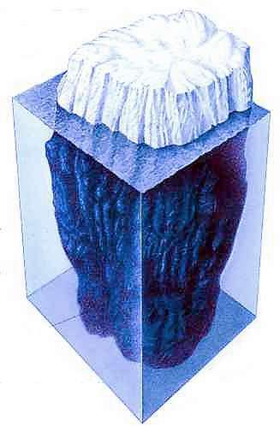
The Knowledge Iceberg
EXPLICIT
Can be documented
TACIT
Personal – embedded in experience
Can be articulated
UNCONSCIOUS TACIT
Needs mining by skilled questioning
Socratic method
Nick Milton, Knowledge Transformation™ Int.

Slide 17
How Do You Articulate
Unconscious Tacit Knowledge
How did you choose a university?
How did you choose a career?
How did you choose a spouse?
How did you choose a home?
How do you ski?
How do you stand up?
Could you have written a useful final report on
each of these projects

Slide 18
The Knowledge Spectrum
Explicit Knowledge
Left Brain:
Tacit Knowledge
Right Brain:
Procedures
Steps
Standards
Checklists
Specifications
Intuitive
Contextual
Know But Can’t Tell
Experiential
Pattern Recognition
Subconscious
Feeling
Cook Book Cooks
Creative Chefs

Slide 19


The Challenge of Far Transfer of Knowledge
The knowledge is in his
head. He is probably
unaware of what he knows
The knowledge needs to be
in her head. She is unaware
of what she needs to know
After Nick Milton, Knowledge Transformation™ Int.
In Knowledge Management, Vol.2, 1999

Slide 20
Learning Before Doing-An Interview with
Bill Kirton, BP Amoco Exploration
I was the wells team leader for Schiehallion in 1995. We…estimated about $600
million. “All that you are going to get is $500 million.” We realized that
we couldn’t do things the way it had always been done. We believed
many best practices we needed were in use somewhere already.
One of our people overheard a conversation on the rig where a new roughneck came
on board. “This business about me giving them ideas – I have seen it before and they
never listen, so I’m not giving them my stuff.” The other guy said “let me tell you
something, this rig is different. You give them your ideas and they will listen.”
Foinaven (was) the previous best in class field. They were about 20-22 days per
10K (after a year and a half). (Our) first well was 20 days per 10K. We started at their
best. We drilled six of the 7 fastest wells in the UK that year.
We also made mistakes. We fell back into the action trap when we did not help one
of our new team members learn before.
Source: Knowledge Transformation™ Int.

Slide 21
Networking (BP Amoco)
Formal (50)
Informal (250)
Defined | Voluntary
Business | Members
Yes | No
Formal | Informal or None
High | Low or None
Membership
Customer
Performance
Contract
Management
Company
Resources
Examples:
Maintenance Managers
Operations Managers
Produced Water
Green Operations
Source: Nick Milton and Walt Palen, Knowledge Transformation™ Int.
KNOWLEDGE MANAGEMENT, March, 2000

Slide 22

The Knowledge Universe
You Know
What You
Know
You Don’t
Know What
You Know
You Know
What You
Don’t Know
You
Don’t Know
What You
Don’t Know
After Liam Fahey, Babson College and
Tony Kuhel, Knowledge Transformation™ Int.

Slide 23
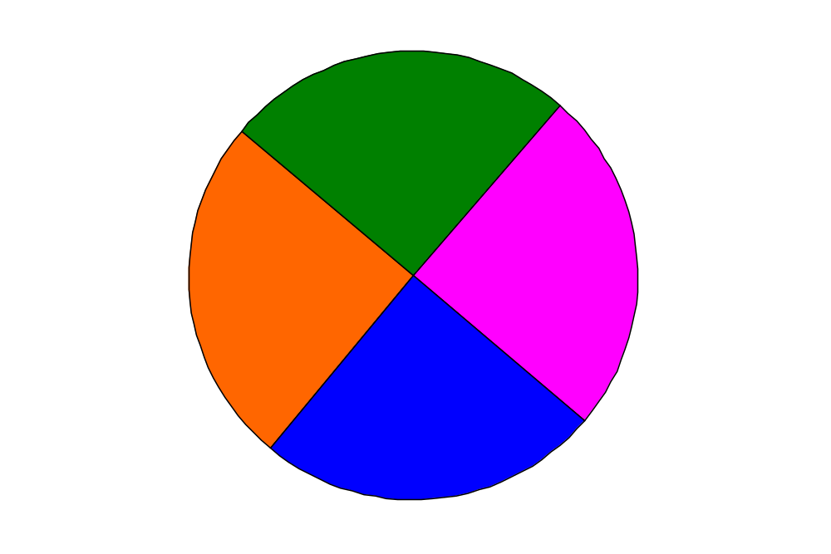
The Knowledge Universe
USE IT
You Know
What You
Know
You Know
What You
Don’t Know
RESEARCH
OR
ACQUIRE
KNOWLEDGE
MINING
You Don’t
Know What
You Know
You
Don’t Know
What You
Don’t Know
TRANSFORMATION
After Liam Fahey, Babson College and
Tony Kuhel, Knowledge Transformation™ Int.

Slide 24
KM in the University
Historically, universities are exemplars of KM
- Outstanding at explicit knowledge
- OK at tacit knowledge
- Could use work at tacit unconscious knowledge
Avoid courses in KM
Embed KM in all courses
Embed KM in the university culture

Slide 25
KM in Engineering Education
Tool
Learning Village
Knowledge Portal
Cribs
Etc.
Teach KM Aspects
To Next Generation
Of Engineers
Process
Expand Course Selection
Pre-energy curriculum
Team projects
Co-ops, interns
What is it?
  KM Principles
People
Culture of sharing
Knowledge Café
Team Classes
Story Telling
KM Courses
Team Projects (simulate life)
  Reuse
  Team Attrition
Warren Stevenson, Purdue University

Slide 26
Knowledge Re-Use
Engineers fail to re-use designs because they
don’t know the context and applicability
Opportunities:
Design
Proposals
Technical Documentation
Software
Cost/Schedule
Presentations
“PLAGIARISE!” Tom Lehrer

Slide 27
Is There a Better Term for
Knowledge Management
Knowledge Networking
Knowledge Sharing
Knowledge Ecology
Knowledge Capitalization

Slide 28
The Way Forward?
How do we integrate KM (tools and techniques) into the academic learning and discovery environment for engineers?
Let the journey begin!

