Slide 1
Air Quality Fans you’re not alone.
Jen Carfagno
The Weather Channel
jcarfagno@weather.com

Slide 2
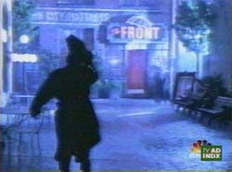
So
A stranger runs toward a bar for cover on a very rainy night.
Source: agencyfaqs!

Slide 3
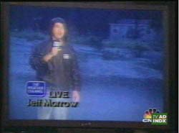
On the TV screen Jeff Morrow, reporter with The Weather Channel, says...
Source: agencyfaqs!

Slide 4
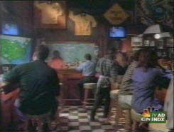
…”Another day of pretty heavy rain…” The people in the bar listen intently as he gives the weather report.
Source: agencyfaqs!

Slide 5
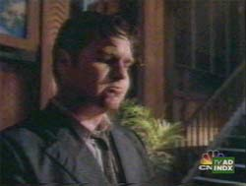
“My shoes are wet, my socks are wet. I hate the rain.”
Source: agencyfaqs!

Slide 6
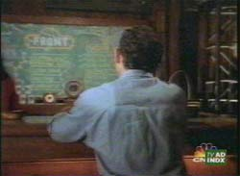
…a man sitting with his back to them. “Or maybe the rain hates you,”...
Source: agencyfaqs!

Slide 7
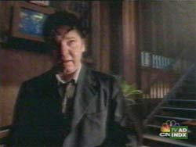
…he says as his friends egg him on, “Yeah, tell him Jim.” The stranger is quite taken back by this hostility.
Source: agencyfaqs!

Slide 8
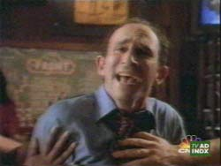
“How can we appreciate the sun if there is no rain?”
Source: agencyfaqs!

Slide 9
“Can you imagine the buildup of Fine Particulate Matter without the rain? What about Ozone…do you want an AQI of 300 every day?!”
Source: agencyfaqs!

Slide 10
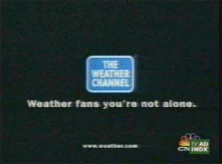
“You took the wrong bar on a wrong night, “ the man is told...
Source: agencyfaqs!

Slide 11



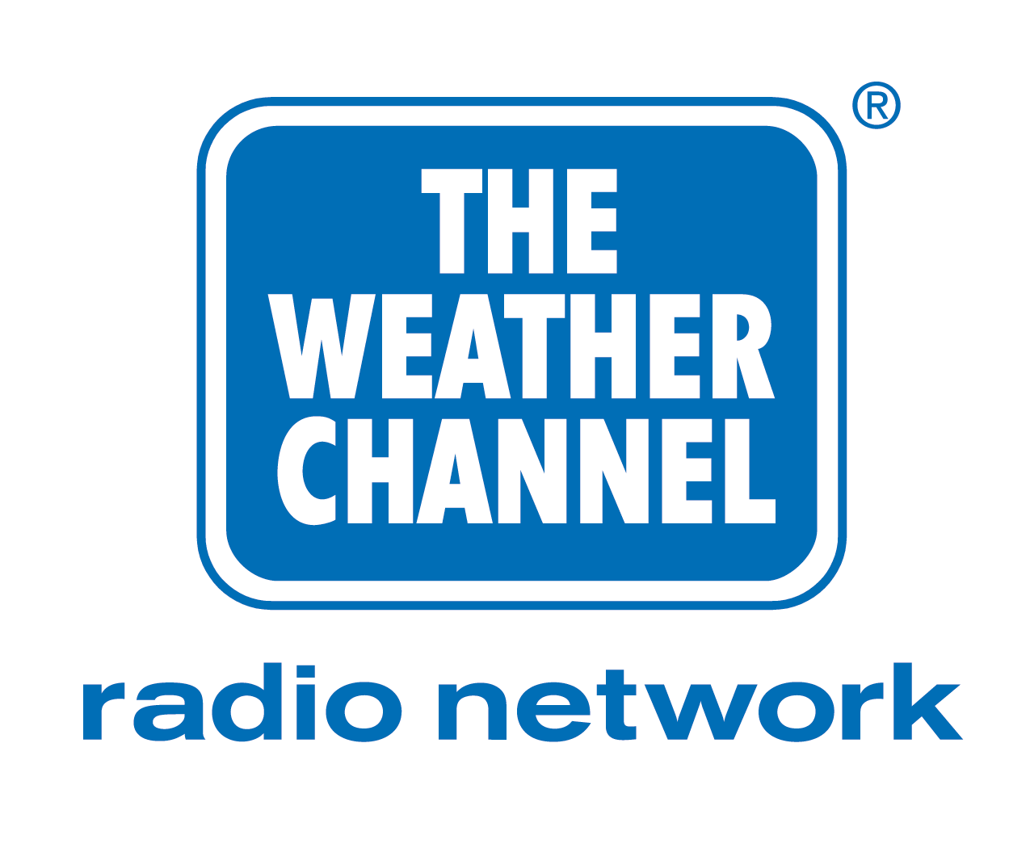
National on-air programming
Local on-air programming
weather.com
Interactive Television
Weatherscan
Wireless Products
Radio
Newspapers - USA Today
The Weather Channel Latin America
  El Canal del Tiempo
  O Canal do Temp
International websites - weather.co.UK

Slide 12
weather.com Air Quality products
The Weather Channel video network Air Quality products
Coming Attractions

Slide 13
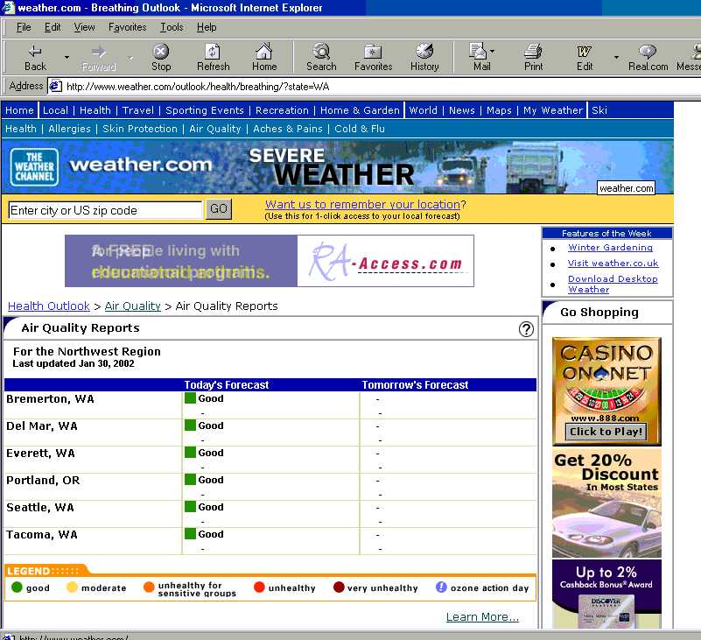

Slide 14

Ozone Action Day

Slide 16
Learn More...

Slide 17
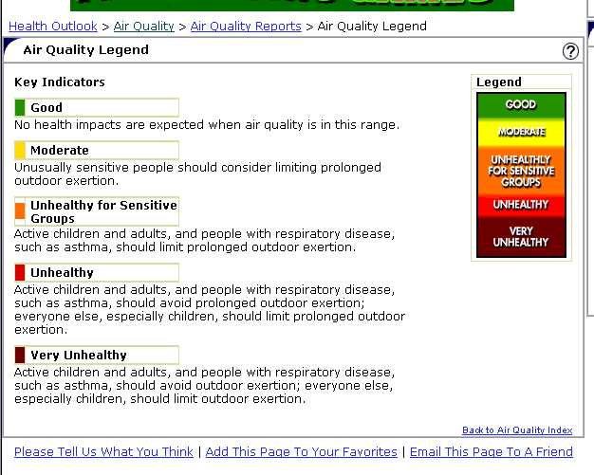
Learn More...

Slide 18
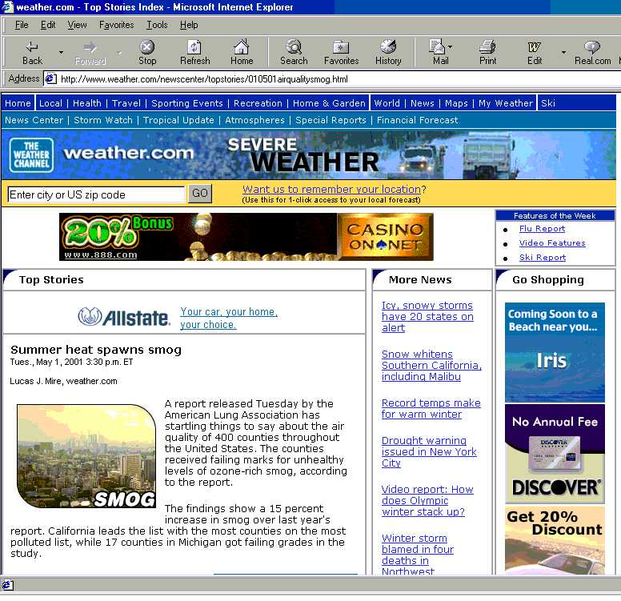

Slide 19
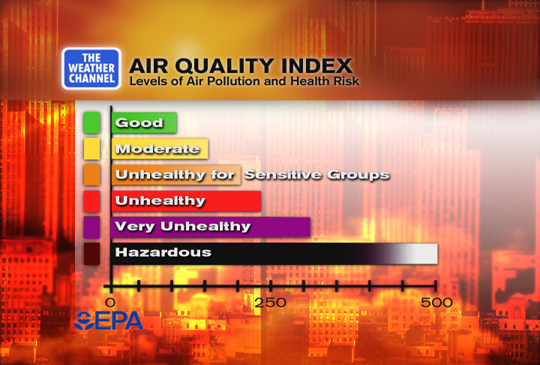
Air Quality On-Air

Slide 20
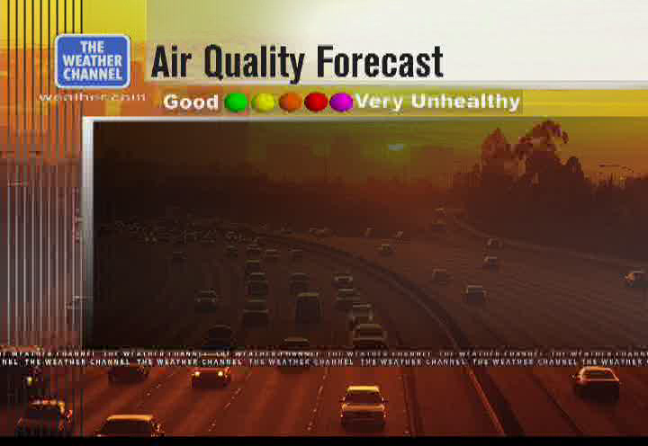
Air Quality On-Air

Slide 21
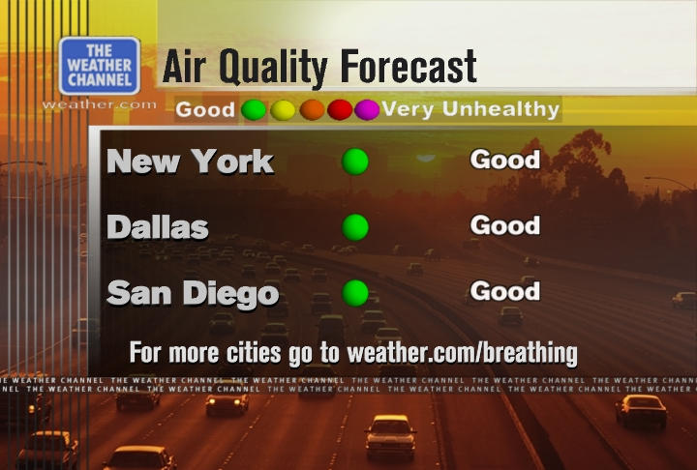
Air Quality On-Air

Slide 22
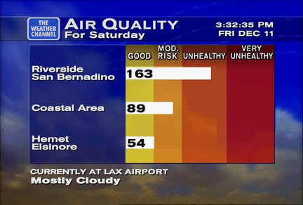
Air Quality On-Air - Local
Southern California Air Quality Management District
http://ozone.aqmd.gov/smog/forecast.shtml

Slide 23
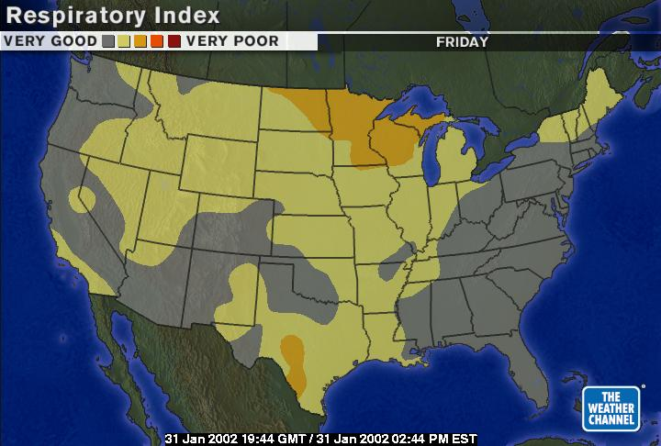
Respiratory Index

Slide 24
Coming Attractions...
NOAA-TWC Partnership
Series of 3 segments on Air Quality

Slide 25
Coming Attractions...
Segment One
“It’s In the Air”
The Current State of Air Quality in US Cities
Who Measures Air Quality
What is the AQI

Slide 26
Coming Attractions...
Segment Two
“The Air Quality Crystal Ball”
Why is AQ forecasting important to you
NOAA air quality forecasting initiatives
Field Experiments

Slide 27
Coming Attractions...
Segment Three
“Can we breathe easy about the Future?”
Understanding and Preparation
Field Experiments
New Products
How AQ Forecasters, People, & Gov’t will use these products

Slide 28
