Slide 1
Software Assurance with SAMATE Reference Dataset, Tool Standards, and Studies
Paul E. Black
National Institute of Standards and Technology
http://samate.nist.gov/
paul.black@nist.gov

Slide 2
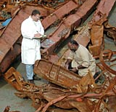
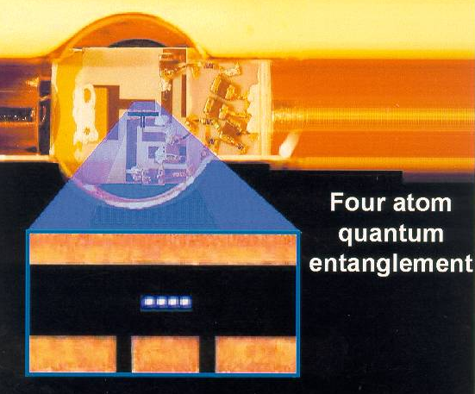
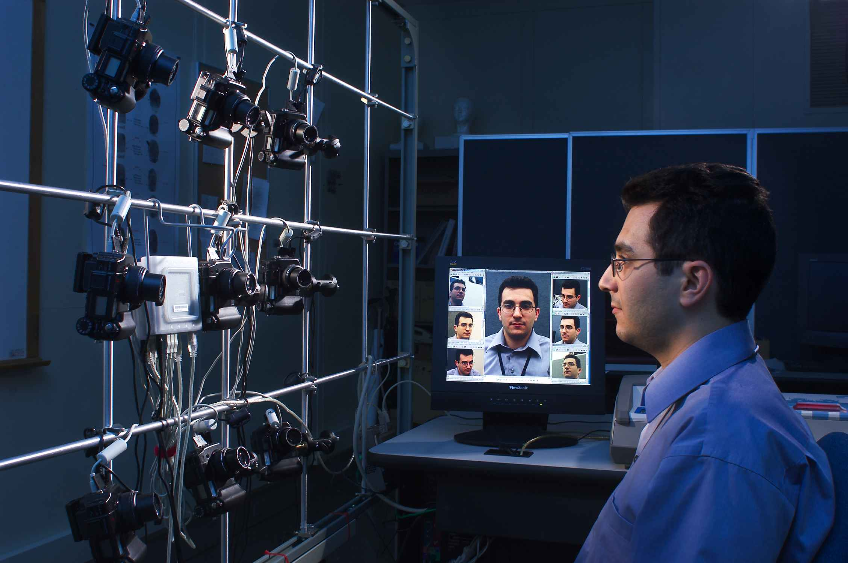
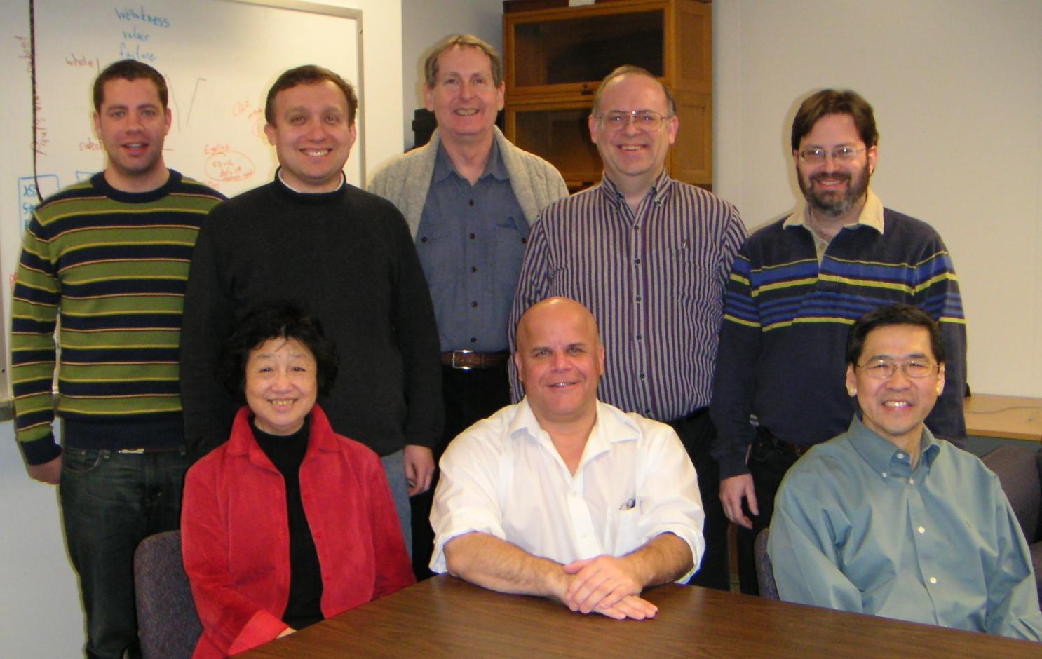
What is NIST?
U.S. National Institute of Standards and Technology
A non-regulatory agency in Dept. of Commerce
3,000 employees + adjuncts
Gaithersburg, Maryland and Boulder, Colorado
Primarily research, not funding
Over 100 years in standards and measurements: from dental ceramics to microspheres, from quantum computers to fire codes, from body armor to DNA forensics, from biometrics to text retrieval.

Slide 3
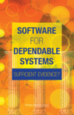
Software for Dependable Systems: Sufficient Evidence?
Just published recomendations of 3 year study by National Research Council (NRC)
Certifiably dependable software needs assurance cases built on
  Explicit claims, evidence, and
  expertise.
System engineering including humans as components
Testing, static analysis, and formal methods

Slide 4


The NIST SAMATE Project
Software Assurance Metrics And Tool Evaluation (SAMATE) project is sponsored in part by DHS
Began 2004 to help improve software assurance
Current areas of concentration
  Source code security analyzers
  Studies of tool effectiveness
  Web application scanners
  Binary analyzers
  Software labels
Web site http://samate.nist.gov/
Notes:
Interagency agreement betwieen NIST and DHS

Slide 5
Web Application Scanning
SRD
Test Cases
Requests
Web Application
Scanner
Web
Application
Weaknesses
&
Vulnerabilities
Responses
Crawls web pages, performs automated penetration testing, and reports weaknesses and vulnerabilities found
Specification released
Test cases under development
Notes:
In the last 5 years, web application vulnerabilities reported in the NVD rose 5 fold

Slide 6

Researching Risky Software
Many people research malware, but there are no widely accepted protocols.
Biological research has defined levels with associated practices, safety equipment, and facilities.
Some approaches are
  Weakened programs (auxotrophs)
  Programs that ALERT
  Outgoing firewalls
  Isolated networks

Slide 7
Static Analysis Tools
SRD
Test Cases
Static
Analyzer
Java,
Ada,
C++,
…
binary
Weaknesses
&
Vulnerabilities
Examine source code or binary for weaknesses, adherence to guidelines, etc.
We need thousands of examples to assess tools …
Notes:
Soundness may vary from program “proofs” to heuristics
Autonomy may vary from analysis assistant to fully automated

Slide 8
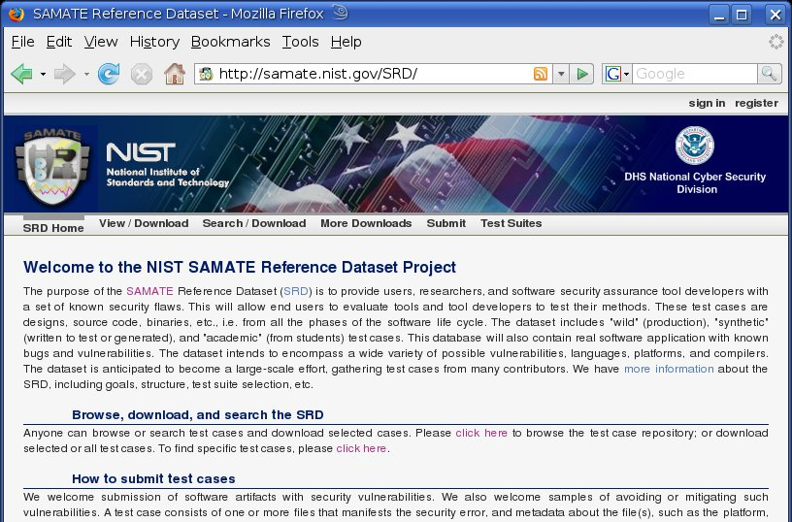
SAMATE Reference Dataset (SRD)

Slide 9
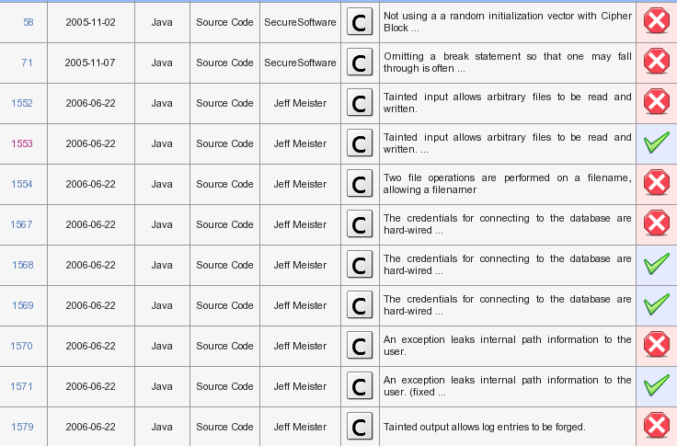

Slide 10
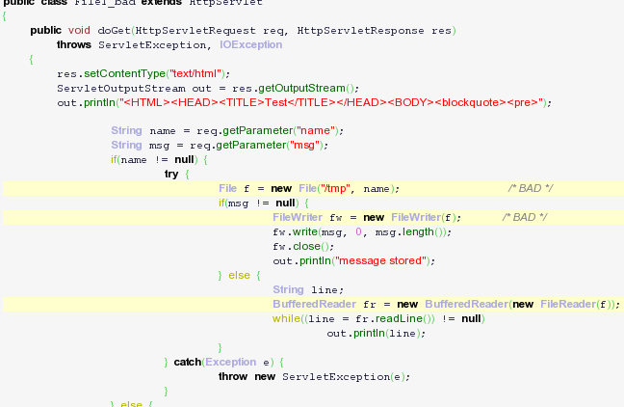

Slide 11
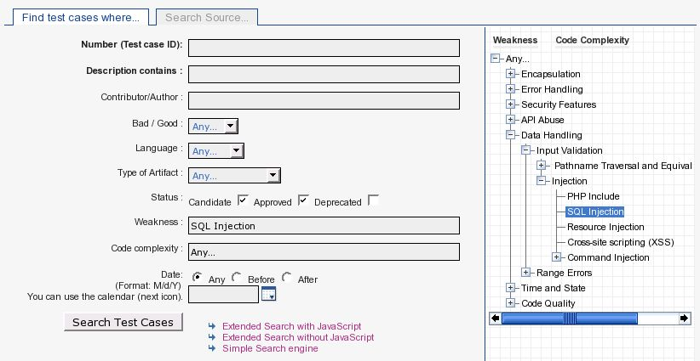
SRD Has Search Facilities

Slide 12
Studies, e.g., Engler’s Question
# vulnerabilities
# vulnerabilities
time fixing weaknesses
reported by tools
time fixing weaknesses
reported by tools

Slide 13
Seeking Participants
Contribute test cases to SRD
Share software development data
Comment on specs and tests for
  Source code security analyzers
  Web application scanners
Join SAMATE email list with ideas on
  Static binary analyzers
  Software labels
  Malware research protocols
contact
Paul E. Black
SAMATE Project Leader
paul.black@nist.gov

