Slide 1

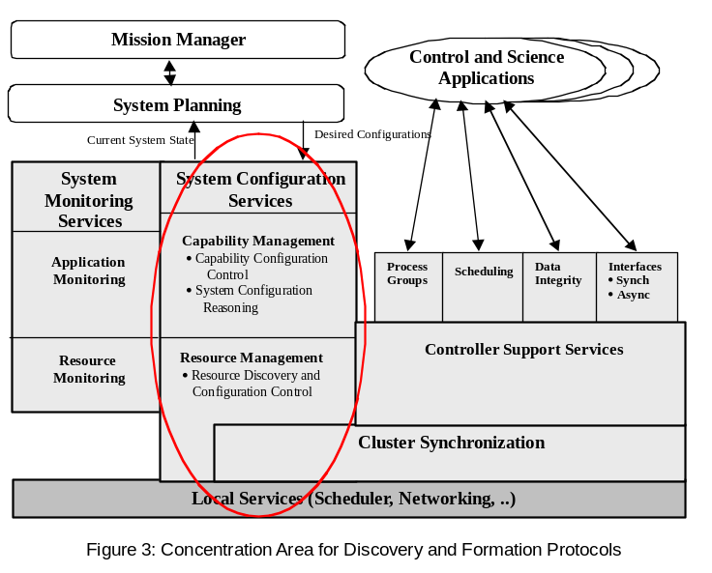
A Distributed Cluster Based Architecture for Constellations
WW Technology Group
Ellicott City MD
Small
Business
Innovation
Research
    INNOVATION
  Software based infrastructure that facilitates dependable formation and operation of distributed real-time control systems. Several innovations advance the state of the art in distributed systems technology, including: (1) cold start algorithms for autonomous, dependable system organization and formation, (2) distributed on-line configuration control, monitoring and health assessment processes operating in concert across the entire system for coordinated system operation, (3) a multi-level scheduling approach, so distributed control elements will be responsive to local events and participate in system wide coordinated operations and (4) a robust fault/error model accounting for arbitrary fault/error cases and anomalies, thereby providing superior fault tolerance, particularly for Single Event Upsets.
    ACCOMPLISHMENTS
Formulation of a System Organization Framework.
Production of a Baseline Use Case Analysis.
Production of a Distributed Fault Tolerant Element Discovery Protocol.
Implementation of a System Organization Prototype.
  COMMERCIALIZATION
Customers, including industry, already showing interest.
Industry needs architecture for robust multiple peer systems.
Flexible and extendable with multiple applications.
Critical roadmap step for constellations and sensor webs.
  GOVERNMENT/SCIENCE APPLICATIONS
Critical Enabling Technology for Distributed Spacecraft and key for dynamic formulation of Sensor Webs.
  Infrastructure is key to discovering available nodes and initializing a group of distributed spacecraft or forming a sensor web.
  Enables sensor webs to discover elements and form web autonomously.
Fits the GMSEC architecture and middleware paradigm.
Goddard Space Flight Center
Points of Contact:
NASA – John Bristow (301) 286-3647
WWTG - Chris Walter (410) 418-4353
2001 Phase I, SS5-065

