Slide 1
Using a Large-Scale Survivability Architecture to Control
Grids: A Status Report
Zach Hill*, Jonathan Rowanhill*, Jim Basney**, Glenn Wasson*, John Knight*, Anh Nguyen-Tuong*, Andrew Grimshaw* and Marty Humphrey*,
*Department of Computer Science, University of Virginia, Charlottesville, VA
**NCSA/University of Illinois, Urbana-Champaign
Supported in part by the National Science Foundation under grant SCI-0426972

Slide 2
Definitions
Reliability
  An attribute of any system that consistently produces the same results, preferably meeting or exceeding its specifications
  In engineering in general, reliability is the capacity of a component or a system of such components to perform as designed
Robustness
  ... an ability to recover gracefully from the whole range of exceptional inputs and situations in a given environment
  In terms of computer software, refers to the resilience of the system when under stress - for example, when running a large number of processes, or when starved of memory or storage space, or when confronted with an application that has bugs or is behaving in an illegal fashion

Slide 3
Problem Statement
To date: Grids used to aggregate resources for scientific applications
Problem: only tolerant users can use “The Grid”
Survivability: alternate services (different, less dependable, degraded) if primary services are not available due to attack or failure
  Each alternative can deal with a different class of faults
  Note: cannot re-engineer from scratch
Goal: Grids as critical infrastructure

Slide 4
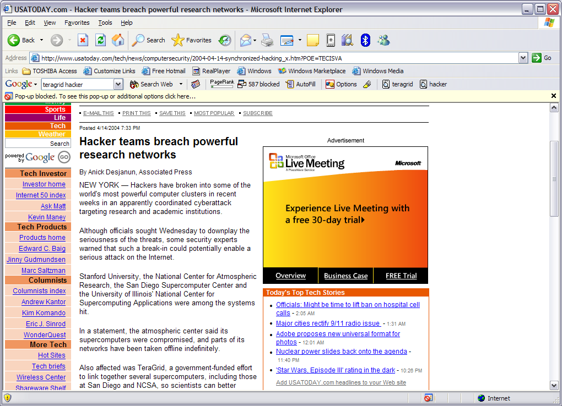
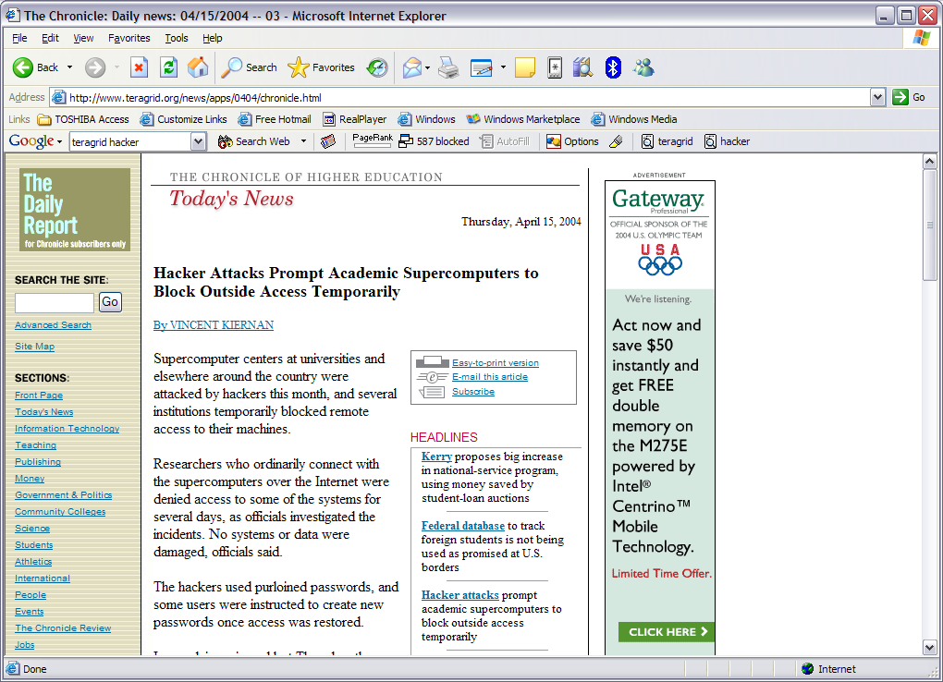
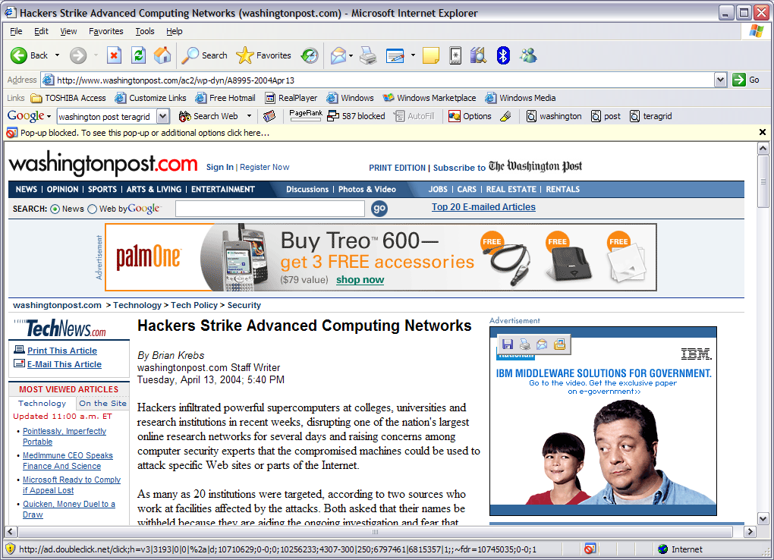

Slide 5
Challenges
How do you implement a single service to meet a particular dependability/survivability requirement?
How do you implement service + alternative services to meet a particular requirement?
How do you dynamically compose services to meet overall dependability/survivability requirements?
How do you monitor/reconfigure the Grid infrastructure for dependability/survivability?
How do you do all of this across admin domains?

Slide 6
Approach
Support/Influence OGSA (and Web services)
Leverage experience
  UVa: Legion, OGSI.NET / WSRF.NET
  UVa: Willow
  NCSA: TeraGrid/NCSA operations, MyProxy
Two major efforts
  Per-service Dependability characteristics (XML)
  Application of Survivability architecture to Grids

Slide 7
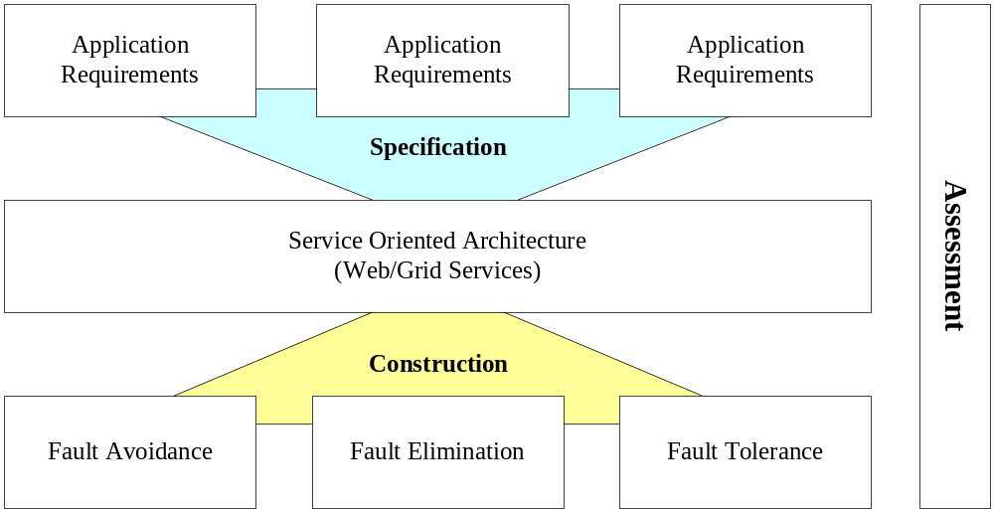
Dependable Applications in Service-Oriented Architectures (SOAs)

Slide 8
Willow: Survivability As Control
From Sensors
To Actuators
Control Function
“Sensor” Signals
“Actuator” Commands

Slide 9
Willow Architectural Issues
Hierarchic faults
Control loop interactions:
  Asynchronous
  Priority & resources
  Conflicting goals
Network scale:
  Volume of software
  State model
  Wide area change
Exceptions and results:
  Dynamic app’l membership
  Absolute vs. statistical
  Result “harvesting”
Target system actuation:
  Lightweight
  Standard interface & protocol
Critical Networked
Application
Actuators
Sensors
Network State &Analysis Model
Self
Healing
Tolerate
Anticipated
Faults
Planned
Posture
Change
System
Update
System
Deployment
External Input

Slide 10
Focus: Monitoring/Reconfiguring
As grids grow in size we must find a way to monitor and manage them
  Must maintain site-autonomy
Fast-reaction systems are required
  Viruses and Worms can propagate across the entire internet in minutes or hours.
  In grids with bursts of high load (i.e. LHC output) failure can cause loss of unrecoverable data.
  Real-Time services in grids (i.e. visualization and collaboration) must minimize service interruptions. Particularly if grids are to become woven into critical infrastructure.

Slide 11
Our Solution: ANDREA and Spartan
Use a real-time sensing and actuation system with potentially complex rules to monitor and manage the grid both locally and globally
ANDREA and Spartan are components of the Willow system
  ANDREA is a distributed actuation system that handles workflows and decentralized control while allowing node-level autonomy.
  Spartan is a distributed sensing system composed of finite-state machines which implement the sensing rules based on sets of events.

Slide 12
Architecture
Global Node
“High Latency” events
Workflows
ANDREA
Controller
Spartan
Node
Site Node
Site Node
ANDREA
Controller
Spartan
Node
ANDREA
Controller
Spartan
Node
Workflows
Latency Events
ANDREA
Controller
Compute
Node
ANDREA
Controller
Compute
Node
ANDREA
Controller
Compute
Node
ANDREA
Controller
Compute
Node
ANDREA
Controller
Compute
Node
ANDREA
Controller
Compute
Node

Slide 13
Experiment
A VO is not getting its work done in a timely fashion
Basic premise is that one site cannot handle its computational load
  Priorities or resources must be reconfigured to help the grid meet overall latency requirements
The site tries to decrease latency locally
If that doesn’t work then the global controller is activated to reconfigure/reprioritize the entire grid to reduce latency

Slide 14
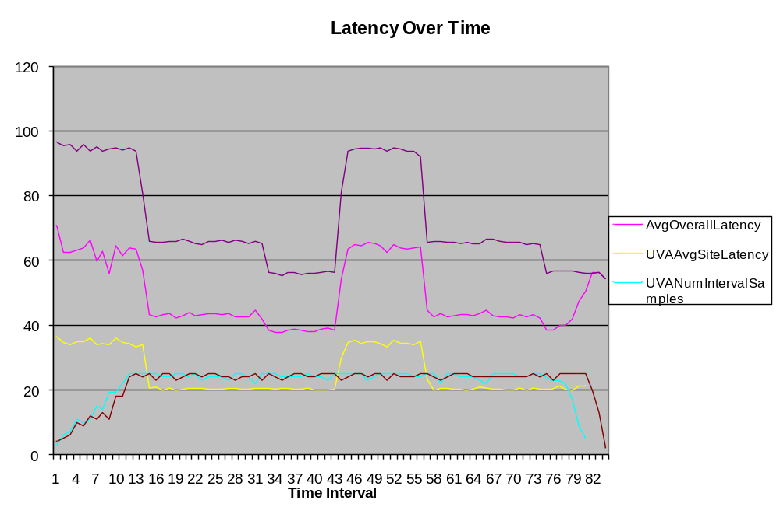
“High Latency” Event count crosses threshold. Local (NCSA site) workflow enacted.
Workflow lifetime expires (artificially)
Global workflow enacted
(delay at NCSA but not at UVA)

Slide 15
Summary
Grids must become robust, critical infrastructure
Application and extension of Willow survivability architecture shows good promise
Next Steps
  More comprehensive use-cases (and subsequent implementation)
  Looking for concrete deployment
  More site autonomy
    What if we can’t get all monitoring info from a site?
    What if a site says “no” to an actuation?

