Slide 1
Market Monitoring and Wholesale
Power Transmission Issues
William F. Hederman, Director
Office of Market Oversight and Investigations
Federal Energy Regulatory Commission
Presented to:
Carnegie Mellon University
Pittsburgh, PA
December 16, 2004
WH-12-16-04

Slide 2
Outline
Introduction
The Legacy of Legacies
Transmission Challenges
Monitoring Agenda
- Organized Markets
- Other Areas
Conclusion

Slide 3
The FERC strategy to provide dependable, affordable energy through sustained competitive markets has 3 elements.
Infrastructure
Effective Rules
Strategic
Approach
Rules
Competitive
Markets
Just & Reasonable
Outcomes
Enforcement

Slide 4
Background: This difficult transition suffers from a legacy of legacies.
Inadequate interconnections (reliability driven, not market driven)
Patchwork of laws/regulations/responsibilities (assumed service areas)
Many entrenched interests with varying objectives

Slide 5
Transmission Policy Challenges
Market Power
Regional Planning
Reliability
Investment
Innovation
Transitions

Slide 6
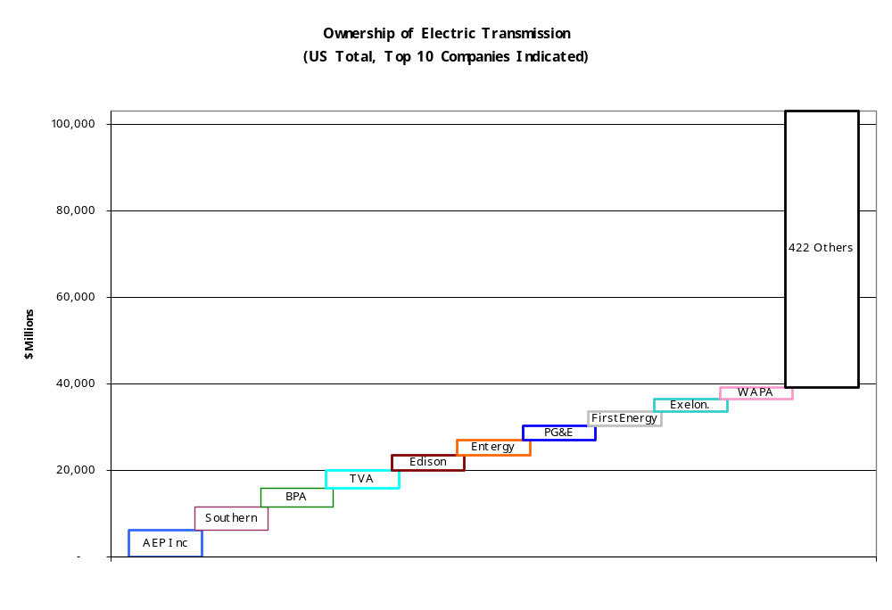
6

Slide 7
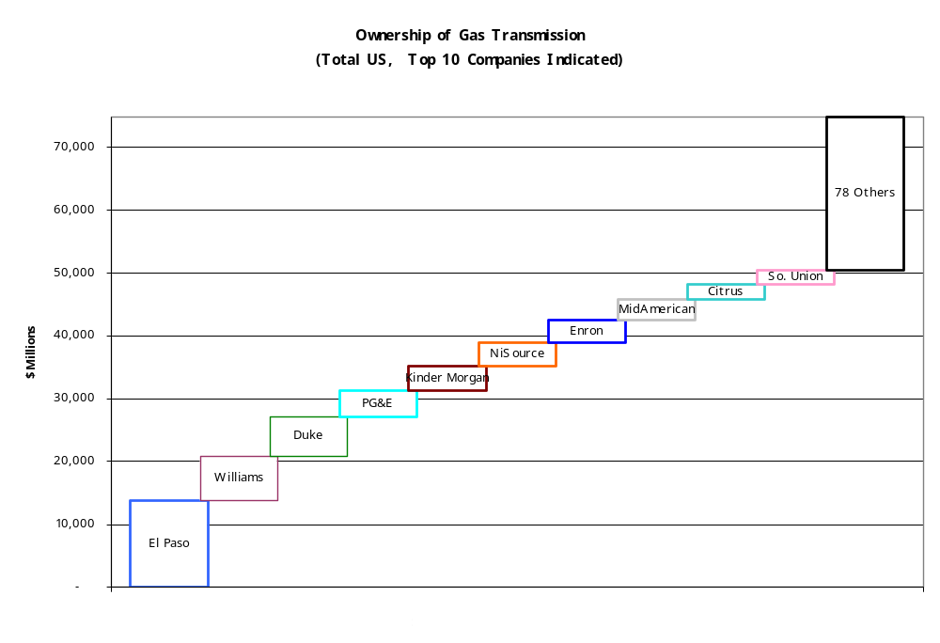
7

Slide 8
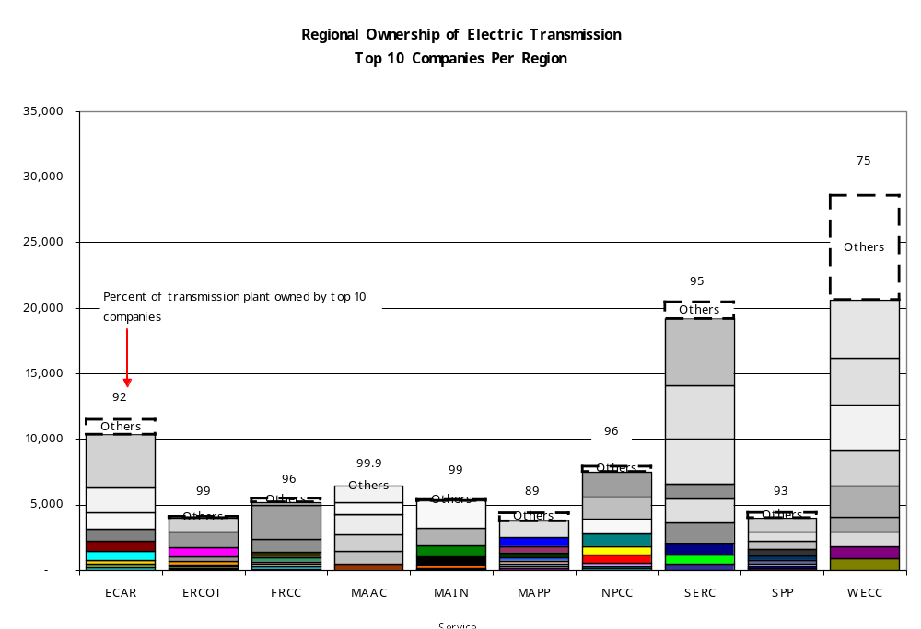
8

Slide 9
Investments We Need
Hardware
-- AC and DC lines
-- Substations, capacitors, sensors
-- FACTS
Software
-- State estimators
-- System monitoring, evaluation, visualization, information sharing

Slide 10
Wall Street Waits
“There is a cap on how much I can earn and no floor
on how much I can lose”
J. Holzschuh, Managing Director
Global Power Group
Morgan Stanley

Slide 11
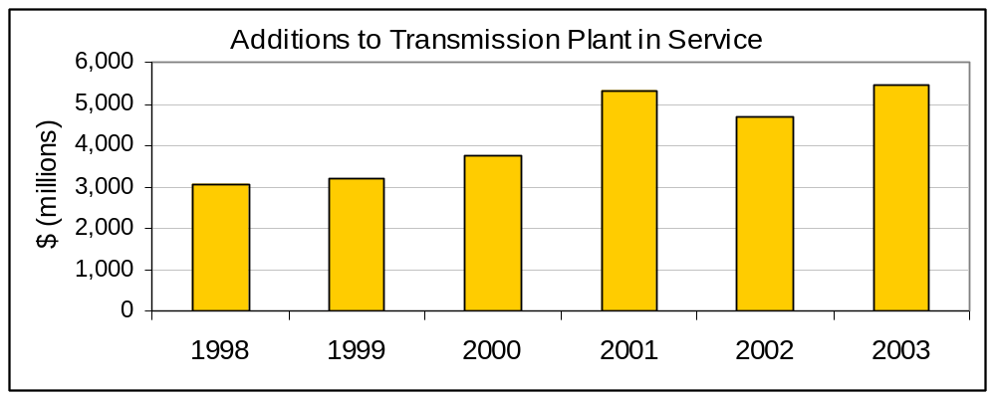
Transmission Investment
Source: Platts

Slide 12
Monitoring approaches differ significantly by market conditions.
Organized Markets
-- Access assured
-- Information rich
-- Local monitoring
-- Investment/mitigation challenges
-- Seams
Opaque Markets
-- Access problematic
-- Affiliate issues
-- Little information

Slide 13
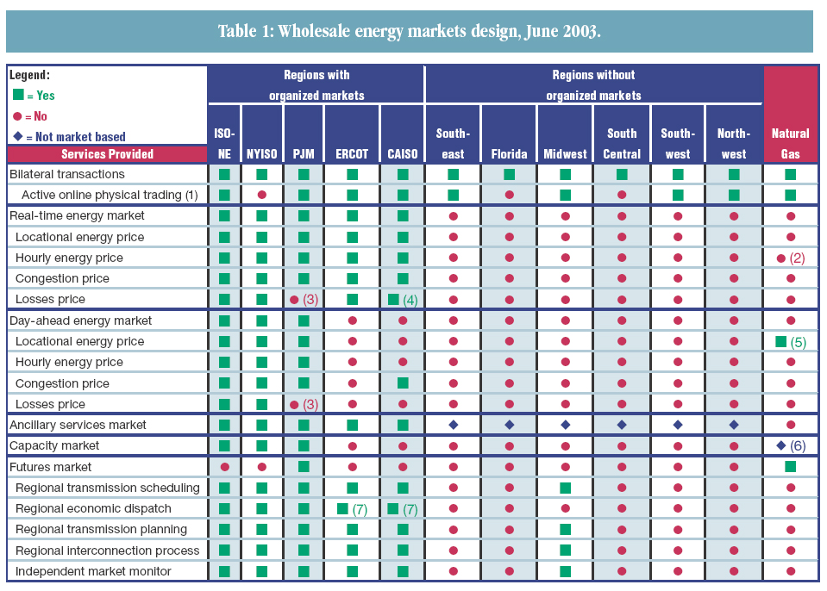
Organized Markets Provide Options and Transparency
13

Slide 14
Conclusion
Structural solutions appear best.
Effective rules plus monitoring and enforcement is a second-best solution.
Relative lack of investment in transmission has FERC’s attention.

Slide 15
FERC is addressing transmission challenges.
Initiatives include:
-- Transmission policy
-- Reliability Division
-- Reactive Power conference

Slide 16
Market Integrity is Everyone’s Business
FERC Hotline:
1-888-889-8030

