Slide 1
Requirements for Ethical Human Research
A valid and important question
Valid methodology
Balance between risks/benefits
Independent ethical review
Informed consent
Thanks to Zeke Emanuel

Slide 2
Requirements for Ethical Human Research
A valid and important question
Valid methodology
Balance between risks/benefits
Independent ethical review
Informed consent

Slide 3
The
“Purpose”
of IRBs

Slide 4

The global, “motherhood and apple pie” answer:
The purpose of IRBs is to protect human research subjects
Notes:
1

Slide 5
IRB
Research Subjects

Slide 6
Beecher:
(In talking about consent)... “A far more dependable safeguard … is the presence of a truly responsible investigator.”

Slide 7
There really are several “purposes” of IRBs;
Many of these can be wrapped together:
“Helping investigators recognize and address human subjects’ issues in their research”

Slide 8
Fundamental Constructs:
Beneficence (do no harm; do good)
Justice (distribute risk and benefit fairly; treat individuals fairly)
Autonomy / respect for persons (need for consent)
These are age-old, but higher profile and more codified in last 50 years

Slide 9
Why a Greater Emphasis?
Education of patients/subjects
Public funding
News reporting
Desire for access
Scandal
Near misses (thalidomide)
Scandal

Slide 10
Why a Greater Emphasis?
High-profile scandals
War atrocities (⇒ Nürnberg Code)
Beecher’s 1966 article: “Ethics and Clinical Research” N Engl J Med 274:1354ff [June 16th]
Tuskegee natural history study of syphilis
...latter two said problems are mainstream, not fringe

Slide 11

Why a Greater Emphasis?
Phocomelia
Near misses
Thalidomide not licensed in US through a regulatory fluke rather than through having a good process to ensure safety;
Birth defects in countries where it was licensed were a wake-up call

Slide 12
Results of Scandals and Near-Misses:
1962 Amendment to the Pure Food, Drug and Cosmetic Act
Helsinki Declaration and other codes of ethics
National Research Act of 1974; Belmont Commission & Report
Federal research regulations to protect research subjects

Slide 13
Helsinki Declaration:
First edition 1964; several revisions
(WMA) Went beyond Nuremberg Code, to address research with therapeutic intent
Also addressed diminished competence
Called for oversight of research
IRBs called “Helsinki Committees” in some venues

Slide 14
Helsinki Declaration I(§2):
…in an experimental protocol which should be transmitted for consideration, comment and guidance to a specially appointed committee independent of the investigator and the sponsor…

Slide 15
Helsinki Declaration I(§2):
…in an experimental protocol which should be transmitted for consideration, comment and guidance to a specially appointed committee independent of the investigator and the sponsor…

Slide 16
Helsinki Declaration I(§2):
…in an experimental protocol which should be transmitted for consideration, comment and guidance to a specially appointed committee independent of the investigator and the sponsor…

Slide 17
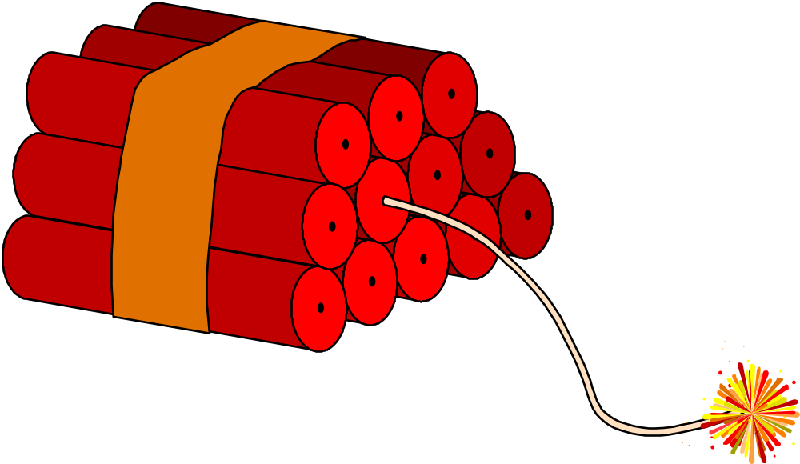
1970: Jean Heller, an investigative reporter for the Washington Star, made public…...

Slide 18
Tuskegee:
Natural history study of untreated syphilis in 400 black men
Patients allowed to believe they were being treated
New treatments ( e.g. PCN) neither studied nor offered as they became available
PHS funding; PHS researchers, etc.

Slide 19
1974: “Defense of Tuskegee”
Elliot Richardson ⇒ Charles McCarthy:
∃ No Effective Defense
∴Need Mechanism to Prevent Recurrence
45 CFR §46: Basic DHHS Policy re: Human Subjects
Promulgated for NIH: May, 1974

Slide 20
1974: “Defense of Tuskegee”
Elliot Richardson ⇒ Charles McCarthy:
∃ No Effective Defense
∴Need Mechanism to Prevent Recurrence
45 CFR §46: Basic DHHS Policy re: Human Subjects
Several revisions since then

Slide 21
45 CFR § 46:
Subpart A:
  “The Common Rule”
Subpart B:
  Reproductive Issues
Subpart C: Prisoners
Subpart D: Children
Subpart E: Decisionally Impaired (never formally adopted)

Slide 22
Also Important:
Lots of other regs, codes and statutes might apply, depending on the type of research and where it’s done
(FDA, JCAHO, VA, local statutes, etc.)

Slide 23
That’s a refresher on the background stuff; now we can talk a bit about the mechanics of dealing with an IRB:

Slide 24
Institutional Review Boards:
Prospective review of research proposals
Continuing review of ongoing research
Idea is to protect human subjects from inappropriate risk
Ideally a coöperative venture with the investigator, rather than a police function

Slide 25
Composition of IRBs:
Investigators and Non-investigators
People linked to the institution and people independent of it
People with useful expertise (in science, ethics, law, community concerns)
Ideally a body with a broad background, capable of independent action

Slide 26
IRBs ask about scientific merit:
But only in a very narrow way:

Slide 27
IRBs ask about scientific merit:
Does the scientific merit warrant putting subjects at risk?
Have the risks been minimized insofar as is practicable?
General scientific merit review is usually better done elsewhere

Slide 28
IRBs ask about conflict of interest:
But only in a very narrow way:

Slide 29
IRBs ask about conflict of interest:
Is there something that might adversely impact clinical decision making?
Is there something that might distort the consent process?
Are these bad enough that they need to be disclosed?
Is disclosure a sufficient remedy?

Slide 30
IRBs ask about conflict of interest:
Is there something that might adversely impact clinical decision making?
Is there something that might distort the consent process?
Are these bad enough that they need to be disclosed?
Is disclosure a sufficient remedy?
Academic misconduct issues re: C-of-I
usually belong elsewhere

Slide 31
The most important questions IRBs ask:
Are the risks and benefits (personal and societal) in reasonable balance?
Is the information and consent process adequate?

Slide 32
IRBs also must ask:
Does the research conform to federal regulations?
How about local ordinances and institutional policies?
How about relevant ethical norms?
Are there justice concerns re: inclusiveness or vulnerable groups?

Slide 33
IRB Reporting Lines:
To the institution
  – Administratively
  – Maintaining an effective IRB is something the institution guarantees to the feds
To the feds
  Substantively
  OHRP and FDA
Obligations to feds and to subjects may require decisions in tension with institution’s interests

Slide 34
It’s crucial to remember:
We’re all in favor of good science
We’re all in favor of doing the right thing by research subjects
We all have things to teach one another
We’ll do a far better job as colleagues than we will as adversaries

Slide 35
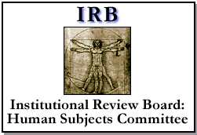
IRB: Institutional Review Board
Regulatory Authority---
Office of Human Subjects Protection (OHRP)
Food and Drug Administration (FDA)

Slide 36


Review:
“…irrespective of funding source”
Not just federal monies

Slide 37
Important Regulatory Authority
Federal-Wide Assurance of Compliance
Institutional agreement with the feds that we will follow the rules
Includes the assurance that all research done at an institution will be done in accordance with federal rules
Thus, IRB review is for all human subjects’ research

Slide 38
Important Regulatory Authority
45 CFR §46
Basic federal regs covering human subjects
AKA “OPRR Regs” (historically)
AKA “OHRP Regs” (currently)
Rules establishing and guiding the Office for Human Research Protection

Slide 39
Important Regulatory Authority
45 CFR §46
Defines “human subject,” “research”
Sets standards for IRB composition and function
Defines levels of review for different types of research
Sets expectations (rules) re: consent, protections, reporting, special classes of research subjects, etc.

Slide 40
Important Regulatory Authority
45 CFR §46
Defines “human subject,” “research”
Sets standards for IRB composition and function
Defines levels of review for different types of research
Sets expectations (rules) re: consent, protections, reporting, special classes of research subjects, etc.

Slide 41
Review Continuum
Level of risk determines
route of review
Exempt Expedited Full
Lowest Low High

Slide 42
What Needs IRB Review?
Certain research may not need IRB review because it doesn’t meet the regulatory definition of “research.”
Certain research may not need review because it doesn’t meet the regulatory definition for involving “human subjects.”

Slide 43
What Needs IRB Review?
Certain research may be exempt because an individual investigator’s part of the study may be remote from human subjects.

Slide 44
What Needs IRB Review?
TYPICAL INVESTIGATOR PROCESS:
File an abbreviated form with the IRB, in which the claim of exempt status is set forth and explained … the IRB then decides if it really qualifies as exempt
Certain research may be exempt because an individual investigator’s part of the study may be remote from human subjects.
Certain research may be exempt because it is of such low risk that IRB review would be overkill.

Slide 45
Exemption Categories:
Federal regulatory criteria for low-risk research
Six specific categories of research
Cannot involve vulnerable population
Qualifying studies usually are of short duration
Cannot create a durable confidentiality risk (no permanent record of individual)

Slide 46
Exemption Examples:
Anonymous re-use of data
Anonymous questionnaires on non-sensitive topics
Observation of public behavior without recording identities
Field testing educational strategies or curricula

Slide 47
Important Regulatory Issue
Investigator has an inherent conflict in deciding if research is exempt;
Investigator, Dept. Chair, etc. may well not know the regs well enough to make the right call;
Regulatory expectation (FDA/OHRP) is that there will be a process for making this decision knowledgeably;
At most centers it’s having the IRB office screen for exempt status.

Slide 48
Not Quite Exempt:
Expedited Review
Federal regulations also recognize that there is some research that is of very low risk, but needs a bit of IRB scrutiny;
For specific designated categories of risk, IRB review may be carried out by the chair or by an experienced member (rather than by a duly-convened quorum).

Slide 49
Not Quite Exempt:
Expedited Review
If that experienced member agrees that the criteria are met, full approval may be granted without waiting for the next full IRB meeting;
Usually is faster, simpler.
TYPICAL INVESTIGATOR PROCESS:
File usual IRB application form with IRB; include consent forms and other supporting info; specifically ask for expedited review (explaining why it would qualify)

Slide 50
Important Regulatory Issues
Investigator can request expedited review, but the eligibility call must be made by someone who knows the regs (i.e. the expedited reviewer);
Expedited review is not “review light”; requirements are exactly the same as in full-board review;
Difference is (only) that review doesn’t require a convened quorum to grant approval.

Slide 51
Full Committee Review
Anything Else
Vulnerable populations
Invasive procedures (physically or psychologically invasive)
Sensitive topics
Investigational products (FDA)

Slide 52
Continuing Review
Approval expires after a set time period or a set subject accrual
Approval cannot be valid for more than one year
Re-review has to occur before the approval expires, or there’s a lapse
Re-review must be substantive

Slide 53
Why Continuing Review?
Details of studies change
Available information changes
As a result, risk/benefit balance may change
Also as a result, consent burden may change

Slide 54
Important Regulatory Issue
It’s the PI’s obligation to get the continuing review info in on time (IRB sends two reminders at our shop);
It’s the PI’s obligation to provide all the required information;
The regs make no provision for a grace period, so the IRB has no authority to cut a procrastinator any slack.

Slide 55
In order to regulate something, you’ve got to define it…

Slide 56
So What’s Research?
A systematic activity designed to develop or contribute to generalizable knowledge
Note that this is a regulatory definition
Some things we may think of as research don’t meet this standard (e.g. intramural QA studies)
Irony: Even if activities carry risk, they may not be required to be subject to oversight
45CFR§46.102(e)

Slide 57
So What’s a Human Subject?
A living individual about whom an investigator (whether professional or student) conducting research obtains
data through intervention or interaction with the individual, or
identifiable private information.
Unless totally anonymous, any time you have private information you have a human subject…
Dead folks don’t count, unless the information to be gained has impact for the living (e.g. relatives) (who are then the subjects)
45CFR§46.102(f)

Slide 58
IRBs give special consideration to:
Vulnerable Subjects:
children
prisoners
mentally disabled persons
economically disadvantaged persons
educationally disadvantaged persons

Slide 59
There are two concerns about vulnerable subjects:
Do they need special protections because of their vulnerability?
Are they being inappropriately excluded from research participation because of their vulnerability?

Slide 60
Example: Research Involving Kids
No more than minimal risk
More than minimal risk, but benefit offsets the risk (e.g. clinical trials)
Benefit doesn’t fully offset risk, but risk excess is small and information important for the subjects’ disease or condition
Basic idea: take a more conservative view of risk/benefit balance when the subjects are vulnerable
45CFR§46: Subpart D

Slide 61
IRBs tend to spend a lot of effort on the information and consent process and consent forms:

Slide 62

Informed Consent:
What it is:
  ongoing process of communication and mutual understanding
What it isn’t:
  a piece of paper
  a moment in time
  a contract

Slide 63
Essential elements for Consent Process and Document:
Regs list nine features -- the biggies:
Must know it’s research;
Must know it’s voluntary;
Must know what they’re getting into:
  What’s being asked of them
  Risks and benefits
  Alternatives (especially in clinical trials)

Slide 64
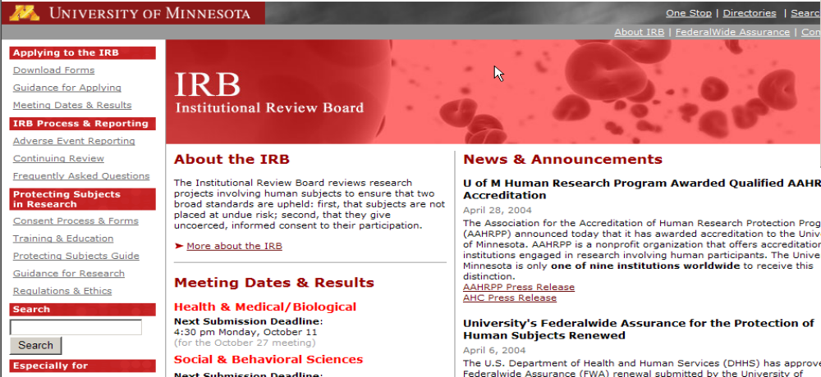
Help with drafting consent forms
www.research.umn.edu/irb/

Slide 65
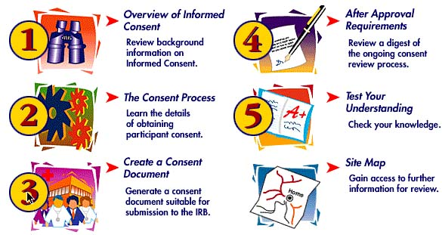

Slide 66
Informed Consent:
The norm is a written consent form executed prospectively
Oral consent may be OK in certain low-risk studies
Oral consent may be OK if a written form creates a confidentiality risk
Surrogate consent may be OK if risk/benefit balance suitable

Slide 67
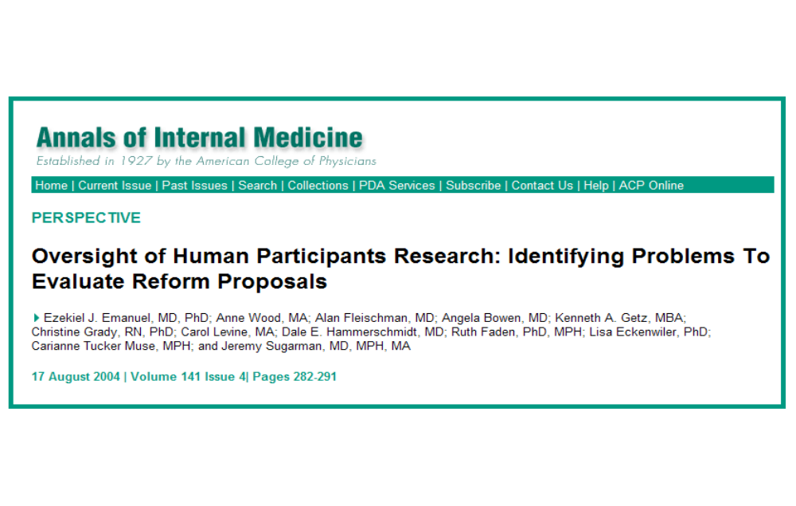
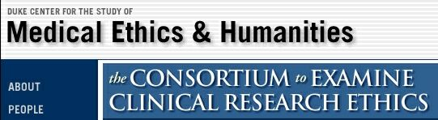
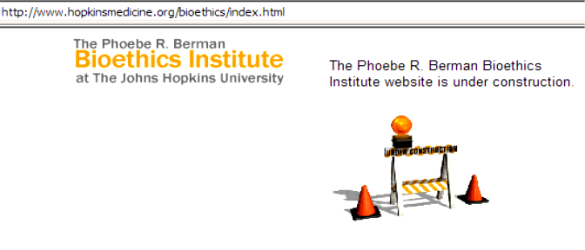
Problems with IRBs:
Often too late in the process;
Tension between local savvy and institutional conflict of interest;
Redundancy in multicenter research
Tough to get real diversity of viewpoint
Tough to have sufficient expertise
May get bogged down in the most concrete rather than the most important issues
Inadequate resources may force into adversarial role

Slide 68
IRB

Slide 69
IRS

Slide 70
IRS

Slide 71

IRB

Slide 72


