Slide 1

The Future of Satellite Navigation Services
“Evolving to a Multiple GNSS Environment”
Civil GPS Interface Committee
International Sub-Committee
May 7, 2006
John E. Augustine
Acting Director, Office of Navigation and Spectrum Policy
U.S. Department of Transportation

Slide 2
Overview
GPS Today
New Horizons
U.S. Policy Update
Investments for the Future
The Way Ahead

Slide 3
SatNav/GPS Today
Satellite navigation is a global utility with GPS providing solid foundation for global users
  Consistent, predictable, dependable performance
  Facilitating efficiency, safety, environmental, public security, scientific and many other innovations
GPS and its augmentations were wonderful concepts 15-20 years ago, now a reality like Internet
  Augmentations assure safety services and further improve performance free of direct use charges
  Scalable applications enabling untold, new capabilities
  Toolkit — plug in, use what you need, add what you want
Available Now--Empowering the Future

Slide 4
New Horizons
Sep 2005 – launch first GPS with 2nd civil signal
Dec 2005 – launch first Galileo test satellite
Dec 2005 – launch 3 GLONASS satellites
This year – European EGNOS goes operational
Japan preparing for MTSAT ops and QZSS
India moving ahead with GAGAN and IRNS
Interoperability key to seamless global operations

Slide 5
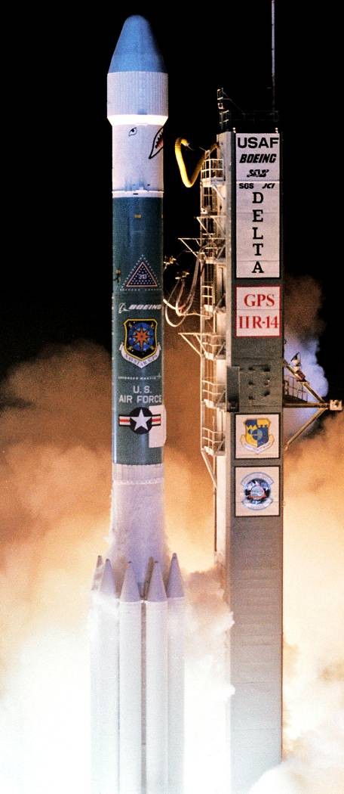
Recent GPS Improvements
1st modernized satellite (IIR-M)
  Set operational Dec 16, 2005
  Broadcasting L2C and M-Code
5 new monitor stations integrated into GPS operational network
  6 more stations to follow by end of year
Accuracy Improvement Initiative
  Improves accuracy 10-15%
GPS Ops Center (GPSOC) on-line
  Supporting customers worldwide
GPS continuing to improve its global service

Slide 6
U.S. Policy Update
2005 Federal Radionavigation Plan (FRP) published
PNT Policy expanded to address all Space-Based Positioning, Navigation, and Timing (PNT)
  GPS and augmentations
  Recognizes other States as service providers
New U.S. PNT Management Processes
  National Space-Based PNT Executive Committee and National Coordination Office
Establishing a formal PNT Advisory Committee
  Assessing best means for international participation
Demonstrates U.S. Government commitment to all stakeholders, including international community

Slide 7
U.S. PNT Policy
Recognizes increased civil, commercial, homeland security and scientific use
  Spans economic and critical infrastructures
  Need to plan for backup capabilities and services
Commits to continued modernization of GPS and its augmentations for improving global services
  Keeps GPS free of direct user fees
  Maintains open, free access to information necessary to use these civil services
  Reaffirms end of civil service degradation (SA)
  Performance to meet, or exceed, foreign PNT systems
Work to ensure that foreign PNT systems are interoperable, as well as compatible, with GPS

Slide 8
Investments for the Future
All future GPS will transmit the 2nd civil signal (L2C)
GLONASS and augmentations expanding
First GPS launch with 3rd civil signal (L5) – Jan 2007
Full Galileo constellation – 2011-2012
Completing definition phase for GPS III
  Introduces new capabilities including L1C (2013-2030)
Promotes opportunities for greater cooperation in future system of systems
Space-based PNT is centerpiece of the future transportation infrastructure

Slide 9
The Way Ahead
U.S. looks forward to working with all to ensure GNSS systems are interoperable for the benefit of all users worldwide
GPS will continue modernizing and improving its capabilities to remain a leader in GNSS global capabilities

Slide 10
BACKUPS

Slide 11
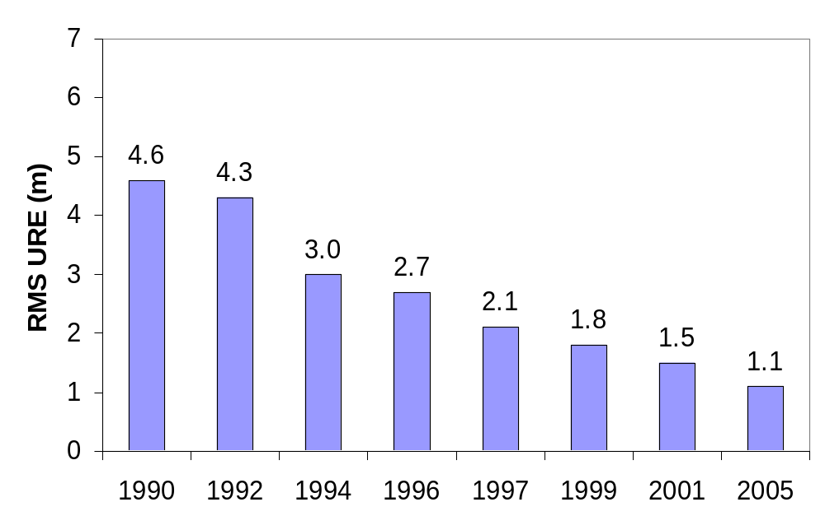
GPS Single Frequency Performance
Standard
Decreasing range error
Signal in Space RMS URE: Root Mean Square User Range Error
Continuously Improving GPS Performance

Slide 12
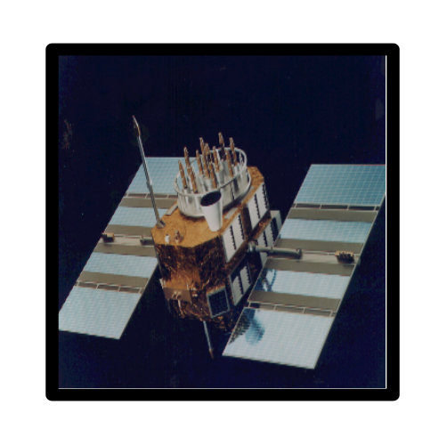
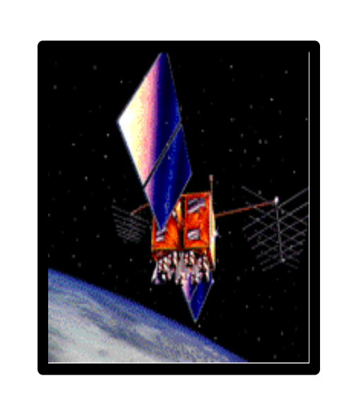
GPS Constellation Status
29 Operating Satellites
(to ensure 24)
16 Block II/IIA satellites operational
12 Block IIR satellites operational
  Modernizing 8 more Block IIR satellites
First Block IIR-M now in orbit
  Launched Sep 25, 2005
  GPS IIF launch projected for Jan 2007
Continuously assessing constellation health to determine launch need
  Next launch no earlier than May 2006
Global GPS civil service performance commitment met continuously without interruption since Dec 1993

Slide 13
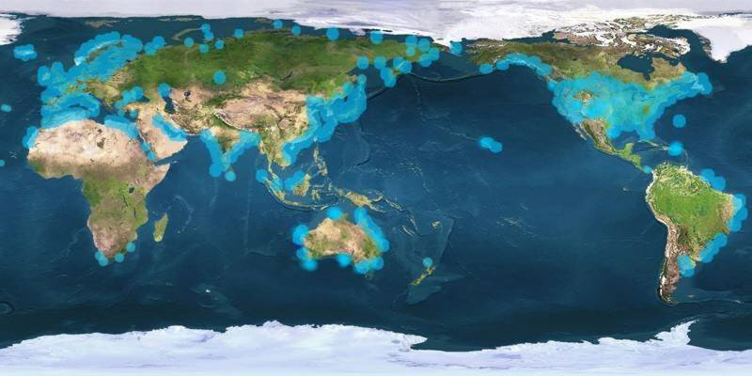
Ground Differential GPS Networks
Over 50 international partners provide common services for maritime use--now expanding to inland applications

Slide 14
GPS Space-Based Augmentations
Geostationary satellites provide regional coverage
GPS-like signals permit use by simple receivers
International Partner Service Providers
  US (WAAS), Europe (EGNOS), Japan (MTSAT), and India (GAGAN)
  WAAS operational – Jul 03; Expanding capability with L5
  GPS-based EGNOS leading way for Galileo
Independent signal monitoring supports the interests of each individual State
  International assured aviation integrity standard

Slide 15
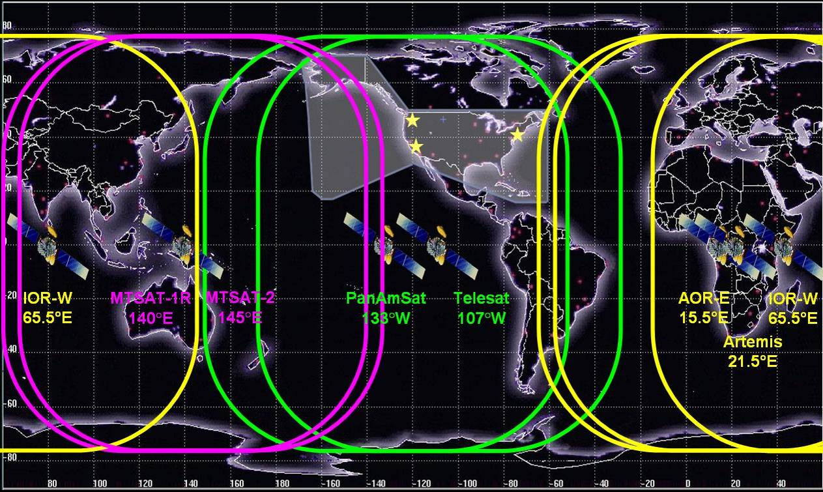
GPS Space-Based Augmentations
Indian GAGAN
Japanese MSAS
U.S. WAAS
E.U. EGNOS

