Slide 1
An Architectural Concept for Intrusion Tolerance in Air Traffic Networks
Jeffrey Maddalon
Paul Miner
{jeffrey.m.maddalon, paul.s.miner}@nasa.gov
NASA Langley
22 Oct 2003

Slide 2

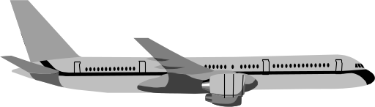
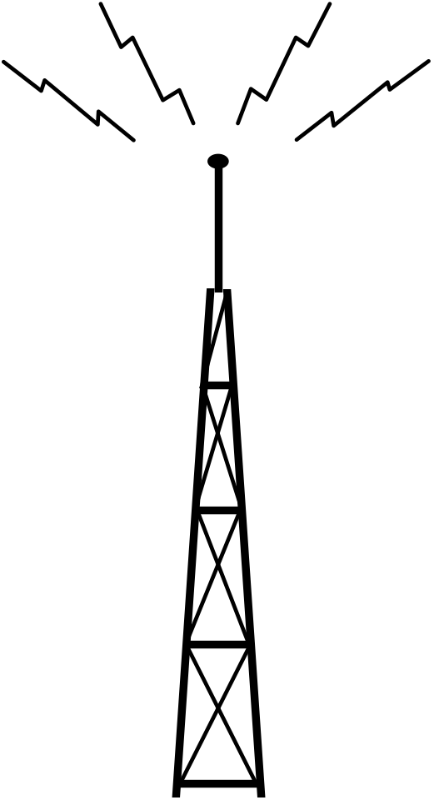


Notes:
Let’s consider an air traffic network.
Let’s consider the types of communication (controller – controller, controller – air, air – air)
This assumes a “happy day” scenerio, that is, that everything works correctly and there are no attacks on the system.

Slide 3
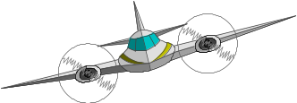



Notes:
Let’s consider how these types of communication can be compromised
destroy critical infrastructure
Inject invalid messages (duck and aircraft)
Install malicious software and start a coordinated attack.

Slide 4
Desired Security Properties
Confidentiality No unauthorized disclosure of information
Integrity No improper alteration of data
Availability System always completes authorized actions
    From Jean-Claude Laprie, Dependability - Its Attributes, Impairments, and Means, In Randell, et al. Eds., Predictably Dependable Computer Systems, Springer-Verlag, 1995
Notes:
Lets get a little more specific about what sorts of properties a secure system should have.
This model is just one, there are other models.
Talk about confidentially, integrity, availability
It is interesting that the security community (both national security and e-commerce) is most concerned with confidentially than with Availability,
In the air traffic world, availability is more important than confidentially. In other words, the “denial of service” attacks are a nusiance in the commerical world, but can be life threatening in the air traffic world.

Slide 5
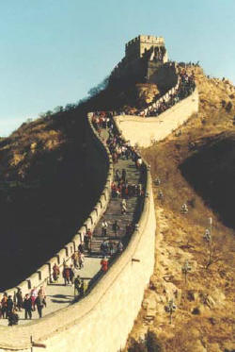


Intrusion Resilience
Make the system difficult to enter
  Firewalls, strong encryption, up-to-date security patches, etc.
Add monitoring so intrusions can be handled quickly
  Automated network monitoring, audits, network isolation, etc.
Great techniques, but they are not enough…
Notes:
When one starts thinking about making a secure system, their first steps are to make the “Intrusion resilient”
This involves two things: (Read slide)
In preparing for this talk I found two articles that have recently appeared
Reuters October 7th, 2003: the source code for the video game “Half Life II” was stolen. How? The hacker apparently knew who one of the game developers was, broke into the e-mail software. Used this compromise of the e-mail system to installed spying software on the game developer’s computer. Once the hacker had the password to the system, he stole the code.
You might say that the problem was that the system was connected to a public network and that an air traffic network should never be connected to a public network.
For that I will offer this Sydney Morning Herald story from September 5, 2003:
(read story)

Slide 6
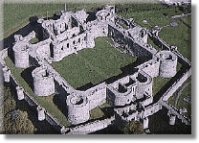
System Protection Goals
Attackers look for the
weakest link, so we need
not just strong barriers,
but …
strong barriers and
redundancy
Notes:
My point with these two stories is that: Attackers look for the weakest link…. (read slide)
In other words the metaphor should be a medieval castle, instead of a Great Wall of China.
The people who built the castle, expected that at some point the walls would be compromised. And just because one security measure was compromised, the security of the whole castle is not compromised.

Slide 7
Intrusion Tolerance
Ability to preserve Availability and Integrity, in presence of bounded number of compromised network nodes
A compromised node may exhibit
    Crashed (unable to deliver any service)
    Unable to deliver timely service (e.g. Denial of Service)
    Uniformly corrupted data (consistent misinformation)
    Arbitrary behavior (includes malicious human-directed behavior)
Notes:
You might ask how can one build an intrusion tolerant network?

Slide 8
Fault-Tolerance (FT) and
Intrusion Tolerance (InT)
Similar
Worst case scenario in FT is arbitrary behavior
  identical to InT worst case
Easily detectable failures (crash, omission) are similar in both domains
Different
Fault arrival rates are not comparable
  In FT: independence of failure
    exponential fault arrival rate
    multiple fault scenarios are rare
  In InT: expect coordinated attack
    potential for simultaneous arrival of multiple faults

Slide 9
What is SPIDER?
A family of fault-tolerant architectures
  Scalable Processor-Independent Design for Electromagnetic Resilience (SPIDER)
A system built using SPIDER can continue to operate with
  arbitrary malicious failures
  many easy-to-detect failures
  multiple simultaneous failures
Notes:
I will assume that most people here already know what SPIDER is, so I won’t go into detail.
(read slide)
Notice how SPIDER was designed to continue to operate with multiple, arbitrarily bad nodes.
In this way SPIDER is well-positioned to be deployed in intrusion tolerant enviroments.

Slide 10
ROBUS Topology
ROBUS_{N,M}
PE 1
BIU 1
RMU 1
PE 2
BIU 2
RMU 2
PE 3
BIU 3
RMU M
PE N
BIU N

Slide 11
SPIDER Fault Tolerance
ROBUS Guarantees
  All processors attached to a good port will observe identical message streams
  All processors attached to a good port will by synchronized within a bounded amount of time
  All processors attached to a good port will have correct and consistent diagnostic information
From these guarantees SPIDER can provide
  Interactive Consistency (Distributed Agreement)
  Distributed Diagnosis
  Clock Synchronization

Slide 12
Intrusion Tolerance and SPIDER
With enough good (not compromised) nodes, SPIDER can still provide service
Standard versions of fault tolerant protocols that can withstand a bounded number of faulty nodes
  deemed too expensive in both time and space to be of practical use
  variant of SPIDER protocols might provide cost-effective Intrusion Tolerance
Fault arrival rates are different between fault tolerant and intrusion tolerant systems
  SPIDER architecture designed for multiple active faults

Slide 13
Arbitrary Network Structures?
ROBUS can use a distributed implementation (not necessarily optical)
Can generalize the bus-oriented structure to establish a intrusion tolerant version of classical network topologies
  Rings
  Hub and Spoke
  For any particular network topology, there is a corresponding intrusion tolerant topology (at cost of adding redundant links and nodes, and ensuring independence of failure)
Many existing network structures may include sub-networks capable of supporting this idea

Slide 14
Network Concept
BIU/PEs
RMUs
BIU/PEs

Slide 15
Formal Verification
Sound concepts with poor designs can result in security issues
A poor design of these protocols could cause security problems
Solution: formal verification
SPIDER fault tolerance properties have been formally verified
We expect any modifications to provide intrusion tolerance will also be formally verified.

Slide 16
Summary
Intrusion resilience vs. Intrusion tolerance
Techniques from fault tolerance used to achieve intrusion tolerance
The SPIDER fault tolerant architecture may be adapted for intrusion tolerance

