Slide 1
STEP Tutorial
Effective Exchange of STEP data
January 16, 2001
PDES, Inc.
®

Slide 2
…..a little background:
Experience with ‘homegrown’ translators ~1991
AeroSTEP with Boeing ~ 1994
PowerSTEP project ~1995
Turbine pilot with MTU and P&W 1995-99
current PDES pilot: Aerospace Engine Alliance
STEPnet and CAX-IF test rallies

Slide 3
What constitutes effective
STEP exchange?
…from the management perspective
cheaper and faster than alternatives
more efficient: ‘requires fewer people’
all inclusive data exchange, and
satisfies customers request

Slide 4
What constituents effective
STEP exchange?
..and from a technical point of view
quicker and more reliable than other means
dependable: wisiwyg
  “what I sent is what you got”
easy to use, consistent process
no specialized training required
satisfies customers’ request

Slide 5
Effective STEP exchange
“Expectations”
STEP will:
  handle solids and surfaces
  multiple use parts and assemblies
  subset of configuration (PDM) data
  support colors/layers/valprops extensions
Step doesn’t support:
  parametrics, design features, or csg history
  imbedded tolerances
  prayer

Slide 6
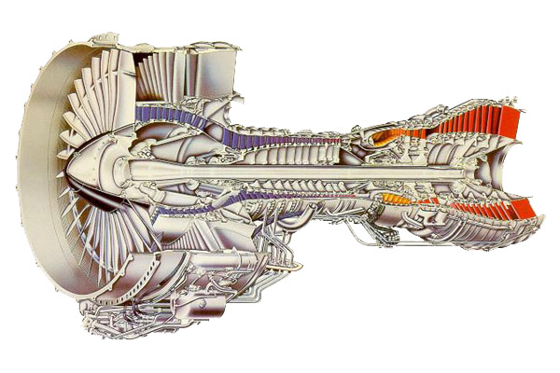
Effective Step Exchange
“the problem”

Slide 7
Effective Step Exchange
“expectations”
High
Accuracy
70 - 75% Success
Model Quality
Step
Problems
Add quality
checking
Incorporate
Healing Tech
Low
90 - 95% Success
Today
Time

Slide 8
Effective STEP exchange
“GIGO”

Slide 9
Effective STEP exchange
“Ingredients”
‘bullet proof’ native model
Sending system capability
Receiving system capability
identify customer requirements
consistent procedure
establish success criteria
build Best Practices & Lessons Learned

Slide 10
Effective Step Exchange
“High level Perspective”
Native
Model
Do Quality Checks
Create Step File
Check for Errors
Send STEP file
Documentation.
Step
Create
Target
File
Validate/heal
Notify Sender
& Recipient
Archive

Slide 11
Effective Step Exchange
“model correct”
Complete Model?
Native
Model
Do Quality Checks
Create Step File
Check for Errors
Send STEP file
Documentation.
Step
Create
Target
File
Validate/heal
Notify Sender
& Recipient
Archive

Slide 12
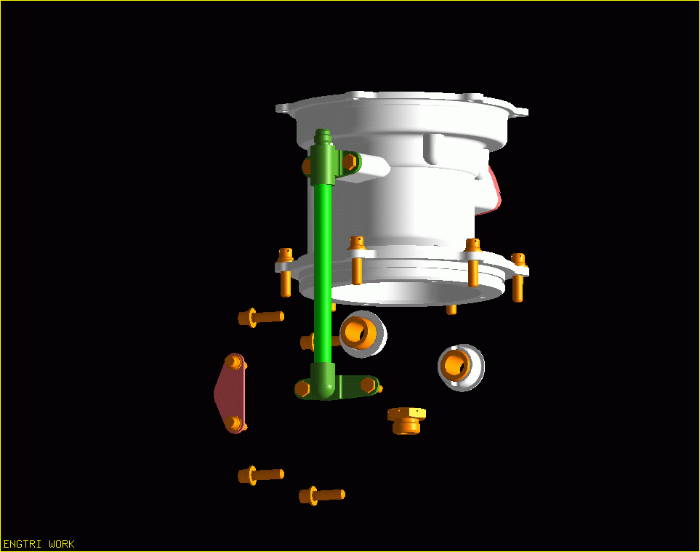
Effective Step Exchange
“model correct”?

Slide 13
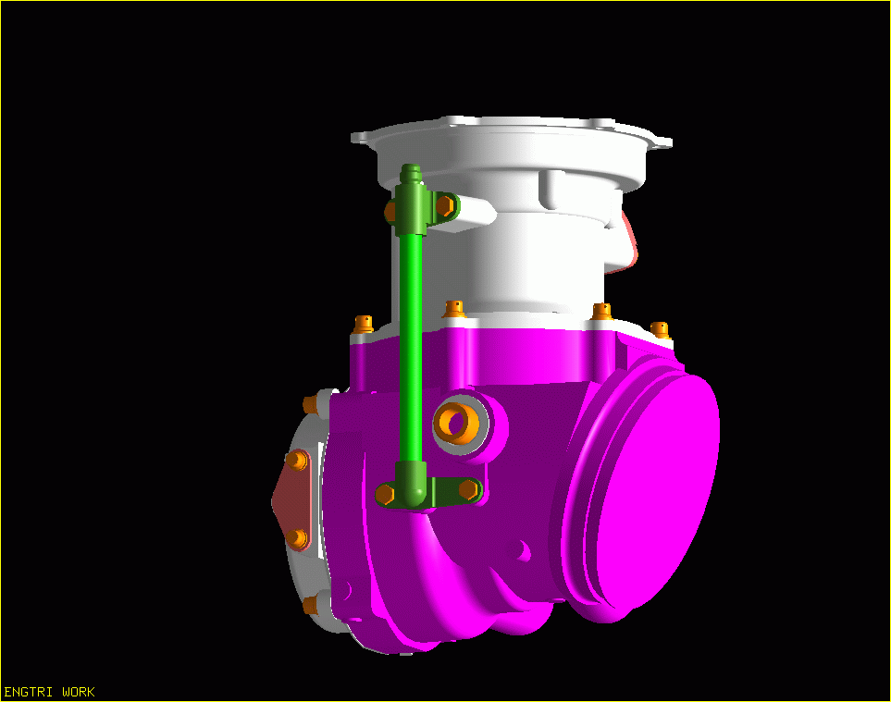
Effective Step Exchange
“model correct”?

Slide 14
Effective Step Exchange
“accuracy & tolerance”
Complete Model?
Native
Model
Do Quality Checks
Target system
capabilities?
Create Step File
B-spline tolerances
Check for Errors
Send STEP file
Documentation.
Step
Create
Target
File
Validate/heal
Notify Sender
& Recipient
Archive

Slide 15
Effective Step Exchange
“accuracy & tolerance”
Acis 0.000001in
Unigraphics 0.00001 mm
Pro-E 0.0012 in
Cadds 0.001 mm
I-DEAS 0.01 mm
Catia 0.1 mm

Slide 16
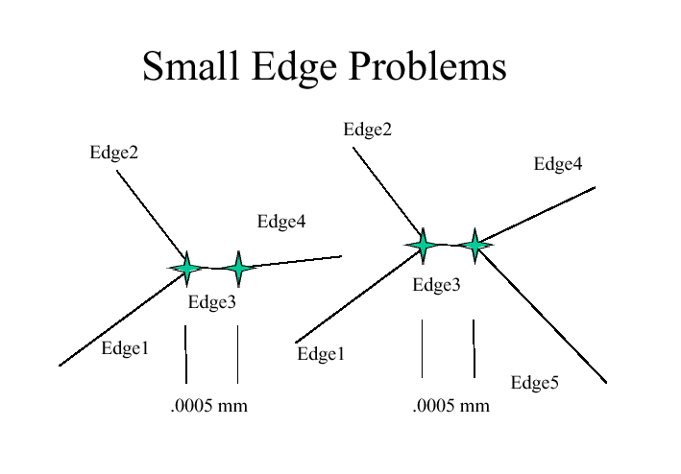
Effective STEP exchange
“Accuracy Issues”

Slide 17
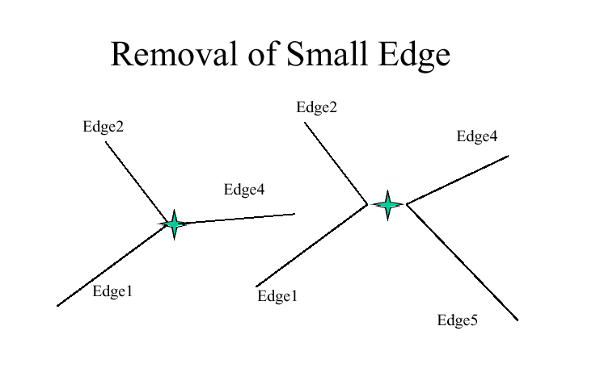
Effective STEP exchange
“Corrective action”

Slide 18
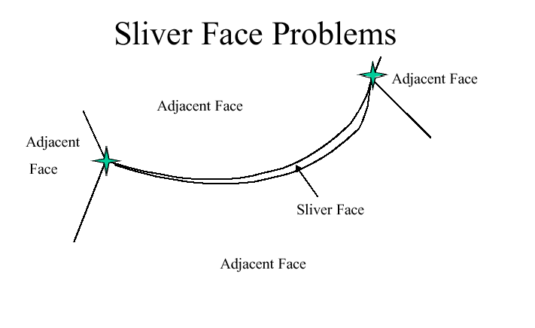
Effective STEP exchange
“Accuracy Issues”

Slide 19
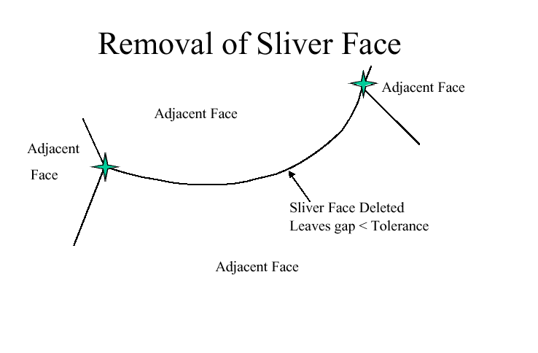
Effective STEP exchange
“Corrective action”

Slide 20
Effective Step Exchange
“Model quality/Best Practices”
Complete Model?
Best Practices
& model quality
Native
Model
Do Quality Checks
Target system
capabilities?
Create Step File
Bspline tolerances
Check for Errors
Send STEP file
Documentation.
Step
Validation OK?
Create
Target
File
To heal or not to heal..
Validate/heal
Notify Sender
& Recipient
Archive

Slide 21
Effective STEP exchange
“Model Quality checks”

Slide 22
Effective STEP exchange
“Model Quality checks”

Slide 23
Effective STEP exchange
“Model Quality checks”

Slide 24


Effective STEP exchange
“Model Quality checks”
Sliver Face in Bolt

Slide 25
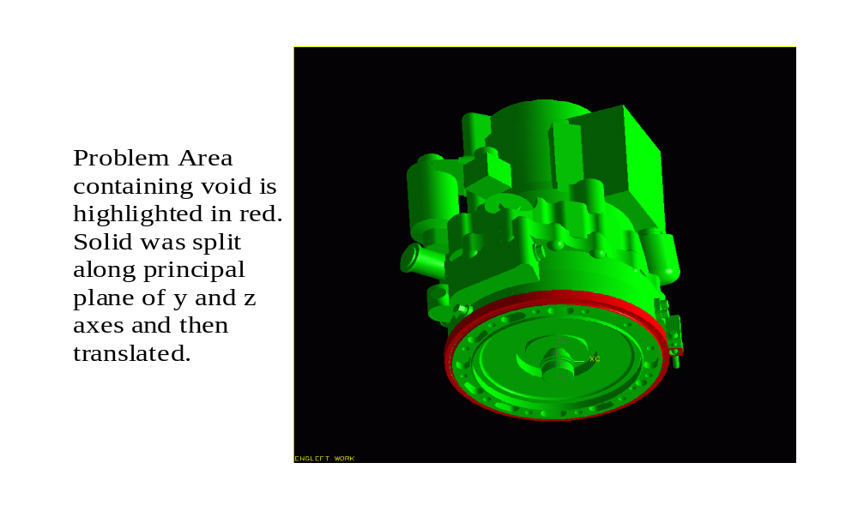
Effective STEP exchange
“Model Quality checks”

Slide 26
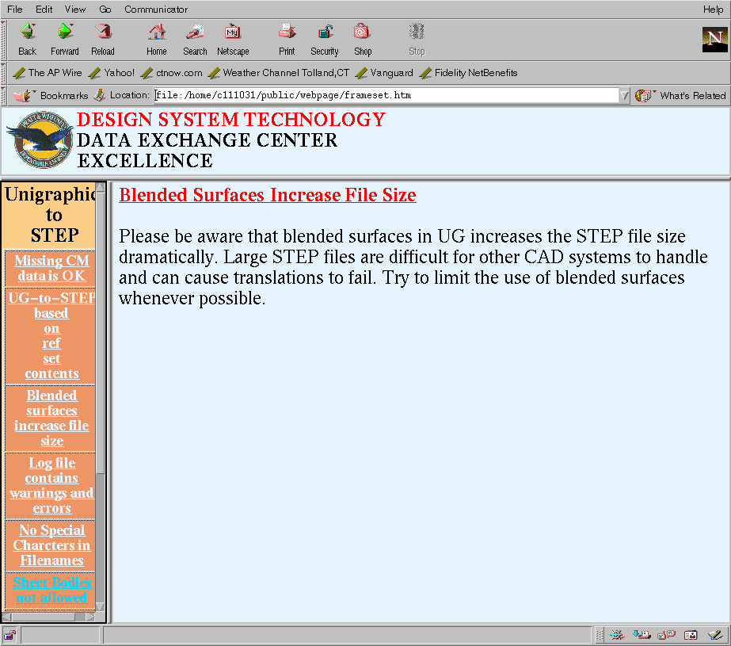
Effective STEP exchange
“ Best Practices”

Slide 27
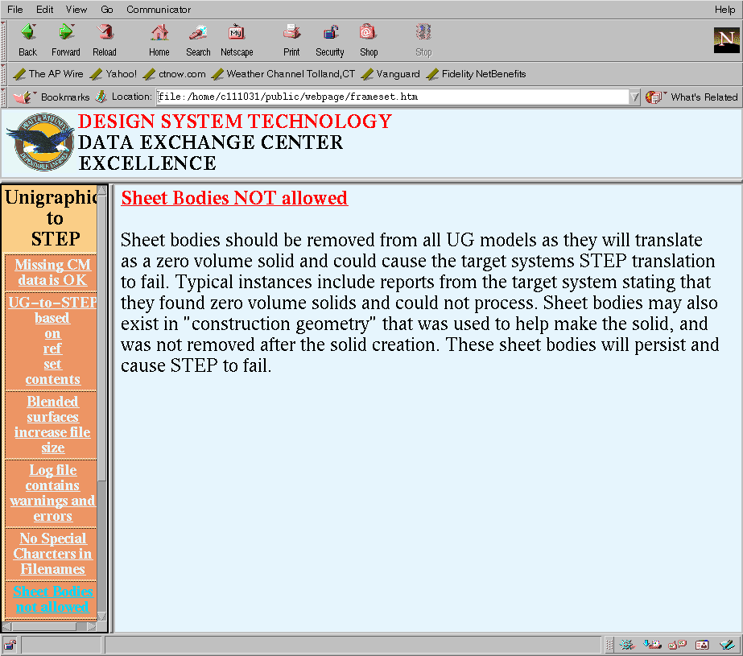
Effective STEP exchange
“ Best Practices”

Slide 28
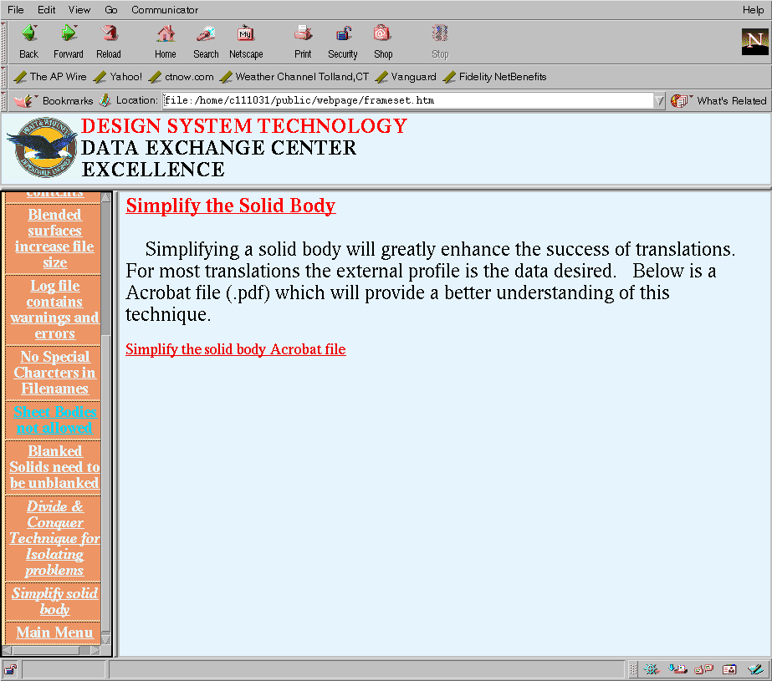
Effective STEP exchange
“ Best Practices”

Slide 29
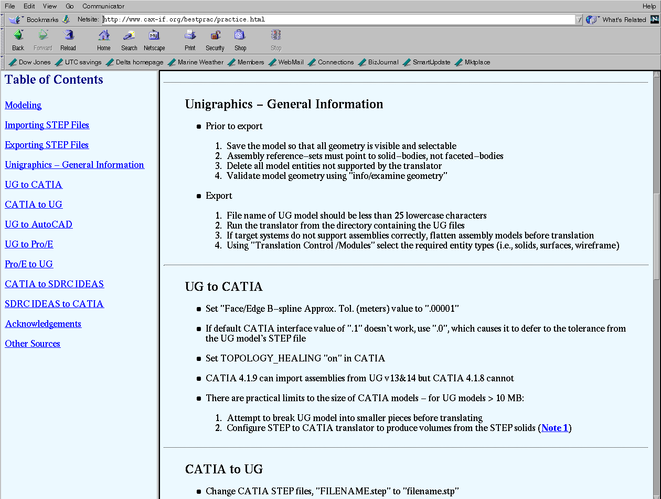
Effective STEP exchange
“ Best Practices”

Slide 30
Effective Step Exchange
“create STEP file”
Complete Model?
Native
Model
Best Practices
& model quality
Do Quality Checks
Target system
capabilities?
Create Step File
Check for Errors
Send STEP file
Documentation.
Step
Log file look ok?
Create
Target
File
Validate/heal
Notify Sender
& Recipient
Archive

Slide 31
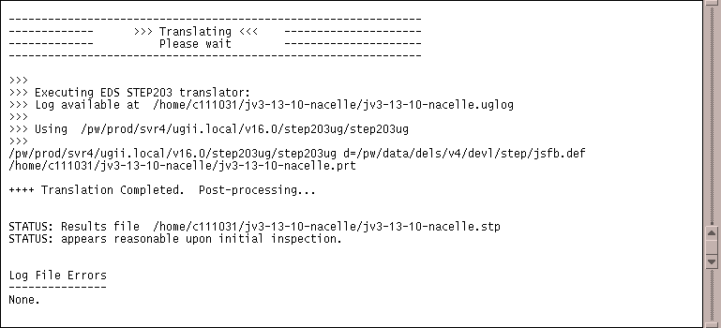
Effective STEP exchange
“successful STEP file”

Slide 32
Effective Step Exchange
“ready to send”
Complete Model?
Native
Model
Best Practices
& model quality
Do Quality Checks
Target system
capabilities?
Create Step File
Check for Errors
Send STEP file
Documentation.
Step
Log file look ok?
Create
Target
File
Contents complete?
Validate/heal
Notify Sender
& Recipient
Archive

Slide 33
Effective Step Exchange
“ready to send”
Most, if not all, vendors have 2nd or 3rd generation STEP translators in use
Generally, all vendors have undertaken some form of ‘step file certification’
Tools to check step file structure, syntax, and semantics are used to ensure compliant STEP files are created
participate in CAX Implementors forum

Slide 34
Effective Step Exchange
“Validation & Healing”
Complete Model?
Native
Model
Best Practices
& model quality
Do Quality Checks
Target system
capabilities?
Create Step File
Check for Errors
Send STEP file
Documentation.
Step
Log file look ok?
Validation OK?
Create
Target
File
Contents complete?
To heal or not to heal..
Validate/heal
Notify Sender
& Recipient
Archive

Slide 35
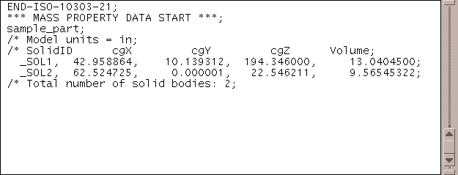
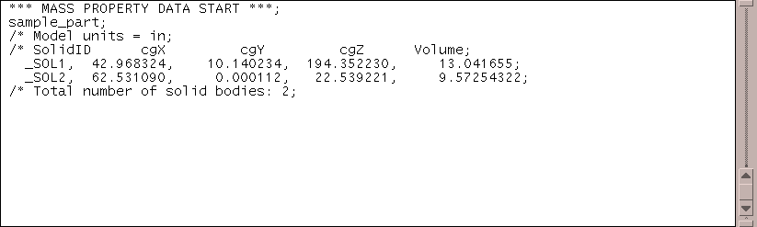
Effective STEP exchange
“validated STEP file”
Native system data
Target system data

Slide 36
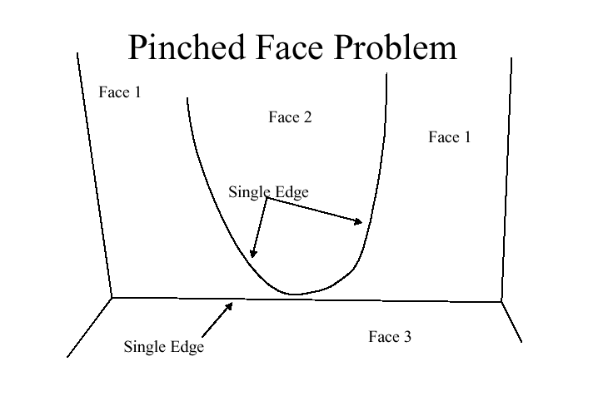
Effective STEP exchange
“problem STEP file”

Slide 37
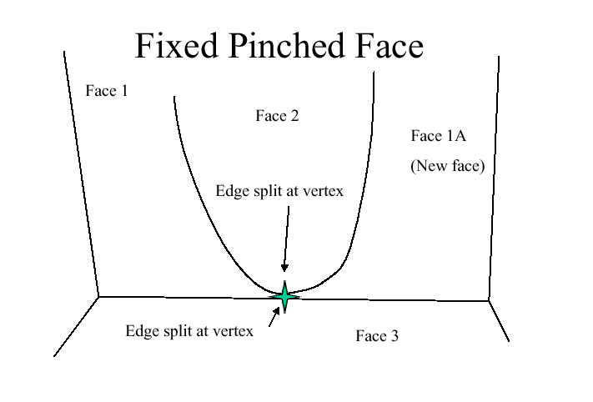
Effective STEP exchange
…the problem ‘healed’

Slide 38
Effective Step Exchange
“Problem Resolution Process”
Complete Model?
Native
Model
Best Practices &
model quality
Do Quality Checks
Target system
capabilities?
Create Step File
Bspline tolerances
Check for Errors
Send STEP file
Documentation.
Problem Resolution
Step
Log file look ok?
Create
Target
File
Validation OK?
Contents complete?
Validate/heal
To heal or not to heal..
Notify Sender
& Recipient
Archive

Slide 39

Effective STEP Exchange
Problem Resolution
A
CAD Model
Native Model
Problem
B
Prepare/Translate and make
ready for Export
IPT focal has responsibility for the
data exchange of the
Design/Product Definition (A)
Output
OK
N
Problem Resolution team
C
Y
Send to Process Owner
@ Target System
Translate & Import to
Target System
Model
OK
N
Problem Resolution team
D
E
Y
model passes validation checks
Delighted/Customer

Slide 40
Effective Step Exchange
PRP
C
“Problem Resolution Process (PRP)
Responsibility Center”
Identify
Source of
Failure
DST/CSC/
UGS Work
Solution
Software
Problem
Source
Of
Failure
Design
Process
Notify
Process
Owner
Model
Quality
Issue
Update Lessons
Learned
Vendor
part?
y
PR team Fixes
Model
N
Send to
Vender for
Correction
& Notify IPT
n
Notify IPT
Of Problem

Slide 41
Effective Step Exchange
PRP
D
Review Error message
from Target System
Design Systems Technology
“Problem Resolution Process”
PR team Identifies
Source of Error
UG - info/exam geometry
CAD - IQ
Theorem DXN
Mass Property Data
Other Tricks and resources
DST
Model corrected
or updated
Native System
Who
Owns
Problem
Notify IPT
& Discipline Manager
DST
Fix Process
& update Lessons
Learned
Target
System
Is Target
System a
Customer
Y
Work with
customer to
fix process
N
Target
System
fixes problem

Slide 42
Effective Step Exchange
“check list”
Complete Model?
Native
Model
Best Practices
& model quality
Do Quality Checks
Target system
capabilities?
Create Step File
Bspline tolerances
Check for Errors
Send STEP file
Documentation.
Problem Resolution
Step
Log file look ok?
Create
Target
File
Validation OK?
Contents complete?
Validate/heal
To heal or not to heal..
Notify Sender
& Recipient
Archive

Slide 43
Effective STEP exchange
“ coming soon”
New Release of AP203:
  Modular Extension architecture
  includes colors and layers
  imbedded validation properties
In test with CAX Implementors:
  enhanced validation properties
  dimensional tolerances
CSG, GD&T in development phase

Slide 44
Effective STEP exchange
“ summary /recommendations”
Current step exchange rate is >90%
Incorporate Best Practices/model quality into your design practice; try www.caxif.org/bestprac/practice.html
Quality checkers and Healing tools can improve STEP ‘successes’
Stay on top of your CAD vendor STEP translator development; practice regression testing on new releases
Understand Native and Target system STEP capabilities

