Slide 1




Lecture 2
Basic Grid Skills
Presenter Name
Presenter Institution
Presenter email address
Grid Summer Workshop
June 21-25, 2004

Slide 2
Credit Where Credit Is Due
A few of these slides were copied, in whole or in part, from past Globus presentations.
  http://www.globus.org/about/presentations/
One slide was copied from Miron Livny

Slide 3
What is a Grid?
1969, Len Kleinrock:
  “We will probably see the spread of ‘computer utilities’, which, like present electric and telephone utilities, will service individual homes and offices across the country.”
1998, Kesselman & Foster:
  “A computational grid is a hardware and software infrastructure that provides dependable, consistent, pervasive, and inexpensive access to high-end computational capabilities.”
2000, Kesselman, Foster, Tuecke:
  “…coordinated resource sharing and problem solving in dynamic, multi-institutional virtual organizations.”

Slide 4
Ian Foster’s Grid Checklist (2002)
A Grid is a system that:
  Coordinates resources that are not subject to centralized control
  Uses standard, open, general-purpose protocols and interfaces
  Delivers non-trivial qualities of service

Slide 5
Bill Johnston’s Definition (2002)
A Grid is an environment that provides access and management for the whole range of computing resources needed to solve complex computing and data handling problems… a Grid is a well understood and standardized set of services that provide uniform access to a large number of diverse and distributed resources, together with several critical auxiliary services for resource discovery and secure communication based on authenticated, global identity.
  Resource discovery
  Resource scheduling
  Uniform computing access
  Uniform data access
  Asynchronous information sources
  Authentication, delegation, and secure communication
  Identify certificate management
  System management and access

Slide 6
Our Definition of a Grid
A distributed computing environment that coordinates:
  Computational jobs
  Data placement
  Information management
Scales from one computer to thousands
Capable of working across many administrative domains
That is: Get lots of work done, securely

Slide 7
How Do You Build a Grid?
Method 1: First buy 1,000 computers…
Method 2:
  Start small. Build a grid of one computer, then a grid of ten computers, then expand…

Slide 8
Expanding Your Grid
world
region
campus
building
floor
desktop

Slide 9
Example Grid: Grid2003
Built by iVDGL (one of the sponsors of this school)
At its peak:
  Spanned 27 grid sites across the US and Korea
  Included 2000+ CPUs
  Ran 7 different scientific applications
  100 users had access to Grid2003
    Users were divided into distinct virtual organizations
  Ran up to 500-700 concurrent jobs, with 75% efficiency

Slide 10
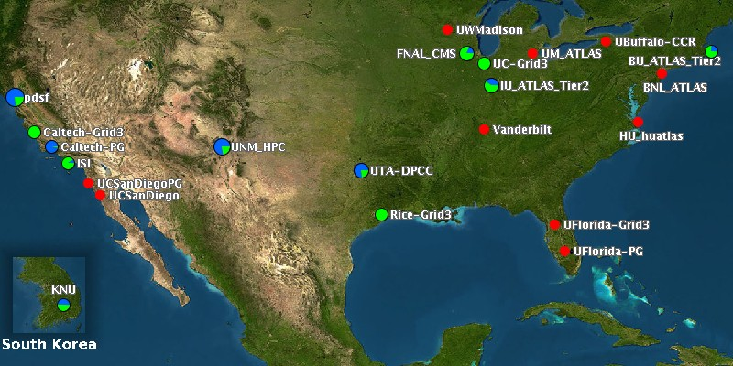
Grid2003

Slide 11
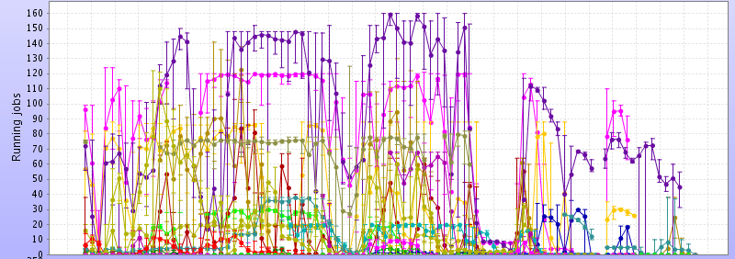
USCMS Running Jobs On Grid3
  Each colored line is a different site
  Nov. 21, 2003 to May 28, 2003
  Grid2003 really worked!

Slide 12
Grid With a Grid
Recall this morning’s grid without a grid
  Security infrastructure: ssh/https
  Running jobs: ssh
  Transferring data: FTP, HTTP, scp
  Discovering information: Google, LDAP
How does this change with grid technology?

Slide 13
Which Grid Technology?
There are lots of grid technologies
  Globus
  Condor
  Unicore
We will focus on Globus, Condor, and related software.
  Avaki
  NorduGrid
  SETI@home

Slide 14
Grid with a Grid
Now we will use:
  Security infrastructure: GSI
  Running jobs: GRAM/Condor-G
  Transferring data: GridFTP & friends
  Discovering information: MDS

Slide 15
GSI: Terminology
Authentication: Establishing identity
Authorization: Establishing rights
Message protection
  Message integrity
  Message confidentiality
Non-repudiation
Digital signature
Accounting
Delegation

Slide 16
GSI: Why Grid Security is Hard
Resources may be valuable & the problems being solved sensitive
Resources are often located in distinct administrative domains
  Each resource has own policies, procedures, security mechanisms, etc.
Implementation must be broadly available & applicable
  Standard, well-tested, well-understood protocols; integrated with wide variety of tools

Slide 17
GSI: Features
Users:
  Easy to use
  Single sign-on: only type your password once
  Delegate proxies
Administrators
  Can specify local access controls
  Have accounting

Slide 18
GSI: How Do We Get These Features?
From the Public Key Infrastructure: PKI
PKI allows you to know that a given key belongs to a given user
PKI builds off of asymmetric encryption:
  Each entity has two keys: public and private
  Data encrypted with one key can only be decrypted with other
  The public key is public
  The private key is known only to the entity
The public key is given to the world encapsulated in a X.509 certificate

Slide 19

GSI: What is a Certificate?
Similar to passport or driver’s license: Identity signed by a trusted party
State of Illinois
Name
Issuer
Public Key
Signature
John Doe
755 E. Woodlawn
Urbana IL 61801
State of
Illinois
Seal
BD 08-06-65
Male 6’0” 200lbs
GRN Eyes

Slide 20
GSI: Certificates
By checking the signature, one can determine that a public key belongs to a given user
Hash
Hash
Name
Issuer
Public Key
Signature
=?
Decrypt
Hash
Public Key from
Issuer
Issuer

Slide 21
GSI: Certificate Authorities (CAs)
A small set of trusted entities known as Certificate Authorities (CAs) are established to sign certificates
A Certificate Authority is an entity that exists only to sign user certificates
The CA signs it’s own certificate which is distributed in a trusted manner
Name: CA
Issuer: CA
CA’s Public Key
CA’s Signature

Slide 22
GSI: Certificate Authorities
The public key from the CA certificate can then be used to verify other certificates
Hash
Hash
Name
Issuer: CA
Public Key
Signature
=?
Decrypt
Hash
Name: CA
Issuer: CA
CA’s Public Key
CA’s Signature
CA

Slide 23


GSI: How Do You Get a Certificate?
User generates
public/private
key pair
User send public key to CA along with proof of identity
CA confirms identity, signs certificate and sends back to user
Cert
Request
Public Key
Cert
Certificate
Authority
State of Illinois
ID
Private Key encrypted on local disk

Slide 24
GSI: Proxies
It’s a bad idea to use your certificate as identification
  What if someone successfully steals it? They can impersonate you until the certificate expires
  Certificates usually last about a year
Using your certificate, GSI can create a proxy certificate.
  This represents you in the same way.
  It has a short life-time: usually 12 hours, but configurable

Slide 25
GSI: How Does Single Sign-on Work?
Look at your certificate subject name
  grid-cert-info –subject
  /DC=org/DC=doegrids/OU=People/CN=Alain Roy 424511
Tell people that wish to accept you what your subject name is—they put it into an authorization file
From your certificate, create a proxy
  grid-proxy-init
  grid-proxy-info –subject: note the “/CN=proxy”
Each person that likes you will accept your proxy: you only have to create it once
  Well, until it expires anyway

Slide 26
GSI: Your Certificates
Sometimes it can take a few days to get a certificate from a CA, because it takes time to verify your identity
We have gotten generic certificates from you using the Globus Certification Service
  These are low-quality: there is no identify verification
  http://gcs.globus.org:8080/gcs/index.html
What does your certificate look like?
  grid-cert-info

Slide 27
GSI: OpenSSH
OpenSSH has been modified to use GSI
This means that you can use ssh like you are used to, but you don’t have to type your password: just use your proxy
We’ll try it out during the exercises: gsissh

Slide 28
GSI: What Else Uses It?
All of Globus uses GSI, so you’ll use it for:
  Submitting jobs
  Transferring data
  Querying information services (maybe)
    It’s often turned off.
Condor uses GSI
Lots of other software uses GSI:
  GSI OpenSSH
  MyProxy
  …

Slide 29
GSI: Certificate Details
User certificates are stored in your .globus directory:
  % ls –l .globus
  -rw-r----- 1 roy roy 1317 Sep 24 2003 usercert.pem
  -r-------- 1 roy roy 1209 Sep 24 2003 userkey.pem
Usercert.pem is the public key and is not private
-----BEGIN CERTIFICATE-----
MIIDHjCCAgagAwIBAgICAe8wDQYJKoZIhvcNAQEFBJomT8ixk
…
-----END CERTIFICATE-----
Userkey.pem is the private key, and it private

Slide 30
GSI: Proxy Details
Create a proxy with grid-proxy-init [-hours N]
A proxy is marked with a “not valid before” timestamp
  If your clocks are not synchronized, you may experience security failures!
Your proxy is stored in /tmp/x509up_uNNNN
  NNNN is your numeric user ID
  You can store it elsewhere, if you need to.
Destroy a local proxy: grid-proxy-destroy

Slide 31
GSI: Proxy Delegation
When you submit a job or transfer data, your proxy travels over the network to that computer
  The remote computer actually gets a limited proxy
    Not all services accept a limited proxy. This is another layer of safety
  Grid-proxy-destroy does not remove proxies that have been transferred.

Slide 32
GSI: /etc/grid-security
/etc/grid-security is the default location to store GSI information for a host: hosts have certificates too
Job authorization happens in /etc/grid-security/grid-mapfile. This maps certificates to users:
  “/DC=org/DC=doegrids/OU=People/CN=Alain Roy 424511” roy
  “/DC=org/DC=doegrids/OU=People/CN=Mike Wilde 326321” wilde

Slide 33
GSI: The Gory Details
GSI works great…
Until there is a problem—then GSI gives ugly, hard-to-interpret error messages.
We love GSI
We hate GSI

Slide 34
GRAM: What is it?
Given a job specification:
  Create an environment for a job
  Stage files to/from the environment
  Submit a job to a local scheduler
  Monitor a job
  Send job state change notifications
  Stream a job’s stdout/err during execution

Slide 35
GRAM: Some Terminology
We speak loosely most of the time, but:
Globus Job Management Service
  Starts up and monitors jobs
  Stages data in and out
GRAM
  Protocol to communicate with the job management service
We often say “GRAM” as a shorthand for either of these

Slide 36
GRAM: How Does it Work?
Head Node
a.k.a “Gatekeeper”
Compute Resource
Gatekeeper
(Authenticates
&
Authorizes)
Client
GRAM
Local Resource Manager
Results
Process
Job Manager
(Submits job
&
Monitors job)
Process
Process

Slide 37
GRAM: What is a “Local Resource Manager?”
It’s usually a batch system that allows you to run jobs across a cluster of computers
Examples:
  Condor
  PBS
  LSF
  Sun Grid Engine
Most systems allow you to access “fork”
  It’s the default
  It runs on the gatekeeper: a bad idea in general, but okay for testing

Slide 38
GRAM: RSL
The client describes the job with the Resource Specification Language (RSL)
  & (executable = a.out)
  (directory = /home/nobody )
  (arguments = arg1 "arg 2")
You don’t usually need to specify RSL directly, unless you have special needs.
http://www.globus.org/gram/rsl_spec1.html

Slide 39
GRAM: Security
GRAM uses GSI for security
Submitting a job requires a full proxy
  The remote system & your job will get a limited proxy
  The job will run—you had a full proxy when you submitted
  But your job cannot submit other jobs

Slide 40
GRAM: Basic Usage
grid-proxy-init
  You need your proxy first
globus-job-run hostX /bin/hostname
  This runs /bin/hostname on hostX
  It expects /bin/hostname to already be there
globusrun -o -r hostX '&(executable = /bin/echo) (arguments = Hello Grid) '
  This is the RSL.
  We could specify lots of things here, but we didn’t.
These just ran with the fork job manager, not an “interesting” batch system

Slide 41
GRAM: Running on a Batch System
Append the batch system to the hostname:
  globus-job-run hostX/condor /bin/hostname
You will do this for most real work
  The batch system can handle many more jobs
  Batch systems are reliable and track your jobs
  Fork is not reliable, and your job may be lost

Slide 42
GRAM: The Gory Details
GRAM works pretty well
It doesn’t scale too well
  Each job has a job manager.
  Each job manager polls the local batch system every few seconds to get job status
  After a couple hundred jobs, everything slows down
You may lose jobs if you use these command-line tools
  What happens when you type control-C after globus-job-run?
    Where is your job?
    Will it ever finish?
    How will you get the output?
  There are no good answers

Slide 43
GRAM: The Future
If you use Condor-G today:
  It will keep track of your jobs for you and recover from errors, unlike the Globus command-line tools
  Condor-G has some tricks up its sleeve to improve job management scalability significantly
  We’ll learn more about Condor-G soon
The Globus Alliance is making the job management more scalable for tomorrow

Slide 44
GridFTP: What is it?
A secure, robust, fast, efficient, standards based, widely accepted data transfer protocol
An implementation:
  Globus provides a server
  Globus provides a client: globus-url-copy
  Other people provide clients: uberftp

Slide 45
GridFTP: Features
Security through GSI
  Note that GSI can provide encryption in addition to authentication and authorization
Reliability by restarting failed transfers
Fast
  Can set TCP buffers for optimal performance
  Parallel transfers
  Striping (multiple endpoints)
Not all features easily accessible from basic client

Slide 46
GridFTP: Basic Use
globus-url-copy file:fullpath/file gsiftp://host/path/file
The file: url refers to a local file
The gsiftp url refers to a remote file, accessed with GridFTP
You can specify two gsiftp URLs to do third-party transfers
You can specify other URLs, including http & https

Slide 47
MDS: What is it?
MDS is a grid information service
It provides:
  Uniform, flexible access to information
  Scalable, efficient access to dynamic data
  Access to multiple information sources
  Decentralized maintenance
Based on LDAP

Slide 48
MDS: Architecture
Resources run a standard information service (GRIS) which speaks LDAP and provides information about the resource (no searching).
GIIS provides a “caching” service much like a web search engine. Resources register with GIIS and GIIS pulls information from them when requested by a client and the cache as expired.
GIIS provides the collective-level indexing/searching function.
Client 1
Resource A
Clients 1 and 2 request info
directly from resources.
GRIS
Resource B
Client 2
GRIS
GIIS requests information from
GRIS services as needed.
Client 3 uses GIIS for searching
collective information.
Client 3
GIIS
Cache contains info from A and B

Slide 49
MDS: Implementation
Grid Information Service (GRIS)
  Provides resource description
  Modular content gateway
Grid Index Information Service (GIIS)
  Provides aggregate directory
  Hierarchical groups of resources
Lightweight Dir. Access Protocol (LDAP)
  Standard with many client implementations
  Used for GRIP (and GRRP currently)

Slide 50
MDS: Security
Security is optional. Not everyone uses it. Perhaps they should
When security is used, it is with GSI

Slide 51
MDS: What can you Learn From It?
Globus provides schema which describe the way information is presented
Globus comes with information providers, which fill in the information
You can find out information about hosts, disk, etc…

Slide 52
MDS: Example Information
hn=
hostname
CPU
RAM
DISK
OS
CPU
VM
NET
software=
OS
OS
dev group=
CPUs
CPU
CPU
dev group=
memory
dev group=
disk
dev group=
net
dev=
cpu 0
dev=
cpu 1
RAM
DISK
NET
CPU
CPU
VM
dev=
RAM
dev=
VM
dev=
/scratch1
dev=
eth0
RAM
VM
DISK
NET

Slide 53
MDS: More Schemas
Not everyone agrees on what schema should be provided
Grid2003 & LCG (in Europe) use the GLUE Schema.
  It provides similar information to the Globus schema
  The details of the schema are completely different
Grid2003 adds extra schema for information they need
  MDS should be dynamic and match your needs

Slide 54
MDS: Client Tools
Globus Toolkit includes 2 command line client tools for querying MDS services
  grid-info-search: General purpose client
    grid-info-search –h <host> -p <port> -b <base> \
    -T <timeout> [<filter>] [<attributes>]
    -x: Anonymous access
  grid-info-host-search: Same as grid-info-search, but defaults to GRIS standard port
    E.g. grid-info-host-search –h localhost
Example:
grid-info-search -x -h lhc.uits.indiana.edu -p 2170
-b "Mds-vo-name=grid3,o=grid"
Both clients can search for specific system information and filter results
You can use other LDAP tools, if you like.

Slide 55
Schema, or the Lack Thereof
There is debate on schema: should we define one or not? You can make up your own mind, but note:
  It took many months of discussion to develop the GLUE Schema
  People always wish to extend the schema
I propose:
  Don’t enforce your schema too carefully
  Allow people to easily add information that’s not in the official schema
  Allow for a more organic, communal approach to developing a schema: see what you need before setting a committee down for several months

