Slide 1
Generation Subgroup Report
SSG-WI Technical Support Group Meeting
June 1, 2005
Mary Johannis

Slide 2

Existing Generation
WGA Comparison of WECC, SSG-WI, CEC Data Bases—complete
Comments received from States
Incorporated into ABB GridView Model Data Base
Still need final review by States and Subregional Planning Groups (SPGs)

Slide 3

Existing Generation
HYDRO REPRESENTATION:
  Northwest: Recent historical hourly generation for Federal, Mid-Cs, PAC and Williamettes:
    2002 = Average
    2003 = Dry
    1999 = Wet
  California: Recent historical hourly generation aggregated by river system; CVP hourly projections need to be disaggregated to plants
  Desert SW and Rocky Mountains: only Federal hydro for monthly timestep; still need non-Federal hydro

Slide 4
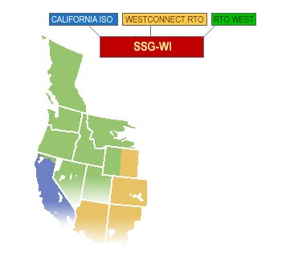
Incremental Generation 2008 Base:
WGA Comparison of Data Bases;
Starting Point = Western Gas Study Generation from CEC
340
1012
571
461
193
131
124
651
216
7525
1253
631
Dependable MWs shown
0

Slide 5
Incremental Generation for 2008
NEXT STEPS:
  Provide SPGs Existing and Incremental Generation to Review
  Ask States for Final Review
  Bring any Disagreements to TSG for Resolution

