Slide 1
Marketer Transportation Concerns
Pilot Travel Centers LLC
  238 Travel Centers in 38 states
  950 Transport deliveries daily
    83% Highway diesel
  65% Corporate fleet
  35% Common Carrier

Slide 2
Marketer’s ULSD
Transportation Issues
Terminal loading mistake by driver or problem at loading rack.
Multiple suppliers
  Multiple terminals
Winter blending
Marketer tank switching because of price or availability

Slide 3
Marketer’s ULSD
Transportation Issues
Common carrier – prior load of off road
  Off loaded at an off road site- tanker not level
Accidental mis-drop by transport driver
Retailer’s tanks not marked properly
Downgrading

Slide 4
Marketer’s Transportation Issues
Contamination Concerns:
7,500 Gallons 15ppm ULSD contaminated with: | <500 ppm Diesel Fuel | <3000 ppm Jet/Diesel Fuel | <5000 ppm Heating Oil
7 Gallons or .1% | + .5 ppm | + 3 ppm | + 5 ppm
37 Gallons or .5% | + 2.5 ppm | + 15 ppm | + 25 ppm
75 Gallons or 1% | + 5 ppm | + 30 ppm | + 50 ppm

Slide 5
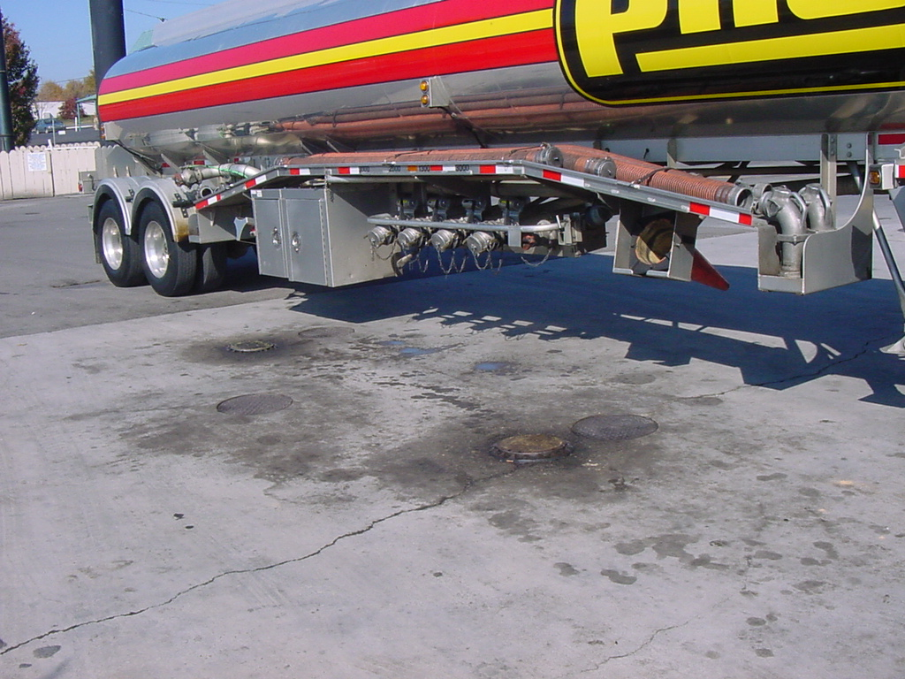
Possible Solutions
Good Quality controls
Require prior load of Gasoline or ULSD
Lock 15 ppm storage tank
Driver training
Good dependable suppliers

Slide 6
Possible Solutions
Test product regularly and especially after tank turn
  Need inexpensive, easy test
Make sure storage tanks are labeled clearly
Good common carriers
Need 500 ppm or less off road diesel

