Slide 1
Grids: The Top Ten Questions
Jennifer M. Schopf
UK National eScience Centre
Argonne National Lab
January 14, 2005

Slide 2
Ten Things We
Hate About The Grid
Jennifer M. Schopf
UK National eScience Centre
Argonne National Lab
(With significant input from
Bill Nitzberg, PBS)
January 14, 2005

Slide 3
What Is a Grid?
Shared resources
  Computers, storage, sensors, networks, …
  Sharing always conditional: issues of trust, policy, negotiation, payment, …
Coordinated problem solving
  Beyond client-server: distributed data analysis, computation, collaboration, …
Multiple sites (multiple administrative domains)
  Dynamic, multi-institutional virtual orgs
  Community overlays on classic org structures
  Large or small, static or dynamic

Slide 4
Not A New Idea
Late 70’s – Networked operating systems
Late 80’s – Distributed operating system
Early 90’s – Heterogeneous computing
Mid 90’s - Metacomputing
Then the “Grid” – Foster and Keselman, 1999

Slide 5
Relation to Other Approaches
Distributed computing
  Generally a client-server model
Parallel computing
  Limited to one machine/site
Peer-to-peer technologies
  Limited scope and mechanisms
Enterprise-level distributed computing
  Limited cross-organizational support

Slide 6
How are Grids Different?
Autonomy
Heterogeneity
Resources are more the CPU and networks
Focus on the user
These differences create many of the problems addressed in this talk but also make the system much more usable than its predecessors

Slide 7
Who uses Grids?
A biochemist exploits 10,000 computers to screen 100,000 compounds in an hour
1,000 physicists worldwide pool resources for petaop analyses of petabytes of data
Civil engineers collaborate to design, execute, & analyze shake table experiments
Climate scientists visualize, annotate, & analyze terabyte simulation datasets
An emergency response team couples real time data, weather model, population data

Slide 8
Who uses Grids? (contd)
A multidisciplinary analysis in aerospace couples code and data in four companies
A home user invokes architectural design functions at an application service provider
An application service provider purchases cycles from compute cycle providers
Scientists working for a multinational soap company design a new product
A community group pools members’ PCs to analyze alternative designs for a local road

Slide 9
What’s the problem?
Computational Grids are becoming more and more common
Collaborations are being developed
Governments are giving lots of money
Globus seems to be everywhere
Happy application scientists are few and far between

Slide 10
Things heard recently…
“Isn’t the Grid just a funding construct?”
“No one can really define it, everyone wants an app that can do it, and companies that claim to do it are getting a lot of interest.” – SlashDot, March 2003
"Grid computing has been more hype than reality,“ - Hewlett-Packard CEO Carly Fiorina, Fall 2003
“We tried to install Globus and found out that it was too hard to do. So we decided to just write our own….”

Slide 11
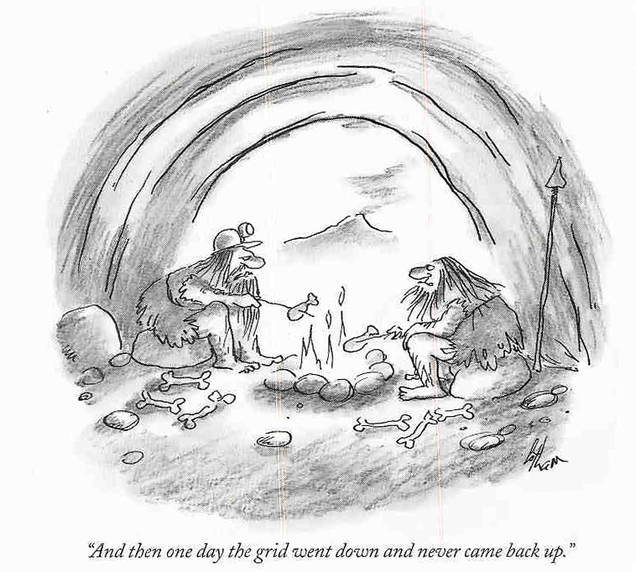
Grid2096

Slide 12
This Talk- FIX
Intro Bits (done that)
Open issues in Grid computing
  Users
  Information
  Security
  Performance
  Socio-Political
Structure:
  Question, Discussion, Moral (def. a lesson or principle contained in or taught by a fable, a story, or an event)

Slide 13
A grain of salt
Many of the problems I’ll discuss are in the process of being addressed by various groups
There may be on-going work or solutions that I don’t know about, I’ll apologize now
These are my opinions, not those of Argonne National Lab, the Globus Alliance, NeSC, EPCC, etc…

Slide 14
1. Why aren’t there (happy) users?
FACT: Many users have been told to use the Grid to get funding, not because they actually want to
FACT: There are a few well known successes (LHC, CACTUS, and a couple others) but some people think these are one-offs
FACT: In July I spoke with 25 UK user groups, and on occasion it got ugly
  www.nesc.ac.uk/technical_papers/UKeS-2004-08.pdf

Slide 15
Move from sequential to parallel computing
Parallel computing showed us that they “If you build it they will come” scenario just won’t work
Until debuggers, fast compilers, languages, libraries, etc. the users didn’t want to use parallel machines
Many hundreds, even thousand, of hours went into re-writing codes for parallel machines

Slide 16
Heroic Effort Required for the Grid
There is the impression (right or wrong) that only heroic efforts will allow you to use a Grid
Some re-writing of code required
Access to resources isn’t easy even once code is changed

Slide 17
Where are the user level tools?
What a user would like:
  “Run my job, finish by lunch”
  “Get a data set that has these attributes”
  “Tell me when that simulation will finish”
Where are we today:
  Specify exact machines, data files, explicit data transfers, etc
  Little (or no) dynamic information or prediction

Slide 18
The “Ideal” Grid (F&K, 1999)
  Pervasive
  Dependable
  Consistent
  Inexpensive

Slide 19
Today
  Pervasive
    Special case testbeds in most instances
  Dependable
    Resources up and down
  Consistent
    Standards still developing
  Inexpensive
    Not yet!
  So can we get there?

Slide 20
Why aren’t there end-to-end solutions yet?
Globus Toolkit is to a Grid Application
Like
Apache is to an eCommerce Website
Glue is needed to make it real

Slide 21
Moral: How do we move forward?
Users will only come when they have decent tools
  simple enough for “easy” use
  robust enough for “stupid” use
  still allow work arounds for “hard-core” use
We (arguably) now have basic functionality, but we don’t know the (real) use cases yet

Slide 22
2. Why don’t we have usage scenarios?
Software often doesn’t do what a user wants
One example- original replica catalogue from Globus, logical name to physical file name mapping
  The way the developer envisioned the software being used was/is very different from how the user wants to use it
Many tools are used “off label”

Slide 23
“Off Label” Use
Tool built to do A is used for B
  This is good since a user has something to use
  This is bad since the tool is being in a way that wasn’t envisaged
    Arch concerns
    Scaling concerns
    Etc
But without use of the tool, there’s no way to know how it will be used!

Slide 24
What is a usage scenario?
Information from the user about a specific use case
What’s the right level of detail?
What’s a “general” use case?
  Note: much application built software is one-off, but we need general tools that can adapt
Who does this?
  Application scientists and computer scientists speak different languages (eg. C. Pancake)

Slide 25
Moral:
Without better communication between developers and users, the Grid cannot succeed
Grid is about people, not just machines

Slide 26
Information
The Grid IS information
  How do we find out about it?
  How do we understand what it is?

Slide 27
3. Where do we get information from?
Open question – how should I store the information about a Grid?
  Globus Monitoring and Discovery Service (MDS)
  A tool that does streaming data like R-GMA?
  A cluster tool over many sites like Ganglia?
  A certification tool like Inca from the TG project?
  A Grid-wide data base?
All of these are right for some of the data, no one is right for all uses

Slide 28
Why are so many tools bad?
Large number of tools isn’t bad
Large number of tools that have no way to interoperate is!

Slide 29
Need for Standard Interfaces
Need for standard APIs and protocols to allow easier
  Access to data sources
  Registration of data
  Archiving tools
Standards for what information is available
Standards for communication of errors
  This is in part what inspired the move to GT3!

Slide 30
Moral:
We have 100’s of monitoring systems but no real monitoring going on for many projects
Without information about the Grid, it will not be usable

Slide 31
4. How do we understand information once we get it?
Assume we have access to information about the Grid – can we use it?
A monitoring system says “the load on machine X is Y”
A scheduler wants to evaluate this data
No common language for this to be communicated
  Some effort now to come up with a common schema (GLUE schema, work with CIM in GGF) but this only touched the surface, no agreement for moving forward

Slide 32
Moral:
Without some kind of standards or agreements, all the information in the world won’t do us any good

Slide 33
Overview-FIX
What is a Grid
Information
Security
Performance
Socio-Political
Other issues

Slide 34
5. How do we make Grids secure?
Without security we can’t have a Grid
EVERYTHING needs to be secure-
  Who can run on a machine
  File transfers
  What data does someone have access to (program data, system data)
  Who can access which services?

Slide 35
Security vs. Usability
Users want security but don’t want to deal with it
If security is hard- it won’t be used
Most security (including Grid Security Infrastructure (GSI)) is based on public key infrastructure (PKI)
Users have files (public and private keys) that must be secure, use reasonable passwords, etc.

Slide 36
What about…
Multiple certificates?
Group access?
Dynamic policy changes?
Scalability?
Overheads
Etc., etc., etc…

Slide 37
Moral:
Until security is made easier to use, it won’t be used
Until security is made easier to manage at the group level, it won’t be used
Without security no one will really use the Grid

Slide 38
6. What about performance?
It’s not enough to use the Grid, it has to perform – otherwise, why bother?
First prototypes rarely consider perf.
  MDS1–centralized LDAP
  MDS2–decentralized LDAP
  MDS3–decentralized Grid service
  MDS4-decentralized Web service
Often performance is simply not known

Slide 39
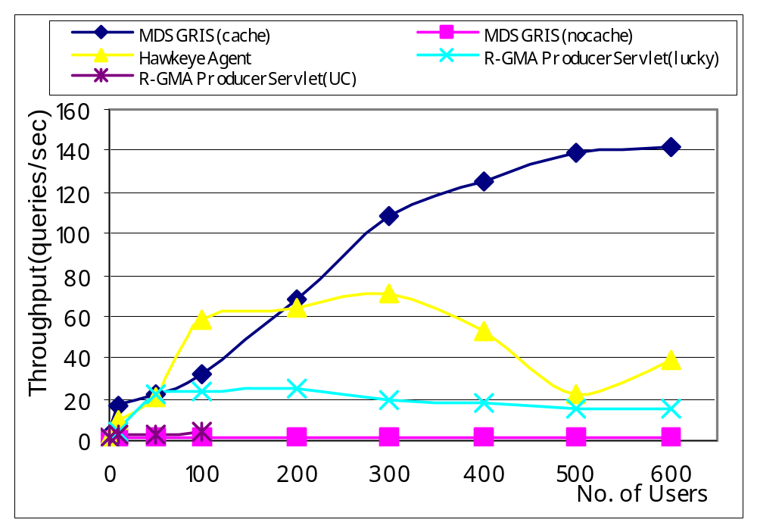
Performance of GIS Information Servers vs. Number of Users
Zhang, Freschl, and Schopf, A Performance Study of Monitoring and Information Services for Distributed Systems, submitted to HPDC 2003.

Slide 40
What we found
Performance can be a matter of deployment
  Effect of background load
  Effect of network bandwidth
Performance can be affected by underlying infrastructure
  LDAP/JAVA strengths and weaknesses
Performance can be improved using standard CS techniques
  Caching; multi-threading; etc.

Slide 41
Moral:
Performance should be analyzed early and often
Prototypes should be recognized as such and thrown out
Without performance, no reason to use a Grid

Slide 42
7. What do we do about variance?
Resources on the Grid change with time
  Bandwidth
  CPU load
  Disk space
  Memory usage
  Queue sizes

Slide 43
Variance – technical problem
How do you tell if something is slow versus broken?
How do you make a prediction?

Slide 44
Variance – socio-political
Users want the same application to take roughly the same amount of time every time you run it
Our experience – a longer running time that’s more predictable is preferred to a high variance, high risk situation

Slide 45
Moral:
Variance is here to live with, we need techniques to take advantage of it

Slide 46
8. How do we set up a Grid testbed?
Bill Johnson, LBNL, talks about this often, based on IPG experience
  Get the sys admins involved
  Have a standard set-up
  Make this a priority at the start of a project
Accounting – open issue
Cross-site scheduling – open issue

Slide 47
Example: Installing Globus
Problem with GT2- how do you know it’s ok?
  Now have test scripts
  http://www-unix.globus.org/toolkit/testing/
  But it would be better to have somethig automatic

Slide 48
Moral:
Users are building testbeds, but this is still hard
Need to have rule of thumb published for assistance with this

Slide 49
9. Socio-political Issues
Hardest problems are often not technical ones
  Multiple administration domains means multiple policies
  Multiple countries means multiple communication styles
  Decisions are often made on non-technical basis

Slide 50
Communication is hard
Too many people in the mix
  Not everyone is informed of status updates
Often hallway conversation becomes what people believe
Too often assumptions are not verified
Many communication styles can lead to misunderstandings

Slide 51
Moral:
Ongoing efforts to continue better communication are needed to build a global community
When in doubt – ask someone of directly!

Slide 52
Overview-FIX
What is a Grid
Information
Security
Performance
Socio-Political
Other issues

Slide 53
10+: Other open problems
Where are the benefits to encourage sharing on the Grid?
Where are the benefits for the sys admins – users get a plus, PIs get a plus but what about them?
How do we educate the funding agencies about the need for hardened software, documentation, and support?
What cost models are needed by the Grid?
  Economic Grids are only the first step

Slide 54
Progress
Significant improvements in security infrastructure
Basic functionality is much closer
More funding aid for support
Need for better-defined use cases and simpler deployment has been strengthened, as has the need for basic information and basic information services
Over 100K downloads of Globus Toolkit v3

Slide 55
Where are the performance metrics for success?
No more “Grid” papers, just a footnote that states “This work was achieved using the Grid”
Supercomputer centers don’t give a user the choice of using their machines or the Grid, that line doesn’t exist
SuperComputing demos can be run at any time of the year

Slide 56
Conclusion
Many interesting problems are left – both in terms of research and deployment issues
Much work is being done to help address these open issues
Next year’s open issues will be very different

Slide 57
References
This talk:
  www.mcs.anl.gov/~jms/Talks (not there yet)
Journal paper version of this talk (dated):
  www.mcs.anl.gov/Pubs/jmspubs.html
Globus:
  www.globus.org
GGF:
  www.ggf.org
Conversations with 25 UK User groups
  http://www.nesc.ac.uk/technical_papers/UKeS-2004-08.pdf

Slide 58
Contact Information
Jennifer M. Schopf
jms@mcs.anl.gov
www.mcs.anl.gov/~jms
Support from DOE, NASA, NSF, IBM, Microsoft

