Slide 1
Proposed Approach for Generation Assumptions for 2015 Reference Case
SSG-WI Technical Support Group Meeting
July 13, 2005
Angela Tanghetti--CEC/Mary Johannis--BPA

Slide 2

Overview of CEC Approach to Forecasting Resources
Study Region – Topology
Assumptions & Forecast Methodology
  Peak and Energy
  Resource Assumptions
  Renewable
  Fossil
  Transmission Assumptions
Notes:
Today I am going to provide a quick overview of the Summer 2005 outlooks for the state, CA ISO Control Area and two geographic regions of the CA ISO.
I will then review our resource assumptions to include outages, transmission congestion and net imports.
Net imports potentially account for about 20% of California’s resource mix. I will discuss what impact dry hydro conditions in the northwest will have on California.
I will conclude by taking care of some accounting issues by explaining why the two regional tables do not add up to the CA ISO table at first glance.

Slide 3
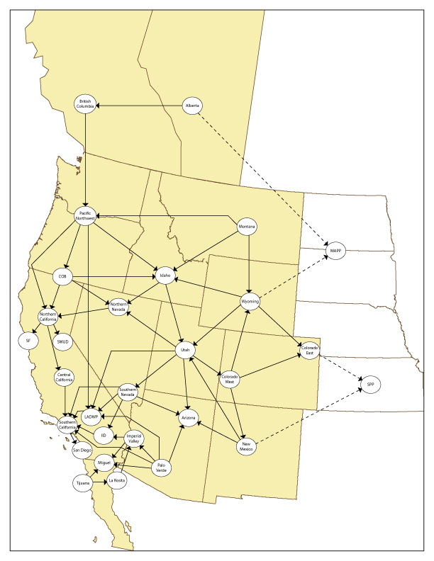
Topology Used To Describe CEC’s Version of the WECC
Notes:
California typically reaches its peak in August
Statewide includes all CA ISO utilities, LADWP, Burbank, Glendale, IID, Far North and East Sierra and the Expanded SMUD Control area (which includes Redding Roseville and WAPA).
1-in-2 resource margins look pretty good on a statewide basis.
1-in-10 resource margins fall below 7% without considering DR programs, but are about where you expect during hot weather conditions.

Slide 4

Assumptions & Forecast Methodology
Peak and Energy Forecasts
California
Forecast is developed by the CEC
Regions Outside California
Purchased from Global Energy Solutions
Source of this purchased forecast is basically publicly available information that has been “scrubbed”
Notes:
CA ISO is also August peaking however little variation from July through early September.
Again, 1-in-2 margins appear adequate and 1-in-10 margins fall below 7% and could result in a CA ISO declaring a Stage 2 emergency.

Slide 5
Assumptions & Forecast Methodology
Resource Assumptions
Make sure you have the existing set of resources correct
Consider RPS and other renewables first
California - 20%by 2010 (assume 20% level sustained through 2016)
Arizona – 1.1% between 2007-2012, 60% solar set aside
Colorado – 3% by 2007, 6% by 2011 and 10% by 2015
Montana – recently passed
Renewables have shorter construction lead time
Notes:
CA ISO is also August peaking however little variation from July through early September.
Again, 1-in-2 margins appear adequate and 1-in-10 margins fall below 7% and could result in a CA ISO declaring a Stage 2 emergency.

Slide 6
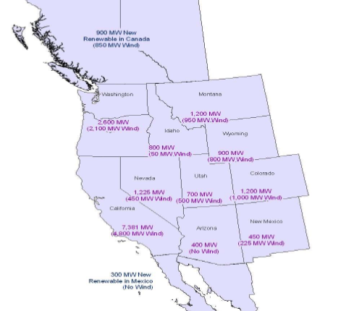
CEC Renewable Assumptions For the WECC

Slide 7
Assumptions & Forecast Methodology
Resource Assumptions
Fossil Resource Additions Prior to 2009
Construction lead times limit what is available to serve load prior to this time period
Rely on CEC Siting Office for resources within California
Rely on trade press, utility IRPs, other state’s energy agencies and regional planning groups
Notes:
CA ISO is also August peaking however little variation from July through early September.
Again, 1-in-2 margins appear adequate and 1-in-10 margins fall below 7% and could result in a CA ISO declaring a Stage 2 emergency.

Slide 8
Assumptions & Forecast Methodology
Resource Assumptions
4. Fossil Resource Additions 2009 and beyond
Balancing the demand forecast with an “appropriate” amount of supply
Post California deregulation the WECC supply scenario appeared most stable during 1999.
Fossil resources added to meet supply after 2009 based on 1999 reserve levels by transmission region
Notes:
CA ISO is also August peaking however little variation from July through early September.
Again, 1-in-2 margins appear adequate and 1-in-10 margins fall below 7% and could result in a CA ISO declaring a Stage 2 emergency.

Slide 9
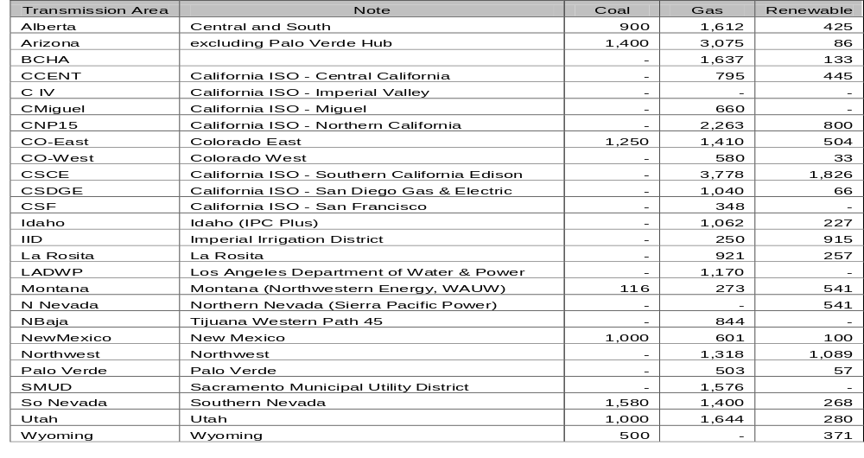
Assumptions & Forecast Methodology
Resource Assumptions
2005-2016 Dependable MWs
CEC Staff Estimate Spring 2005
WECC | 45,468
Renewable | 8,963 | 20%
Gas | 28,759 | 63%
Coal | 7,746 | 17%

Slide 10
2015 Reference Case(s)
CEC Gas Study Incremental Resources between 2008 and 2015 = Starting Point
Convene meetings of State PUCs/ Energy Offices and Sub-regional Planning Groups to make final decision on incremental resources, where located and generation attributes
  Possibly use already scheduled SPG Meetings to make these decisions

Slide 11
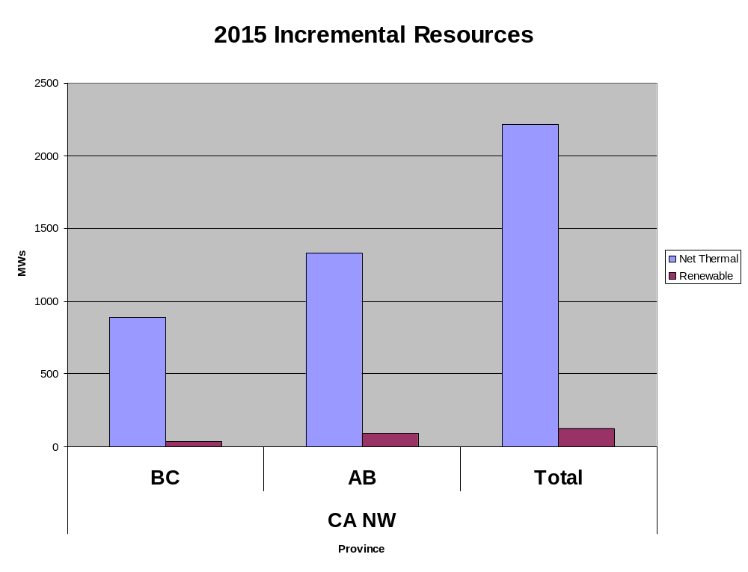

Slide 12
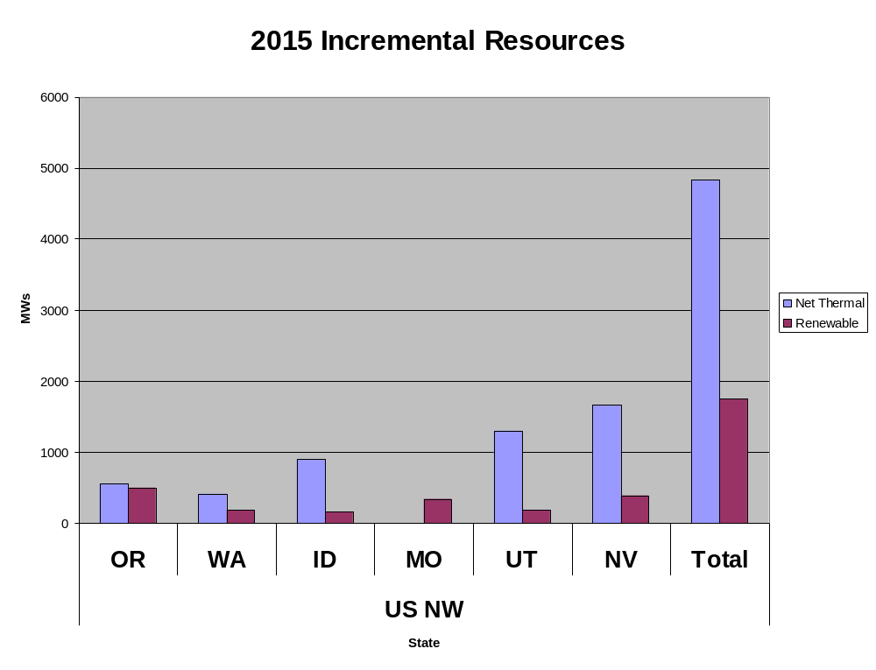

Slide 13
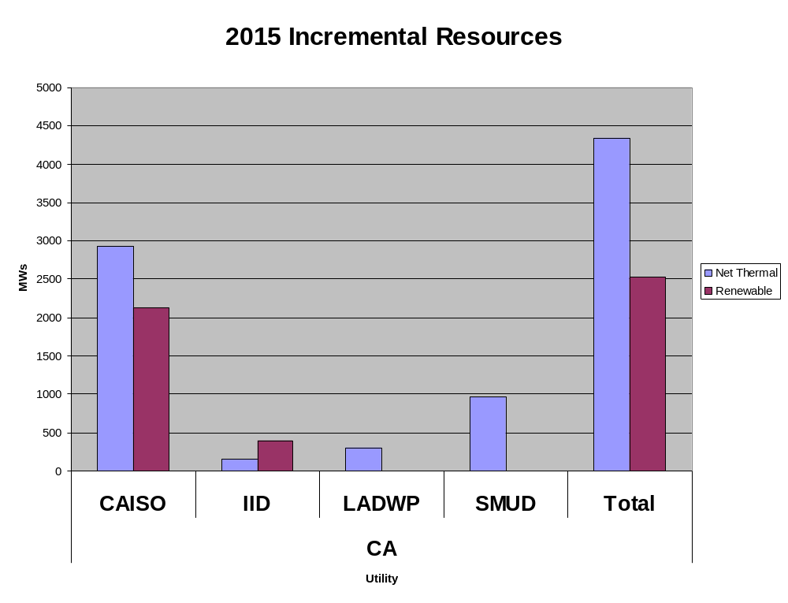

Slide 14
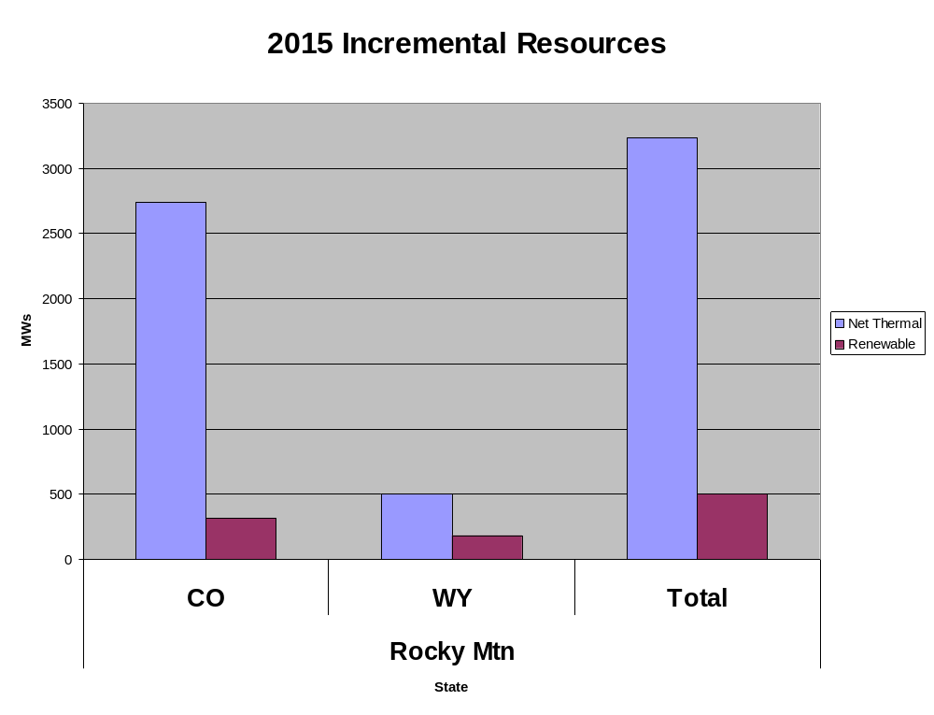

Slide 15
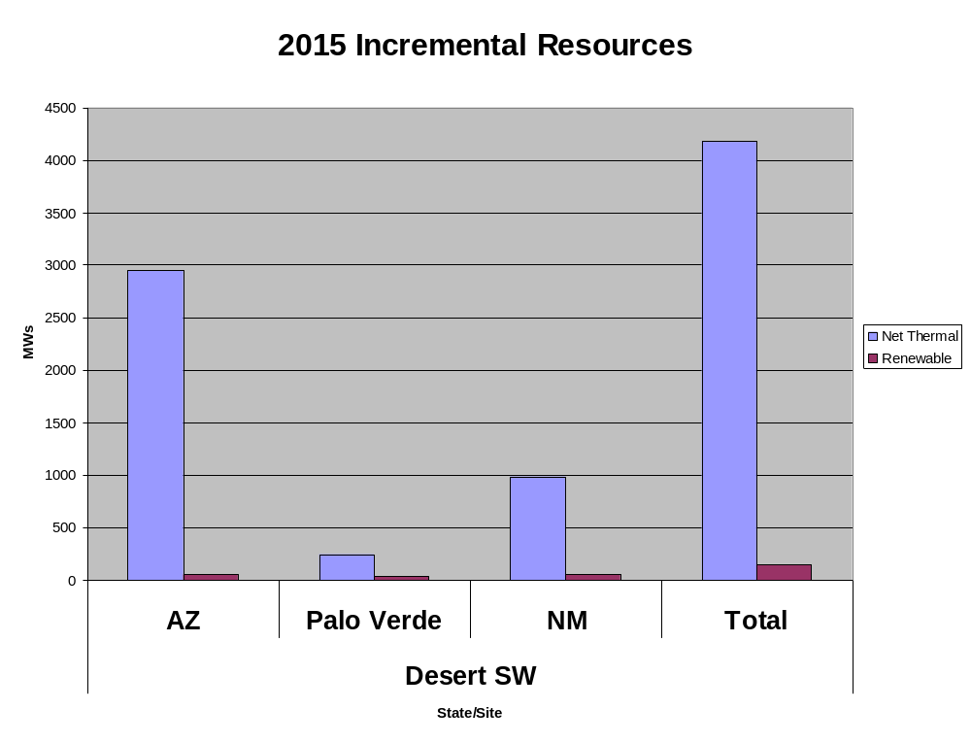

Slide 16
