Slide 1
Titanium: A High Performance Dialect of Java
Kathy Yelick
http://www.cs.berkeley.edu/projects/titanium
U.C. Berkeley
Computer Science Division

Slide 2
Titanium Group
Susan Graham
Katherine Yelick
Paul Hilfinger
Phillip Colella (LBNL)
Alex Aiken
Greg Balls
Peter McQuorquodale (LBNL)
Andrew Begel
Dan Bonachea
David Gay
Arvind Krishnamurthy
Ben Liblit
Carleton Miyamoto
Chang Sun Lin
Geoff Pike
Luigi Semenzato (LBNL)
Siu Man Yau

Slide 3
A Little History
Most parallel programs are written using explicit parallelism, either:
  Message passing with a SPMD model
    Usually for scientific applications with C++/Fortran
    Scales easily
  Shared memory with a thread C or Java
    Usually for non-scientific applications
    Easier to program
Take the best features of both for Titanium
  Builds on ideas in Split-C, AC, and UPC
  Safer language and more sophisticated implementation

Slide 4
Titanium
Take the best features of threads and MPI
  global address space like threads (programming)
  SPMD parallelism like MPI (performance)
  local/global distinction, i.e., layout matters (performance)
Based on Java, a cleaner C++
  classes, automatic memory management
  compiled to C and then assembly (no JVM)
Optimizing compiler
  communication and memory optimizations
  synchronization analysis
  cache and other uniprocessor optimizations

Slide 5
Summary of Features Added to Java
Scalable parallelism:
  SPMD model of execution with global address space
Multidimensional arrays with iterators
Checked Synchronization
Immutable classes
  user-definable non-reference types for performance
Operator overloading
Zone-based memory management
Libraries
  Global communication
  Distributed arrays
  Fast bulk I/O

Slide 6
Lecture Outline
Language and compiler support for uniprocessor performance
  Immutable classes
  Multidimensional Arrays
  foreach
Language support for parallel computation
Applications and application-level libraries
Summary and future directions

Slide 7
Java: A Cleaner C++
Java is an object-oriented language
  classes (no standalone functions) with methods
  inheritance between classes
Documentation on web at java.sun.com
Syntax similar to C++
  class Hello {
  public static void main (String [] argv) {
  System.out.println(“Hello, world!”);
  }
  }
Safe: strongly typed, auto memory management
Titanium is (almost) strict superset

Slide 8
Java Objects
Primitive scalar types: boolean, double, int, etc.
  implementations will store these on the program stack
  access is fast -- comparable to other languages
Objects: user-defined and standard library
  passed by pointer value (object sharing) into functions
  has level of indirection (pointer to) implicit
  simple model, but inefficient for small objects
2.6
3
true
r: 7.1
i: 4.3

Slide 9
Java Object Example
class Complex {
private double real;
private double imag;
public Complex(double r, double i) {
real = r; imag = i; }
public Complex operator+(Complex c) {
return new Complex(c.real + real,
c.imag + imag); }
public double getReal {return real; }
public double getImag {return imag; }
}
Complex c = new Complex(7.1, 4.3);
c = c + c;

Slide 10
Immutable Classes in Titanium
For small objects, would sometimes prefer
  to avoid level of indirection
  pass by value (copying of entire object)
  especially when immutable -- fields never modified
    extends the idea of primitive values to user-defined values
Titanium introduces immutable classes
  all fields are final (implicitly)
  cannot inherit from or be inherited by other classes
  needs to have 0-argument constructor

Slide 11
Example of Immutable Classes
  The immutable complex class nearly the same
  immutable class Complex {
  Complex () {real=0; imag=0; }
  ..…
  }
  Use of immutable complex values
  Complex c1 = new Complex(7.1, 4.3);
  Complex c2 = new Complex(2.5, 9.0);
  c1 = c1 + c2;
  Similar to structs in C in terms of performance
Zero-argument constructor required
new keyword
Rest unchanged. No assignment to fields outside of constructors.

Slide 12
Arrays in Java
Arrays in Java are objects
Only 1D arrays are directly supported
Array bounds are checked
  Safe but potentially slow
Multidimensional arrays as arrays-of-arrays
  General, but slow

Slide 13
Multidimensional Arrays in Titanium
New kind of multidimensional array added
  Subarrays are supported (unlike Java arrays)
  Indexed by Points (tuple of ints)
  Constructed over a set of Points, called Domains
  RectDomains (rectangular domains) are a special case
  Points, Domains, RectDomains are immutable classes
Support for adaptive meshes and other mesh/grid operations
  e.g., can refer to the boundary region of an array

Slide 14
Point, RectDomain, Arrays in General
Points specified by a tuple of ints
RectDomains given by 3 points:
  lower bound, upper bound (and stride)
Array declared by # dimensions and type
Array created by passing RectDomain
Point<2> lb = [1, 1];
Point<2> ub = [10, 20];
RectDomain<2> r = [lb : ub];
double [2d] a;
a = new double [r];

Slide 15
Simple Array Example
Matrix sum in Titanium
Point<2> lb = [1,1];
Point<2> ub = [10,20];
RectDomain<2> r = [lb,ub];
double [2d] a = new double [r];
double [2d] b = new double [1:10,1:20];
double [2d] c = new double [lb:ub:[1,1]];
for (int i = 1; i <= 10; i++)
for (int j = 1; j <= 20; j++)
c[i,j] = a[i,j] + b[i,j];
No array allocation here
Syntactic sugar
Optional stride

Slide 16
Naïve MatMul with Titanium Arrays
public static void matMul(double [2d] a,
double [2d] b, double [2d] c) {
int n = c.domain().max()[1]; // square
for (int i = 0; i < n; i++) {
for (int j = 0; j < n; j++) {
for (int k = 0; k < n; k++) {
c[i,j] += a[i,k] * b[k,j];
}
}
}
}

Slide 17
Array Performance Issues
Array representation is fast, but access methods can be slow, e.g., bounds checking, strides
Compiler optimizes these
  common subexpression elimination
  eliminate (or hoist) bounds checking
  strength reduce: e.g., naïve code has 1 divide per dimension for each array access
Currently +/- 20% of C/Fortran for large loops
Future: small loop and cache optimizations

Slide 18
Unordered iteration
All of these optimizations require loop analysis
Compilers can do this for simple operations, e.g., matrix multiply, but hard in general
Titanium adds unordered iteration on rectangular domains -- gives user more control
foreach (p within r) { ... }
  p is a Point new point within the foreach body
  r is a previously-declared RectDomain

Slide 19
Laplacian Example
Simple example of using arrays and foreach
Domain<2> interior = A.domain().shrink(1);
Point<2> dx = [1,0];
Point<2> dy = [0,1];
foreach (p in interior) {
L[p] = 4*a[p] - a[p+dx] - a[p-dx]
- a[p+dy] - a[p-dy];
}

Slide 20
Better MatMul with Titanium Arrays
public static void matMul(double [2d] a,
double [2d] b, double [2d] c) {
foreach (ij within c.domain()) {
double [1d] aRowi = a.slice(1, ij[1]);
double [1d] bColj = b.slice(2, ij[2]);
foreach (k within aRowi.domain()) {
c[ij] += aRowi[k] * bColj[k];
}
}
}
Current performance: comparable to 3 nested loops in C

Slide 21
Sequential Performance
Ultrasparc:
C/C++/
FORTRAN
Java
Arrays
Titanium
Arrays
Overhead
DAXPY
1.4s
6.8s
1.5s
7%
3D multigrid
12s
22s
83%
2D multigrid
5.4s
6.2s
15%
MatMul
1.8s
2.2s
22%
Pentium II:
C/C++/
FORTRAN
Java
Arrays
Titanium
Arrays
Overhead
DAXPY
1.8s
2.3s
27%
3D multigrid
23.0s
20.0s
-13%
2D multigrid
7.3s
5.5s
-25%
Compares to naïve C code; neither compiler does cache blocking (yet).

Slide 22
Lecture Outline
Language and compiler support for uniprocessor performance
Language support for parallel computation
  SPMD execution
  Barriers and single
  Explicit Communication
  Implicit Communication (global and local references)
  More on Single
  Synchronized methods and blocks (as in Java)
Applications and application-level libraries
Summary and future directions

Slide 23
SPMD Execution Model
Java programs can be run as Titanium, but the result will be that all processors do all the work
E.g., parallel hello world
class HelloWorld {
public static void main (String [] argv) {
System.out.println(‘’Hello from proc ‘’ +
Ti.thisProc());
}
}
Any non-trivial program will have communication and synchronization

Slide 24
SPMD Execution Model
A common style is compute/communicate
E.g., in each timestep within particle simulation with gravitation attraction
read all particles and compute forces on mine
Ti.barrier();
write to my particles using new forces
Ti.barrier();

Slide 25
SPMD Model
All processor start together and execute same code, but not in lock-step
Basic control done using
  Ti.numProcs() total number of processors
  Ti.thisProc() number of executing processor
Sometimes they take different branches
if (Ti.thisProc() == 0) { ….. do setup ..… }
System.out.println(‘’Hello from ‘’ + Ti.thisProc());
double [1d] a = new double [Ti.numProcs()];

Slide 26
Barriers and Single
Common source of bugs is barriers or other global operations inside branches or loops
  barrier, broadcast, reduction, exchange
A “single” method is one called by all procs
  public single static void allStep(..…)
A “single” variable has same value on all procs
  int single timestep = 0;
Single annotation on methods (also called “sglobal”) is optional, but useful to understanding compiler messages.

Slide 27
Explicit Communication: Broadcast
Broadcast is a one-to-all communication
broadcast <value> from <processor>
For example:
int count = 0;
int allCount = 0;
if (Ti.thisProc() == 0) count = computeCount();
allCount = broadcast count from 0;
The processor number in the broadcast must be single; all constants are single.
The allCount variable could be declared single.

Slide 28
Example of Data Input
Same example, but reading from keyboard
Shows use of Java exceptions
int single count = 0;
int allCount = 0;
if (Ti.thisProc() == 0)
try {
DataInputStream kb = new DataInputStream(System.in);
myCount = Integer.valueOf(kb.readLine()).intValue();
} catch (Exception e) {
System.err.println(``Illegal Input’’);
allCount = myCount from 0;

Slide 29
Explicit Communication: Exchange
To create shared data structures
  each processor builds its own piece
  pieces are exchanged (for object, just exchange pointers)
Exchange primitive in Titanium
int [1d] single allData;
allData = new int [0:Ti.numProcs()-1];
allData.exchange(Ti.thisProc()*2);
E.g., on 4 procs, each will have copy of allData:
0
2
4
6

Slide 30
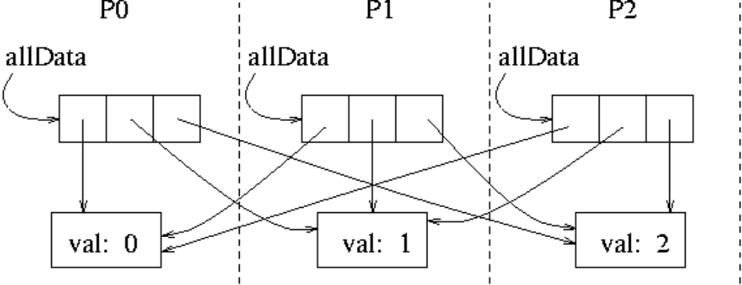
Exchange on Objects
More interesting example:
class Boxed {
public Boxed (int j) {
val = j;
}
public in val;
}
Object [1d] single allData;
allData = new Object [0:Ti.numProcs()-1];
allData.exchange(new Boxed(Ti.thisProc());

Slide 31
Distributed Data Structures
Build distributed data structures with arrays:
RectDomain <1> single allProcs = [0:Ti.numProcs-1];
RectDomain <1> myParticleDomain = [0:myPartCount-1];
Particle [1d] single [1d] allParticle =
new Particle [allProcs][1d];
Particle [1d] myParticle =
new Particle [myParticleDomain];
allParticle.exchange(myParticle);
Now each processor has array of pointers, one to each processor’s chunk of particles

Slide 32
More on Single
Global synchronization needs to be controlled
  if (this processor owns some data) {
  compute on it
  barrier
  }
Hence the use of “single” variables in Titanium
If a conditional or loop block contains a barrier, all processors must execute it
  conditions in such loops, if statements, etc. must contain only single variables

Slide 33
Single Variable Example
Barriers and single in N-body Simulation
class ParticleSim {
public static void main (String [] argv) {
int single allTimestep = 0;
int single allEndTime = 100;
for (; allTimestep < allEndTime; allTimestep++){
read all particles and compute forces on mine
Ti.barrier();
write to my particles using new forces
Ti.barrier();
}
}
}
Single methods inferred; see David Gay’s work

Slide 34
Use of Global / Local
As seen, references (pointers) may be remote
  easy to port shared-memory programs
Global pointers are more expensive than local
  True even when data is on the same processor
  Use local declarations in critical sections
Costs of global:
  space (processor number + memory address)
  dereference time (check to see if local)
May declare references as local

Slide 35
Global Address Space
Processes allocate locally
References can be passed to other processes
Other processes
Process 0
lv
lv
LOCAL HEAP
LOCAL HEAP
gv
gv
Class C { int val;.. }
C gv; // global pointer
C local lv; // local pointer
if (thisProc() == 0) {
lv = new C();
}
gv = broadcast lv from 0;
gv.val = ..; // full
.. = gv.val; // functionality
lv
lv
gv
gv
lv
lv
gv
gv

Slide 36
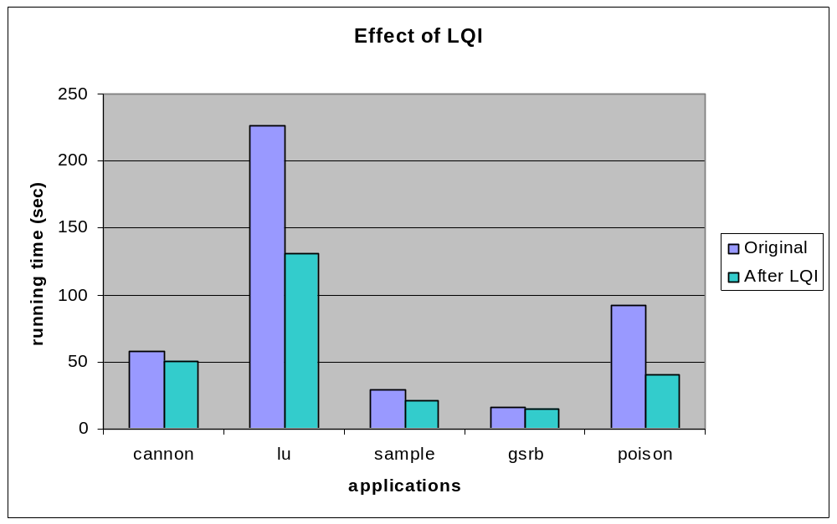
Local Pointer Analysis
Compiler can infer many uses of local
  See Liblit’s work on Local Qualification Inference
Data structures must be well partitioned

Slide 37
Region-Based Memory Management
PrivateRegion r = new PrivateRegion();
For (int j = 0; j < 10; j++) {
int[] x = new ( r ) int[j + 1];
work(j, x);
}
try { r.delete; }
catch (RegionInUse oops) {
system.out.println(“failed to delete”);
}
}

Slide 38
Lecture Outline
Language and compiler support for uniprocessor performance
Language support for parallel computation
Applications and application-level libraries
  AMR overview
  AMR and uniform grid algorithms in Titanium
  Several smaller benchmarks
    MatMul, LU, FFT, Join, Sort, EM3d
  Library interfaces
    PETSc, Metis,
Summary and future directions

Slide 39
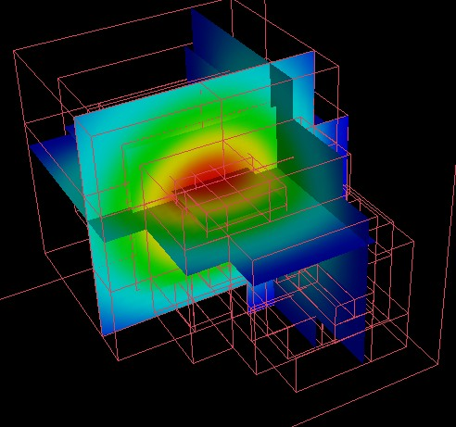
Block-Structured AMR
Algorithms for many rectangular, grid-based computations are
  communication intensive
  memory intensive
AMR makes these harder
  more small messages
  more complex data structures
  most of the programming effort is debugging the boundary cases
  locality and load balance trade-off is hard

Slide 40
Algorithms for AMR
Existing algorithms in Titanium
  3D AMR Poisson solver
  3D AMR Gas dynamics
  Domain-decomposition MLC Poisson
Under development
  Self-gravitating gas dynamics (3D AMR)
    For stellar collapse, etc.
  Immersed boundary method (3D, non-adaptive)
    Peskin and MacQueen’s method for heart model, etc.
  Embedded boundaries
    Simulation of bio-MEMs devices and cellular level modeling
  Project Idea:
    Multiblock Java code with self-scheduling. Contact me, yelick@cs.
    Evaluation of and proposal for general domains.
All joint with Colella’s group at LBNL

Slide 41
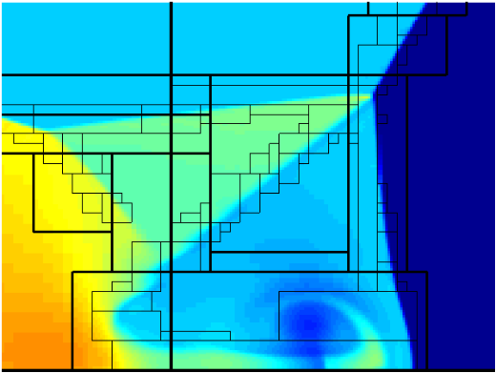
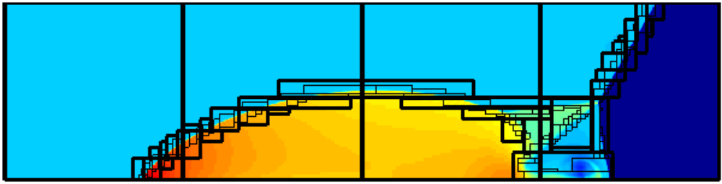
3D AMR Gas Dynamics
Hyperbolic Solver [McCorquodale and Colella]
  Implementation of Berger-Colella algorithm
  Mesh generation algorithm included
2D Example (3D supported)
  Mach-10 shock on solid surface at oblique angle
Future: Self-gravitating gas dynamics package

Slide 42
3D AMR Poisson
Poisson Solver [Semenzato, Pike, Colella]
  finite domain
  variable coefficients
  multigrid across levels
Currently synthetic grids, no grid generation
Under construction
  reengineered to interface with hyperbolic solver
  including mesh generation
Level 2
Level 1
Level 0

Slide 43
MLC for Finite-Differences
Poisson solver with infinite domains [Colella, Balls]
  Uses a Method of Local Corrections (MLC)
  Currently non-adaptive and 2D
  Supports only constant coefficients
Uses 2-level, domain decomposition approach
  Fine-grid solutions are computed in parallel
  Information transferred to a coarse-grid and solved serially
  Fine-grid solutions is computed using boundary conditions from the coarse grid
Future work includes 3D Adaptive version

Slide 44
MLC for Finite-Differences
Features of the method
  Solution is still second-order accurate
  Accuracy depends only weakly on the coarse-grid spacing
Scalability
  No communication during fine-grid solves
  Single communication step (global all-to-all)
  coarse grid work is serial (replicated), but relatively small
Future work: extend to 3D and adaptive meshes
  Project idea: extension to 3D: see Greg Balls, gballs@cs

Slide 45
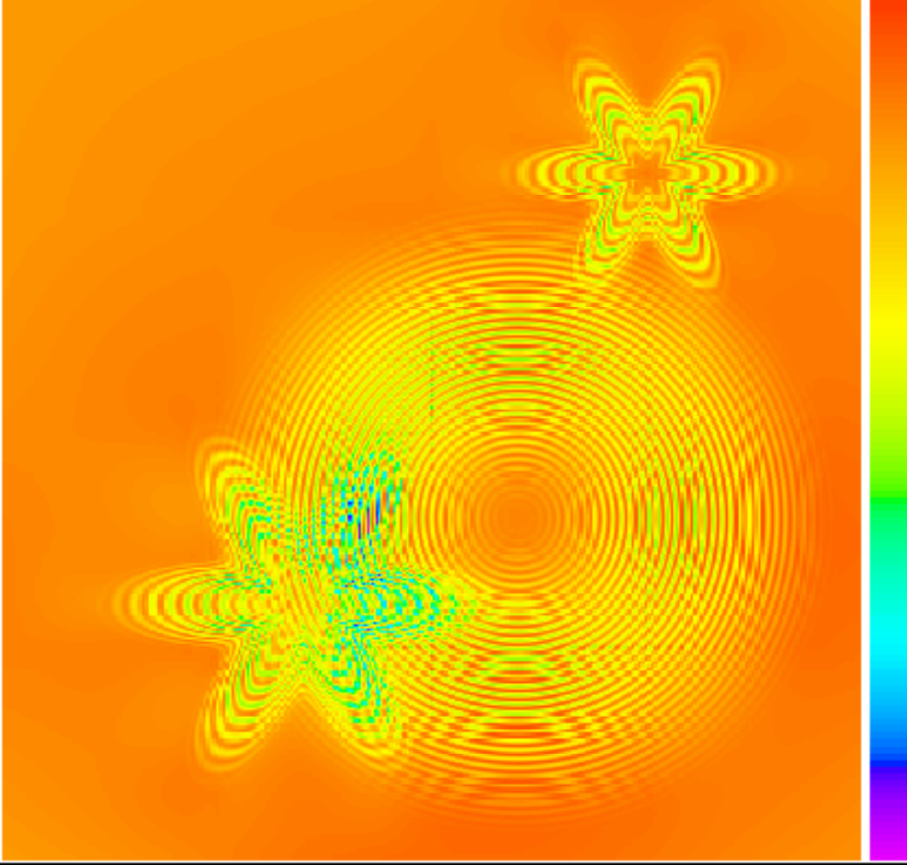
Error on High-Wavenumber Problem
Charge is
  1 charge of concentric waves
  2 star-shaped charges.
Largest error is where the charge is changing rapidly. Note:
  discretization error
  faint decomposition error
Run on 16 procs
-6.47x10⁻⁹ 0 1.31x10⁻⁹
Notes:
This was solved on sixteen processors.
Zero is around light orange.
The charge distribution for this problem is a combination of several high-wavenumber charges: one large radially symmetric charge of concentric waves and two star-shaped charges.
The error is largest where the charge is changing rapidly, as we would expect. It is possible to detect faint lines where the pieces are joined together, but the important point is that those errors induced by the domain decomposition are very small compared to the other errors.

Slide 46
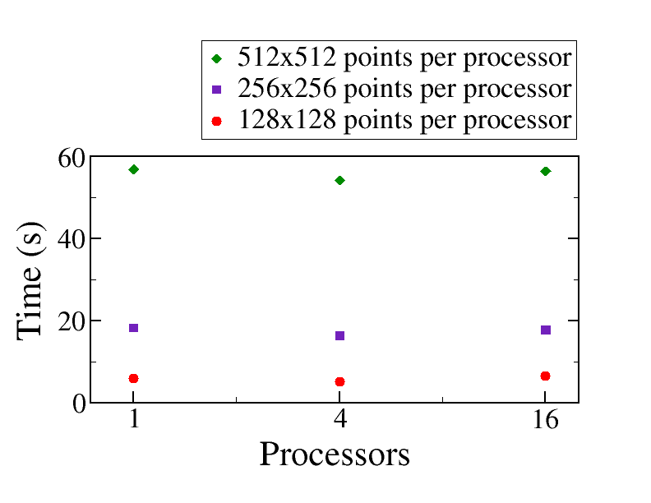
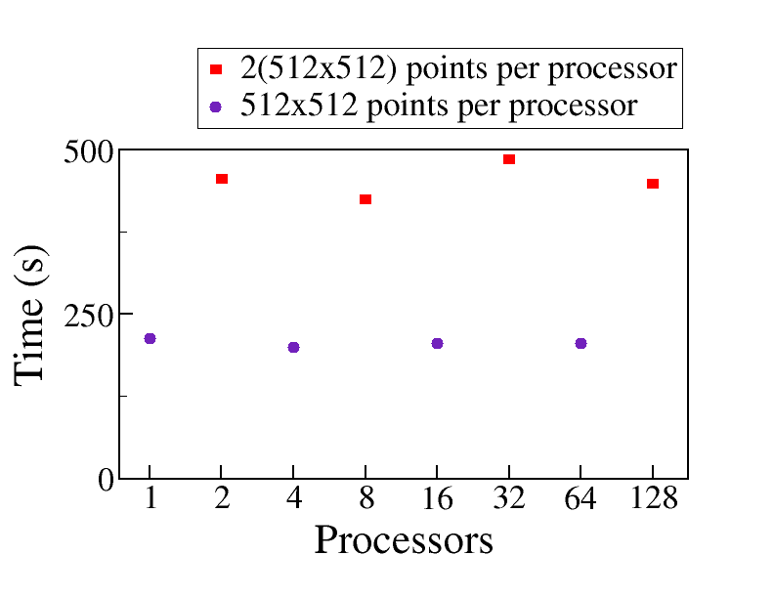
Scalable Poisson Solver (MLC)
Communication performance is low (< 5%)
Scaled speedup experiments are nearly ideal (flat)
IBM SP2 at SDSC Cray t3e at NERSC

Slide 47
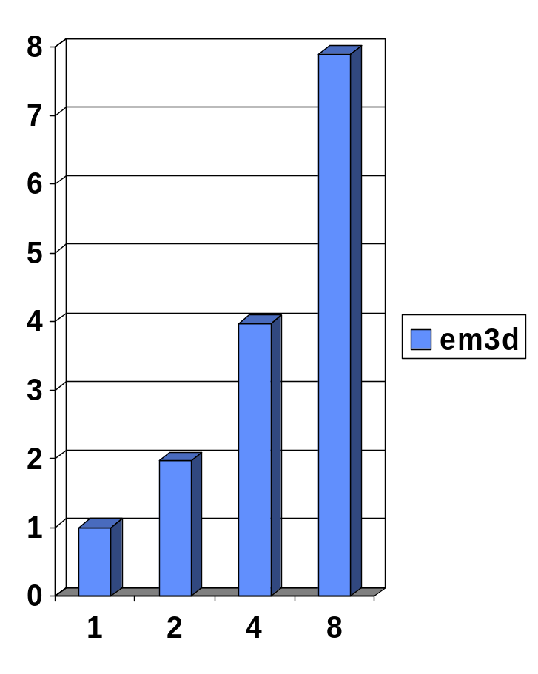
Unstructured Mesh Kernel
EM3D: Relaxation on a 3D unstructured mesh
Speedup on Ultrasparc SMP
Simple kernel: mesh not partitioned.

Slide 48
Calling Other Languages
We have built interfaces to
  PETSc : scientific library for finite element applications
  Metis: graph partitioning library
Two issues with cross-language calls
  accessing Titanium data structures (arrays) from C
    possible because Titanium arrays have same format on inside
  having a common message layer
    Titanium is built on lightweight communication

Slide 49
Lecture Outline
Language and compiler support for uniprocessor performance
Language support for parallel computation
Applications and application-level libraries
Summary and future directions
  Implementation

Slide 50
Implementation
Strategy
  Titanium into C
  Solaris or Posix threads for SMPs
  Lightweight communication for MPPs/Clusters
Status: Titanium runs on
  Solaris or Linux SMPs and uniprocessors
  Berkeley NOW
  SDSC Tera, SP2, T3E (NERSC and NPACI)
  SP3 (and IBM SP Power3) port underway

Slide 51
Titanium Summary
Performance
  close to C/FORTRAN + MPI on limited class of problems
Portability
  develop on uniprocessor, then SMP, then MPP/Cluster
Safety
  as safe as Java, extended to parallel framework
Expressiveness
  easier than MPI, harder than threads
Compatibility, interoperability, etc.
  no gratuitous departures from Java standard

Slide 52
Using Titanium
On machines in the CS Division
  /srs/titanium/*/bin/tcbuild file.ti
  Solaris 2.6 and Linux supported; need to mount this filesystem
On NERSC t3e use:
/u/mp215/miyamoto/tc-1.44/tcbuild/tcbuild file.ti
On SP2 contact: cjlin@cs.berkeley.edu
For documentation, source code, see the home page
  http://www.cs.berkeley.edu/projects/titanium
Documentation includes
  Language reference, terse but complete
  Tutorial, incomplete
For problems or questions:
titanium-group@cs.berkeley.edu

Slide 53
Future Plans
Improved compiler optimizations for scalar code
  large loops are currently +/- 20% of Fortran
  working on small loop performance
Packaged solvers written in Titanium
  Elliptic and hyperbolic solvers, both regular and adaptive
New application collaboration
  Peskin and McQueen (NYU) with Colella (LBNL)
  Immersed boundary method, currently use for heart simulation, platelet coagulation, and others

Slide 54
Backup Slides

Slide 55
Other Language Extensions
Java extensions for expressiveness & performance
Operator overloading
Zone-based memory management
Foreign function interface
The following is not yet implemented in the compiler
Parameterized types (aka templates)

Slide 56
Consistency Model
Titanium adopts the Java memory consistency model
Roughly: Access to shared variables that are not synchronized have undefined behavior.
Use synchronization to control access to shared variables.
  barriers
  synchronized methods and blocks

