Slide 1
Global Address Space Languages
Kathy Yelick
http://titanium.cs.berkeley.edu/
http://upc.nersc.gov
U.C. Berkeley
Computer Science Division

Slide 2
Titanium Group (Past and Present)
Susan Graham
Katherine Yelick
Paul Hilfinger
Phillip Colella (LBNL)
Alex Aiken
Greg Balls
Andrew Begel
Dan Bonachea
Kaushik Datta
David Gay
Arvind Krishnamurthy
Ben Liblit
Peter McQuorquodale (LBNL)
Sabrina Merchant
Carleton Miyamoto
Chang Sun Lin
Geoff Pike
Luigi Semenzato (LBNL)
Jimmy Su
Tong Wen (LBNL)
Siu Man Yau
(and many undergrad researchers)
Notes:
My background in compiler analysis & optimizations and runtime systems support and networking
We've had cooperation from scientific computing experts at LBL during language design & refinement

Slide 3
UPC Group
Kathy Yelick
Christian Bell
Dan Bonachea
Wei Chen
Yannick Cote
Jason Duell
Paul Hargrove,
Parry Husbands
Costin Iancu
Mike Welcome
Yannick Cote

Slide 4
A Little History
Most parallel programs are written using explicit parallelism, either:
  Message passing with a SPMD model
    Usually for scientific applications with C++/Fortran
    Scales easily
  Shared memory with threads C or Java
    Usually for non-scientific applications
    Easier to program, but usually provide less scalable performance
Global Address Space Languages take the best of both
  global address space like threads (programming)
  SPMD parallelism like MPI (performance)
  local/global distinction, i.e., layout matters (performance)

Slide 5
Unified Parallel C (UPC)
UPC compilers
  IDA: t3e implementation based on old gcc
  NERSC: Open64 implementation + generic runtime
  GMU (documentation) and UMD (benchmarking)
  Compaq/HP (Alpha cluster)
  MTU (based on Compaq compiler, but C+MPI)
  Cray, Sun, and HP (implementations)
  Intrepid (SGI compiler and t3e compiler)

Slide 6
Titanium
Take the best features of threads and MPI
Based on Java, a cleaner C++
  classes, automatic memory management, etc.
  compiled to C and then native binary (no JVM)
Optimizing compiler
  static (compile-time) optimizer, not a JIT
  communication and memory optimizations
  synchronization analysis (e.g. static barrier analysis)
  cache and other uniprocessor optimizations
Notes:
Java is already being used for scientific computing.
Personal experience with development (research vehicle)
The Titanium project seeks to improve Java, making a better language for scientific computing on parallel machines.

Slide 7
Summary of Features Added to Java
Scalable parallelism:
  SPMD model of execution with global address space
Multidimensional arrays with language-level iterators
Checked Synchronization
  Statically prevent barrier deadlocks
Immutable classes
  user-definable non-reference types for performance
Operator overloading
Templates
Zone-based memory management (regions)
Libraries
  Useful collective communication primitives
  Distributed arrays & scientific kernels
  Fast bulk I/O
Support a large variety of parallel architectures
  Shared-memory, distributed-memory and hierarchical architectures

Slide 8
Lecture Outline
Language and compiler support for uniprocessor performance
  Immutable classes
  Operator overloading
  Templates (parameterized types)
  Multidimensional Arrays
  Unordered iteration
Language support for parallel computation
Applications and application-level libraries
Summary and future directions

Slide 9
Java: A Cleaner C++
Java is an object-oriented language
  classes (no standalone functions) with methods
  inheritance between classes
Documentation on web at java.sun.com
Syntax similar to C++
  public class Hello {
  public static void main (String [] argv) {
  System.out.println("Hello, world!");
  }
  }
Safe: strongly typed, auto memory management
Titanium is (almost) strict superset
Notes:
Java 1.0

Slide 10
Traditional Java Objects
Primitive scalar types: boolean, double, int, etc.
  implementations will store these on the program stack
  access is fast -- comparable to other languages
Objects: user-defined and standard library
  passed by pointer value (object sharing) into functions
  has level of indirection (pointer to) implicit
  simple model, but inefficient for small objects
2.6
3
true
(bookkeeping info)
r: 7.1
i: 4.3
Notes:
Review of how boxed Objects work in Java
The only language feature useful for building abstractions - Used ubiquitously throughout Java applications & libraries
Bad for sequential performance – Why?
memory overhead, gc churn, indirection performance cost, aliasing difficulties, dynamic dispatch

Slide 11
Java Object Example
class Complex {
private double real;
private double imag;
public Complex(double r, double i) {
real = r; imag = i; }
public Complex add(Complex c) {
return new Complex(c.real + real, c.imag + imag);
public double getReal {return real; }
public double getImag {return imag;}
}
Complex c = new Complex(7.1, 4.3);
c = c.add(c);
class VisComplex extends Complex { ... }

Slide 12
Immutable Classes in Titanium
For small objects, would sometimes prefer
  to avoid level of indirection
  pass by value (copying of entire object)
  especially when immutable -- fields never modified
    extends the idea of primitive values to user-defined values
Titanium introduces immutable classes
  also known as "value classes" in the PL literature
  all fields are final (implicitly)
  cannot inherit from or be inherited by other classes
  needs to have 0-argument constructor
Note: considering extension to allow mutation
Notes:
No inheritance => no polymorphism => static dispatch
No aliasing problems – more aggressive optimizations

Slide 13
Example of Immutable Classes
  The immutable complex class nearly the same
  immutable class Complex {
  Complex () {real=0; imag=0; }
  ...
  }
  Use of immutable complex values
  Complex c1 = new Complex(7.1, 4.3);
  Complex c2 = new Complex(2.5, 9.0);
  c1 = c1.add(c2);
  Similar to structs in C in terms of performance
Zero-argument constructor required
new keyword
Rest unchanged. No assignment to fields outside of constructors.

Slide 14
Example of Operator Overloading
  Titanium allows a more intuitive definition of the sum() method using operator overloading
    Very similar to operator overloading in C++
    (Standard Java lacks operator overloading)
  public Complex operator+(Complex c) {
return new Complex(c.real + real, c.imag + imag);
  }
  Use of operator overloading
  Complex c1 = new Complex(7.1, 4.3);
  Complex c2 = new Complex(2.5, 9.0);
  c1 = c1 + c2;
Same meaning,
more intuitive syntax

Slide 15
Templates
Many applications use containers:
  E.g., arrays parameterized by dimensions, element types
  Java supports this kind of parameterization through inheritance
    Only put Object types into containers
    Inefficient when used extensively
Titanium provides a template mechanism like C++
  Used to build a distributed array package
  Hides the details of exchange, indirection within the data structure, etc.

Slide 16
Example of Templates
  template <class Element> class Cons {
  public final Element head;
  public final Cons tail;
  public Cons( Element head, Cons tail ) {...}
  }
  template <class Element> class Stack {
  private template Cons< Element > data;
  public boolean empty() {...}
  public Element pop() {...}
  public void push( Element arrival ) {...}
  }
  template Stack<int> list = new template Stack<int>();
  list.push( 1 );
  int x = list.pop();
Strongly typed,
No dynamic cast

Slide 17
Arrays in Java
Arrays in Java are objects
Only 1D arrays are directly supported
Array bounds are checked
  Safe but potentially slow
Multidimensional arrays as arrays-of-arrays
  General, but slow
Subarrays are important in AMR (e.g., interior of a grid)
  Even C and C++ don’t support these well
  Hand-coding (array libraries) can confuse optimizer
Notes:
Multi-D slow because of:
indexing requires several lookups
potential row aliasing kills optimizations – hard to analyze effectively

Slide 18
Multidimensional Arrays in Titanium
New kind of multidimensional array added
  Subarrays are supported (unlike Java arrays)
  Indexed by Points (tuple of ints)
  Constructed over a set of Points, called Domains
  RectDomains (rectangular domains) are a special case
  Points, Domains, RectDomains are immutable classes
Support for adaptive meshes and other mesh/grid operations
  e.g., can refer to the boundary region of an array
Notes:
Sophisticated operations for taking subarrays (e.g. just the interior points in a grid)

Slide 19
Point, RectDomain, Arrays in General
Points specified by a tuple of ints
RectDomains given by 3 points:
  lower bound, upper bound (and stride)
Array declared by # dimensions and type
Array created by passing RectDomain
Point<2> lb = [1, 1];
Point<2> ub = [10, 20];
RectDomain<2> r = [lb : ub];
double [2d] a;
a = new double [r];

Slide 20
Simple Array Example
Matrix sum in Titanium
Point<2> lb = [1,1];
Point<2> ub = [10,20];
RectDomain<2> r = [lb,ub];
double [2d] a = new double [r];
double [2d] b = new double [1:10,1:20];
double [2d] c = new double [lb:ub:[1,1]];
for (int i = 1; i <= 10; i++)
for (int j = 1; j <= 20; j++)
c[i,j] = a[i,j] + b[i,j];
No array allocation here
Syntactic sugar
Optional stride

Slide 21
Naïve MatMul with Titanium Arrays
public static void matMul(double [2d] a,
double [2d] b, double [2d] c) {
int n = c.domain().max()[1]; // square
for (int i = 0; i < n; i++) {
for (int j = 0; j < n; j++) {
for (int k = 0; k < n; k++) {
c[i,j] += a[i,k] * b[k,j];
}
}
}
}
Notes:
For illustration purposes – will show a better version shortly

Slide 22
Array Performance Issues
Array representation is fast, but access methods can be slow, e.g., bounds checking, strides
Compiler optimizes these
  common subexpression elimination
  eliminate (or hoist) bounds checking
  sophisticated strength reduction: e.g., naïve code has 1 divide per dimension for each array access
Currently +/- 20% of C/Fortran for large loops
Future: small loop and cache optimizations
Notes:
Geoff working on memory tiliing optimizations

Slide 23
Unordered iteration
All of these optimizations require loop analysis
Compilers can do this for simple operations, e.g., matrix multiply, but hard in general
Titanium adds unordered iteration on rectangular domains -- gives user more control
foreach (p within r) { ... }
  p is a new Point within the foreach body
  r is a previously-declared RectDomain (often the domain of some Titanium array)
Notes:
Not a data parallel contruct

Slide 24
Laplacian Example
Simple example of using arrays and foreach
Domain<2> interior = A.domain().shrink(1);
Point<2> dx = [1,0];
Point<2> dy = [0,1];
foreach (p in interior) {
L[p] = 4*a[p] - a[p+dx] - a[p-dx]
- a[p+dy] - a[p-dy];
}

Slide 25
Better MatMul with Titanium Arrays
public static void matMul(double [2d] a,
double [2d] b, double [2d] c) {
foreach (ij within c.domain()) {
double [1d] aRowi = a.slice(1, ij[1]);
double [1d] bColj = b.slice(2, ij[2]);
foreach (k within aRowi.domain()) {
c[ij] += aRowi[k] * bColj[k];
}
}
}
Current performance: comparable to 3 nested loops in C

Slide 26
SciMark Benchmark
Numerical benchmark for Java, C/C++
Five kernels:
  FFT (complex, 1D)
  Successive Over-Relaxation (SOR)
  Monte Carlo integration (MC)
  Sparse matrix multiply
  dense LU factorization
Results are reported in Mflops
Download and run on your machine from:
  http://math.nist.gov/scimark2
  C and Java sources also provided
Notes:
100% Pure Java / ANSI C
SOR- nearest neighbor relaxation on a mesh (2-D) w/ red-black ordering

Slide 27
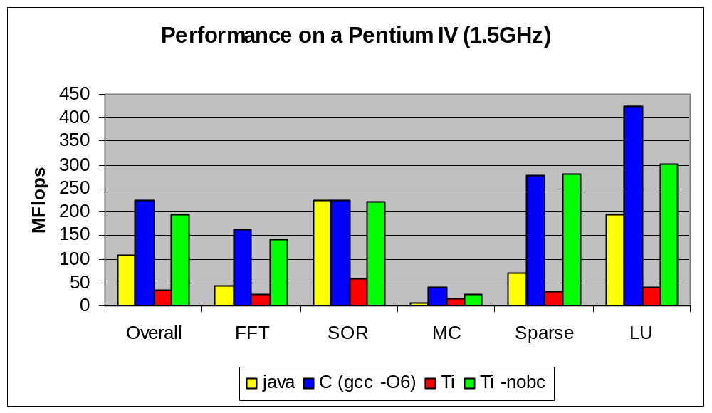
Java Compiled by Titanium Compiler
Note the Ti/Java numbers use (slow) Java arrays, not Titanium arrays
Ti -nobc is with bounds-checking disabled

Slide 28
Lecture Outline
Language and compiler support for uniprocessor performance
Language support for parallel computation
  SPMD execution
  Barriers and single
  Explicit Communication
  Implicit Communication (global and local references)
  More on Single
  Synchronized methods and blocks (as in Java)
Applications and application-level libraries
Summary and future directions

Slide 29
SPMD Execution Model
Java programs can be run as Titanium, but the result will be that all processors do all the work
E.g., parallel hello world
class HelloWorld {
public static void main (String [] argv) {
System.out.println("Hello from proc " +
Ti.thisProc());
}
}
Any non-trivial program will have communication and synchronization
Notes:
Define SPMD CONTROL model

Slide 30
SPMD Execution Model
A common style is compute/communicate
E.g., in each timestep within particle simulation with gravitation attraction
read all particles and compute forces on mine
Ti.barrier();
write to my particles using new forces
Ti.barrier();
This is neither message passing nor data-parallel

Slide 31
SPMD Model
All processor start together and execute same code, but not in lock-step
Basic control done using
  Ti.numProcs() total number of processors
  Ti.thisProc() number of executing processor
Sometimes they take different branches
if (Ti.thisProc() == 0) { /*.. do setup ..*/ }
System.out.println("Hello from " + Ti.thisProc());
double [1d] a = new double [Ti.numProcs()];

Slide 32
Barriers and Single
Common source of bugs is barriers or other global operations inside branches or loops
  barrier, broadcast, reduction, exchange
A “single” method is one called by all procs
  public single static void allStep(...)
A “single” variable has same value on all procs
  int single timestep = 0;
Single annotation on methods (also called “sglobal”) is optional, but useful to understanding compiler messages.
Notes:
Single methods - Called by all procs "at the same time"
Single variables – same value on all procs, changes in value happen everywhere "at the same time"
"at the same time" basically means in a total ordering relative to other global operations
Given a few small annotations reflecting program structure, compiler enforces these constraints

Slide 33
Explicit Communication: Broadcast
Broadcast is a one-to-all communication
broadcast <value> from <processor>
For example:
int count = 0;
int allCount = 0;
if (Ti.thisProc() == 0) count = computeCount();
allCount = broadcast count from 0;
The processor number in the broadcast must be single (trivially satisfied for constants like 0)
The allCount variable could be declared single.

Slide 34
Example of Data Input
Same example, but reading from keyboard
Shows use of Java exceptions
int myCount = 0;
int single allCount = 0;
if (Ti.thisProc() == 0)
try {
DataInputStream kb = new DataInputStream(System.in);
myCount = Integer.valueOf(kb.readLine()).intValue();
} catch (Exception e) {
System.err.println("Illegal Input");
}
allCount = broadcast myCount from 0;

Slide 35
Explicit Communication: Exchange
To create shared data structures
  each processor builds its own piece
  pieces are exchanged (for objects, just exchange pointers)
Exchange primitive in Titanium
int [1d] single allData;
allData = new int [0:Ti.numProcs()-1];
allData.exchange(Ti.thisProc()*2);
E.g., on 4 procs, each will have copy of allData:
0
2
4
6

Slide 36
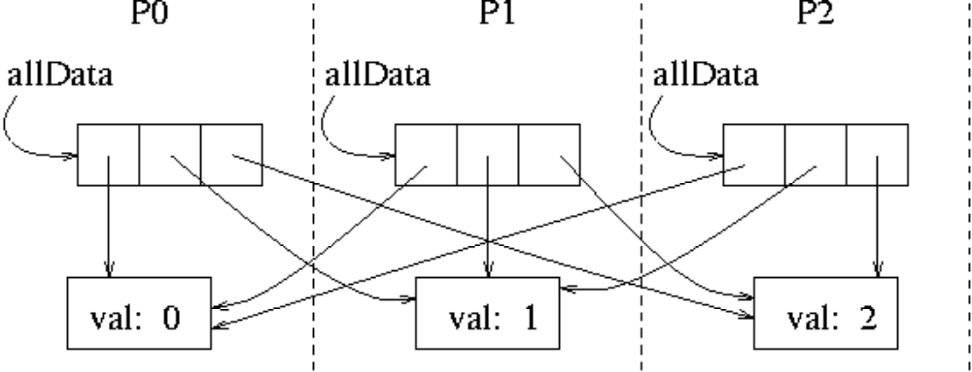
Exchange on Objects
More interesting example:
class Boxed {
public Boxed (int j) {
val = j;
}
public int val;
}
Object [1d] single allData;
allData = new Object [0:Ti.numProcs()-1];
allData.exchange(new Boxed(Ti.thisProc());

Slide 37
Distributed Data Structures
Building distributed arrays:
Particle [1d] single [1d] allParticle =
new Particle [0:Ti.numProcs-1][1d];
Particle [1d] myParticle =
new Particle [0:myParticleCount-1];
allParticle.exchange(myParticle);
Now each processor has array of pointers, one to each processor’s chunk of particles
P0
P1
P2

Slide 38
More on Single
Global synchronization needs to be controlled
  if (this processor owns some data) {
  compute on it
  barrier
  }
Hence the use of “single” variables in Titanium
If a conditional or loop block contains a barrier, all processors must execute it
  conditions in such loops, if statements, etc. must contain only single variables

Slide 39
Single Variable Example
Barriers and single in N-body Simulation
class ParticleSim {
public static void main (String [] argv) {
int single allTimestep = 0;
int single allEndTime = 100;
for (; allTimestep < allEndTime; allTimestep++){
// ...read all particles and compute forces on mine...
Ti.barrier();
// ...write to my particles using new forces...
Ti.barrier();
}
}
}
Single methods inferred; see David Gay’s work

Slide 40
Use of Global / Local
As seen, references (pointers) may be remote
  easy to port shared-memory programs
Global pointers are more expensive than local
  True even when data is on the same processor
  Use local declarations in critical sections
Costs of global:
  space (processor number + memory address)
  dereference time (check to see if local)
May declare references as local
Notes:
Good for debugging & testing

Slide 41
Global Address Space
Processes allocate locally
References can be passed to other processes
Other processes
Process 0
lv
lv
LOCAL HEAP
LOCAL HEAP
gv
gv
Class C { int val;.. }
C gv; // global pointer
C local lv; // local pointer
if (Ti.thisProc() == 0) {
lv = new C();
}
gv = broadcast lv from 0;
gv.val = ..; // full
.. = gv.val; // functionality
lv
lv
gv
gv
lv
lv
gv
gv
Notes:
Each row is a memory snapshot

Slide 42
Shared/Private vs Global/Local
Titanium’s global address space is based on pointers rather than shared variables
There is no distinction between a private and shared heap for storing objects
All objects may be referenced by global pointers or by local ones
There is no direct support for distributed arrays
  Irregular problems do not map easily to distributed arrays, since each processor will own a set of objects (sub-grids)
  For regular problems, Titanium uses pointer dereference instead of index calculation
  Important to have local “views” of data structures

Slide 43
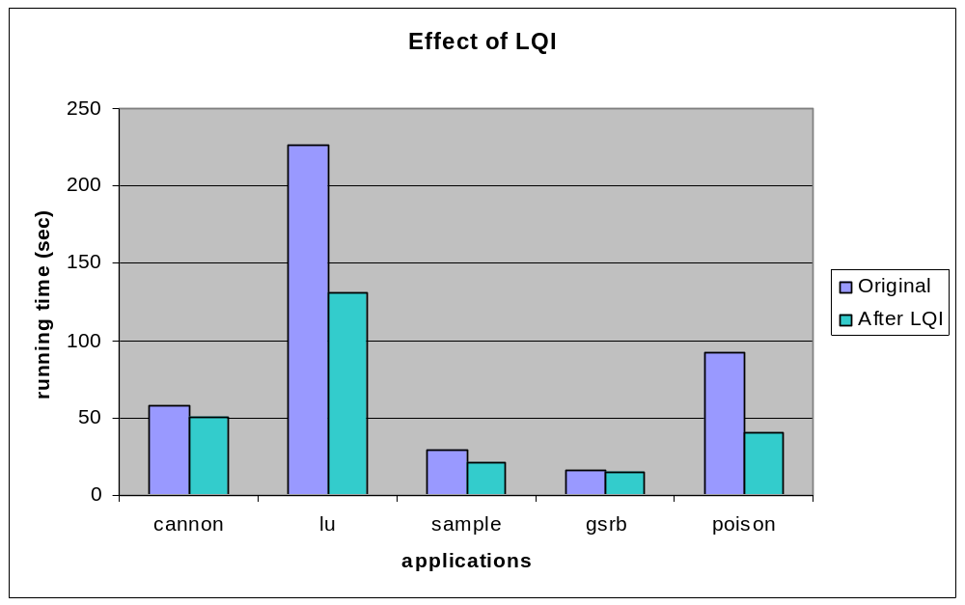
Local Pointer Analysis
Compiler can infer many uses of local
  See Liblit’s work on Local Qualification Inference
Data structures must be well partitioned

Slide 44
Region-Based Memory Management
PrivateRegion r = new PrivateRegion();
for (int j = 0; j < 10; j++) {
int[] x = new ( r ) int[j + 1];
work(j, x);
}
try { r.delete(); }
catch (RegionInUse oops) {
System.out.println(“failed to delete”);
}
}
Notes:
No gc overhead – explicitly free objects
Free all objects in a single operation
David Gay's work has made this a safe operation

Slide 45
Lecture Outline
Language and compiler support for uniprocessor performance
Language support for parallel computation
Applications and application-level libraries
  AMR overview
  AMR and uniform grid algorithms in Titanium
  Several smaller benchmarks
    MatMul, LU, FFT, Join, Sort, EM3d
  Library interfaces
    PETSc, Metis,
Summary and future directions

Slide 46
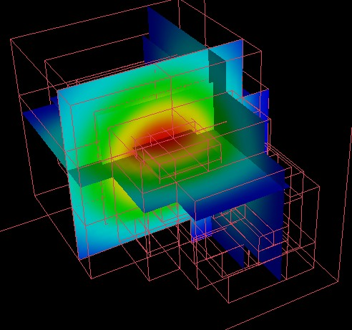
Block-Structured AMR
Algorithms for many rectangular, grid-based computations are
  communication intensive
  memory intensive
AMR makes these harder
  more small messages
  more complex data structures
  most of the programming effort is debugging the boundary cases
  locality and load balance trade-off is hard
Notes:
Define AMR

Slide 47
Algorithms for AMR
Existing algorithms in Titanium
  3D AMR Poisson solver (multi-grid)
  3D AMR Gas dynamics
  Domain-decomposition MLC Poisson
  Immersed boundary method (3D, non-adaptive)
    Peskin and MacQueen’s method for heart model, etc.
All joint with Colella’s group at LBNL
Project Ideas (contact Prof. Yelick):
  3-D MLC Poisson solver
  Evaluation of and proposal for general domains
  See Titanium website for a broad list of project ideas
Notes:
Define AMR – one driving application for Titanium
MultiGrid – coarsen grid (for performance), solve coarse (often replicated), solve more refined meshes in parallel
Projects must include careful performance analysis, but need not be scientific programs

Slide 48
3D AMR Poisson
Poisson Solver [Semenzato, Pike, Colella]
  finite domain
  variable coefficients
  multigrid across levels
Performance of Titanium implementation
  Sequential multigrid performance +/- 20% of Fortran
    On fixed, well-balanced problem of 8 patches, each 72³
    parallel speedups of 5.5 on 8 processors
Level 2
Level 1
Level 0
Notes:
Mesh refinement levels – finer meshes for more interesting areas
Solve multigrid across each level

Slide 49
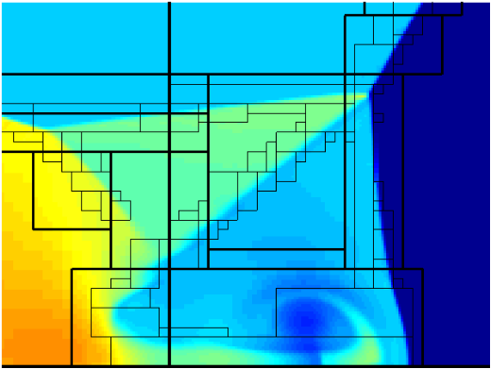
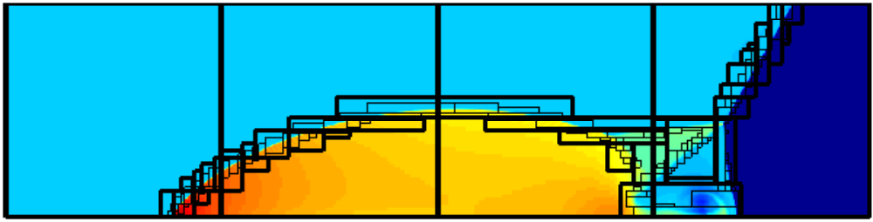
3D AMR Gas Dynamics
Hyperbolic Solver [McCorquodale and Colella]
  Implementation of Berger-Colella algorithm
  Mesh generation algorithm included
2D Example (3D supported)
  Mach-10 shock on solid surface at oblique angle
Future: Self-gravitating gas dynamics package
Notes:
Bottom of picture is the wall
Shockwave entering at 45 deg like / and reflecting back from wall
Color is areal density

Slide 50
MLC for Finite-Differences
Poisson solver with infinite domains [Colella, Balls]
  Uses a Method of Local Corrections (MLC)
  Currently non-adaptive, 2D and only constant coefficients
Uses 2-level, domain decomposition approach
  Fine-grid solutions are computed in parallel (no communication)
  Information transferred to a coarse-grid and solved serially (replicated)
  Fine-grid solutions is computed using boundary conditions from the coarse grid (accuracy still very good – 2nd order)
Future work & project idea
  extend to 3D and Adaptive mesh

Slide 51
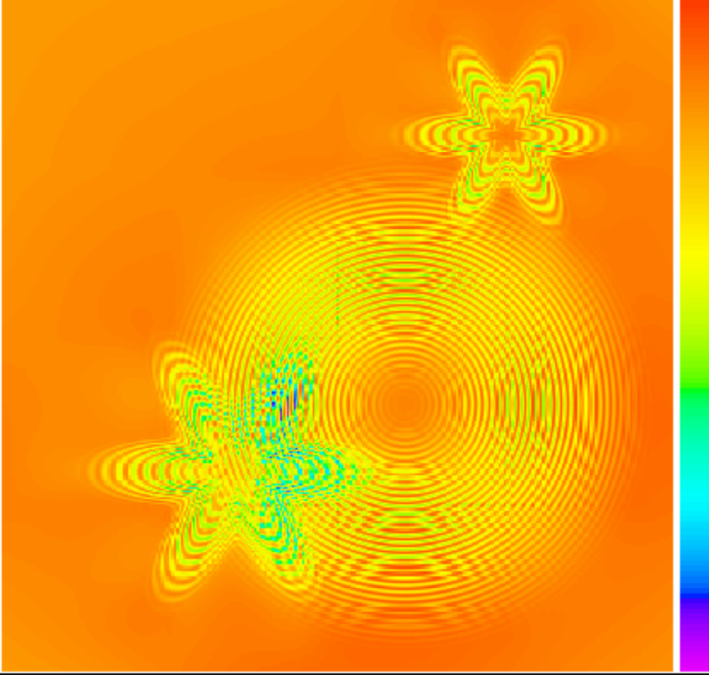
Error on High-Wavenumber Problem
Charge is
  1 charge of concentric waves
  2 star-shaped charges.
Largest error is where the charge is changing rapidly. Note:
  discretization error
  faint decomposition error
Run on 16 procs
-6.47x10⁻⁹ 0 1.31x10⁻⁹
Notes:
This was solved on sixteen processors.
Zero is around light orange.
The charge distribution for this problem is a combination of several high-wavenumber charges: one large radially symmetric charge of concentric waves and two star-shaped charges.
The error is largest where the charge is changing rapidly, as we would expect. It is possible to detect faint lines where the pieces are joined together, but the important point is that those errors induced by the domain decomposition are very small compared to the other errors.

Slide 52
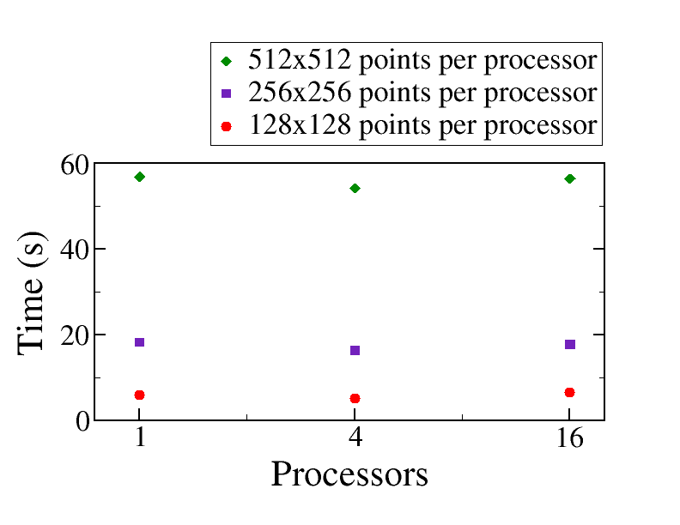
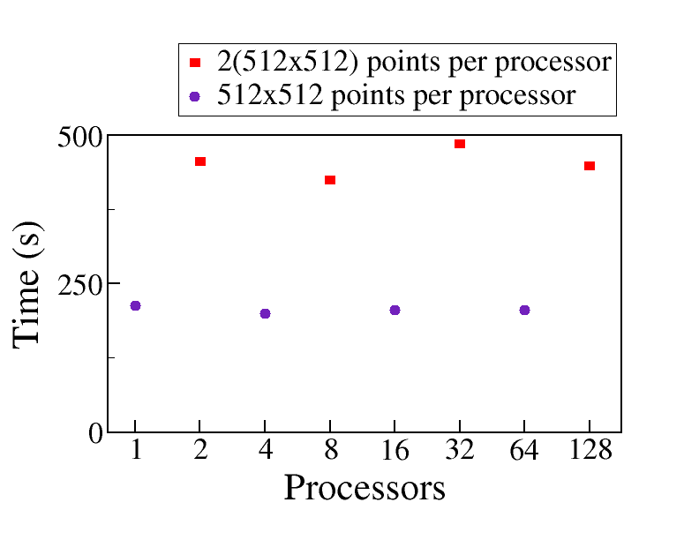
Scalable Poisson Solver (MLC)
Communication performance is good (< 5%)
Scaled speedup experiments are nearly ideal (flat)
IBM SP at SDSC Cray T3E at NERSC
Notes:
Explain scaled speedup – scale problem size with num procs
Problem (work) itself doesn't always scale exactly linearly

Slide 53
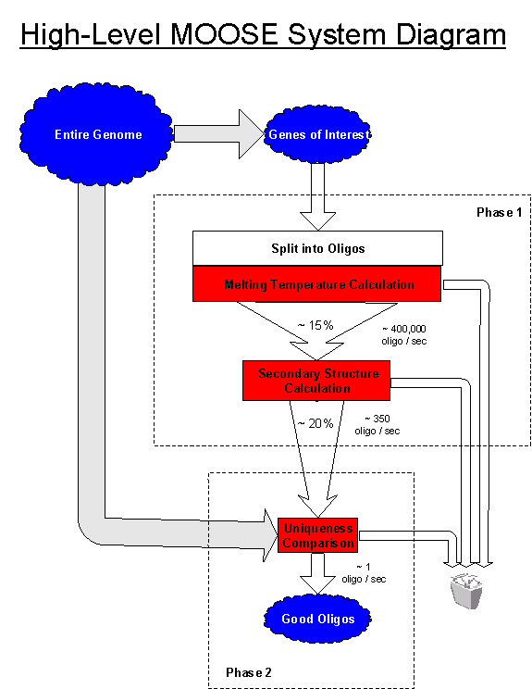
OligoNucleotide Selection Engine
Titanium in non-grid applications
M.O.O.S.E.
Bio information-processing
  Select optimal nucleotide sequences from the genome of an organism for use in manufacturing DNA microarrays
  Parallel properties differ from AMR
    High degree of parallelism
    Low communication requirements
    Unpredictable workload –
    uses dynamic load balancing
    I/O intensive
CS267 Final Project: F2000!

Slide 54
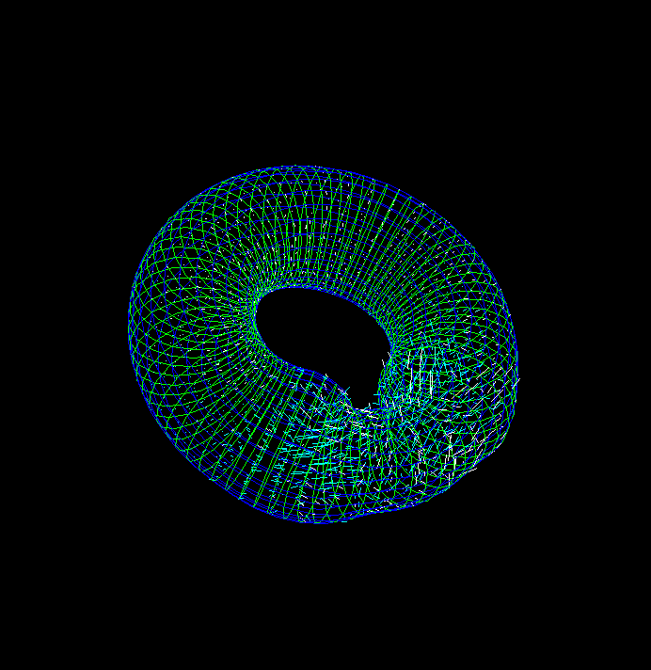
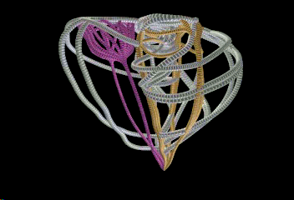
Human Heart Simulation
Immersed Boundary Method [Peskin/MacQueen, Yau]
  Fibers (e.g., heart muscles) modeled by list of fiber points
  Fluid space modeled by a regular lattice
Irregular fiber lists need to interact with regular fluid lattice
  Trade-off between load balancing of fibers and minimizing communication
  memory and communication intensive
Uses several parallel numerical kernels
  Navier-Stokes solver
  3-D FFT solver
  Soon to be enhanced using an adaptive multigrid solver (possibly written in KeLP)
Notes:
Current model can be used to design heart valves
Ultimately: real-time clinical work

Slide 55
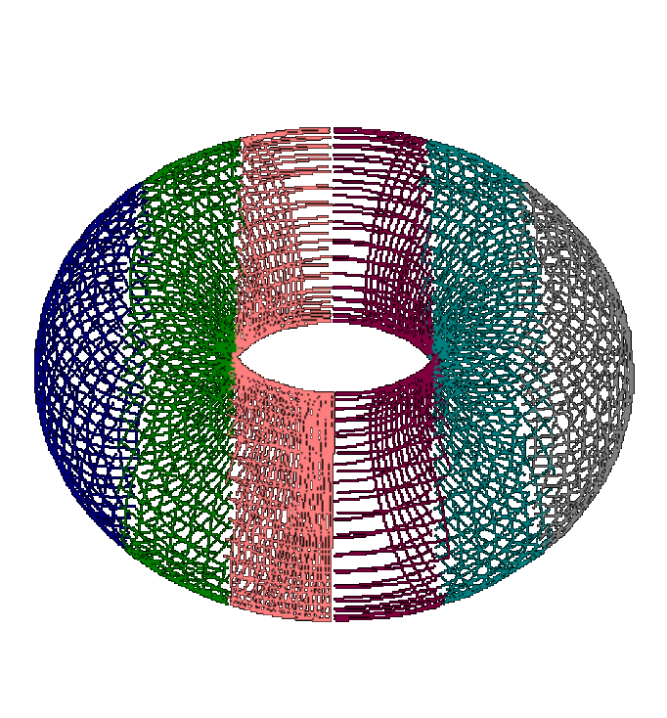
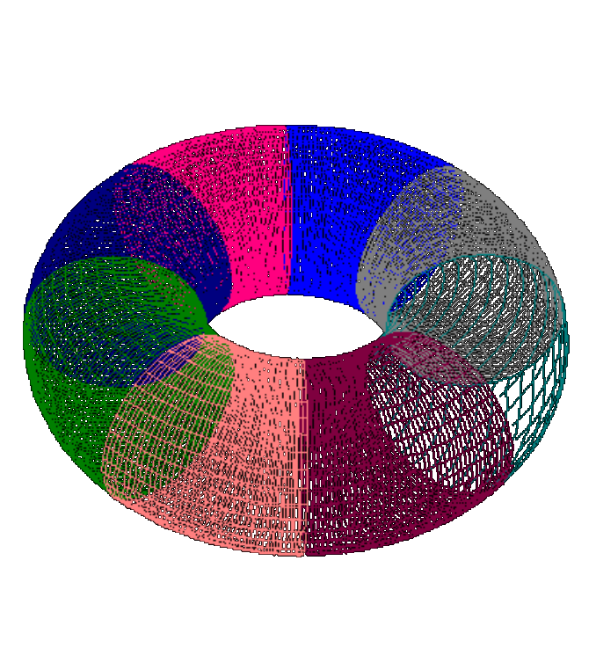
Load Balance vs. Locality
Tried various assignments of fiber points
Optimized
for Locality
Optimized for
Load Balance
Optimizing for load balance generally better
  Application (fiber structure) dependent
  Somewhat constrained by spectral solver
  Multigrid should give more options

Slide 56
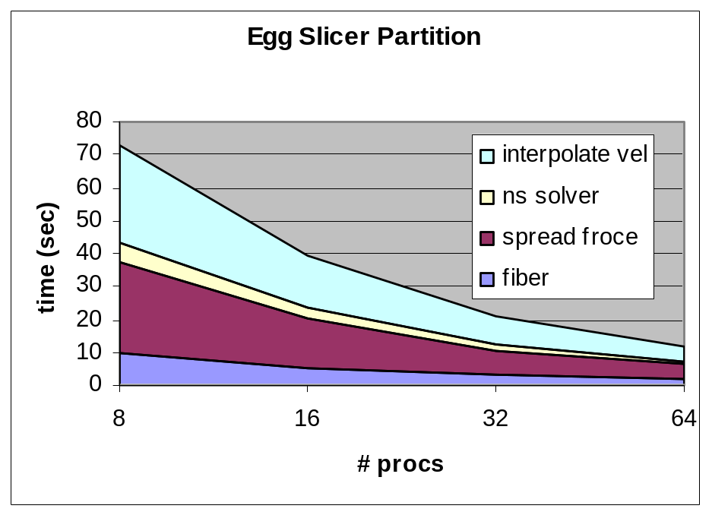
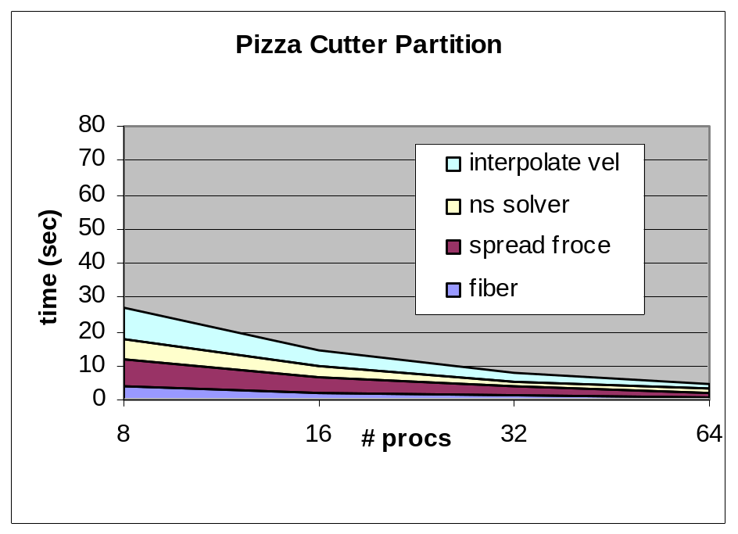
Load Balancing vs. Locality

Slide 57
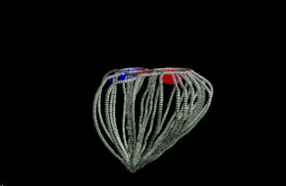
Heart Simulation
Source: www.psc.org

Slide 58
An Irregular Problem: EM3D
Maxwells Equations on an Unstructured 3D Mesh: Explicit Method
Irregular Bipartite Graph of varying degree
(about 20) with weighted edges
v1
v2
w1
w2
H
E
B
D
Basic operation is to subtract weighted sum of
neighboring values
for all E nodes
for all H nodes

Slide 59
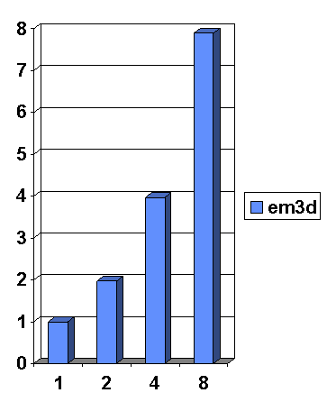
EM3D: Unstructured Mesh Kernel
Relaxation on a 3D unstructured mesh
  Propagation of electromagnetic waves through objects in 3-D
  Overlapping grids representing electric & magnetic fields with weighed edges between nodes
Speedup on Ultrasparc SMP
Simple kernel: mesh not partitioned

Slide 60
Calling Other Languages
We have built interfaces to
  PETSc : scientific library for finite element applications
  Metis: graph partitioning library
  KeLP: starting work on this
Two issues with cross-language calls
  accessing Titanium data structures (arrays) from C
    possible because Titanium arrays have same format on inside
  having a common message layer
    Titanium is built on lightweight communication
PETSc was 267 Final Project (with benchmark)!

Slide 61
Lecture Outline
Language and compiler support for uniprocessor performance
Language support for parallel computation
Applications and application-level libraries
Summary
  Performance tuning notes
  Implementation
  Project ideas

Slide 62
Titanium Summary
Performance
  close to C/FORTRAN + MPI on limited class of problems
Portability
  develop on uniprocessor, then SMP, then MPP/Cluster
Safety
  as safe as Java, extended to parallel framework
Expressiveness
  easier than MPI, harder than threads
Compatibility, interoperability, etc.
  no gratuitous departures from Java standard
  Important caveat: based on Java 1.0

Slide 63
Performance Tuning Notes
Arrays
  Multi-dimensional Ti arrays are stored contiguously (+)
  Rich set of operations (transpose, slice, stride) (-)
  Only “foreach” loops are optimized, not “for” loops
  Turn off bounds checking (-nobcheck) when tuning
Communication
  Beware of repeated remote reads: no caching
  Array copy or immutable copy is “shallow”

Slide 64
Implementation
Strategy
  Titanium into C
  Solaris or Posix threads for SMPs
  Lightweight communication for MPPs/Clusters
    Active messages, LAPI, shmem, MPI, UDP, others…
Status: Titanium runs on
  Solaris or Linux SMPs, clusters, CLUMPS
  Berkeley NOW & Berkeley Millennium clusters
  Cray T3E (NERSC and NPACI)
  IBM SP2/SP Power3
  SGI Origin 2000

Slide 65
Using Titanium
On machines in the CS Division
/project/cs/titanium/srs/titanium/*/bin/tcbuild file.ti
  Solaris 2.6 and Linux supported; need to mount this filesystem
On NERSC SP (seaborg)
For documentation, source code, see the home page
  http://www.cs.berkeley.edu/projects/titanium
  Web page includes a list of research project ideas!!
Documentation includes
  Language reference, terse but complete
  Tutorial, incomplete
For problems or questions:
titanium-group@cs.berkeley.edu

Slide 66
CS267 Project Ideas
Titanium
  Small application in Titanium with performance analysis
    FEM method, FMM method done last year
    Possibilities: Sparse Cholesky factorization, NAS PB, AMR, N-Body extension, Data mining
  Extension of the immersed boundary method code
    “Plates” as part of cochlea model done last year
    Platelet coagulation, small animal swimming, others?
UPC
  Benchmarking/applications
    NERSC compiler is very new, so smaller problems should be used
    Contact upc@lbl.gov if you’re interested
Sparsity

