Slide 1
USING GIS TO ELIMINATE DISPARITIES IN HEALTH CARE
Kevin Fiscella, MD, MPH
Primary Care Institute University of Rochester
Notes:
Good Afternoon. I’m Kevin Fiscella and I am honored to have the opportunity to present to you on Using GIS to eliminate disparities in Health Care.

Slide 2
The Elimination of Racial and Ethnic Disparities in Health by 2010
Notes:
As you know, a key, overarching goal of Health People 2010 is the...

Slide 3
Socioeconomic position and race/ethnicity are risk factors for disparities in the process and outcome of care.
Notes:
As most of you know, both socioeconomic position and minority race or ethnicity are risk factors for suboptimal health care.

Slide 4
The Elimination of Socioeconomic,
Racial, and Ethnic Disparities in Health Care by 2010
Notes:
So, a key step toward the elimination of disparities in health is the elimination of disparities in health care.

Slide 5
Linking disparities to quality
Concepts are incompatible
Disparities are a quality issue
QI should focus on the elimination of disparities
Existing measures can be adapted to monitor disparities
Notes:
Before I describe the role of GIS in this process, I will first present a conceptual framework that links monitoring and addressing disparities in health care to quality. Then I will outline the role of GIS in this framework, and given sufficient time, I will discuss important research questions related to the use of GIS in this regard.
The framework that I will outline, links quality and disparities. Disparities in health care are not compatible with quality. As such, disparities represent a quality issue. Thus, disparities represent a focus for quality improvement. Disparities can be identified and monitored by adapting existing measures.

Slide 6
I. Disparities in the process and outcome of care are incompatible with quality
Notes:
READ SLIDE

Slide 7
The notion of quality implies not simply the overall attainment of a defined standard (benchmark), but uniformity and consistency in process and outcome.
Notes:
READ SLIDE

Slide 8
If an HMO that achieves an overall 90% immunization rate by immunizing 95% of low risk patients, but only a 60% of high risk patients (who comprise only 15% of the population), is the HMO providing quality care?
Notes:
To illustrate this point, consider the example of an HMO immunization program.
READ SLIDE.
I submit they are not for two reasons:
First, the immunization rate is not consistent across all enrollees.
Second, the program is engaging in reverse targeting. Those who would benefit the most from immunization have the lowest rates.

Slide 9
Quality implies that care will be allocated according to need; priority will be given to those who will derive the most benefit.
Notes:
This illustrates a fundamental aspect of quality when applied to health care. READ SLIDE.

Slide 10
II. Disparities are a quality issue and represent a key component of performance assessment.
Notes:
The second principle follows from the first. READ SLIDE

Slide 11
If the goal is the elimination of disparities in care, then we must begin to routinely monitor the care provided to groups at risk for suboptimal care.
Notes:
Therefore READ SLIDE

Slide 12
If you don’t count it, it doesn’t count.
Notes:
In other words, READ SLIDE.

Slide 13
III. A central role of quality improvement should be the elimination of disparities in health care.
Notes:
The third principle continues in this vane.

Slide 14
Disparities in health care are not immutable
High performing HMOs in NYS show little gap in HEDIS scores between Medicaid and commercial plans.
There are no appreciable racial disparities in access to cardiovascular procedures in NYC.
Racial disparities in mammography and breast cancer survival have been eliminated through targeted interventions.
Notes:
I want to emphasize at this point that socioeconomic and racial/ethnic disparities in health care are not a fact of life. They are not immutable as shown by the following.

Slide 15
IV. Existing performance measures such as HEDIS can be adapted to monitor care provided to groups at risk for suboptimal care and/or worse outcomes.
Notes:
The last principle is that we do not need to re-invent the wheel to monitor many of the disparities in care. We can begin the process by adapting existing measures such as HEDIS for this purpose.

Slide 16
Absence of reliable data is a major barrier to monitoring socioeconomic, racial, and ethnic disparities in care.
Notes:
The biggest obstacle to linking disparities to quality is the absence of reliable data by socioeconomic position or race.

Slide 17
HMOs and Hospitals do not collect socioeconomic data on their patients.
Notes:
READ SLIDE

Slide 18
Hospitals do not uniformly collect race/ethnicity data or do so reliably.
Notes:
READ SLIDE

Slide 19
HMOs do not collect race/ethnicity data.
Notes:
READ SLIDE

Slide 20
GIS technology can be used to overcome this barrier
Patient addresses can be geocoded to census blocks or tracts.
Census data can used to approximate socioeconomic position.
A similar approach could be used for race/ethnicity.
Notes:
As most have guessed by now, this is where GIS comes into play. READ SLIDE

Slide 21
This GIS derived measures can then be used to report performance for at-risk groups.
Notes:
READ SLIDE

Slide 22
Advantages to using GIS to monitor disparities in health care
Notes:
READ SLIDE

Slide 23
Relies on existing data - no additional data collection needed
Notes:
READ SLIDE

Slide 24
Avoids asking sensitive questions
Notes:
READ SLIDE

Slide 25
Avoids non-response or response bias to questions
Notes:
READ SLIDE

Slide 26
Avoids misclassification associated with individual measures
Estimating parental or spousal SES
Age-education confound
Non equivalence of schools
Income vs wealth
Notes:
READ SLIDE

Slide 27
Captures neighborhood contextual data
Notes:
READ SLIDE

Slide 28
Performance can be mapped to neighborhoods providing the opportunity for targeted interventions
Notes:
READ SLIDE

Slide 29
Enrollment/disenrollment patterns by neighborhood or SES can be monitored over time
Notes:
READ SLIDE

Slide 30
Data can be used to adjust payments to HMOs based on the socioeconomic position of plan members (in addition to adjusting for case mix).
Notes:
READ SLIDE

Slide 31
What are the limitations of using GIS to monitor care to vulnerable groups?
Notes:
READ SLIDE

Slide 32
Relies on census data collected every ten years.
Notes:
READ SLIDE

Slide 33
Misclassification of SES or race based on residence
Notes:
READ SLIDE

Slide 34
May require larger sample sizes
(Due to increased measurement error)
Notes:
READ SLIDE

Slide 35
Potential for misuse by health care organizations
Notes:
READ SLIDE

Slide 36
Research questions
Notes:
READ SLIDE

Slide 37
To what extent can socioeconomic measures be used to monitor care provided to racial/ethnic minority groups?
Notes:
READ SLIDE

Slide 38
How do GIS derived measures compare to individual measures of socioeconomic position (or race/ethnicity) for monitoring disparities in health care?
Notes:
READ SLIDE

Slide 39
Project Design
Sample: Data from AHCPR Medical Expenditure Panel Survey (MEPS)
Independent measures: GIS derived SES measures and individual SES measures (education, income, occupation)
Dependent measures: HEDIS type measures of quality of care.
Analyses: Will compare the effect of GIS with individual measures on quality measures. Will also explore the effect of race/ethnicity on quality after complete adjustment for SES.
Notes:
In this project, we will use data from AHCPRs Medical Expenditure Panel Survey to compare the effect on Quality measures of individual measures of SEP such as family income, years of schooling, and occupational rank with GIS derived measures of SEP. This will allow us to define more precisely the advantages and limitations of this approach.

Slide 40
What is the impact on physician report cards of adjusting for patients socioeconomic position using GIS?
Notes:
Another project addresses a related but perhaps more controversial question. READ SLIDE.

Slide 41
Project Design
Sample: Claims data from an HMO in Rochester.
Independent Measure: GIS derived patient SES.
Covariates: Casemix, age and sex.
Dependent measures: Visits, preventive care, diabetic care, avoidable hospitalizations, total expenditures.
Physician Performance measures: Impact of SES adjustment on change in physician performance rank
Notes:
In this project, we will link GIS measures of SEP to actual HMO claims data. We will begin by ranking physicians based on various measures after adjusting for age, sex, and case-mix. We will then compare these rankings after additional adjustment for GIS.

Slide 42
Effect of GIS-SES on Change in Physician Rank by Mean Patient Physical Health According to Mean Practice Education Level
20
15
10
5
Change in rank
0
-5
-10
-15
-20
-25
12
Mean practice patient education level (years)
13
14
15
16
Notes:
Our preliminary data show that GIS measures exert an appreciable effect on physician rankings based on patient reported health status.

Slide 43
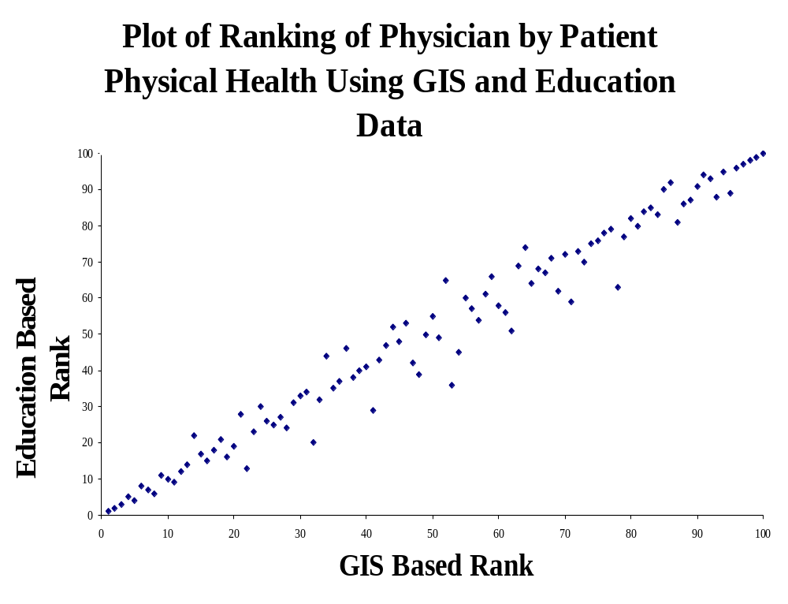
Notes:
As you can see, adjusting for GIS measures exerts a very similar effect on rankings as does adjusting for patient education.
In closing, I want to emphasize that disparities are a quality issue. If we are goal is eliminate disparities we must begin measuring disparities. GIS provides us the tools to begin doing so. Thank you for your attention.

