Slide 1

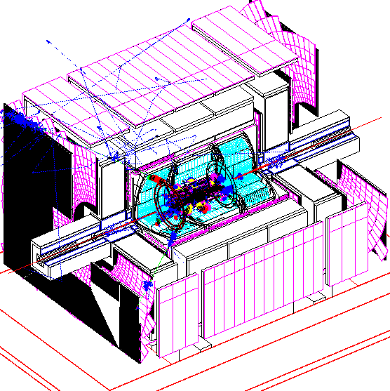
TrigSim Data Flow
Raw Data
Chunk
Copy and
Add to
Raw Data
Chunk
UDC/Direct access
L1 Processors
L1/L2
Collector
L2 Pre-
Processors
Raw data
MBT Channels
L2 Global
Raw Data
Chunk (Copy)
Level 3

Slide 2
Inputs to L1
L1 inputs from Raw Data Chunk
  Possibly use Unpacked Data Chunks but not required
  Alternative route: read Raw Data Chunk directly (I/Ogen)
L1 framework inputs are specific L1 internal format
L2 workers will all use I/Ogen to access data
  Only used in emulation mode w/o L1 running
  One basic package can work for all “simply” stored inputs

Slide 3
L1 Outputs to L2
ALL L2 inputs are MBT channels
  L1 processors are REQUIRED to fill MBT channels to send to L2
  Format must be same as online L2 inputs
  i.e. L1 processors fulfill their full online functionality
SLICs/STT very similar to L1 processors
  Input via Raw/Unpacked DC
  Output via MBT channel

Slide 4
L1 Example
// Example MBT Filler
Result MyClass::ready(DataStore &ds) {
// Create an MBT channel which can
// be filled with up to 40 Electrons
FillableMBTChannel<Electron,40> eleMBT;
Electron *myele=new Electron;
// Fill myele with some data
myele->setPhi(0.1);
myele->setET(100.);
…
// Add myele to the MBT channel
eleMBT.addObject(myele);
// Create a data broadcast class
DataBroadcast *output=
new DataBroadcast;
// Pack the MBT channel into the class
output.store(eleMBT);
// Add output to data store
produceItem(ds,output,”l2output”);
// Return successfully
return SUCCESS;
}

Slide 5
L1/L2 Outputs to L3
All L1/L2 framework packages produce an “L3Output” object
  Contains packed, raw data output written to VRB/VBD
Generated either by
  I/Ogen (recommended)
    all L2 uses this method
  Hand-coded routines
    for those really strange formats I/Ogen can’t handle
Packing routine should be coded to I/Ogen interface
  Will make UDC interface easy

Slide 6
L1/L2 Collector
Configured by a crate readout list from COORsim
Each incoming raw data packets assigned to a L3 crate
Crates for new Raw Data Chunk extracted from following sources (in order)
  L1/L2 Raw Data packets
  Old Raw Data Chunk
  New, dynamically allocated, empty crate

Slide 7
L1/L2 Collector
Has to copy Raw Data Chunk
  “chunks are immutable”
Does no packing
  All input data comes in pre-packed form
Copying only done when Chunk added to event
  Chunk built from a system of L3 crate objects
  Each L3 crate needs a block or raw data (pointer)
  Automatically handles VBD/VRB headers
  Thank you Gordon!

Slide 8
L1/L2 Collector
COORsim Crate List
Crate 1
Crate 2
Crate 3
Crate 4
Crate 5
New Raw Data Chunk
Crate 1
Crate 2
Crate 3
Crate 4
Crate 5
L1/L2 Outputs to L3
Crate 1
Crate 3
Crate 4
Old Raw Data Chunk
Crate 2
Crate 4
Create new, empty crate
Crate 5

Slide 9
Current Status
Few days away from working L1/L2 framework
  Basic functionality only
  Uses Data Flow framework thanks to Jim Kowalkowski
Next steps (after release)
  Insert L1Cal, L2Cal & Global
  Add L3 output mechanism
  Add L2Parser Interface to allow fully functional Global

Slide 10


How I/Ogen Works
(Normal C++ class)
Loose
Memory Map
Defined
Memory Map
I/Ogen Data
Class
Un/pack
I/Ogen IO
Class
Compiled
Not compiled
Python Script
Configuration
File [l2io.iogen]

Slide 11
Offline Design
Event
L1 Processor
L1 Processor
SLIC
Level1
Framework
L2 Pre-Proc
L2 Pre-Proc
L2 Pre-Proc
L2 Global
L1/L2
Collector

Slide 12
Data Flow Types
Event
Data
Access
L1 Processor
L1 Processor
SLIC
L1
Framework
Data
Level1
Framework
L2 Pre-Proc
L2 Pre-Proc
L2 Pre-Proc
L2 Global
MBT
Channel

