Slide 1
eXtensible Name Service
How XNS provides Web Identity
A briefing from OneName Corporation
December, 2001

Slide 2
Topics
The XNS protocol for Web identity services
Extending enterprise identity to Web identity
  The fit between XNS and enterprise SSO
  The fit between XNS and enterprise PKI

Slide 3
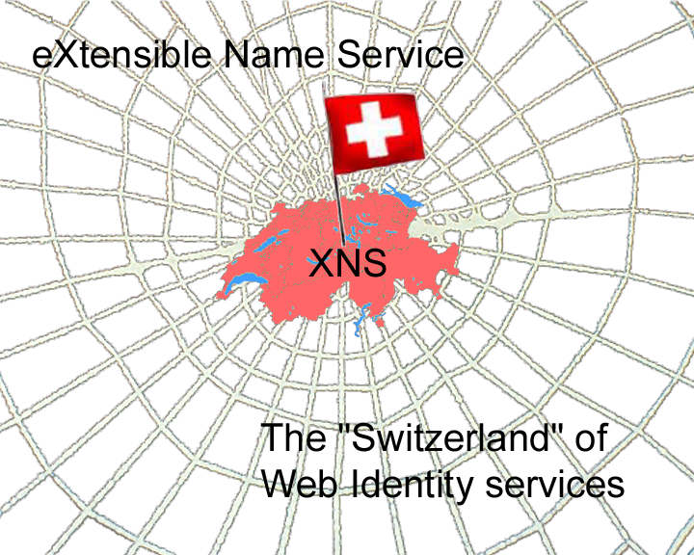

Slide 4
eXtensible Name Service (XNS)
An open protocol for Web Identity Services based on XML and web agent linking (publication in Feb 2002)
Protocol to be managed by XNSORG (non-profit)
12 web services specified in WSDL 1.1 and XML Schemas 1.0
XNS marries the emerging XML trust standards (XML Signatures, XML Encryption, SAML, XKMS) with the power of Web identity architecture
Describes the metastructure of identity agent documents, links, contracts, and messages
Fully distributed and federated just like DNS
Includes both name and ID services for lifetime persistence of identities and links

Slide 5
XNS in the Internet protocol stack
The Web Services Layer
XML / XMLP
XNS Governance
(XNSORG)
XNS
DNS Governance
(ICANN)
Web Services
Standards
(ebXML, W3C)
DNS
IP Governance
(IANA)
Caching
IP
Web Standards
( W3C, IETF)
HTML / HTTP
Internet Standards
(IETF)
TCP
Names and addresses for
real world identity
XNS is to Web Services what DNS is to the Web

Slide 6
The evolution of
Web identity (step 1)
Logical Organization and Linking
Web Servers
The force that drove the Web was the elevation of content to a logical level of representation (HTML) and access (HTTP). Now it could be linked (using URIs) across web servers regardless of the physical system on which it was stored. The rest is history.
Web Pages
File Servers
Files
Millions of files were available on Internet-connected enterprise file servers but there was no common way to view, access, or link them.
Physical Organization and Storage
Content

Slide 7
The evolution of
Web identity (step 2)
Today enterprise identity is in the same predicament as enterprise content was ten years ago. It is constrained by the organizational, access, and adminis-trative requirements of enterprise directory servers. Sharing identity across domains is as difficult as sharing files across domains was in 1990.
Logical Organization and Linking
Web Servers
Web Pages
File Servers
Directory Servers
Files
Directory
Entries
Physical Organization and Storage
Content
Relationships

Slide 8
The evolution of
Web identity (step 3)
By abstracting identity to the logical level, web identity agents and identity servers solve the identity sharing problem the same way the Web solved the problem of content sharing. In addition, web identity can leverage the logical viewing layer provided by the Web.
Logical Organization and Linking
Web Servers
Identity Servers
Web Pages
Web Identity Agents
File Servers
Directory Servers
Files
Directory
Entries
Physical Organization and Storage
Content
Relationships

Slide 9


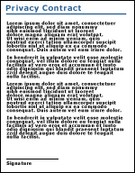


A Web of identity
Web identity agents represent either people or businesses. Links are formed automatically as transactions take place. Any agent can form a link with any other agent – web identity makes the agent document’s physical location as trans-parent as the physical location of a document on the Web.
Identity Server
(i.e. Bank)
Identity Server
(i.e. HMO)
Extended Personal Agent
Link
Con-tract
Business Agent
Link
Con-tract
A single logical identity can be represented by linking multiple agent documents in different domains. These are called extended agents.
Identity Server
(Merchant)
Link
Con-tract
Primary
Personal Agent
Business Agent
Link
Con-tract
Extended Personal
Agent
Customer

Slide 10
Web agent linking
Identity servers host XML documents representing data associated with an identity. These documents can be “virtual”, i.e., the phys-ical data can be stored in lower-layer systems.
Identity Server
Identity Server
Agent Document
Agent Document
Identity Data
Identity Data
Each link with another agent is defined by a subdocument inside the agent document.
Link
Link
Contract
Trusted
“Pipe”
Contract
Permissions
Permissions
A link can contain any number of contracts, each defining a set of data shared with the other agent and the applicable security, privacy, and synchro-nization permissions.
Contract
Contract
Permissions
Permissions
Links create trusted, bidirectional data “pipes” between any two systems or web services.

Slide 11
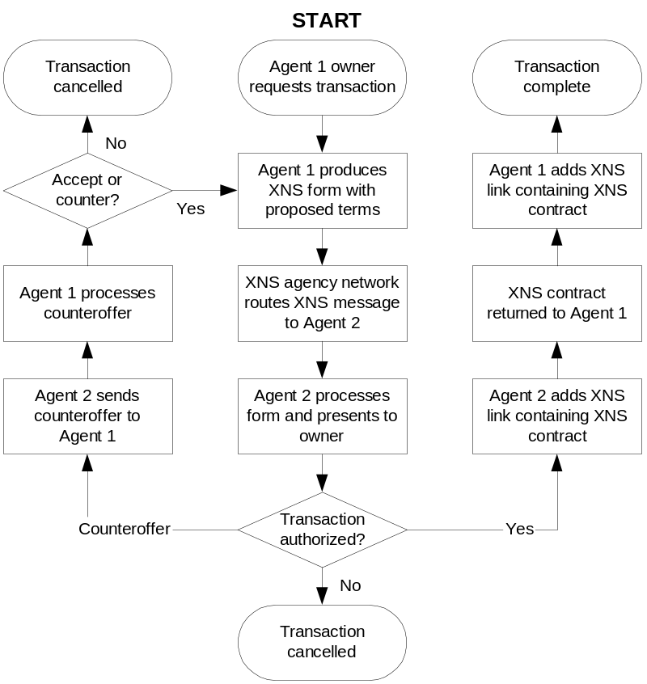
XNS Contract Negotiation
In XNS any agent (Business or Personal) can exchange a contract with any other agent
Version 1
  Only Business Agent owners can can serve contracts
Future Versions
  Either Agent owner can serve the contract

Slide 12
XNS Base Services
Category
Service
Spec
Action in the Agent Document
Introspection Services
Core
1.0
Defines XNS base schemas
Discovery
1.0
Introspection of XNS service & schema defs
Directory
Future
Listing and searching of XNS agents
Registration Services
ID
1.0
Register an ID (immutable address)
Naming
1.0
Register a name (human-readable address)
Location
1.0
Resolve an ID to a network location
Management Services
Hosting
1.0
Create, delete, move agents
Data
1.0
Get/set schema definitions and instances
Folder
1.0
Manage folders
Notification
Future
Event triggers and notifications
Assertion Services
Authentication
1.0
Assert an identity
Session
1.0
Persist an authentication assertion
Certification
1.0
Link to a certifying agent
Reputation
Future
Link to a reputation agent
Transaction Services
Negotiation
1.0
Create, update, or delete a contract
Introduction
Future
Propose a contract between two other agents

Slide 13
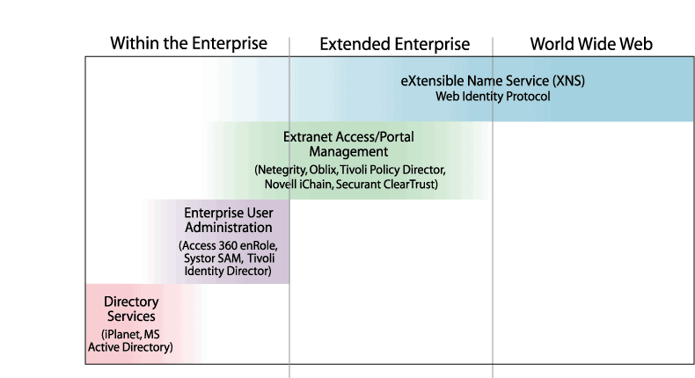
Web identity: beyond enterprise identity management

Slide 14
Identity Today
Identity is usually established through an enterprise directory, security, or application domain
The root of enterprise identity is most commonly a directory entry in an X.500 tree
Enterprise identity is extended by:
  Adding attributes (instances of directory schemas)
  Adding references to other directory entries (groups or roles)

Slide 15
The overarching problem with today’s identity solutions
It is always relative to one directory context
Extending enterprise identity requires mapping it to other directory contexts
Two common approaches to this problem:
  Metadirectory – a higher-level directory
  Affiliates –hard-wired connections between trusted domains
Neither solves the “n-wise” problem – the number of mappings grows exponentially as you scale

Slide 16
Additional problems with identity
Besides one directory context, enterprise identity is also limited to:
  One security context
  One privacy context
  One administrative context
Thus enterprise identity cannot provide for:
  Persistence outside these contexts
  Transactions outside these contexts
  Administration outside these contexts

Slide 17
The challenge
Web Services requires:
  Persistent, unified identity independent of location, network, or device
  Seamless transactions across trust domains
  Strong protection of security and privacy
Enterprise identity solutions cannot provide this because they are context-dependent
In short, Web Services requires a Web identity architecture

Slide 18
Web identity
Web identity has one context: global
Web identity solves the n-wise mapping problem by abstracting identity to a logical level
Web identity agents map logical Web identity to physical enterprise identity
Maintaining this mapping automatically is the magic of web agent linking technology
Web agent linking also manages the hard security, privacy, and administration problems

Slide 19
Benefits of the XNS standard for Web Identity Services
Identity Owner
Unified
Identity
Unified, lifetime Web identity
Authentication, authorization, SSO, Web PKI, reputation
Strong Security
Permissions, negotiations, enforceable contracts
Strong Privacy
Automatically negotiated transactions, e.g., e-payment
Smart Personalized Transactions
Persistent relationships, automated updates
Lifetime Synchronized Connections

Slide 20
Web PKI
Web Identity for SSO is only the first step towards rich Web identity services
Web PKI is the second step
XNS web identity agents and web agent linking provides the infrastructure for both
XNS marries the emerging XML trust standards (XML Signatures, XML Encryption, SAML, XKMS) with the power of Web identity architecture and agent linking

Slide 21
The XNS Security Services Layer
Enterprise
SSO
Products
Authentication
Session
Certification
Identity
Reputation
Security
Privacy
Enterprise SSO solutions offer:
SSO within one trust domain or directly affiliated trust domains
Policy-based authorization
Delegated authorization management
XNS Offers:
Web SSO (SSO across all domains)
Web PKI (automated key and signature management across all domains)
Smart Transactions
Lifetime Connections

Slide 22
XNS overcomes the three major barriers to Web PKI
Interoperability
  XNS establishes a globally interoperable, fully distributed, open web service for PKI
  XNS provides a common protocol for RA and CA services
Identity Management
  PKI requires identity assertions
  PKI has never had a directory-independent web identity service for a foundation
Key Management
  XNS negotiation automates key and certificate management
  XNS negotiation automates applying & verifying digital sig’s
  XNS agent linking solves the CRL problem

Slide 23

XNS key management
Certifying Authority (CA)
XNS is the only globally interoperable solution to automated key management:
4 Key Revocation
XNS
Certifying Agent
Key Generation & Certification
Key Exchange
Key Verification
Key Revocation
Key
Certified/Denied

1 Key Certification
3b
X
1b
3 Key Verification
CA Certificate
1a. Public Key
Signed
Certificate
3a
X

Personal Certificate Verified/Denied
XNS
Personal Agent
XNS
Business Agent
Customer
Merchant
2
Signed
Certificate
2 Key Exchange

Slide 24
Web identity service components
Web Portal
Wireless Portal
Other Application
Other XNS Server
HTML Exposure
WML Exposure
SOAP Exposure
Connector
Connector
Connector
Connector
Firewall
Connector
Connector
Connector
Connector
Custom Service
Custom Service
Custom Service
XNS Base Services
Agent
Document
(XML)
Agent
Document
(XML)
XNS
Identity Server
Agent
Document
(XML)
Agent
Document
(XML)
LDAP Adapter
SAML Adapter
Enterprise Directory Server
(e.g., iPlanet)
Enterprise Security Server
(e.g., Netegrity)

Slide 25
Summary
Web identity is global; it will do for people and businesses what the Web did for documents
The key to Web identity is a common protocol for Web identity agents and web agent linking XNS is a protocol that will do for Web Services what DNS did for the Web
Web identity layers over enterprise identity the way web servers layered over file servers
XNS marries the emerging XML trust standards (XML Signatures, XML Encryption, SAML, XKMS) with the power of Web identity architecture

Slide 26
Further Reading
XNS Public Trust Organization
  www.xns.org
OneName Corporation
  www.onename.com

