Slide 1

Information Sharing Environment (ISE)
Privacy Guidelines
Jane Horvath
Chief Privacy and Civil Liberties Officer
U.S. Department of Justice

Slide 2
Applicability
The ISE Privacy Guidelines apply to information about U.S. citizens and lawful permanent residents that is subject to information privacy or other legal protections under the U.S. Constitution and federal laws of the United States
For the intelligence community, protected information includes information about “United States persons” as defined in Executive Order 12333
Protected information may also include other information that the U.S. government expressly determines—by Executive Order, international agreement, or other similar instrument— should be covered by these Guidelines

Slide 3
Governance
ISE Privacy Officials
  Each “federal” agency’s senior official with overall agency-wide responsibility for information privacy issues shall directly oversee the agency’s implementation of and compliance with these Guidelines
ISE Privacy Guidelines Committee
  Established by the ISE Program Manager (PM-ISE) to provide ongoing guidance on the implementation of these Guidelines, so that agencies follow consistent interpretations of applicable legal requirements, avoid duplication of effort, share best practices, and have a forum for resolving issues on an interagency basis. Chaired jointly by Jane Horvath, DOJ, and Alex Joel, Office of the Director of National Intelligence (ODNI), with membership consisting of the ISE Privacy Officials

Slide 4
Governance (continued)
Privacy and Civil Liberties Oversight Board (PCLOB)
  The PCLOB should be consulted for ongoing advice regarding the protection of privacy and civil liberties in agencies’ development and use of the ISE. The ISE Privacy Guidelines Committee serves as a mechanism for the PCLOB to obtain information from agencies and to provide advice and guidance consistent with the PCLOB’s statutory responsibilities. The ISE Privacy Guidelines Committee works in consultation with the PCLOB

Slide 5
Governance (continued)
ISE Privacy Protection Policy
  Each agency shall develop and implement a written ISE privacy protection policy that sets forth the mechanisms, policies, and procedures its personnel will follow in implementing these Guidelines. Agencies should consult with the ISE Privacy Guidelines Committee as appropriate in the development and implementation of such policy

Slide 6
Guidance
Ambassador Thomas E. McNamara, Program Manager-ISE Office of the PM-ISE, Office of the Director of National Intelligence
ISE Privacy Guidelines Committee (Meets Monthly)
Model Privacy Policy Implementation Process Working Group | Training and Outreach Working Group
State/Local/Tribal Working Group | Legal Issues Ad Hoc Group

Slide 7
Nonfederal Entities
Consistent with any standards and procedures that may be issued to govern participation in the ISE by state, local, and tribal governments and private sector entities, the agencies and the PM-ISE will work with nonfederal entities seeking to access protected information through the ISE to ensure that such nonfederal entities develop and implement appropriate policies and procedures that provide protections that are at least as comprehensive as those contained in these Guidelines

Slide 8
ISE Privacy Guidelines
Compliance with laws
  General
    U.S. Constitution
    Executive Orders
    Applicable laws
  Rules assessment
    Ongoing process for identifying and assessing laws, Executive Orders, and policies and procedures applicable to ISE shared protected information
    Identify, document, and comply with legal restrictions
    Adopt internal policies and procedures requiring and agency to only seek or retain protected information that is legally permissible and ensure that the protected information shared through the ISE has been lawfully obtained and can be lawfully made available through the ISE

Slide 9
ISE Privacy Guidelines (continued)
Purpose specification
  Protected information should be shared through the ISE only if it is
    Terrorism information
    Homeland security information
    Law enforcement information
  Adopt internal polices and procedures to ensure that the agency’s access to and use of protected information available through the ISE is consistent with the authorized purpose of the ISE

Slide 10
ISE Privacy Guidelines (continued)
Identification of protected information
  Identification and prior review
    Each agency shall identify its data holdings that contain protected information to be shared through the ISE
    Each agency shall put in place such mechanisms as may be reasonably feasible to ensure that protected information has been reviewed pursuant to the ISE Privacy Guidelines before it is made available to the ISE
  Notice mechanisms
    Each agency shall put in place a mechanism for enabling ISE participants to determine the nature of the protected information that the agency is making available to the ISE, so that such participants can handle the information in accordance with applicable legal requirements

Slide 11
ISE Privacy Guidelines (continued)
Data quality
  Accuracy
    Each agency shall adopt and implement procedures, as appropriate, to facilitate the prevention, identification, and correction of any errors in protected information with the objective of ensuring that such information is accurate and has not erroneously been shared through the ISE
  Notice of errors
    Each agency shall ensure that when it determines that protected information originating from another agency may be erroneous, the potential error or deficiency will be communicated in writing to the other agency’s ISE Privacy Official

Slide 12
ISE Privacy Guidelines (continued)
Data quality (continued)
  Procedures
    Each agency shall adopt and implement policies and procedures with respect to the ISE requiring the agency to
      Take appropriate steps when merging protected information about an individual from two or more sources to ensure that the information is about the same individual
      Investigate in a timely manner alleged errors and deficiencies and correct, delete, or refrain from using protected information found to be erroneous or deficient
      Retain protected information only so long as it is relevant and timely for appropriate use by the agency and update, delete, or refrain from using protected information that is outdated or otherwise irrelevant for such use

Slide 13
ISE Privacy Guidelines (continued)
Data security
  Each agency shall use appropriate physical, technical, and administrative measures to safeguard protected information shared through the ISE from unauthorized access, disclosure, modification, use, or destruction

Slide 14
ISE Privacy Guidelines (continued)
Accountability, enforcement, and audit
  Each agency shall modify existing policies and procedures or adopt new ones, as appropriate, requiring the agency to
    Have and enforce policies for reporting, investigating, and responding to violations of agency policies
    Provide training to personnel authorized to share protected information through the ISE
    Cooperate with audits and reviews by officials with responsibility for providing oversight
    Designate each agency’s ISE Privacy Official to receive reports regarding alleged errors in protected information that originate from that agency

Slide 15
ISE Privacy Guidelines (continued)
Accountability, enforcement, and audit (continued)
  Audit
    Each agency shall implement adequate review and audit mechanisms to enable the agency’s ISE Privacy Official and other authorized officials to verify that the agency and its personnel are complying with the ISE Privacy Guidelines
Redress
  To the extent consistent with its legal authorities and mission requirements, each agency shall, with respect to its participation in the development and use of the ISE, put in place internal procedures to address complaints from persons regarding protected information about them that is under the agency’s control

Slide 16
ISE Privacy Guidelines (continued)
Execution, training, and technology
  Execution—the ISE Privacy Official shall be responsible for ensuring that protections are implemented as appropriate through efforts such as training, business process changes, and system designs
  Training—each agency shall develop an ongoing training program in the implementation of these Guidelines and shall provide such training to agency personnel
  Technology—each agency shall consider and implement, as appropriate, privacy-enhancing technologies, including, but not limited to, permissioning systems, hashing, data anonymization, immutable audit logs, and authentication

Slide 17
ISE Privacy Guidelines (continued)
Public Awareness
  Each agency shall take steps to facilitate appropriate public awareness of its policies and procedures for implementing these Guidelines

Slide 18
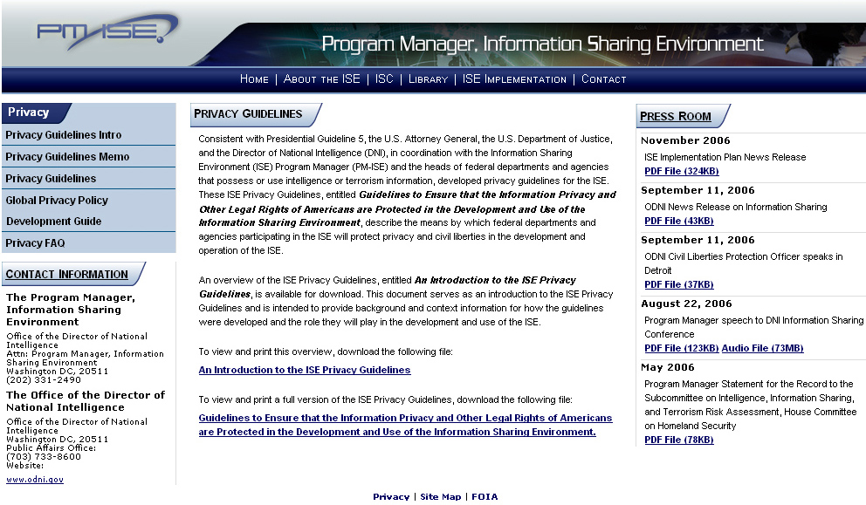
ISE Privacy Guidelines Web Site

Slide 19
ISE Privacy Guidelines Web Site
Content
  ISE Privacy Guidelines Introduction
  ISE Privacy Guidelines Memorandum
  ISE Privacy Guidelines
    Guidelines to Ensure That the Information Privacy and Other Legal Rights of Americans Are Protected in the Development and Use of the Information Sharing Environment
  Press Room
  Global Privacy Policy Development Guide and Implementation Templates
  ISE Privacy Guidelines FAQ
  Contact information

Slide 20
Fusion Centers
Fusion centers are anticipated to be the primary points of contact within states or regions for further disseminating terrorism information consistent with DOJ’s Fusion Center Guidelines and applicable state, local, and tribal laws and regulations
Fusion centers are intended to collaborate with organizations such as the Joint Terrorism Task Forces (JTTFs), Field Intelligence Groups (FIGs), and the Information Sharing Analysis Centers (ISACs)

Slide 21
Next Steps
Model Privacy Policy Development Process
Conduct briefings with federal agencies
Develop a training guide for agencies to follow when implementing the Guidelines
Involve state, local, and tribal agencies through the use of Fusion Centers and existing groups such as IACP and the National Sheriffs Association

Slide 22
Questions?

