Slide 1
Grid Services Overview
Keith R. Jackson
Distributed Systems Department
Lawrence Berkeley National Lab

Slide 2
Overview
Web Service Overview
WSDL Document Review
Web Service Evaluation
Web Services and Grids
Virtualizing Services
Open Grid Services Architecture (OGSA) Overview
WSDL Extensions and Conventions
Standard OGSA Interfaces
Grid Portals
Contacts & Acknowledgements

Slide 3
What is a Web Service?
Web service is an entity that can be:
  Described (using WSDL)
  Published
  Discovered
  Invoked by a client
W3C technology standardization process
Often associated with specific technologies and implementations
  Standards: XML, WSDL, SOAP, UDDI
  Implementations: WebSphere, .NET, others…

Slide 4
Service Oriented Architecture
Service
Registry
Find
Publish
Service
Requestor
Service
Provider
Bind
Publish
  WSDL: Web Services Description Language
  UDDI: Universal Description, Discovery & Integration
Find
  WS-Inspection
Bind
  SOAP: Simple Object Access Protocol

Slide 5
WSDL Document Structure
WSDL: Web Services Definition Language
Document structure:
  Service Description
  Implementation Details
Service Description
  Elements
    PortType (~ class)
    Operations (~ method)
    Messages, message parts (~ parameters)
    Types (type definitions)
  Used for
    Generating stubs and skeletons
    Service discovery

Slide 6
WSDL Document Structure (cont.)
Implementation Details
  Binding
    Messaging protocol (e.g. SOAP)
    Message Interpretation (e.g. RPC or literal)
    Data-encoding model (e.g. SOAP or literal encoding)
    Transport protocol (e.g. HTTP or FTP)
  Port: describes service endpoint
  Service Element: groups Port elements together

Slide 7
Web Service Evaluation (+)
Key to success:
  Emphasize protocols rather than APIs
  Build on established technologies and protocols
  Web-wide rather than enterprise-wide scope
  A set of independent technologies
  Industry support

Slide 8
Web Service Evaluation (-)
Developing technology:
  Lack of standard language bindings
  Others
Web Services applied to Grids:
  WS describe persistent stateless services
    For Grids we must also support transient instances
      Implies a need to uniquely name instances
    Lifecycle management issues
  Need to provide information about a service
    Need ways to access that information
  Implications on how services are managed

Slide 9
WS & Grids
Service orientation
  virtualize resources
  unify resources/services/information
Capitalize on useful WS properties
  Standards for service description and discovery
  Leverage commercial efforts
Refactor Globus protocol suite to enable common base and expose key capabilities
Provide a unifying architecture for computational Grids

Slide 10
Globus Toolkit Refactoring
Grid Security Infrastructure (GSI)
  Used in Grid service network protocol bindings
  Also: Security Services
Meta Directory Service 2 (MDS-2)
  Native part of each Grid service:
    Discovery, Notification, Registry, RegistryManagement
Grid Resource Allocation & Mngt (GRAM)
  Job Manager Service
  Gatekeeper -> Factory for job mgr instances
GridFTP
  Refactor control channel protocol
Other services refactored to used Grid Services

Slide 11
Moving Forward with Grid Services
Benefits of service orientation
  Focus on interface
    Minimal shared understanding between interacting entities
  Local/remote transparency
  Modularity, Reusability, etc.
Virtualization
  Encapsulation of diverse implementation behind a common interface
  Defining interactions with services in terms of QoS constraints and Service Level Agreements (SLA)
  Living up to SLAs: Adaptive behaviors

Slide 12
Virtualizing Resources: Example
Application: Virtual Storage
  Garbage collecting unused space in an organization
  Providing it to users as “virtual storage”
Virtual storage
Physical storage
Client X
Virtual
Storage
Factory
Client X
Client X

Slide 13
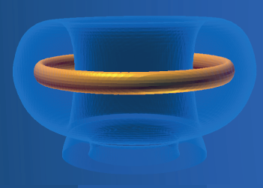
Virtual Application Services (VAS)
Example: the National Fusion Collaboratory
Requirements
  Codes as “network services” (portability reasons)
  Different interaction modes
    Real-time constraints (betw. Experimental pulses: ~15mins)
    Batch jobs where accuracy is important
Client’s view:
Service Provider’s view:
QoS constraints
TRANSP
Factory
Execution
Broker
Meta-data describes
multiple, differently
configured service
Installations

Slide 14
VAS: Behind the scenes
…
usage policies
service meta-data
client (qos1)
Execution Broker
RM
…
VAS
Factory
Negotiate
1. Negotiation
2. Instantiation
execution
plan
execution
plan
client (qosn)
execution
plan
RM
client
service proxy
RM
Adaptive capabilities
Capable of adjusting to different models

Slide 15
Composing Services
Resource composition
  Complex resource configuration
  CPUs, networking, storage…
  Redundant configuration to provide for failure
Application Service Composition
  Workflow and orchestration
  Constraint-based service discovery
  Reliable and Adaptive Workflow execution
  Reproducibility
    Data provenance

Slide 16
Open Grid Services Architecture
From Web services
  Standard interface definition mechanisms
    Interface and implementation (multiple protocol bindings)
    local/remote transparency
    Language interoperability
  A homogenous architecture basis
From Grids
  Service semantics
  Lifecycle management
  Reliability and security models
  Discovery
  Other services: resource management, authorization, etc.

Slide 17
The Grid Service
Description:
Service data access
Explicit destruction
Soft-stage lifetime
Instance:
Reliable invocation
Authentication
…
GridService
(required)
MyService
other interfaces
(optional)
Notification
Service creation
Service registry
Service
data
element
Service
data
element
Service
data
element
Implementation
Hosting environment/runtime
(“C”, J2EE, .NET, Python …)

Slide 18
The Grid Service
A WSDL-defined service that conforms to a set of conventions relating to its interface and behaviors
Description composed of two parts:
  Grid service description
    Describes how a client can interact with service instances: syntax and semantics (portTypes)
    Can be used by any number of GS instances
  Grid service instance
    Embodies state
    Has one or more unique Grid Service Handles
    Has one or more Grid Service References

Slide 19
Grid Service Example
<portType name="GridServicePortType">
<operation name="findServiceData">
<input message="tns:FindServiceDataInputMessage"/>
<output message="tns:FindServiceDataOutputMessage"/>
<fault name="QueryNotSupportedFault" message="ogsa-faults:QueryNotSupportedFault"/>
<fault name="InvalidQueryFault" message="ogsa-faults:InvalidQueryFault"/>
</operation>
<operation name="setTerminationTime">
…
</operation>
<operation name="getTerminationTime">
…
</operation>
<operation name="destroy">
…
</operation>
</portType>
Grid Service Functionality
Database_PortType
Inherits from GridService
<portType name="Database_PortType" extends “gsdl:GridService”>
<operation name="databaseQueryOperation">
<input message="tns:myDatabaseQuery"/>
<output message="tns:myDatabaseResponse"/>
</operation>
</portType>

Slide 20
OGSA Structure
1) WSDL conventions and extensions for describing and structuring services
  Useful independent of “Grid” computing
2) Standard WSDL interfaces & behaviors for core service activities
  Necessary for Grid computing
3) Higher-level services

Slide 21
WSDL Extensions and Conventions
Defined using WSDL extensibility elements
WSDL conventions and extensions
  serviceData: properties of a service that may be queried
  serviceDataDescription:formal description of serviceData elements
  portType inheritance: recently added to WSDL
    Extending portTypes
  Naming conventions on portType and serviceType
  Grid Service Reference (can be a WSDL document)
  Grid Service Handle

Slide 22
Service Data
Describes
  Meta-data (info about the service instance)
  State data (runtime properties)
Service Data Element (SDE)
  Name
  Type (XML type)
  Extensibility attributes
    Lifetime declarations
      goodFrom, goodUntil, availableUntil
    Application-specific
  Extensibility elements
    Service data value
    Application-specific

Slide 23
Service Data Set
A set of SDEs
Each Grid Service must have exactly one service Data Set
Accessible in two ways:
  FindServiceData
  Notification

Slide 24
Naming and Change Management
The change management problem
  GS semantics may evolve
    On the interface level: adding new operations
    On the implementation level: bug fixes, etc.
  Users rely on this behavior
OGSA requirement: all elements of a GS description must be immutable
  Qualified name (namespace and locally unique name) must refer to only one WSDL specification
  If a change is needed a new service with a new qualified name must be defined

Slide 25
Handles and References
Grid Service Handle (GSH)
  Uniquely identifies a service
  Has the form of URI
Grid Service Reference (GSR)
  Contains all the information a client needs in order to communicate with a service
  Its form depends on the binding
GSH must be resolved to GSR in order to use a service
  Information on how to resolve encoded in the URI
Separation of name from implementation details facilitates manipulation of a service

Slide 26
Grid Service Handle
Name in the form of URI
  The URI scheme defines the protocol for resolving it
Properties
  GSH is valid for the lifetime of a GS instance
  Must not refer to more than one service instance
  A GS has at least one GSH
  GSH may resolve to different GSRs pointing to the same service
Resolver protocols
  Untrusted (http)
  Trusted (https)

Slide 27
Grid Service Reference
Network-wide pointer to a specific GS instance
  Web service binding mechanism
  Binding-specific information about the endpoint
  May include expiration time (treat is as a hint)
Binding-specific
  SOAP: WSDL document
  RMI/IIOP: CORBA-compliant IOR
May become invalid during the lifetime of an instance (independent lifecycle)
Many GSRs to a service may exist at the same time
Use of invalid GSR should result in an exception

Slide 28
Standard Interfaces
Grid Service: basic behavior
HandleResolver: mapping from GSH to GSR
Lifecycle
  Support transient services
  Service instances created by factories
  Destroyed explicitly or via soft state
Notifications
  Registering interest and delivering notifications
Registration
  Allows clients to register and unregister registry contents

Slide 29
Grid Service Interface
Must be implemented by all Grid services
Interface:
  FindServiceData
    Input
      QueryExpressionType: query mechanism used
      QueryExpression: actual query
    Output
      Result of Query
  SetTerminationTime
    Request that termination time of this service be changed
    Input: client timestamp and new termination time
    Output: service timestamp and current termination time
  Destroy
    Explicit destruction request, returns an ack

Slide 30
Handle Resolver
Resolves GSH into GSR
  Optionally, the client can do it by itself
Interface
  FindByHandle
    Input: GSH & unsatisfactory GSRs
    Output: GSR
    Faults: invalidHandle, no valid references, etc.

Slide 31
Lifecycle
GS instances created by factory or manually
Destroyed explicitly or via soft state
  Negotiation of initial lifetime with a factory (service supporting Factory interface)
  Lifetime can subsequently be extended by sending “keepalive” messages
Soft state lifetime management avoids
  Explicit client teardown of complex state
  Prevents resource “leaks” in hosting environments

Slide 32
GS Creation: Factory
Creates a new service instance
  Reliable once and only once creation
Interface
  CreateService
    Input:
      TerminationTime
      ServiceParameters (specific to a service)
    Output: ServiceTimestamp information & Service Locator
ServiceLocator can be used to obtain GSH

Slide 33
Grid Service Termination
Explicit destruction
  Destroy operation in the Grid Service
Soft-state destruction
  Allowing the termination time to expire
  SetTerminationTime operation resets the value of the TerminationTime SDE
  Reaffirmation of interest does not guarantee that the service will stay alive

Slide 34
Registry
The Registry interface may be used to register Grid service instances with a registry
  A set of Grid services can periodically register their GSHs into a registry service, to allow for discovery of services in that set
Registrations maintained in a service data element associated with Registry interface
  Standard discovery mechanisms can then be used to discover registered services
  Returns a WS-Inspection document containing the GSHs of a set of Grid services

Slide 35
Example:
Data Mining for Bioinformatics
Community
Registry
Mining
Factory
Database
Service
BioDB 1
User
Application
Compute Service Provider
.
.
.
.
.
.
“I want to create
a personal database
containing data on
e.coli metabolism”
Database
Service
Database
Factory
BioDB n
Storage Service Provider

Slide 36
Example:
Data Mining for Bioinformatics
“Find me a data mining service, and somewhere to store data”
Community
Registry
Mining
Factory
Database
Service
BioDB 1
User
Application
Compute Service Provider
.
.
.
.
.
.
Database
Service
Database
Factory
BioDB n
Storage Service Provider

Slide 37
Example:
Data Mining for Bioinformatics
Community
Registry
Mining
Factory
GSHs for Mining
and Database
factories
Database
Service
BioDB 1
User
Application
Compute Service Provider
.
.
.
.
.
.
Database
Service
Database
Factory
BioDB n
Storage Service Provider

Slide 38
Example:
Data Mining for Bioinformatics
Community
Registry
Mining
Factory
Database
Service
“Create a data mining service with initial lifetime 10”
BioDB 1
User
Application
Compute Service Provider
.
.
.
.
.
.
“Create a
database with initial lifetime 1000”
Database
Service
Database
Factory
BioDB n
Storage Service Provider

Slide 39
Example:
Data Mining for Bioinformatics
Community
Registry
Mining
Factory
Database
Service
“Create a data mining service with initial lifetime 10”
Miner
BioDB 1
User
Application
Compute Service Provider
.
.
.
.
.
.
“Create a
database with initial lifetime 1000”
Database
Service
Database
Factory
BioDB n
Database
Storage Service Provider

Slide 40
Example:
Data Mining for Bioinformatics
Community
Registry
Mining
Factory
Database
Service
Query
Miner
BioDB 1
User
Application
Compute Service Provider
.
.
.
.
.
.
Query
Database
Service
Database
Factory
BioDB n
Database
Storage Service Provider

Slide 41
Example:
Data Mining for Bioinformatics
Community
Registry
Mining
Factory
Database
Service
Query
Miner
BioDB 1
Keepalive
User
Application
Compute Service Provider
.
.
.
.
.
.
Query
Database
Service
Database
Factory
Keepalive
BioDB n
Database
Storage Service Provider

Slide 42
Example:
Data Mining for Bioinformatics
Community
Registry
Mining
Factory
Database
Service
Miner
BioDB 1
Keepalive
User
Application
Compute Service Provider
.
.
.
.
.
.
Results
Database
Service
Database
Factory
Keepalive
Results
BioDB n
Database
Storage Service Provider

Slide 43
Example:
Data Mining for Bioinformatics
Community
Registry
Mining
Factory
Database
Service
Miner
BioDB 1
User
Application
Compute Service Provider
.
.
.
.
.
.
Database
Service
Database
Factory
Keepalive
BioDB n
Database
Storage Service Provider

Slide 44
Example:
Data Mining for Bioinformatics
Community
Registry
Mining
Factory
Database
Service
BioDB 1
User
Application
Compute Service Provider
.
.
.
.
.
.
Database
Service
Database
Factory
Keepalive
BioDB n
Database
Storage Service Provider

Slide 45
Notification Interfaces
NotificationSource for client subscription
  One or more notification generators
    Generates notification message of a specific type
    Typed interest statements: E.g., Filters, topics, …
    Supports messaging services, 3rd party filter services, …
  Soft state subscription to a generator
NotificationSink for asynchronous delivery of notification messages
A wide variety of uses are possible
  E.g. Dynamic discovery/registry services, monitoring, application error notification, …

Slide 46
Grid Portals
A Grid Portal
  An access point and a programming system for using and building grid applications.
Two basic types
  Grid Access Portals
    Provides tools to access standard grid resources and launch and manage jobs
  Science Portals
    Provides a domain specific view of a set of applications that run on the grid.
Accesses Grid Services and uses portlets to provide an interface separate from the service.
Courtesy of Dennis Gannon

Slide 47
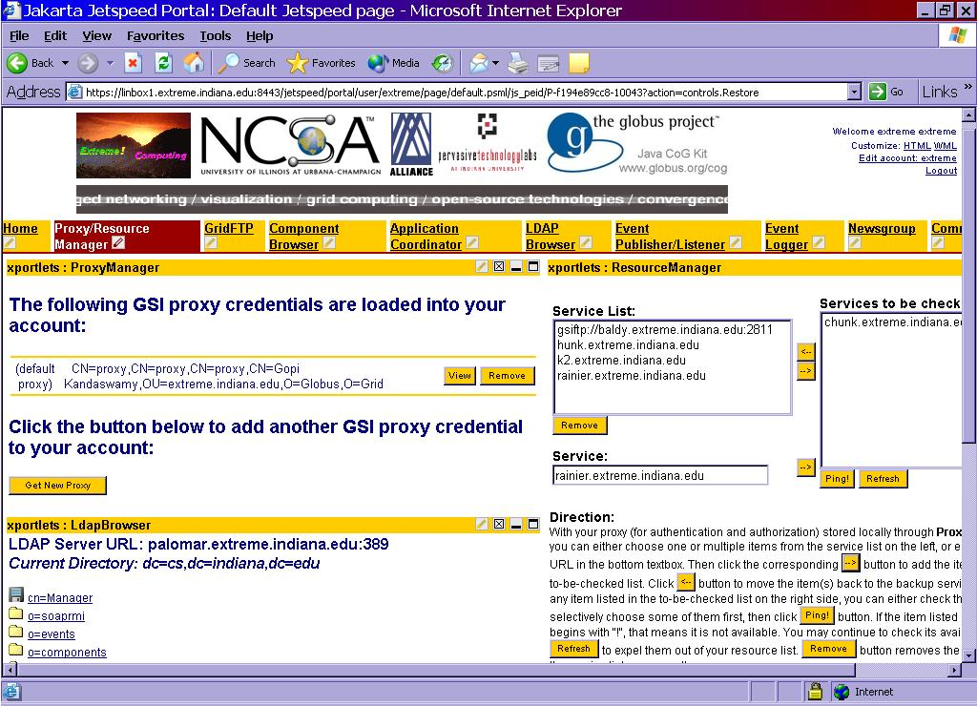

Slide 48
Contacts / Acknowledgements
krjackson@lbl.gov
Slides courtesy of the Globus Project. www.globus.org
This work was supported by the Mathematical, Information, and Computational Science Division subprogram of the Office of Advanced Scientific Computing Research, U.S. Department of Energy, under Contract DE-AC03-76SF00098 with the University of California.

