Slide 1
SYNOPTIC DISPLAY current status
August 13, 2002

Slide 2
Abstract
Synoptic Display is a Java application for flexible online graphical presentation of data received from a data acquisition system.

Slide 3
Structure
Project Builder
Repository Of Components And Projects
Runtime Project Engine
Project Viewer

Slide 4
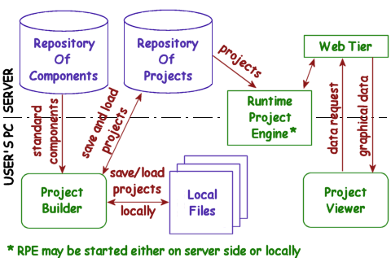
Architecture

Slide 5
Important Points
An open, portable and human readable format is used to convey and store projects, components and graphical data
A central server-side repository is used to store component library and projects (sharing data)
Projects immediately become available for execution

Slide 6
Important Points (continued)
In most cases, a standard web-browser may be used
All console applications are web-startable
Single entry for the Synoptic Display:
http://www-bd.fnal.gov/synoptic

Slide 7
Components
Active – may accept and produce data; have specific runtime implementation
Passive – just immutable SVG elements
Links – describe logical flow of data between active components

Slide 8
Components (continued - I)
Every active component may have some set of internal components (active, passive and links)
Projects are active components
Every component has a set of properties
Active components may have some number of inputs and outputs (pins)

Slide 9
Components (continued - II)
A Java class, responsible for runtime implementation, must be specified for every active component
All active components have description and reference to authors

Slide 10
SVG Availability (Adobe Systems)
 | Microsoft IE | Netscape ver. 4 | Netscape ver. 6 | Mozilla
Windows | Win 98-XP MS IE 4.0+ | Win 98-XP Netsc. 4.5-4.78 | N/A | N/A
UNIXes | N/A | N/A | available ? | available ?
Mac | Mac 8.6-9.1, 10.1 MS IE 5.0+ | Mac 8.6-9.1, 10.1 Netsc. 4.5-4.78 | N/A | N/A

