Slide 1

Parents Under Correctional Supervision: Past Estimates, New Measures
Presented by:
Christopher J. Mumola
Policy Analyst, Bureau of Justice Statistics
U.S. Department of Justice
“Children of Parents in the Criminal Justice System: Children at Risk”
NIDA Research Meeting
North Bethesda, MD - November 6, 2006
Notes:
This afternoon, I will be presenting some findings from an upcoming report on Measures of Length of Stay in State Prisons. Allen and I hope to release that report by the end of the year. I will first describe where the new data come from, then present a few preliminary findings from the report, and I will wrap up with some updates to our Trends in State Parole report that came out in 2001.

Slide 2
Overview
Estimates of the scope of the issue across the criminal justice system
Discussion of data collection challenges
Profile of incarcerated parents’ backgrounds, based on 1997 BJS data
Look ahead to updated measures and new report, Incarcerated Parents, 2004

Slide 3
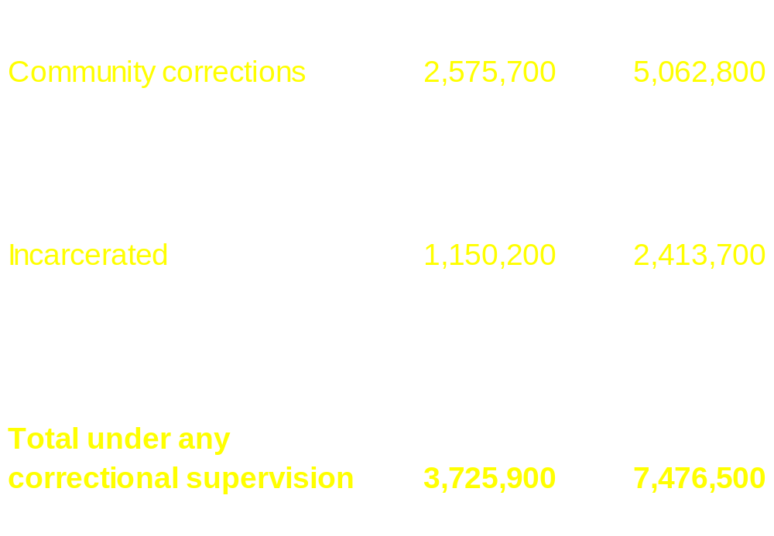
2002 Estimates
Number of parents on probation or parole more than double that of incarcerated parents

Slide 4
Incarcerated Parents and Their Children:
1991-2002 Trends
While substantial, the increase in parents (69%) was actually slower than the growth of other prisoners (75%).
Parents in State & Federal prison: 1991 2002 452,500 765,900
Minor children of prisoners: 1991 2002 936,500 1,591,600
The percentage of State and Federal prisoners who had minor children (56%) changed little since 1991 (57%).

Slide 5
Incarcerated Parents and Their Children:
1991-2002 Trends
Number of parents held in State prison grew by nearly 260,000: violent offenders* = + 113,000 drug offenders = + 60,000 *Admissions data indicate that violent offenders accounted for an even greater share of this growth.
The number of mothers in prison grew 88%, while fathers increased by 61%.

Slide 6

Profile of Parents in State Prison
While parents were more likely to be female than other inmates, over 90% were fathers.
Parents were more likely to be minority inmates (71%) than nonparents (61%).
Though parents were twice as likely (23%) as other inmates (9%) to be married, at least half of parents had their children out of wedlock.

Slide 7
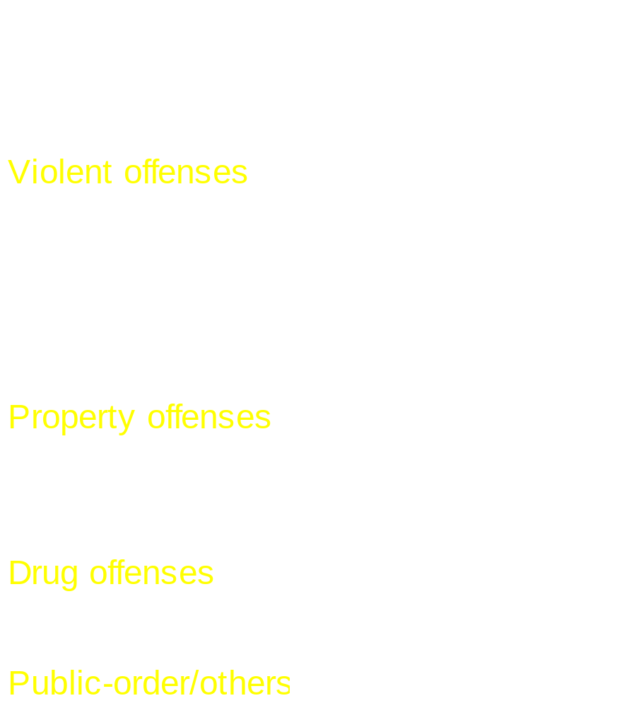
Parents in State Prison: Offenses, Criminal History
Parents (44%) were less likely to be violent offenders than nonparents (51%).
Half (49%) of parents were arrested while already on probation or parole supervision.
60% of parents had multiple prior convictions; 44% had 3+
23% of parents were 1st timers; another 4% were drug crime-only recidivists.

Slide 8
Children of Incarcerated Parents
At yearend 2002, 1 in every 45 minor children in the U.S. had a parent in State or Federal prison
2.2% of the Nation’s 72.5 million minor children had a parent in prison on December 31st, 2002
Racial disparity (1999 estimates): African-American children = 7.0% (1 in 14) Hispanic children = 2.6% (1 in 38) White children = 0.8% (1 in 125)
58% were under 10 years old; mean age = 8 years old

Slide 9
Impact on Children: Households
While not the only measure of parental engagement with children, it is worth noting that most parents in prison were not taken from their children’s homes.
Fewer than 40% of parents in State prison were living with any of their children prior to arrest: Fathers = 36% Mothers = 58%
In 2002, an estimated 358,300 U.S. households with children were missing a resident parent held in State or Federal prison.

Slide 10
Impact on Children: Current Caregivers
The consequences for care of children vary dramatically depending on gender of incarcerated parent
Current caregiver while father is in State prison: 90% = child’s mother 13% = child’s grandparents 5% = other relatives 2% = foster care / agency / institution
Current caregiver while mother is in State prison: 28% = child’s father 53% = child’s grandparents 26% = other relatives 10% = foster care / agency / institution
Note: Percentages sum to more than 100% because some parents had children in more than one residence.

Slide 11
Impact on Children: Contact with Parents
Parents reported frequent telephone/mail contact with their children, but fewer than 1 in 4 reported a monthly visit with their children
Most parents in State prison reported some form of regular contact (phone, mail, or visits):
Monthly: fathers = 62% mothers = 78% Weekly: fathers = 40% mothers = 62%
A majority of both fathers (57%) and mothers (54%) in State prison said they never had visits from their children.

Slide 12
Impact on Children: Prison Time to Serve
Given length of prison terms reported by parents, the average parent in State prison will be released before their child reaches 18.
Total time parents expected to serve (mean): Fathers = 6 yrs. 10 mos. (55% of sentence) Mothers = 4 yrs. 1 month (52% of sentence)
Expected to serve less than 2 years: Fathers = 18% Mothers = 38%
Expected to serve more than 10 years: Fathers = 21% Mothers = 8%

Slide 13
Parents in State Prison: Substance Abuse
Parents reported serious substance abuse histories, slightly higher than other prisoners
Any drug use in the month before offense: Fathers = 58% Mothers = 65% Cocaine/crack: Fathers = 26% Mothers = 45%
Under the influence of drugs when committing crime: Fathers = 33% Mothers = 43%
Committed their crime under the influence of alcohol: Fathers = 37% Mothers = 29%

Slide 14
Parents in State Prison: Mental Illness, Homelessness
Parents were less likely to report indications of mental illness (14%) or recent experiences of homelessness (9%) than other prisoners (19%, and 12% respectively).
Reported indications of mental illness: Fathers = 13% Mothers = 23%
Homeless in the past year before arrest: Fathers = 8% Mothers = 18%

Slide 15
Upcoming Report: Incarcerated Parents, 2004
Updated estimates of number of incarcerated parents, and the number of minor children affected will be based on the Survey of Inmates in State and Federal Correctional Facilities, 2004.
Many topics from the 2000 report will be updated, but new measures also available for the first time:
  DSM-IV measures of alcohol/drug dependence and abuse (see Drug Use and Dependence, State and Federal Prisoners, 2004, released in October)
  Improved measures of mental health problems, based on both a recent history of mental health problems, and self-reports of recent symptoms of three major mental health disorders: depression, mania and psychotic disorders (see Mental Health Problems of Prison and Jail Inmates)

Slide 16
Upcoming Report: Incarcerated Parents, 2004
Report should include an updated count of parents under all forms of correctional supervision:
  New estimates of parents on State and Federal parole can be based on 2004 prisoner survey data
  New estimate of parents in jail can be drawn from the Survey of Inmates in Local Jails, 2002
Release of report expected in early 2007

Slide 17
Contact Info: Christopher Mumola
Bureau of Justice Statistics
Phone: 202-307-0765 christopher.mumola@usdoj.gov
For a copy of the report,
Incarcerated Parents and Their Children
go to:
http://www.ojp.usdoj.gov/bjs

