Slide 1
From Compliance to Alliance for the Medication Management of Clients Suffering from Psychotic Disorders
Peter Weiden, M.D.
Professor of Psychiatry
SUNY Downstate Medical Center
Brooklyn, New York

Slide 2
Power Issues
Power imbalance between client and psychiatrist
Implies disobedience to authority
Socially undesirable

Slide 3
Conceptualizing “Compliance”
Disagreement
Deviation
Cessation
Efficacy

Slide 4
Efficacy Model
Difference between prescribed treatment and actual behavior is large enough to have an adverse effect on outcome.
© Peter Weiden, M.D.

Slide 5

Relapse in Schizophrenia
100
90
80
70
Neuroleptics
60
50
% Not Relapsed
40
Placebo
30
Hogarty et al., N = 374
Prien et al., N ≈ 630
Caffey et al., N = 259
20
Months
Baldessarini RJ et al: Tardive Dyskinesia: APA Task Force Report 18, 1980

Slide 6
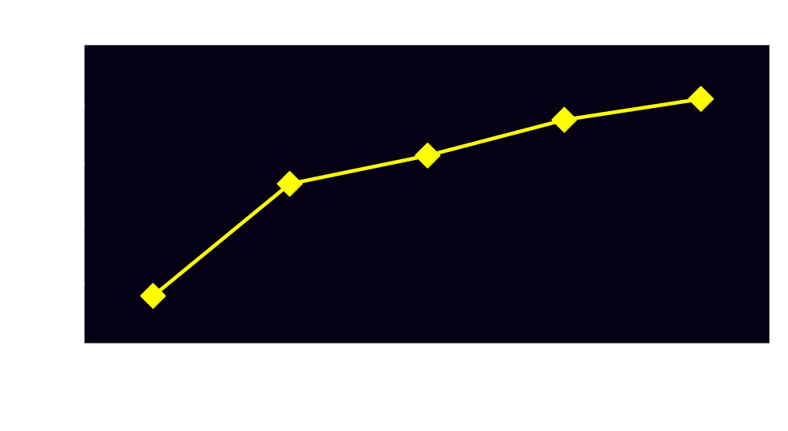
Risk of Relapse Following Recovery in First-Episode Patients
Cumulative Proportion Relapsed
Year After Recovery from First Episode

Slide 7
Efficacy and Compliance
STOPPING antipsychotic medication COMPLETELY EVENTUALLY leads to relapse
Assuming diagnosis of schizophrenia is correct, no way to get around this finding

Slide 8

Time until First-Episode of Medication Noncompliance
Month after discharge
© Peter Weiden, M.D.

Slide 9
Clinical Illusions
Poor outcome ≠ poor compliance
Need to disentangle efficacy limitations from compliance problems

Slide 10
Medication Noncompliance
Symptom Exacerbation
Relapse
© Peter Weiden, M.D.

Slide 11
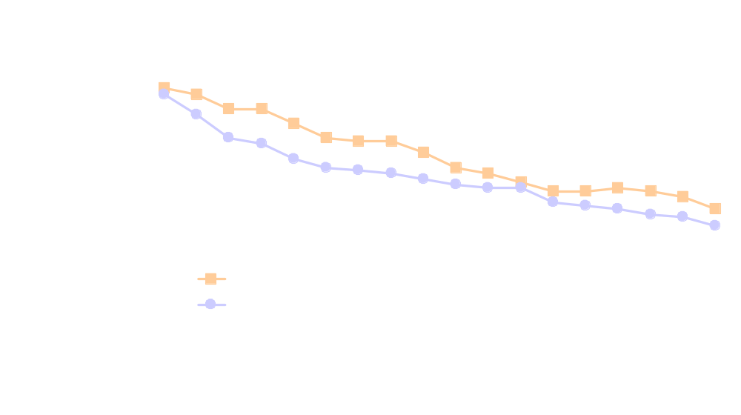
Relapse and Conventional Antipsychotics
Patients Receiving Oral vs Depot Fluphenazine
Proportion remaining
in the community
Schooler et al. Arch Gen Psychiatry. 1980;37:16.

Slide 12
Symptom Exacerbation
Medication Noncompliance
Relapse
© Peter Weiden, M.D.

Slide 13
Hierarchy of Long-Term
Pharmacologic Goals
Regain
Functioning
Improve Quality of Life
Maintain Stability
© Peter Weiden, M.D.

Slide 14
Hierarchy of Long-Term
Pharmacologic Goals
Maintain Stability

Slide 15
Risperidone vs Haloperidol:
Time to Relapse
100
90
1 year
Risperidone
80
Haloperidol
70
60
Survival probability
50
40
30
Mean Time to Relapse (SE)*
Risperidone 452.23 days (17.68)
Haloperidol 391.33 days (21.83)
20
10
P=0.001†
0
0
100
200
300
400
500
600
700
800
Days
Csernansky et al. N Engl J Med. 2002;346:16.

Slide 16
Medications and Life Goals
Many clients have difficult lives
They want to “get a life”
Relapse prevention does not mean “getting a life”
Many clients have trouble connecting taking medications with “getting a life”

Slide 17
Hierarchy of Long-Term
Pharmacologic Goals
Regain
Functioning
Improve Quality of Life
Maintain Stability

Slide 18
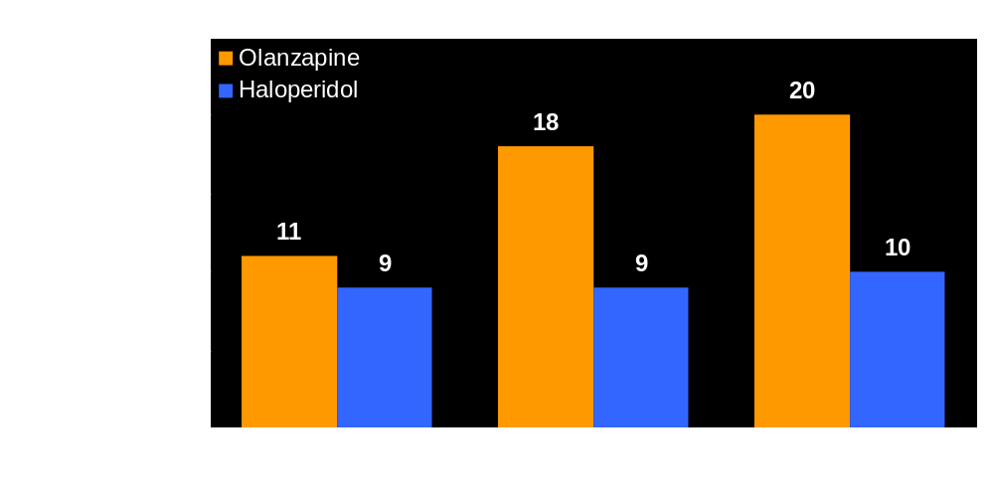
“Getting a Life”: Employment Status Over 1 Year
of Patients on Olanzapine vs Haloperidol

Slide 19
Medications and Life Goals
What are your goals?
What has to happen to meet your goals?
Introduce concept of relapse – would a relapse be disruptive?
Newer medications are much more likely to help you “get a life”

Slide 20
Factors Contributing to
Fluctuating Compliance
Accept-
ability
of side
effects
Change in
relationships
Substance
Abuse
Time
stable
Symptoms
Notes:
6
7

Slide 21
Overview of Health Belief Model
Perception is reality!
Key factors
  Subjective Benefits
  Subjective “Costs”
Behavior determined by summation of both compliance and noncompliance factors
© Peter Weiden, M.D.

Slide 22
Health Belief Model of Compliance
Perceived Benefits
Perceived Costs
Tips scale towards
compliance
Tips scale towards noncompliance
Bottom line: Perception is reality!
© Peter Weiden, M.D.

Slide 23
Rating of Medication Influences (ROMI) Scale
Compliance
Influence
Prevention of illness
Daily benefit
Relationships with others
Noncompliance
Influence
Denial
Dysphoria
Lack of benefit
Stigma
    Weiden PJ et al. Schizophr Bull. 1994;20:297-310.
© Peter Weiden, M.D.

Slide 24
Greater PERCEIVED Benefits?
Better Efficacy
Perceived benefits
Side-effects
© Peter Weiden, M.D.

Slide 25
Fewer PERCEIVED Benefits?
Perceived benefits
Side-effects
Better Efficacy
© Peter Weiden, M.D.

Slide 26
Minimzing Side Effects
Perceived Benefits
Tips scale towards
compliance
Perceived side effects
Tips scale towards noncompliance

Slide 27
Subjective Response to Conventional Antipsychotics
“Haldol brought on the most frightening side effects I’d yet experienced….Haldol made me feel like the Tin Man from the Wizard of Oz …They’re strangling you, said my voices gleefully.” *
* From The Day the Voices Stopped by Ken Steele
Basic Books, 2001, page 93

Slide 28
Subjective Response to Anticholinergic Effects
“ ‘It may be a side effect of your new medication, Cogentin,’ she said. ‘It often causes blurred vision. Don’t worry. It’s nothing serious.’ ”
“ Nothing serious? If I couldn’t read, I wouldn’t survive in this madhouse.” *
* From The Day the Voices Stopped by Ken Steele
Basic Books, 2001, page 67

Slide 29
EPS to Noncompliance
Direct Path
EPS
Distress
“Zombie”
Noncompliance
© Peter Weiden, M.D.

Slide 30
Less EPS May Help Patients Learn About Benefits
Perceived Benefits
EPS
Tips scale towards noncompliance
Tips scale towards
compliance
© Peter Weiden, M.D.

Slide 31
Impact of Visible EPS
Indirect Path
EPS
Visibly
“Medicated”
Family gets distressed
Family stops supporting
medication
Noncompliance
© Peter Weiden, M.D.

Slide 32
Bottom Line:
Goal should be NO EPS
EPS
© Peter Weiden, M.D.
Notes:
It is hard to overstate the importance of this shift in thinking. We have gone 180 degrees from wanting – or expecting – EPS. Now, we don’t have to cause EPS in our patients. of course, that may not be true 100% of the time. There will be patients who require long-acting depot medications, for example. Others may respond only to a given medication that, for that patient, causes EPS. However, that said, MOST OF THE TIME IT IS POSSIBLE TO PROVIDE OPTIMAL ANTIPSYCHOTIC BENEFITS WITHOUT ANY CLINICALLY SIGNIFICANT EPS!

Slide 33
Criteria for Achieving NO EPS
No recent history of EPS
No physical findings of EPS
No subjective complaints of EPS
No need for anti-EPS medications
Notes:
These are some suggested operational criteria for No EPS.
NO HISTORY OF EPS: The patient (or family) do not give a history of recent EPS such as tremor, muscle stiffness, dystonia, restlessness, between sessions. The reason this is important is that EPS tends to wax and wane, and may not be present all the time in physical exam. For example, acute dystonia tends to occur during times of emotional stress. Rigidity may come after repetitive muscle movements from a job.
NO PHYSICAL FINDINGS OF EPS: This is straightforward, but highlights the need to check for subtle signs of EPS on physical exam. While the AIMS is helpful for TD, keep in mind that it does not cover any of the other EPS such as dystonia, akathisia, tremor, muscle rigidity,tremor, or akinesia.
NO SUBJECTIVE COMPLAINTS OF EPS: Many kinds of EPS present with subjective complaints or with behavioral difficulties. The most common complaints are restlessness from akathisia “I’m jumping out of my skin” or akinesia “I feel like a zombie”. One of the problems is that the behavioral/subjective components of EPS often overlap with psychiatric symptoms. Sometimes a way to distinguish between the possiblities is by the pharmacologic history – other times, it may be virtually impossible to distinguish. Nonetheless, these are often misdiagnosed and now can be treated with low-EPS agents.
NO ANTICHOLINERGIC OR OTHER ANTI-EPS MEDICATIONS: if the patient needs ot be on an anticholinergic, the patient is not really EPS free. The patient may be relieved of the worst of the EPS symptoms, but now has to continue on other treatments with their own problems and side effects. Anticholinergic agents may worsen certain cognitive domains, may worsen dyskinetic symptoms, and often are not fully effective in fully treating the subjective distress parts of the EPS.

Slide 34
What about Atypical Antipsychotics?
New medications are better, and …
They are now first line in the US, but …
They do not solve the compliance problem

Slide 35

Availability of Antipsychotic Medication:
One-Year Naturalistic Study
Mean number of days with no therapy
Mahmoud RA et al. Poster presented at: 36th Annual Meeting of the ACNP;
December 8-12; Kamuela, Hawaii; Data on file, Janssen Pharmaceutica Products, L.P. 1997.

Slide 36
Reported Frequency of Side Effects*
Conventional vs Atypical Antipsychotics
Conventional group
Tremors
Atypical
Conventional group
Restless
Jittery
Atypical group
0
10
20
30
40
50
Percentage of Patients
*Includes patients who were frequently or very frequently distressed by their side effect irrespective of frequency
with which they reported it.
Weiden P, Mackell J. Presented at: 152nd Annual Meeting of the APA; May 15-20,1999; Washington, DC.

Slide 37
Frequency of Patients Being
Distressed by Side Effects
Conventional vs Atypical Antipsychotics
Conven
tional
Sexual
Dysfunction
Atypical group
Conventional
Weight Gain
Atypical group
*
0
10
20
30
40
50
Percentage of Patients
*P = .02.
Weiden P, Mackell J. Presented at: 152nd Annual Meeting of the APA; May 15-20,1999; Washington, DC.

Slide 38
Approach to Side Effects
Prevention
Tailoring medication choice using patient preference(s)
Always ask about side effects
Take any distress very seriously

Slide 39
Approach to Side Effects
Collaborate with patient in side effect treatment decisions
Educate significant others about side effects
Consider impact of side effects on others
Consider changing medications when side effects impact on compliance
© Peter Weiden, M.D.

Slide 40
Compliance Interventions
Psychosocial
Pharmacologic

Slide 41
Compliance Therapy Study Methods
Random-assignment inpatient study in London
4-6 sessions in the hospital lasting 20-60 minutes each
Followed as outpatients after discharge
“Booster” sessions at 3, 6, and 12 months
Kemp R et al. Br J Psychiatry. 1998;172:413-419.

Slide 42
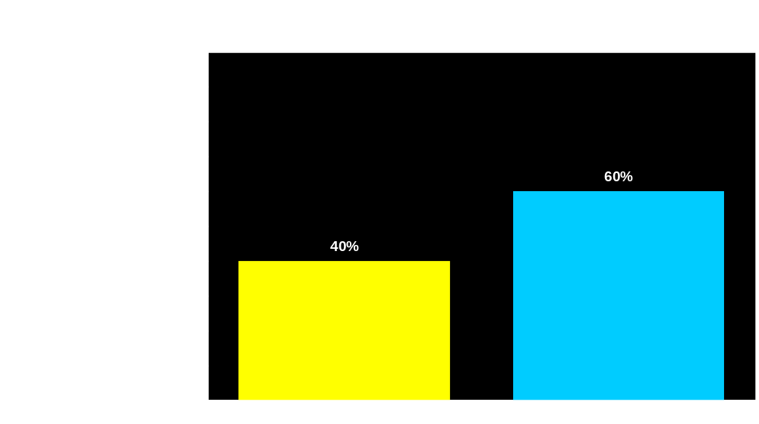
Compliance Therapy: Estimated Rehospitalization Rates at 1-Year Follow-Up
*
* 95% CI 1.16-4.18.
Compliance Therapy
n = 39
Control Group
n = 35
Kemp R et al. Br J Psychiatry. 1998;172:413-419.

Slide 43
Potential Advantage of a
Long-Acting Antipsychotics
Tracking of compliance status
  Eliminates guessing about compliance status
  “Alarm clock” – alerts clinician when noncompliance starts
  Helps disentangle reasons for poor response to medication
© Peter Weiden, M.D.

Slide 44
Conclusion
Always put efficacy before “compliance”
Disentangle lack of efficacy from noncompliance
Important to frame “compliance” as a way to achieve better outcome
Important to understand side effects in context of health belief model

