Slide 1


International Energy Outlook 2003 for India and “Other Asia”
Zia Haq
Energy Information Administration
South Asia Regional Initiative – Energy Workshop
Pokhara, Nepal
January 2004
Notes:
The Energy Information Administration (EIA) released its mid-term projections of international energy use and carbon emissions, published in the International Energy Outlook 2003 (IEO2003) on May 1, 2003. The IEO2003 is EIA’s annual assessment of world energy markets with projections of regional energy consumption, energy consumption by primary fuel, electricity consumption, carbon emissions, nuclear generating capacity, and international coal trade flows. World oil production projections is also included in the report.
There are two new developments associated with the IEO2003. First, the forecast horizon has been extended to 2025. Second, this edition of the IEO marks the debut of our new modeling system, the System for the Analysis of Global Energy Markets-- or SAGE-- model. The new model applies a ‘bottom up’ approach to energy modeling, incorporating assumptions about future technological investments at the energy end use sector to determine the consumption of primary energy sources.
The report is an extension of EIA’s Annual Energy Outlook (AEO), and the U.S. projections that appear in the IEO are consistent with those published in the AEO.
The projections in the IEO2003 are not statements of what will happen, but what might happen given the specific assumptions and methodologies used. These projections provide an objective, policy-neutral reference case that can be used to analyze international energy markets. Models are abstractions of energy production and consumption activities, regulatory activities, and producer and consumer behavior. The forecasts are highly dependent on the data, methodologies, model structures, and specific assumptions used in their development. Trends depicted in the analysis are indicative of tendencies in the real world rather than representations of specific real-world outcomes.

Slide 2
Introduction
International Energy Outlook 2003 provides global world energy forecasts under five scenarios: Reference, high economic growth, low economic growth, high world oil price, low world oil price
The world is divided into six basic regions: Industrialized countries, Eastern Eruope and Former Soviet Union, Developing Asia, Middle East, Africa, Central and South America
“Developing Asia” is further divided into: China, India, South Korea, and other Asia
“Other Asia” includes: SARI countries, and other South Asian countries
Forecasts should be viewed as points for discussion rather than predictors of what will happen – comments are welcome
Updated annually and available on the web at http://www.eia.doe.gov/oiaf/ieo/index.html
Notes:
“Other Asia” includes: Afghanistan, Bangladesh, Bhutan, Brunei, Cambodia (Kampuchea), Fiji, French Polynesia, Guam, Hong Kong, Indonesia, Kiribati, Laos, Malaysia, Macau, Maldives, Mongolia, Burma, Nauru, Nepal, New Caledonia, Niue, North Korea, Pakistan, Papua New Guinea, Philippines, Samoa, Singapore, Solomon Islands, Sri Lanka, Taiwan, Thailand, Tonga, Vanuatu, and Vietnam.
Therefore, it can be expected that “other Asia” will be dominated by trends in the the major energy consumers (Indonesia, Malaysia, Philippines, Singapore, Taiwan, Thailand).

Slide 3
IEO2003 India and Other Asia Economic Growth Forecasts
India GDP growth rate: low economic growth 4.2%/year, reference 5.2%/year, high economic growth 6.3%/year from 2001 through 2025
Prospects for India’s growth through 2025 are encouraging if the country continues to privatize state enterprises and adopt free market policies
Other Asia GDP growth rate: low economic growth 3.2%/year, reference 4.3%/year, high economic growth 5.3%/year from 2001 through 2025
For other Asia, the growth engine continues to be consumer demand and exports such as electronics and computer exports to industrialized countries

Slide 4
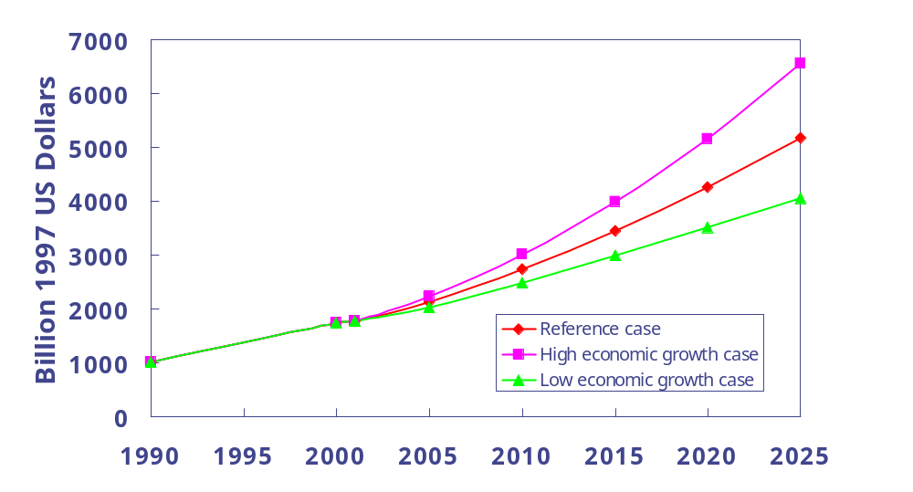
GDP in 3 Growth Cases for India and “Other Asia”
History
Forecast
GDP growth rates (%/year) for India and “Other Asia” combined 2001 - 2025
High growth | 5.61
Reference | 4.57
Low growth | 3.53
Reference case India GDP growth rate forecast 5.2%/year, “other Asia” GDP growth rate forecast 4.3%/year for 2001-2025
High economic growth case India GDP growth rate forecast 6.3%/year, “other Asia” GDP growth rate 5.3%/year
Low economic growth rate India GDP growth rate forecast 4.2%/year, “other Asia” GDP growth rate 3.2%/year
Source: EIA, International Energy Outlook 2003

Slide 5
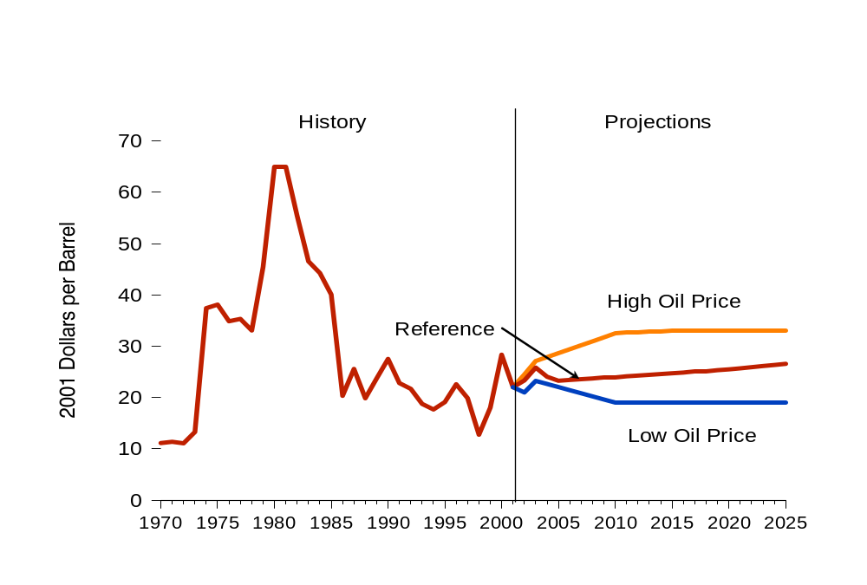
World Oil Prices in Three Cases, 1970-2025
Source: EIA, International Energy Outlook 2003
Notes:
Three possible long-term price paths are included in the IEO2003. In the reference case, projection, world oil prices reach $27 per barrel in 2001 dollars ($48 per barrel in nominal dollars) at the end of the projection period. Prices are substantially the same as in last year’s forecast. In the low price case, prices are projected to fall to $19 per barrel by 2010 and to remain at that level out to 2025. In the high price case, prices are projected to reach $33 per barrel by 2015 and remain at about that level out to 2025. The projected leveling off in the high price case is due to the market penetration of alternative oil supplies that could become economically viable at that price.
In all the IEO2003 oil price cases, oil demand is expected to rise significantly over the projection period. In the high and low world oil price cases, the projected rise in oil consumption ranges from a low of 36 million barrels per day to a high of 48 million barrels per day, respectively. There is widespread agreement that resources are not a key constraint on world demand to 2025. Rather more important are the political, economic, and environmental circumstances that could shape developments in oil supply and demand.

Slide 6
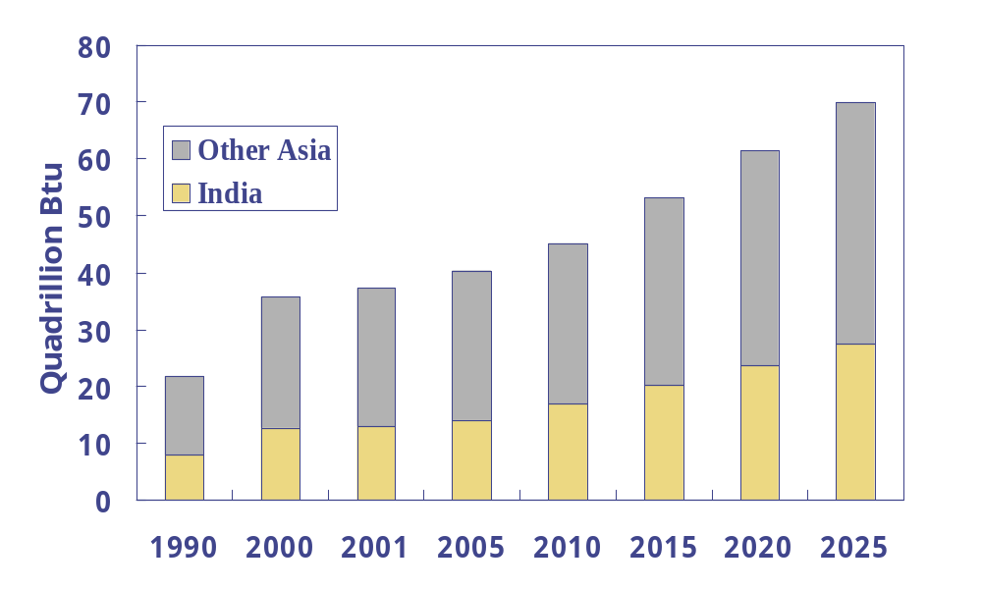
Commercial Energy Consumption,
History and Forecast
History
Forecast
Growth rates (%/year) 2001 - 2025
India | 2.3
Other Asia | 3.2
India commercial energy consumption 12.8 Quads in 2001 growing to 27.4 Quads by 2025
Other Asia commercial energy consumption 24.5 Quads in 2001 growing to 42.5 Quads by 2025
Total 37.3 Quads in 2001 and 69.9 Quads by 2025
Source: EIA, International Energy Outlook 2003
Notes:
The IEO2003 mid-term outlook continues to show robust growth for energy among the developing nations of the world, particularly in developing Asia (including China and India), where demand for energy is expected to more than double over the next quarter century.
This is the reference case scenario. This assumes a “business-as-usual” situation and reference case world oil price projections.
The IEO only accounts for commercial energy consumption, and does not take into account biomass energy use. This is due to the lack of reliable data on biomass use in many countries. This accounts for coal, oil, natural gas, nuclear, and hydroelectricity consumption in all sectors (residential, commercial, industrial, transportation, and electricity generation).

Slide 7
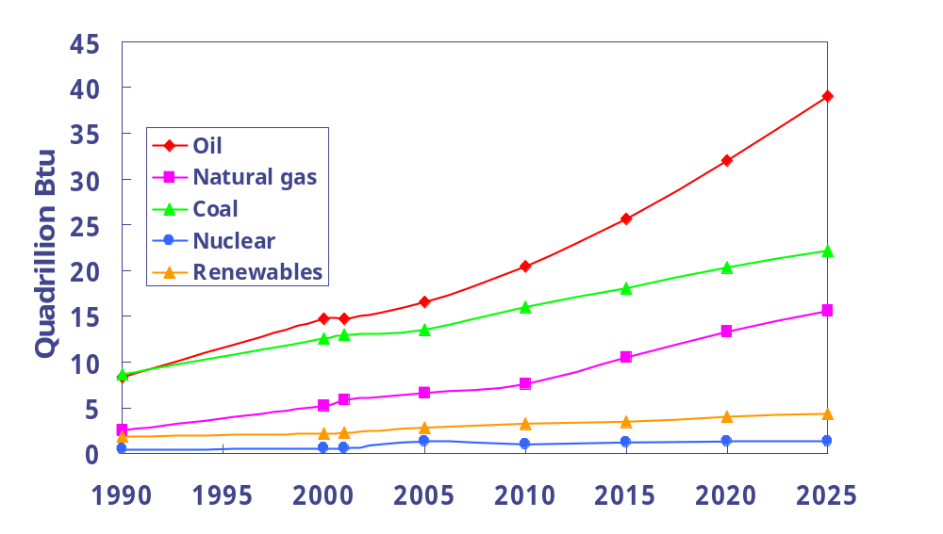
Commercial Energy Consumption by Fuel Type
History
Forecast
Growth rates (%/year) 2001 - 2025
Oil | 4.14
Natural gas | 4.17
Coal | 2.25
Nuclear | 3.49
Renewables | 2.64
By 2025 the 69.9 Quads of demand is met by oil 39.0 Quads, coal 22.2 Quads, natural gas 15.6 Quads
Renewables continues to play a smaller role at 4.3 Quads and nuclear contributes 1.28 Quads to the total energy demand
Source: EIA, International Energy Outlook 2003
Notes:
The total 69.9 Quads by 2025 is accounted for primarily by oil consumption, indicating the growth of the transportation sector.
Natural gas shows the highest growth rate, reflecting the increased demand for natural gas based power generation projects in India and other Asia.

Slide 8
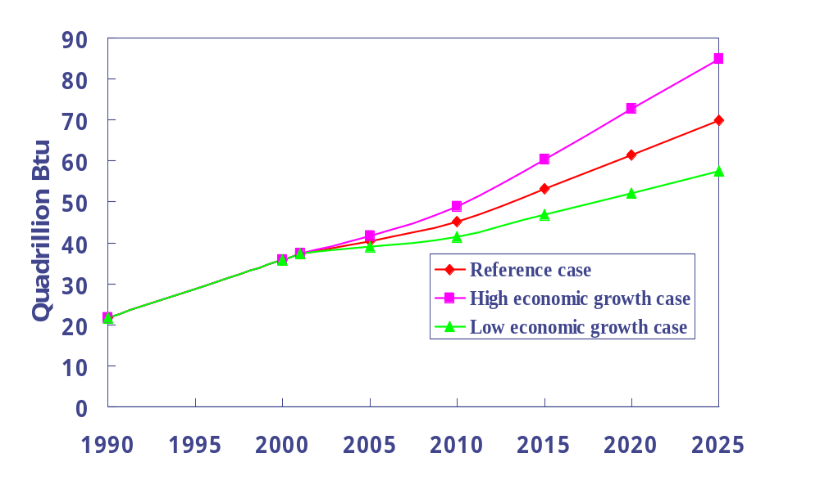
Commercial Energy Consumption in Three Economic Growth Cases
History
Forecast
GDP growth rate (%/year) for India and other Asia 2001 - 2025
High growth | 3.49
Reference | 2.65
Low growth | 1.81
The IEO energy forecasts are dependant upon economic growth rate forecasts for the region
The commercial energy consumption varies from 57.4 Quads in the low economic growth case to 69.9 Quads in the reference case to 84.9 Quads in the high economic growth case
Source: EIA, International Energy Outlook 2003
Notes:
India GDP growth rate: low economic growth 4.2%/year, reference 5.2%/year, high economic growth 6.3%/year from 2001 through 2025
Other Asia GDP growth rate: low economic growth 3.2%/year, reference 4.3%/year, high economic growth 5.3%/year from 2001 through 2025

Slide 9
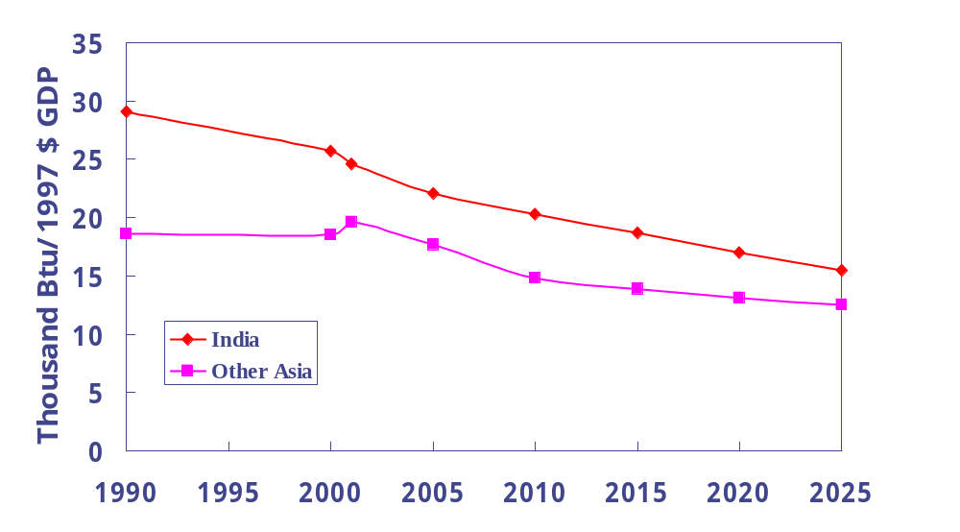
Economic Energy Intensity in Reference Case
History
Forecast
Growth rates (%/year) 2001 - 2025
India | -1.92
Other Asia | -1.86
India energy intensity was 24,570 Btu/$GDP (year 1997$) in 2001, declining to 15,440 Btu/$GDP by 2025
Other Asia energy intensity was 19,650 Btu/$GDP in 2001, declining to 12,520 Btu/$GDP by 2025
Source: EIA, International Energy Outlook 2003
Notes:
Energy intensity measures the link between energy consumption and growth in GDP. Higher energy intensity reflects an economy that is dependant on old and inefficient technologies and manufacturing and industrial sectors for growth. A lower energy intensity reflects an economy with newer manufacturing facilities and one that is dependant on service sector jobs for growth.
In industrialized countries the link between energy consumption and economic growth is weak, whereas in developing countries energy consumption and economic growth are more closely correlated.
For example, for more than 30 years, the Eastern European/Former Soviet Union countries have maintained a much higher level of energy intensity than either the industrialized or developing countries. By 2025, the EE/FSU energy intensity is expected to decline by 2.1%/year, similar to the growth rates seen in India and other Asia. However, it is still expected to be twice as high as in the developing world and 5 times as high as in the industrialized world.

Slide 10
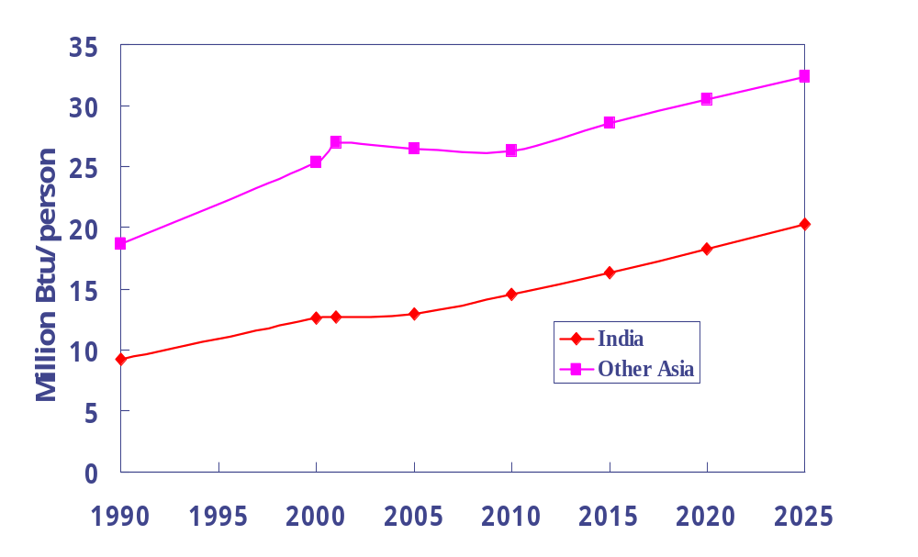
Population Energy Intensity in Reference Case
History
Forecast
Growth rates (%/year) 2001 - 2025
India | 1.97
Other Asia | 0.76
India population energy intensity was 12.69 million Btu/person in 2001, and this grows to 20.27 million Btu/person by 2025
Other Asia population energy intensity was 27.01 million Btu/person in 2001, and this grows to 32.39 million Btu/person by 2025
Source: EIA, International Energy Outlook 2003
Notes:
Another way to analyze the energy situation is the population energy intensity or the amount of energy consumed per capita.
India has a good growth rate in population energy intensity but is significantly below the other Asian countries.
India population was 1,009 million in 2001 and is forecasted grow to 1,352 million by 2025, or a population growth rate of 1.2%/year. Population growth forecasts from UN, “World Populations”, 2000 revision.
Other Asia population was 907 million in 2001 and is forecasted to grow to 1,312 million by 2025, or a population growth rate of 1.6%/year.

Slide 11
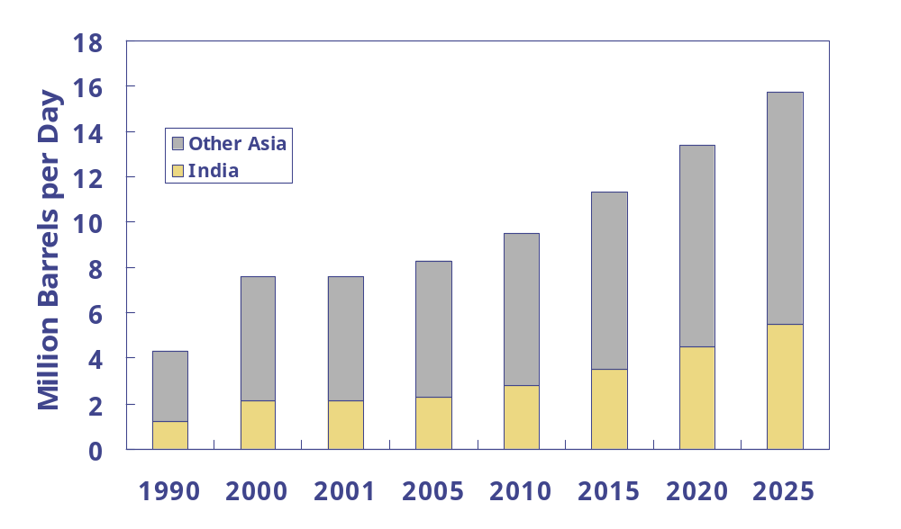
Oil Consumption, Reference Case
History
Forecast
Growth rates (%/year) 2001 - 2025
India | 4.0
Other Asia | 2.6
India oil demand 2.1 million barrels/day in 2001 grows to 5.5 million barrels/day by 2025. 70% of increase in demand is for transportation sector.
Other Asia oil demand 5.5 million barrels/day in 2001 grows to 10.2 million barrels/day by 2025. Lowering of import tariffs within ASEAN-FTA are creating a competitive economic environment and resulting in oil demand growth.
Source: EIA, International Energy Outlook 2003
Notes:
Association of Southeast Asian Nations (ASEAN), Free-Trade Area (FTA)

Slide 12
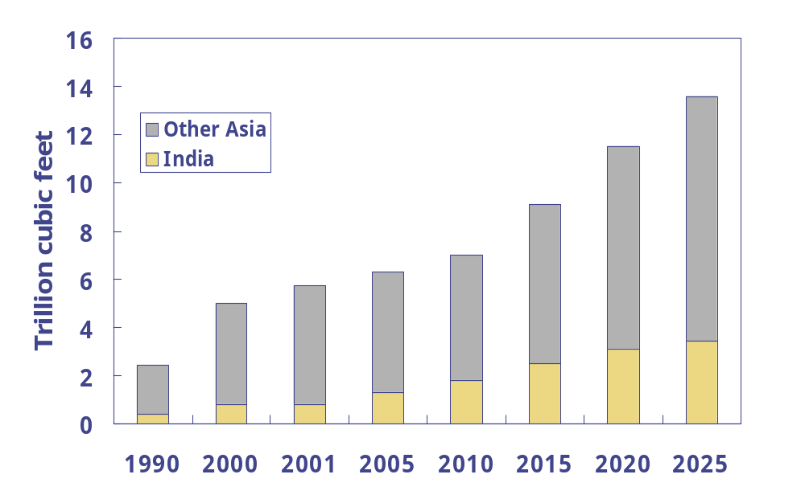
Natural Gas Consumption, Reference Case
History
Forecast
Growth rates (%/year) 2001 - 2025
India | 6.1
Other Asia | 3.1
India’s natural gas consumption in 2001 was 0.8 TCF which rises to 3.4 TCF by 2025
Other Asia’s natural gas consumption in 2001 was 4.9 TCF which rises to 10.2 TCF by 2025
Source: EIA, International Energy Outlook 2003
Notes:
Natural gas is the fastest growing source of primary energy. In the IEO2003 reference case, natural gas consumption for India and Other Asia in 2025 is projected to total 13.6 trillion cubic feet, nearly double the 2001 total of 5.7 trillion cubic feet. The largest increments in natural gas use are expected to occur in the EE/FSU (23 trillion cubic feet), followed by North America (19 trillion cubic feet), and developing Asia (14 trillion cubic feet).
Much of the projected growth in natural gas consumption throughout the world is in response to rising demand for natural gas to fuel efficient new gas turbine power plants. In the IEO2003 reference case, the projections for natural gas consumption by electricity generation show more rapid growth than the projections for any other fuel.
Note the very high growth rates being forecast for India. New categories of natural gas consumption such as CNG vehicles will add to the demand for natural gas in addition to the demand imposed by power plants.

Slide 13
Natural Gas Forecast, Reference Case
India natural gas consumption 0.8 TCF/year in 2001, increasing to 3.4 TCF/year by 2025, met by increases in domestic production and imports
India domestic reserves estimated to be 26 TCF (Bombay High offshore, Gujarat, Brahmaputra Valley, Andhra Pradesh, Krishna Godavari Basin)
Most of the India’s growth in demand expected to be for power generation to be met by imported LNG
Other Asia natural gas consumption 4.9 TCF/year in 2001, increasing to 10.2 TCF/year by 2025
Significant growth potential for Bangladesh to use its natural gas resources for a variety of domestic end uses including electricity, residential, transportation, fertilizer
Major producers and exporters are Indonesia and Malaysia, Brunei and Australia.

Slide 14
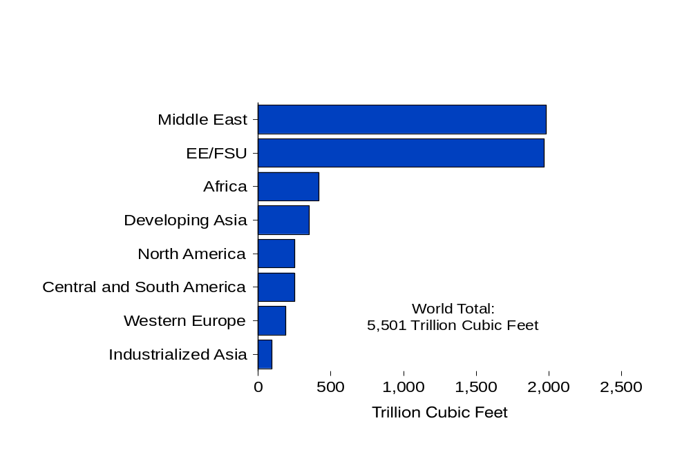
World Natural Gas Reserves by Region, as of January 1, 2003
Source: "Worldwide Look at Reserves and Production," Oil & Gas Journal,
Vol. 100, No. 52, December 23, 2001, pp. 114-115.
Notes:
Natural gas reserves are abundant but concentrated in the former Soviet Union and the Middle East. Since the mid-1970s, world natural gas reserves have in general increased each year. As of January 1, 2003, proved world natural gas reserves, as reported by Oil & Gas Journal, were estimated at 5,501 trillion cubic feet, 50 trillion cubic feet more than the estimate for 2002.
Most (about 71 percent) of the world’s natural gas reserves are located in the Middle East and the EE/FSU, with Russia and Iran together accounting for about 45 percent of the world’s natural gas reserves. Reserves in the rest of the world are fairly evenly distributed on a regional basis.
Despite high rates of increase in natural gas consumption, particularly over the past decade, most regional reserves‑to‑production ratios have remained high. Worldwide, the reserves‑to‑production ratio is estimated at 62 years.
The challenge will remain moving supplies to consuming markets via pipelines and/or LNG facilities.

Slide 15
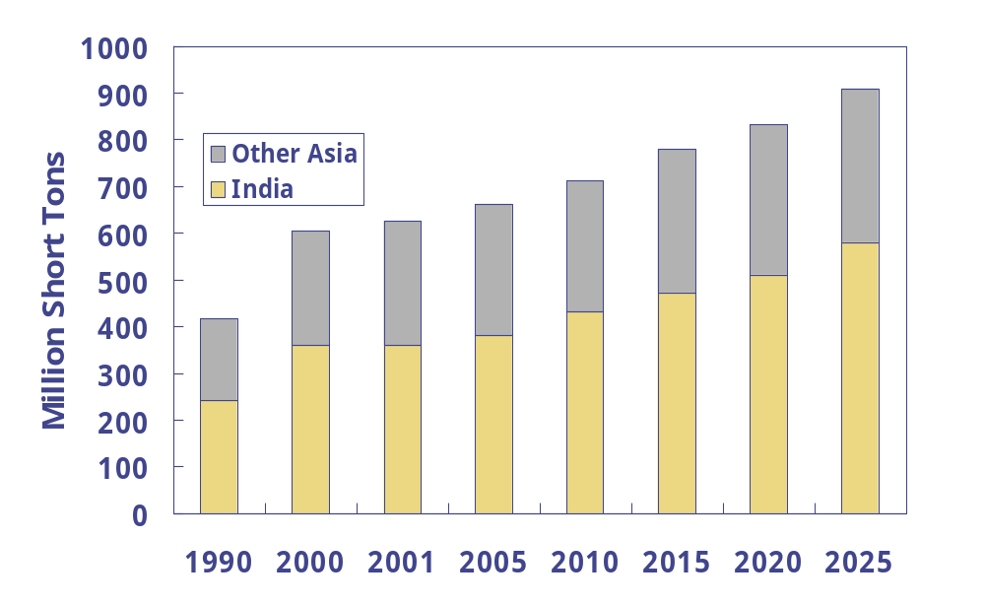
Coal Consumption, Reference Case
History
Forecast
Growth rates (%/year) 2001 - 2025
India | 2.0
Other Asia | 0.9
India’s coal consumption was 360 million short tons in 2001 which is expected to grow to 580 million short tons by 2025
Other Asia’s coal consumption was 265 million short tons in 2001 which is expected to grow to 330 million short tons by 2025
Source: EIA, International Energy Outlook 2003
Notes:
In developing Asia coal continues to dominate many fuel markets, especially in China and India. As very large countries in terms of both population and acreage and with ample domestic coal resources, China and India are projected to account for 75 percent of the total expected increase in coal use worldwide (on a Btu basis).

Slide 16
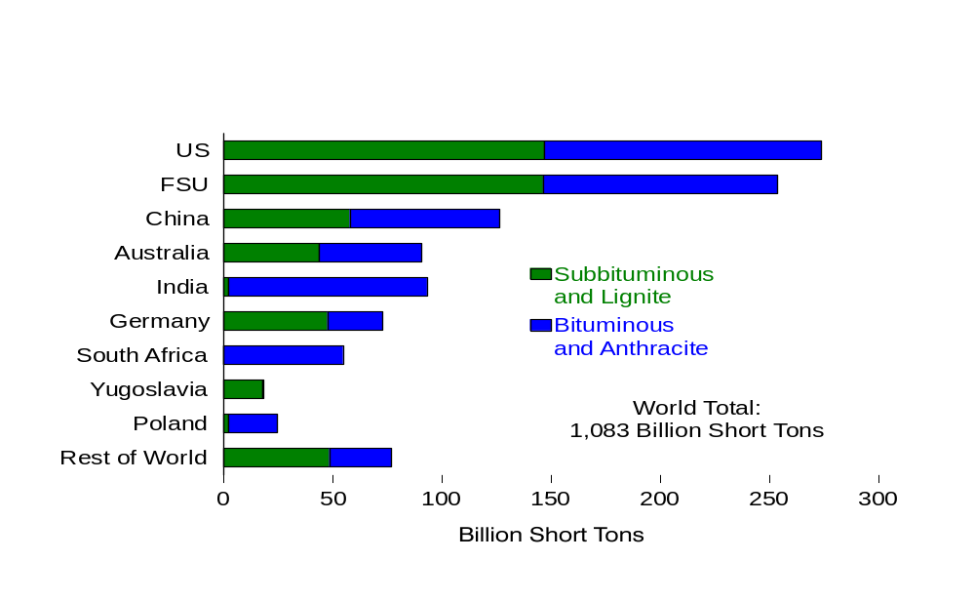
World Recoverable Coal Reserves as of January 1, 2001
Source: EIA, International Energy Annual 2001
Notes:
Coal is the most abundant of the fossil fuels, and its reserves are also the most widely distributed. Estimates of the world’s total recoverable reserves in 2001, as reported by the Energy Information Administration, are essentially unchanged from 1999, at about 1,083 billion short tons. At current rates of production (and with no change in reserves), coal reserves could last for another two centuries.

Slide 17
Coal Forecast, Reference Case
India coal consumption 360 million short tons in 2001 increasing to 580 million short tons by 2025
Growth primarily in electricity sector which currently consumes about 75% of coal consumption
India’s coal fired generating capacity 66,000 MW in 2001, and will need to build 30,000 MW of additional coal-fired capacity
India will have to rely on some imports for meeting future demand
Other Asia coal consumption 265 million short tons in 2001, increasing to 330 million short tons by 2025, based on growth in South Korea, Taiwan, and ASEAN countries
Key motivation for other Asian countries to build coal capacity is diversification
Challenges surrounding adequate transmission capacity, environmental concerns, and local opposition to coal will have to be overcome

Slide 18
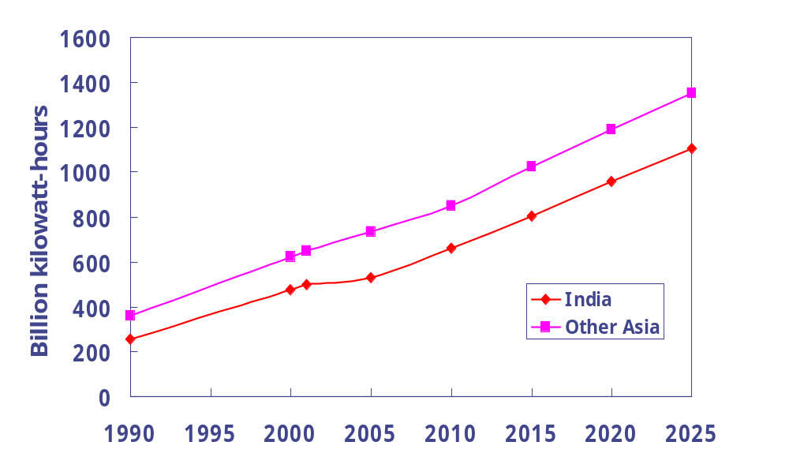
Net Electricity Consumption, Reference Case
History
Forecast
Growth rates (%/year) 2001 - 2025
India | 3.4
Other Asia | 3.1
India’s net electricity consumption in 2001 was 497 billion kWh which is expected to increase to 1,104 billion kWh by 2025
Other Asia’s net electricity consumption in 2001 was 650 billion kWh which is expected to increase to 1,352 billion kWh by 2025
Source: EIA, International Energy Outlook 2003
Notes:
Over the projection period, India and other Asia’s net electricity consumption is projected to increase at an average annual rate of 3.1 to 3.4 percent, rising from 1,147 billion kilowatthours in 2001 to 2,456 billion kilowatthours by 2025. Strong growth in electricity use is expected in the countries of the developing world, particularly in developing Asia, where robust economic growth drives increased demand for electricity to run newly-purchased home appliances such as, air conditioning, refrigeration, cooking, space heating and water heating units. China’s electricity consumption alone is projected to nearly triple, growing by an average of 4.3 percent per year in the IEO2003 reference case.

Slide 19
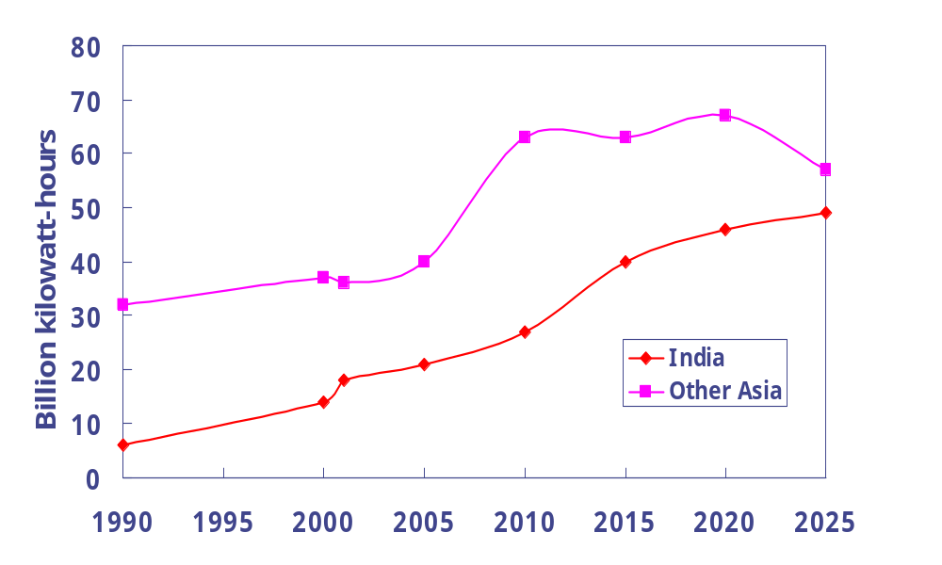
Nuclear Power Forecast, Reference Case
History
Forecast
Growth rates (%/year) 2001 - 2025
India | 4.2
Other Asia | 1.9
India’s nuclear energy consumption in 2001 was 18 billion kWh which is expected to increase to 49 billion kWh by 2025
Other Asia’s nuclear energy consumption in 2001 was 36 billion kWh which is expected to increase to 57 billion kWh by 2025
Source: EIA, International Energy Outlook 2003
Notes:
Although India shows significant growth in nuclear power, compared to total electricity consumption nuclear continues to play a small role in India.
For other Asia, the growth rate of nuclear power is smaller than for India, and compared to total electricity consumption, nuclear continues to play a small role in other Asia as well.
The declines in the forecast are due to expected plant retirements.

Slide 20
India’s Nuclear Power Forecast
India’s installed nuclear power capacity is projected to increase from 2,500 MW in 2001 to 7,000 MW by 2025
India has 14 nuclear power reactors in operation, which make up 4% of the nations capacity
7 nuclear reactors are in various stages of construction
Two 450 MW reactors (Tarapur 3 and 4) are expected to become operational by 2009
Two 90 MW reactors (Kundankulam 1 and 2) are expected to become operational by 2010 and 2011
Three remaining reactors not expected to become operational before 2025
Construction has started on a large prototype fast breeder reactor

Slide 21
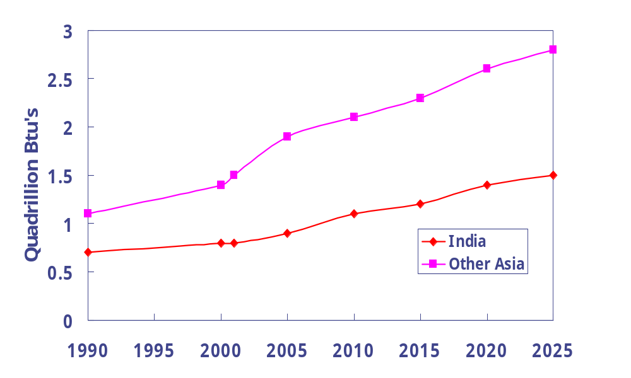
Hydro and Other Renewable Forecast, Reference Case
History
Forecast
Growth rates (%/year) 2001 - 2025
India | 2.6
Other Asia | 2.7
India’s hydroelectricity and other renewable energy consumption in 2001 was 0.8 Quadrillion Btu’s which is expected to increase to 1.5 Quadrillion Btu’s by 2025
Other Asia’s hydroelectricity and other renewable energy consumption in 2001 was 1.5 Quads which is expected to increase to 2.8 Quads by 2025
Source: EIA, International Energy Outlook 2003
Notes:
It should be noted that the IEO does not account for traditional biomass or off-grid renewables. Therefore, this only accounts for grid connected renewables, mainly hydroelectricity and wind. Non-commercial fuels from biomass are an important source of energy, however, comprehensive data on the use of non-commercial fuels are not available and as a result cannot be included in the projections.
In addition, off-grid renewables (photovoltaics, solar hot water systems) are not included because there are very few comprehensive sources of data on their use.

Slide 22
Hydroelectricity and Other Renewables Forecast
India has 25,140 MW of installed hydroelectric capacity
Overall development potential of 84,000 MW
Projects under development include Nathpa Jhakri 1,500 MW, Himachal Pradesh, and Tehri 1,000 MW in Uttar Pradesh, Narmada Valley project
Tehri hydroelectric dam project expected to cost $1.2 billion ($1,200/kW)
In Himachal Pradesh 8 hydroelectricity projects have been awarded permission to begin construction
Projects range in size from 10.5 MW Baragaon to 100 MW Malna II and Sainjii
Government of Himachal Pradesh intends to develop 20,000 MW of hydro. As of 2002, 3,900 MW of hydro installed with another 6,800 MW under construction.
Environmental impact and population relocation issues are major challenges for large scale hydroelectricity development
Notes:
Significant growth in wind and photovoltaics in India
Significant small-hydro potential exists in Nepal
Photovoltaics in Sri Lanka
Renewable energy activities in Bangladesh

Slide 23
International Energy Outlook 2003 Summary
Energy use will grow strongly, especially among the developing countries (2.8% per year in the developing world)
There will be continued reliance on fossil fuels through 2025; oil remains the dominant fuel type (38 % of total world energy use)
Natural gas is the fastest growing source of primary energy (2.8% per year)
Resources will be sufficient to meet the growth in demand
Carbon dioxide emissions resulting from the combustion of fossil fuels will continue to grow (1.9% per year)

Slide 24
International Energy Outlook 2003 Summary
Net electricity consumption will enjoy fast-paced growth (2.4% per year) as developing countries work to provide grid access to populations
Coal will continue to be an important source for electricity generation, but efficient natural gas will be the fuel of choice for new generation worldwide
Nuclear power will expand in several Asian countries, but most industrialized countries are not expected to undertake new construction of nuclear units

