Slide 1
Perspectives on NASA Mission Cost and Schedule Performance Trends
Presentation at GSFC Symposium
3 June 2008
David Bearden
Acknowledgments: Claude Freaner, Bob Bitten, Debra Emmons, Tom Coonce

Slide 2
Typical Questions
What is the magnitude of cost and schedule growth?
How reliable are estimates in the conceptual design stage?
Why does cost growth occur?
What is the relationship between cost, schedule and “complexity”?
Are there any improvements that can be made in estimating the costs of future design concepts?

Slide 3
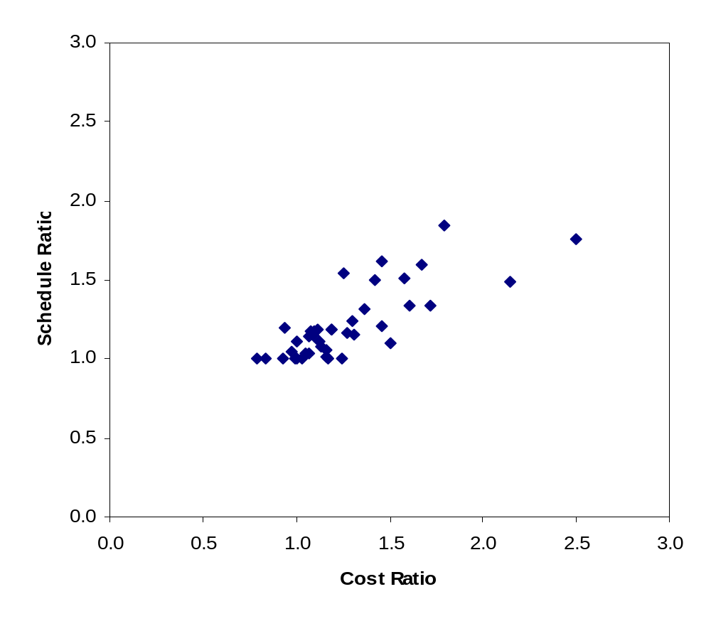
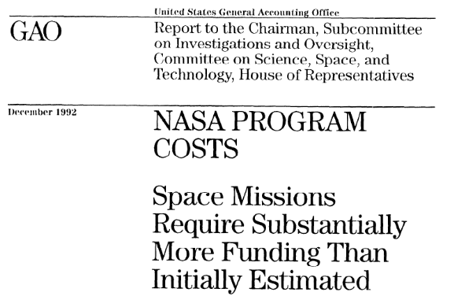
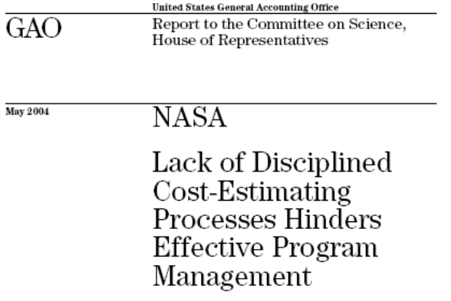
Forty NASA Robotic Science Missions Experienced 27% Cost and 22% Schedule Growth
within cost and schedule
within 100% overrun

Slide 4
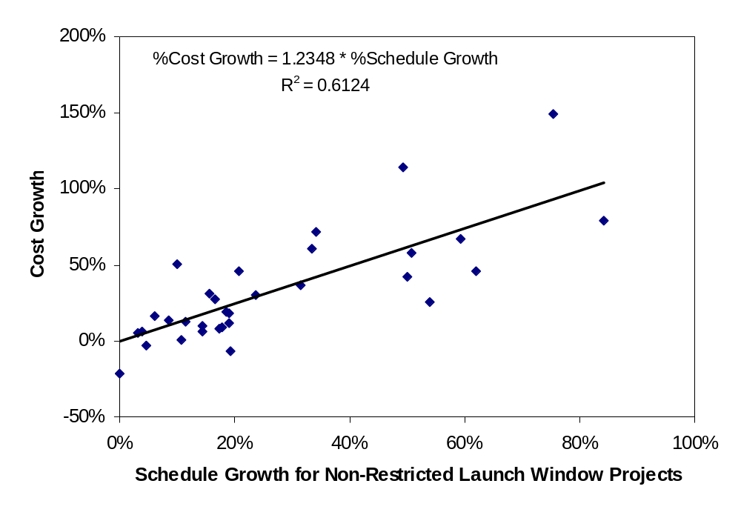
While Significant Variability is Evident, for Every 10% of Schedule Growth, there is a Corresponding 12% Increase in Cost

Slide 5
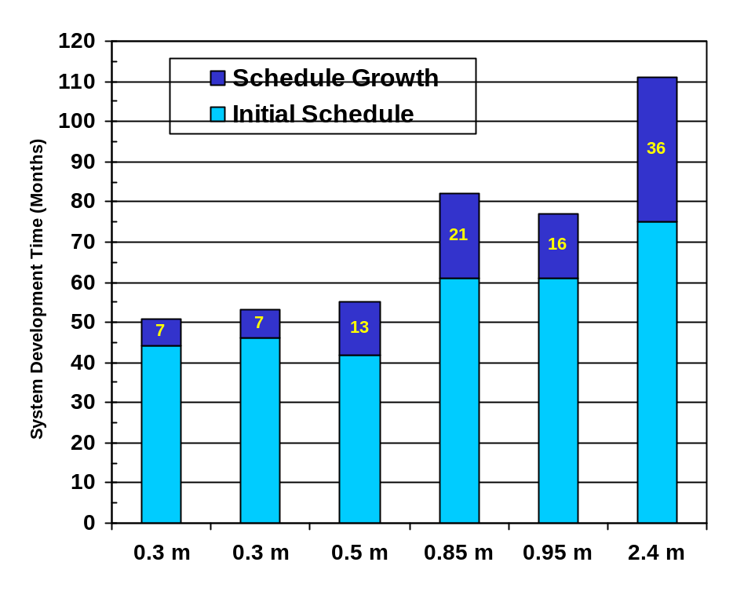
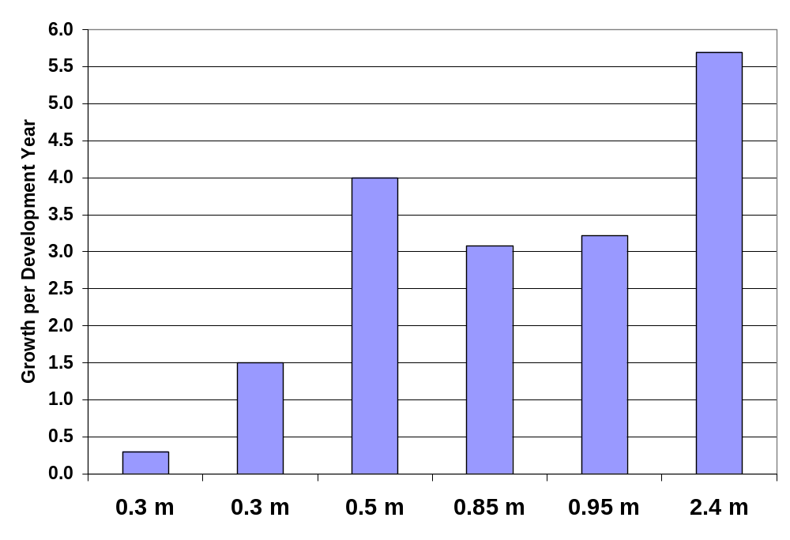
Comparison of Schedule Growth Data with Agency Guidelines: NASA Telescope Missions
Four of Six Telescope Missions Exceeded Common Schedule Reserve Guidelines
NASA/JPL Guidance
1.8 Month per Year
General Rule of Thumb
1 Month per Year

Slide 6
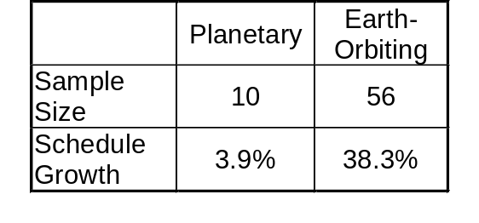
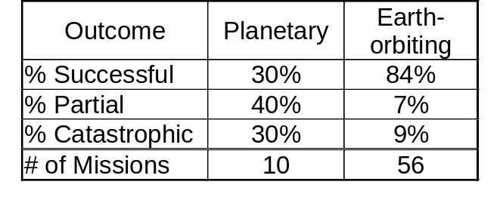
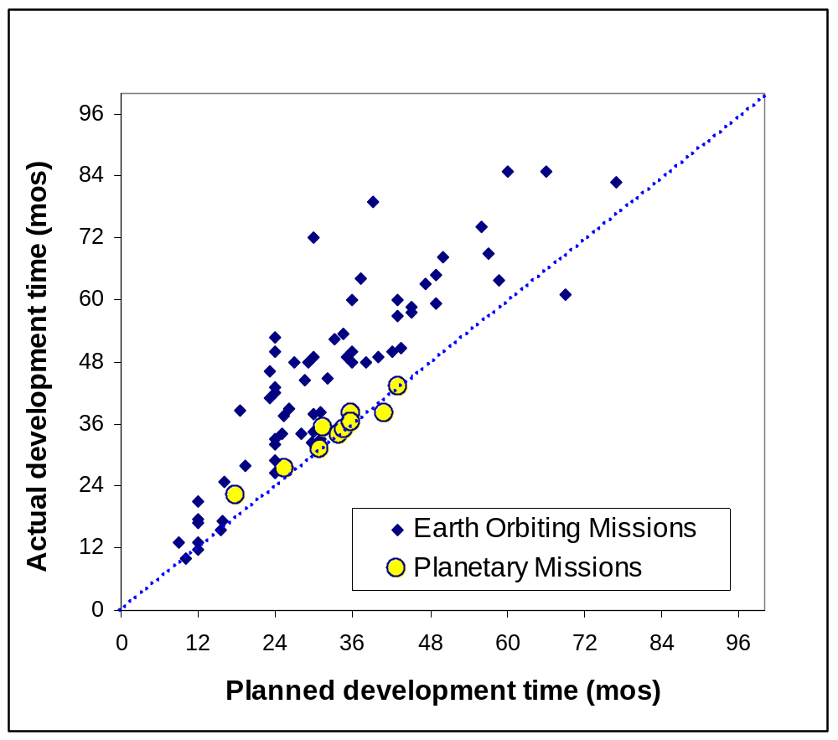
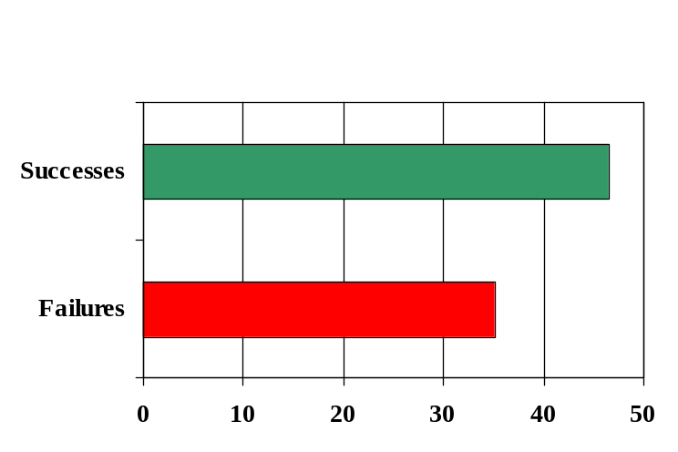
Comparison of Schedule Growth and Success for Planetary Missions vs. Earth-orbiting Missions
Development times for Planetary missions less than Earth-orbiting missions due to constrained launch windows
Planetary missions experienced less schedule slip on average than earth-orbiting missions
However, planetary missions failed or impaired twice as often
Average Development Time

Slide 7
Typical Questions
What is the magnitude of cost and schedule growth?
How reliable are estimates in the conceptual design stage?
Why does cost growth occur?
What is the relationship between cost, schedule and “complexity”?
Are there any improvements that can be made in estimating the costs of future design concepts?

Slide 8
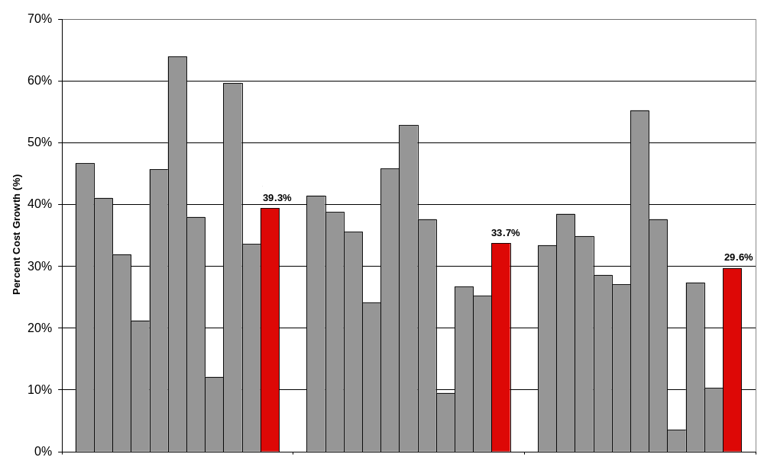
How Reliable are the Projects’ Estimates at the Conceptual Design Stage and How Does Confidence Progress?
Ten Missions Demonstrate How Accuracy of Project Estimates Increases Over Time however Cost Growth, Over and Above Reserves, Still Occurs Deep into the Project Life Cycle

Slide 9
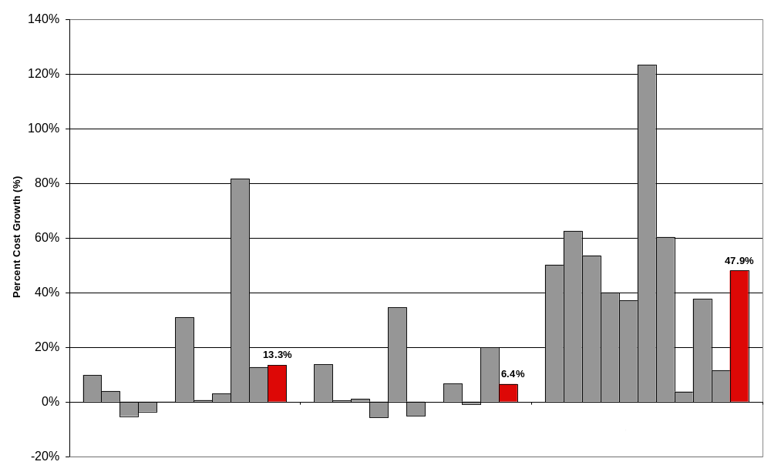
In What Phase Does Cost Growth Occur?
Greatest Growth Occurs During Integration and Test (Phase D) When Trying to Get Hardware & Software to Function as Designed

Slide 10
Typical Questions
What is the magnitude of cost and schedule growth?
How reliable are estimates in the conceptual design stage?
Why does cost growth occur?
What is the relationship between cost, schedule and “complexity”?
Are there any improvements that can be made in estimating the costs of future design concepts?

Slide 11
Some of the Reasons
Inadequate definition of technical and management aspects of a program prior to seeking approval
  (NASA’s Project Management Study, 1980)
Program and funding instability; difficulties in managing programs in an environment where funding must be approved annually and priorities change
  (Advisory Committee on the Future of the U.S. Space Program, 1990)
Lack of emphasis on technological readiness and requirements on the front end of a program
  (NASA’s Roles and Missions Report, 1991)
Program redesign, Technical Complexity, Budget Constraints, Incomplete Estimates
  (GAO Report on NASA Program Costs, 1992)

Slide 12
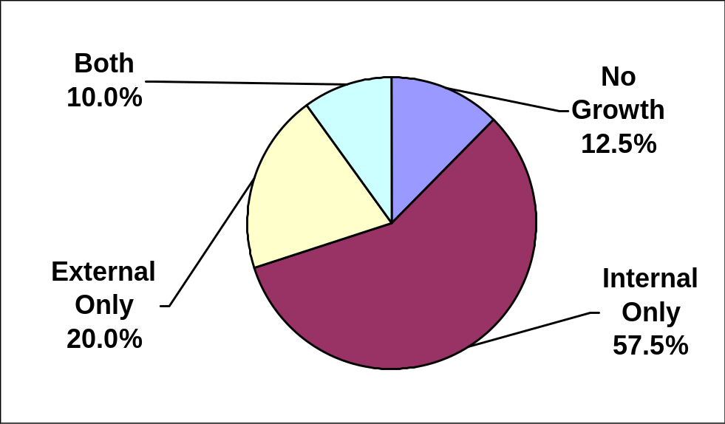
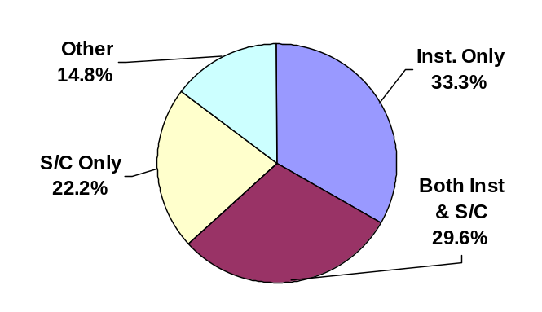
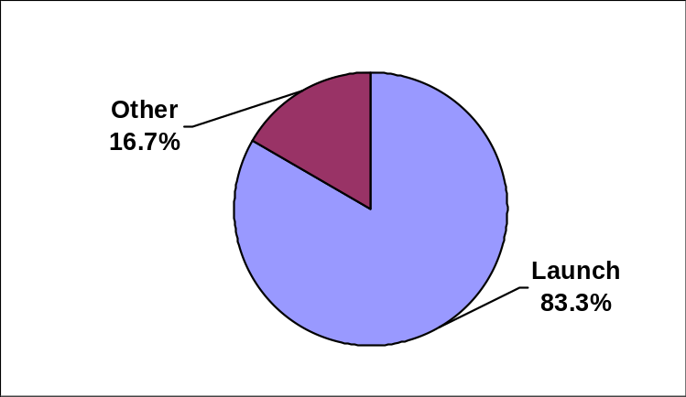
The Reasons for Growth - Study of 40 NASA Missions:
Internal versus External Factors Driven-Growth
Internal Growth
(within Project’s control)
  Technical
    Spacecraft development difficulties
    Instrument development difficulties
    Test failures
    Optimistic heritage assumptions
  Programmatic
    Contractor management issues
    Inability to properly staff an activity
External Growth
(outside Project’s control)
  Launch vehicle delay
  Project redesign
  Requirements growth
  Budget constraint
  Labor strike
  Natural disaster
Distribution of Growth
Distribution of
External Growth
Distribution of
Internal Growth

Slide 13
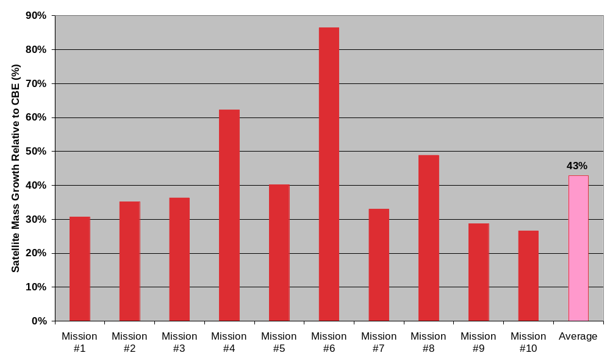
Mass Growth Exceeds Typical Guidance
Average mass growth for ten missions studied is 43% which exceeds the typical industry guidelines of 30% mass reserves (over CBE) at the start of Phase B
Typical Reserves

Slide 14
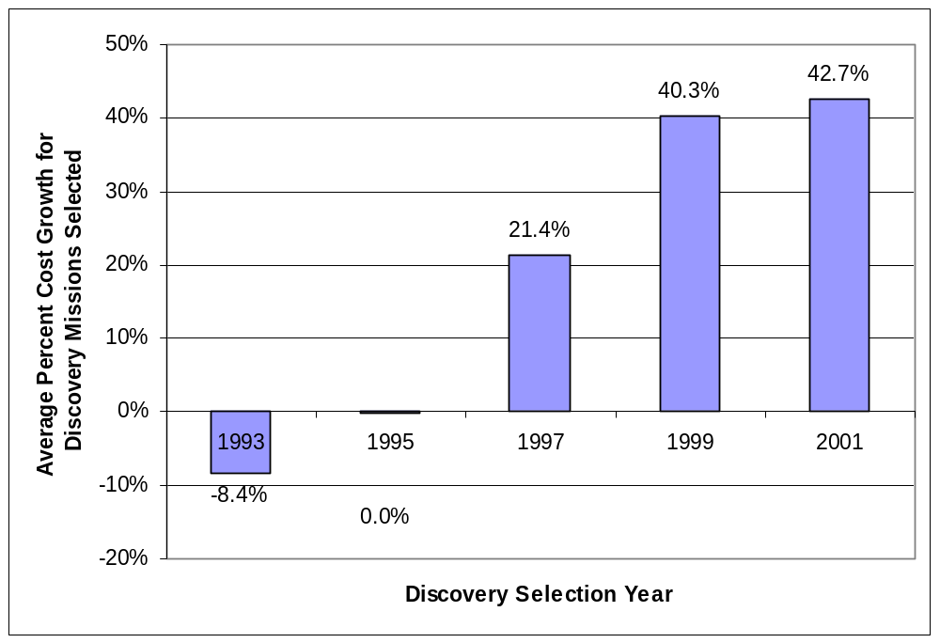
Assessing Relationships for Causality:
Inherent Optimism in Initial Design & Estimates
Progression of Average Cost Growth for Discovery Selections May be Indicative of Competitive Pressures Leading to More Aggressive Designs

Slide 15
Typical Questions
What is the magnitude of cost and schedule growth?
How reliable are estimates in the conceptual design stage?
Why does cost growth occur?
What is the relationship between cost, schedule and “complexity”?
Are there any improvements that can be made in estimating the costs of future design concepts?

Slide 16
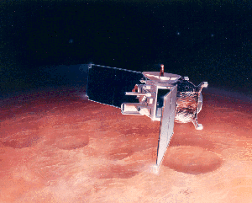
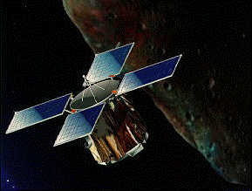

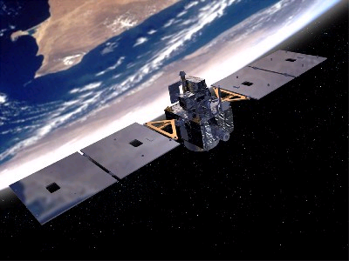
Hypothesis
Complexity Index could be derived using a broad set of parameters to arrive at a top-level representation of the system
Correlation to spacecraft cost and/or development time based on actual program experience might be apparent
Data assembled for most spacecraft launched during past two decades (1989 to present) including technical specifications, costs, development time, mass properties and operational status
Complexity Index calculated based on performance, mass, power and technology choices for purposes of comparison
Relationship between complexity and “failures” investigated compared with adequacy of cost and schedule resources
Method to assess complexity at the system-level should allow more informed overall decisions to be made for new systems being conceived
Illustrations reprinted courtesy of NASA

Slide 17
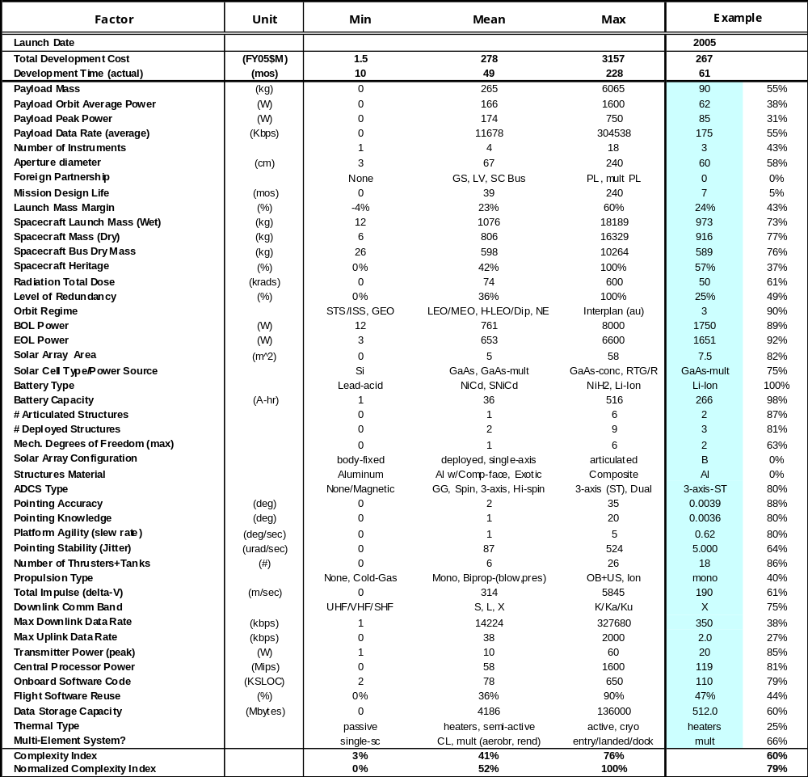
Complexity Index Example

Slide 18
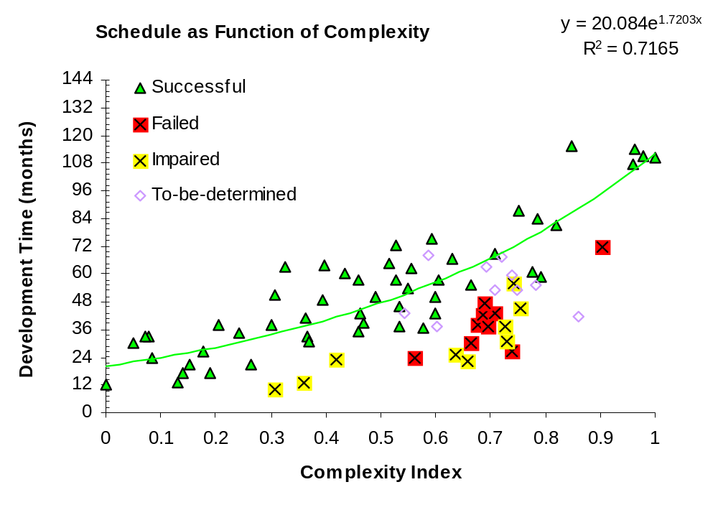
When is a Mission Too Fast?

Slide 19
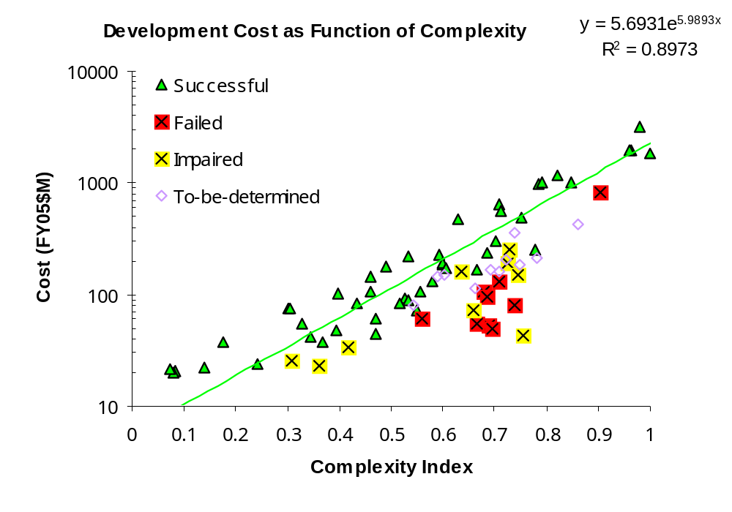
When is a Mission Too Cheap?

Slide 20
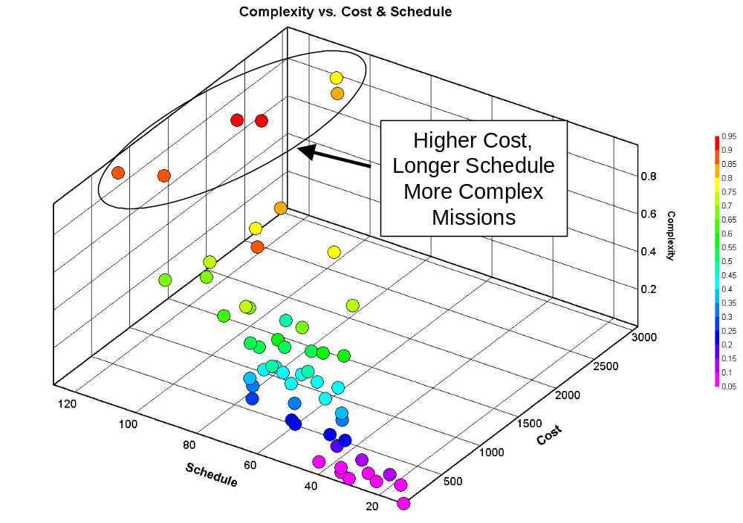
3-D Trade Space – Intuitive Result: Missions that have the greatest complexity, are highest cost and longest development

Slide 21
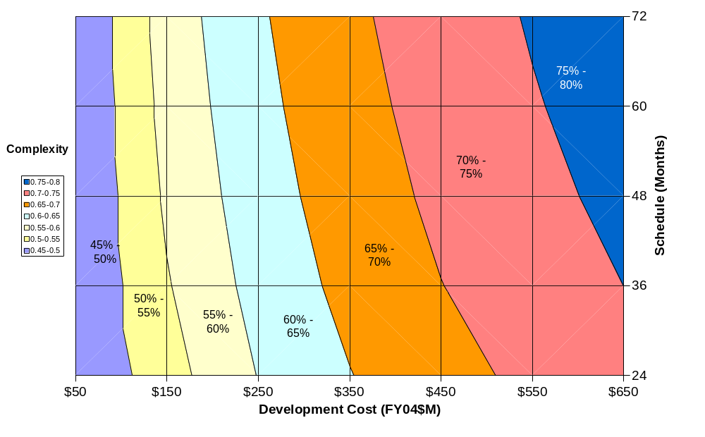
Complexity Bands vs. Cost and Schedule Help Proposers Define Scope of Mission to Fit Fixed Cost & Schedule
2012
2010

Slide 22
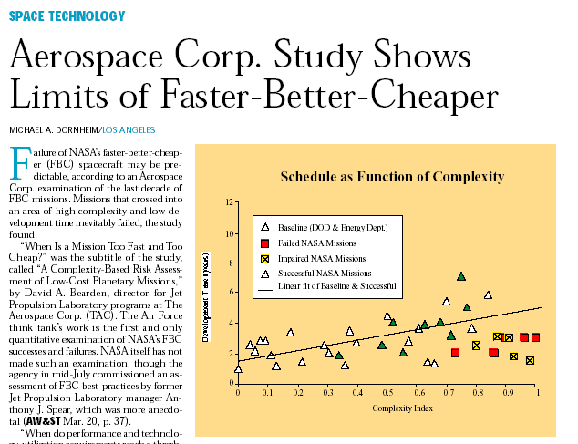
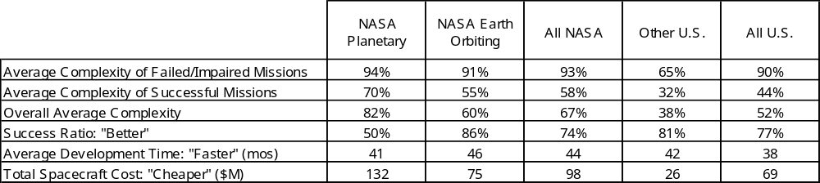
NASA’s Report Card Following Mars ’98 Failures
AW&ST 12 June 2000
Complexity of Failed Missions High in Both Catagories!
Planetary Missions are “Fastest”
  But fail more often than earth-orbiters
NASA Earth-Orbiting Missions are “Cheapest”
  But longer to develop than planetary
Overall Success Record is About 3 out of 4 !
Reprinted with permission of Aviation Weekly and Space Technology

Slide 23
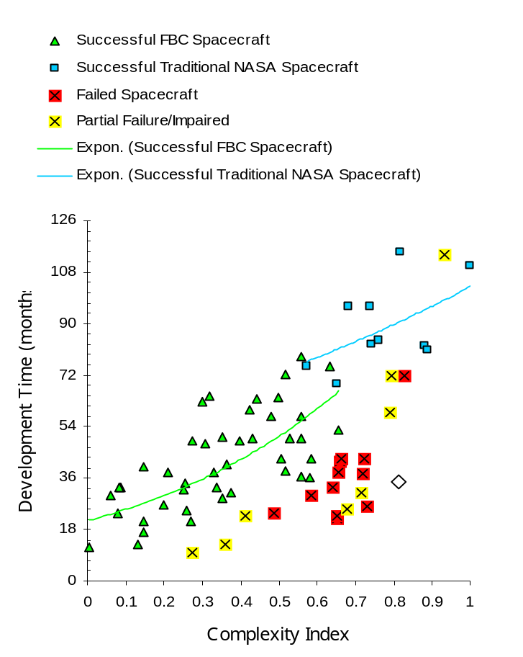
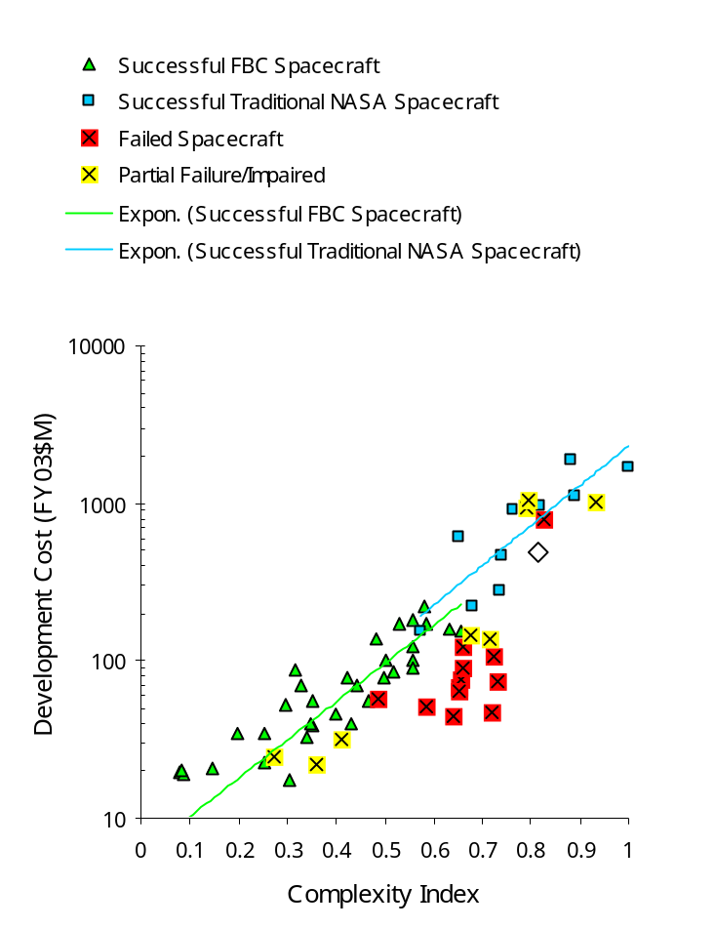
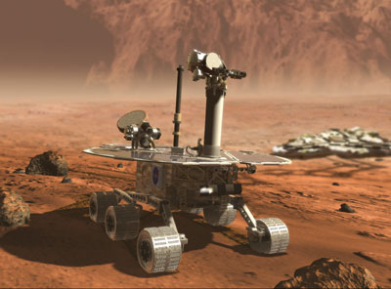
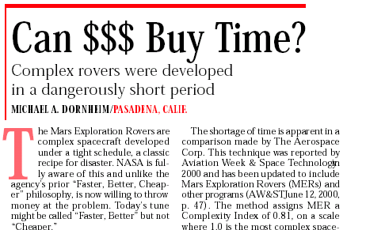
For a project that has fixed requirements and schedule, the inevitable outcome is that cost will grow if developmental problems occur
Case Study: Mars Exploration Rover (MER)
  90-day surface lifetime; ~9-mos cruise
  Launch Mass: 1050 kg (Delta II)
  Mobile platform: 1000-m range
Assessment found that:
  33-month development appeared inadequate
  “Open Checkbook” and heritage offset shortfall
Mitigations:
  Focused on rapidly deploying staff to front load schedule (dual/triple shifts)
  Developed extra hardware test-beds
Cost grew from $299M to $420M
AW&ST, 26 May 2003
Reprinted with permission of Aviation Weekly and Space Technology
Notes:
Findings and recommendations of the complexity-based risk assessment are summarized above.

Slide 24
Typical Questions
What is the magnitude of cost and schedule growth?
How reliable are estimates in the conceptual design stage?
Why does cost growth occur?
What is the relationship between cost, schedule and “complexity”?
Are there any improvements that can be made in estimating the costs of future design concepts?

Slide 25
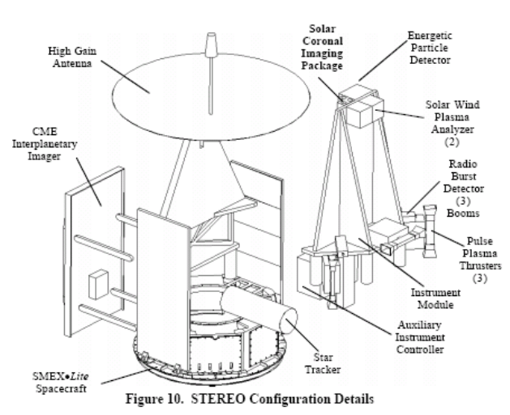
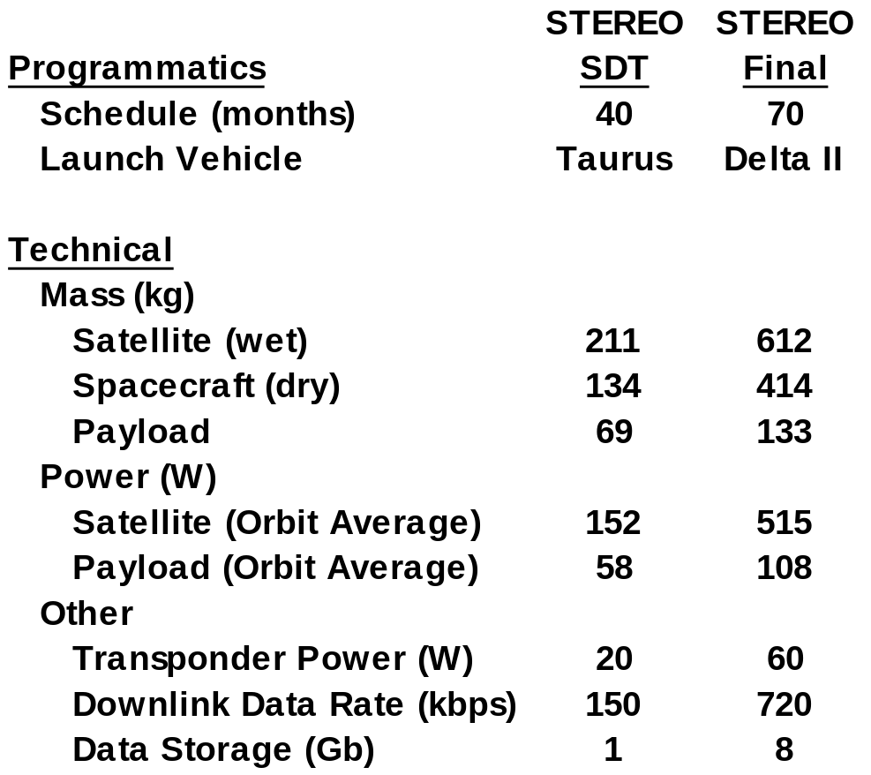
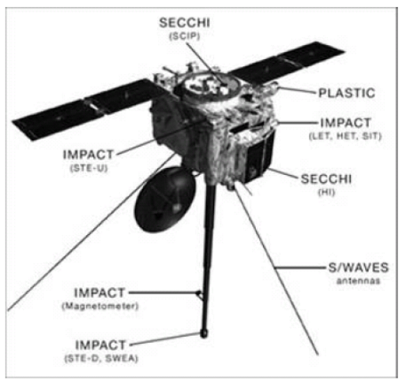
Example: Substantial Differences Exist between STEREO Science Definition Team (SDT) and Final Implemented Configuration
SDT Configuration
Final Configuration
Illustrations reprinted courtesy of NASA

Slide 26
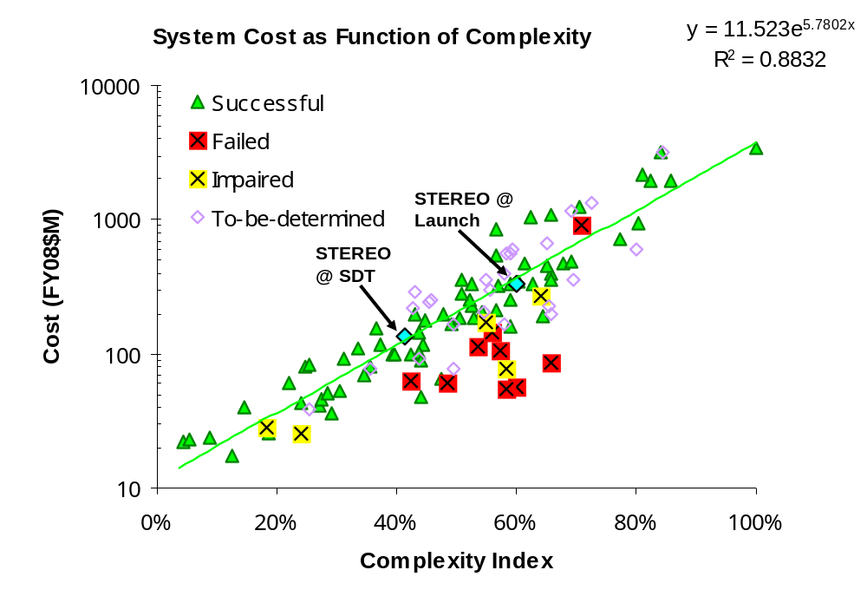
Effect of Increased Complexity on Flight System Cost:
STEREO Complexity Increased from 40% to 60%

Slide 27
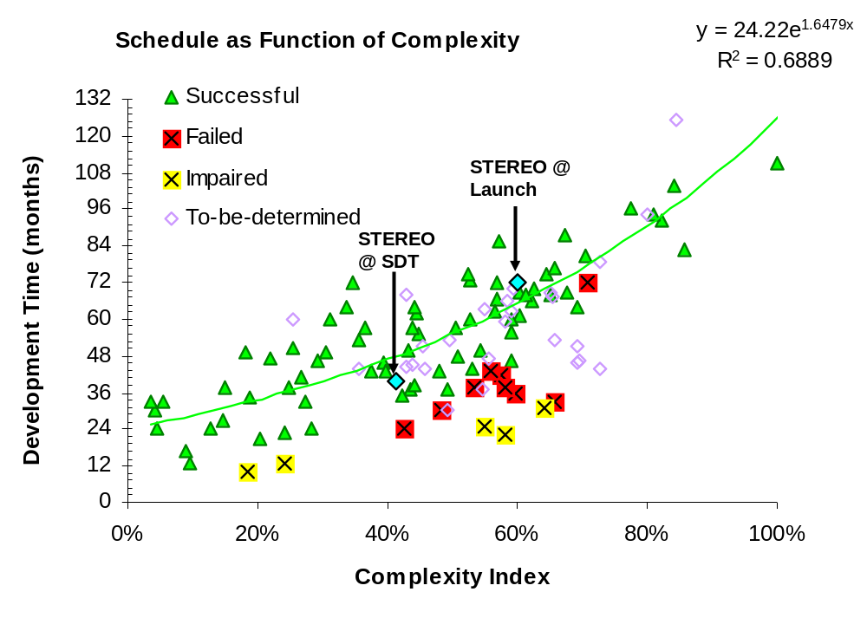
Effect of Increased Complexity on Development Time:
STEREO Complexity Increased from 40% to 60%

Slide 28
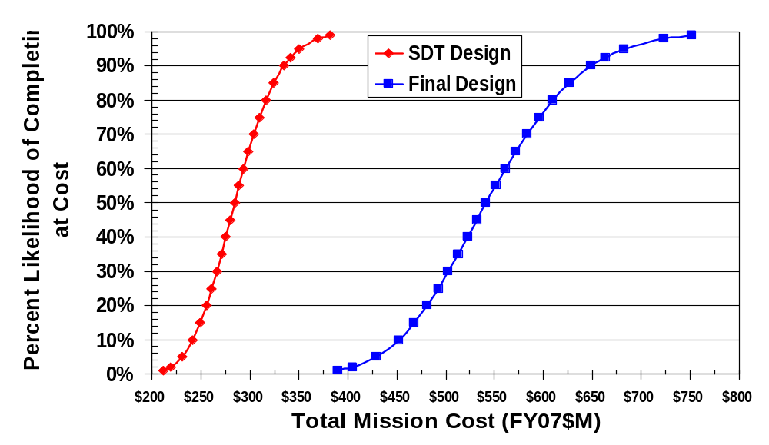
Typical Cost-risk Analyses Won’t Capture Large Changes During Concept Evolution
$299M Estimate with 20% Reserve
Final Cost
$551M

Slide 29
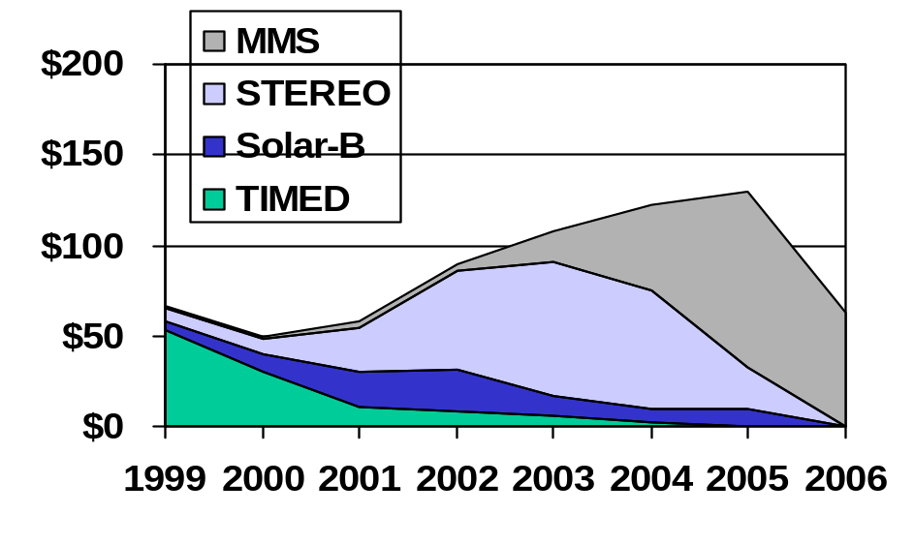
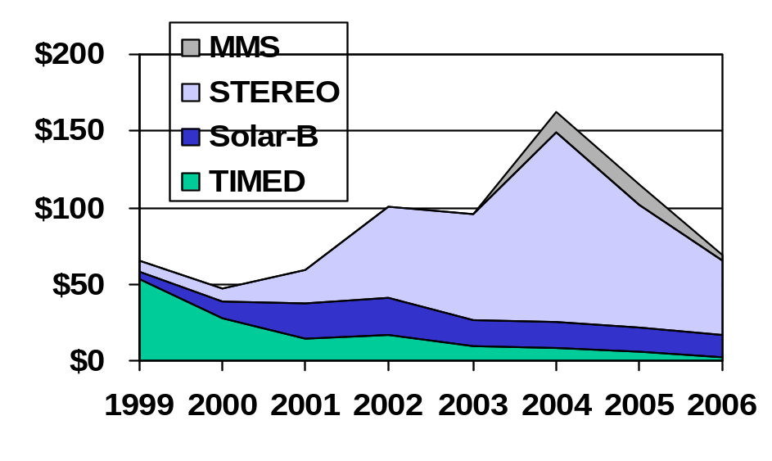
Inadequate Budget Planning for One Project Results in a Domino Effect for Other Projects in the Program Portfolio
STP 2000 Planned Funding
STP Actual Funding History
MMS
MMS
STEREO
STEREO
Total Program Funding 1999-2006
Planned = $689M
Actual = $715M
Although the total program funding remained essentially the same over this time period, implementation of successive missions (e.g. MMS) was substantially affected

Slide 30
Summary
Methods exist to estimate cost and schedule at the conceptual phase albeit with some level of uncertainty
While estimates become more accurate as project matures, the greatest growth manifests itself late in project during Integration & Test
Data highlighted that the primary reason for cost and schedule growth is internal project technical and development issues often associated with instruments
Initial project estimates may be unreliable due to design and technology immaturity and inherent optimism
Success dependence on system complexity and adequacy of resources observed with identification of a “no-fly zone”
Better technical and programmatic appraisal early in lifecycle is needed along with independent assessment of design and programmatic assumptions

Slide 31
References and Further Reading
Bearden, David A., “A Complexity-based Risk Assessment of Low-Cost Planetary Missions: When is a Mission Too Fast and Too Cheap?”, Fourth IAA International Conference on Low-Cost Planetary Missions, JHU/APL, Laurel, MD, 2-5 May, 2000.
Dornheim, Michael, "Aerospace Corp. Study Shows Limits of Faster-Better-Cheaper", Aviation Week and Space Technology, 12 June 2000.
Bearden, David A., "Small Satellite Costs", Crosslink Magazine, The Aerospace Corporation, Winter 2000-2001.
Dornheim, Michael, “Can $$$ Buy Time?", Aviation Week and Space Technology, 26 May 2003.
Bitten R.E., Bearden D.A., Lao N.Y. and Park, T.H., “The Effect of Schedule Constraints on the Success of Planetary Missions”, Fifth IAA International Conference on Low-Cost Planetary Missions, 24 September 2003.
Bearden, D.A., “Perspectives on NASA Robotic Mission Success with a Cost and Schedule-constrained Environment”, Aerospace Risk Symposium, Manhattan Beach, CA, August 2005
Bitten R.E., Bearden D.A., Emmons D.L., “A Quantitative Assessment of Complexity, Cost, And Schedule: Achieving A Balanced Approach For Program Success”, 6th IAA International Low Cost Planetary Conference, Japan, 11-13 October 2005.
Bitten R.E., “Determining When A Mission Is "Outside The Box": Guidelines For A Cost- Constrained Environment”, 6th IAA International Low Cost Planetary Conference, October 11-13, 2005.
Bitten R., Emmons D., Freaner C., “Using Historical NASA Cost and Schedule Growth to Set Future Program and Project Reserve Guidelines”, IEEE Aerospace Conference, Big Sky, Montana, March 3-10, 2007.
Emmons D., “A Quantitative Approach to Independent Schedule Estimates of Planetary & Earth-orbiting Missions”, 2008 ISPA-SCEA Joint International Conference, Netherlands, 12-14 May 2008.
Freaner C., Bitten R., Bearden D., and Emmons D., “An Assessment of the Inherent Optimism in Early Conceptual Designs and its Effect on Cost and Schedule Growth”, 2008 SSCAG/SCAF/EACE Joint International Conference, Noordwijk, The Netherlands, 15-16 May 2008.

