Slide 1

KINETICS OF INTERMETALLIC LAYER GROWTH FOR SOLDERED COPPER AND COPPER-NICKEL ALLOYS
E. K. Ohriner
Metals and Ceramics Division
Oak Ridge National Laboratory
TMS Annual Meeting
San Francisco, CA
Multicomponent Multiphase Diffusion Symposium
In Honor of John E. Morral
February 15, 2005

Slide 2
INTERMETALLIC LAYER GROWTH FOR SOLDERED COPPER AND COPPER-NICKEL ALLOYS
Materials and Procedures
Intermetallic Growth Kinetics
Structures and Chemistry of Intermetallics
Discussion of Multicomponent Diffusion
Conclusions

Slide 3
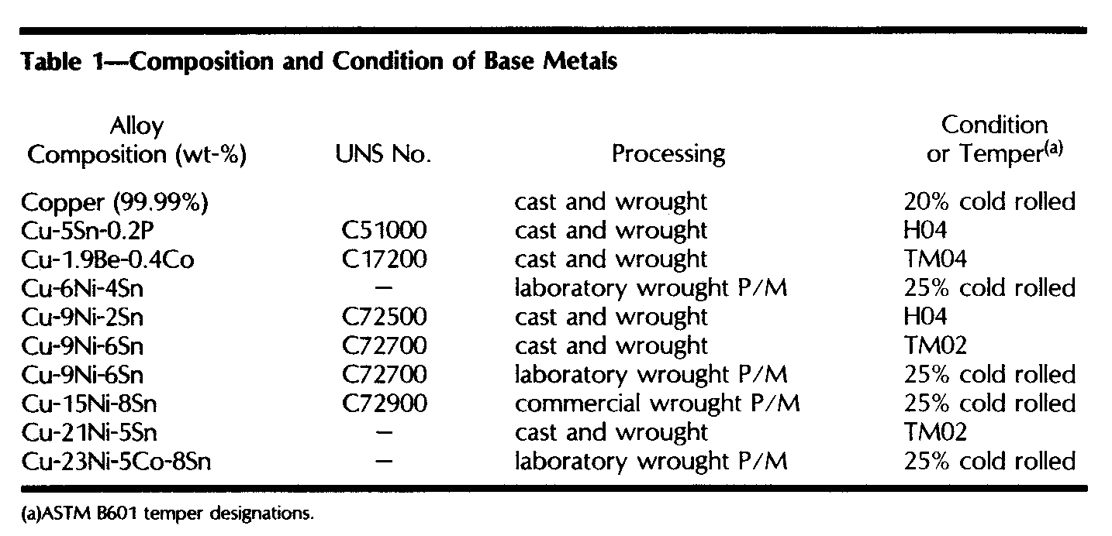
Base Metal Compositions from 0% to 23% Nickel by Weight

Slide 4
Solders Include “High-Tin”, High-Lead”, and “Tin-Lead”
Type | Wt. % | Solidus, °C | Liquidus, °C
High-tin | 100 Sn | 232 | 232
 | 95Sn-5Sb | 232 | 240
 | 95Sn-5Ag | 221 | 241
Tin-lead | 60Sn-40Pb | 183 | 190
 | 30Sn-70Pb | 183 | 255
High-lead | 10Sn-90Pb | 268 | 299
 | 10Sn-88Pb-2Ag | 268 | 302
 | 5Sn-95Pb | 305 | 312

Slide 5
Copper-Tin Phase Diagram

Slide 6
Nickel-Tin Phase Diagram

Slide 7
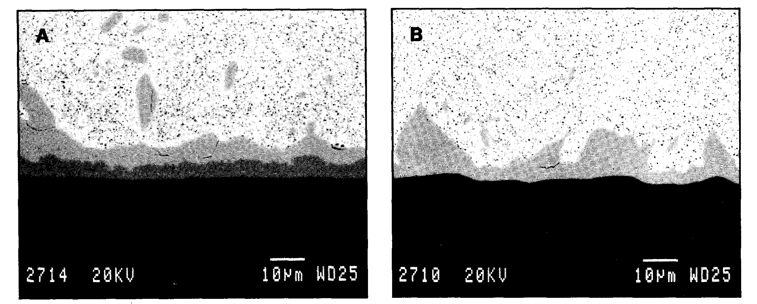
Scanning Electron Micrograph of Soldered Joints with 95Sn-5Sb Exposed 4000 h at 150°C
solder
solder
Cu₆Sn₅
(Cu,Ni)₆Sn₅
Cu₃Sn
Pure copper Cu-15Ni-8Sn

Slide 8
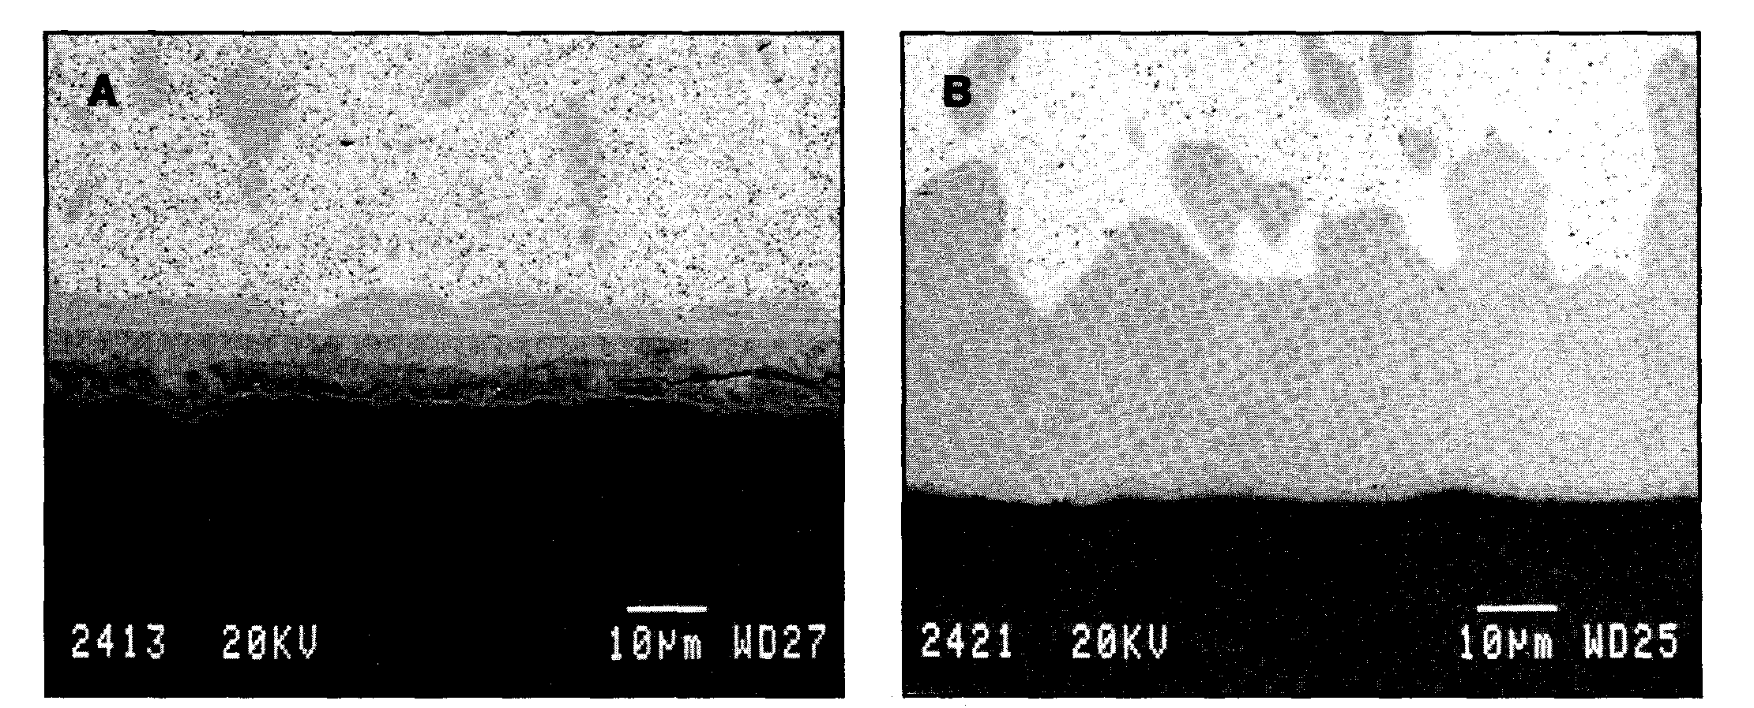
Scanning Electron Micrograph of Soldered Joints with 95Sn-5Sb Exposed 4000 h at 150°C
solder
solder
Cu₆Sn₅
Cu₃Sn
(Cu,Ni)₆Sn₅
Cu-1.9Be-0.4Co Cu-9Ni-6Sn

Slide 9
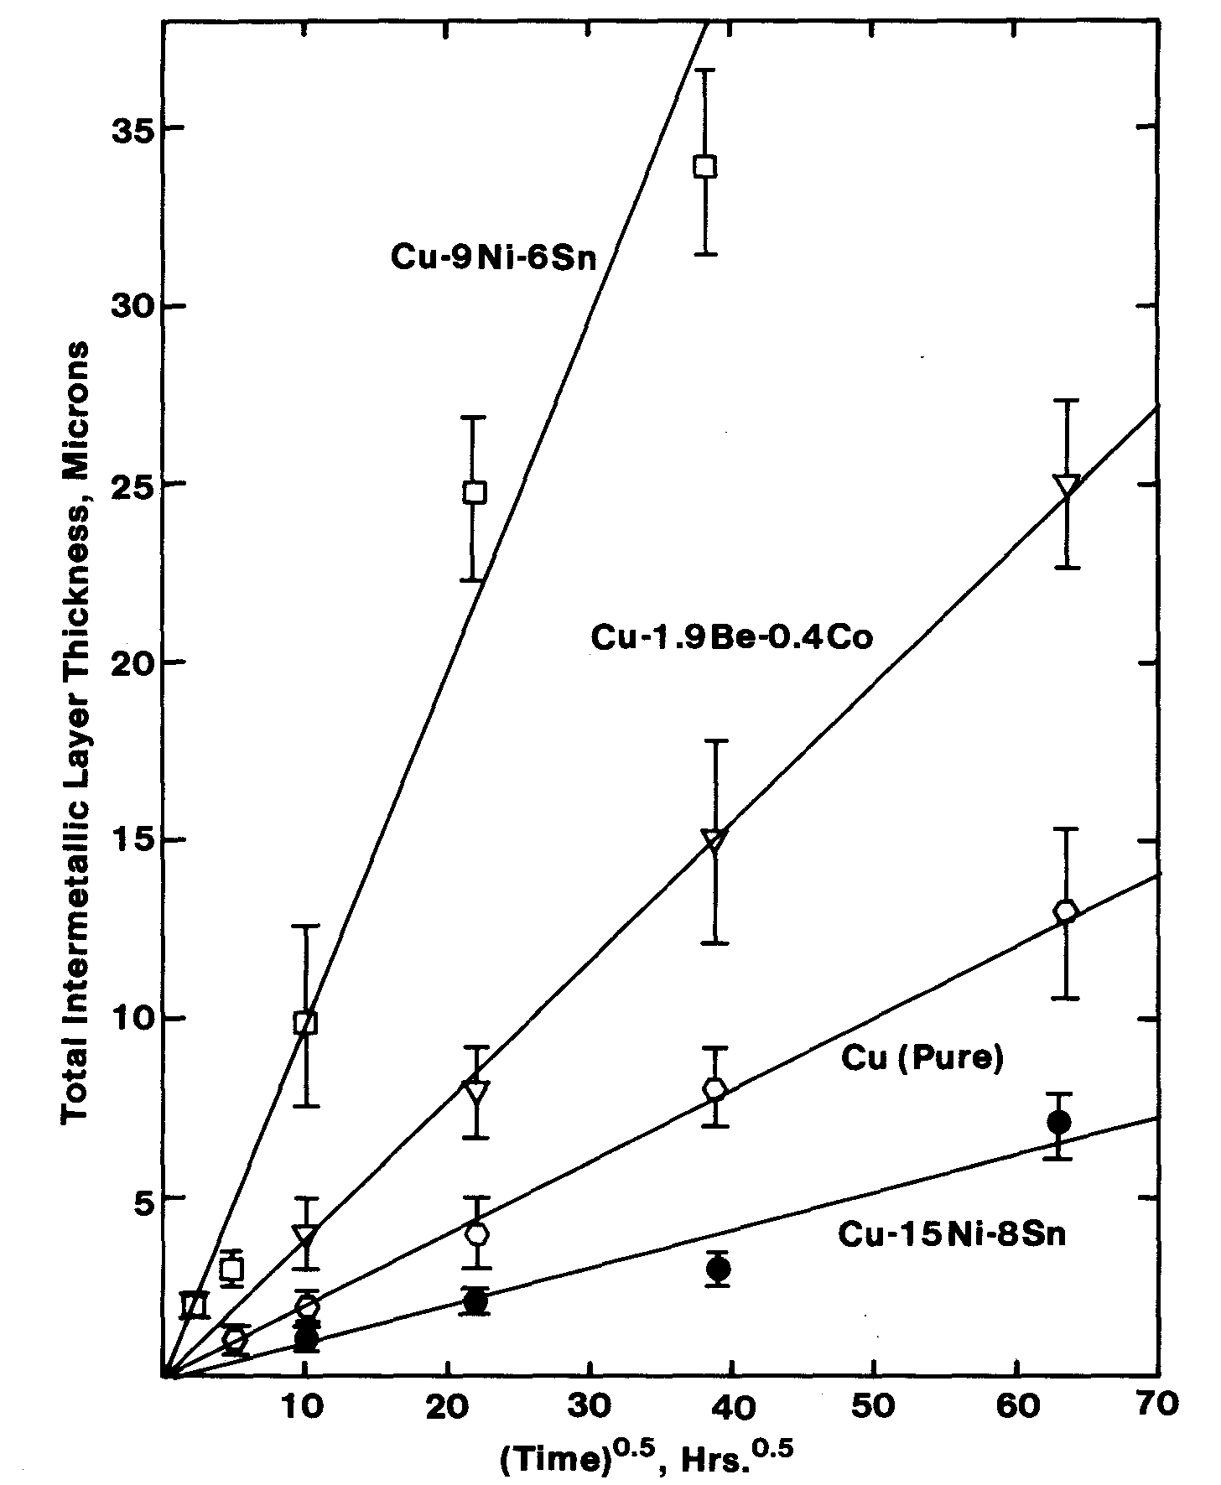
Parabolic Layer Growth With 95Sn-5Sb Solder at 150°C

Slide 10
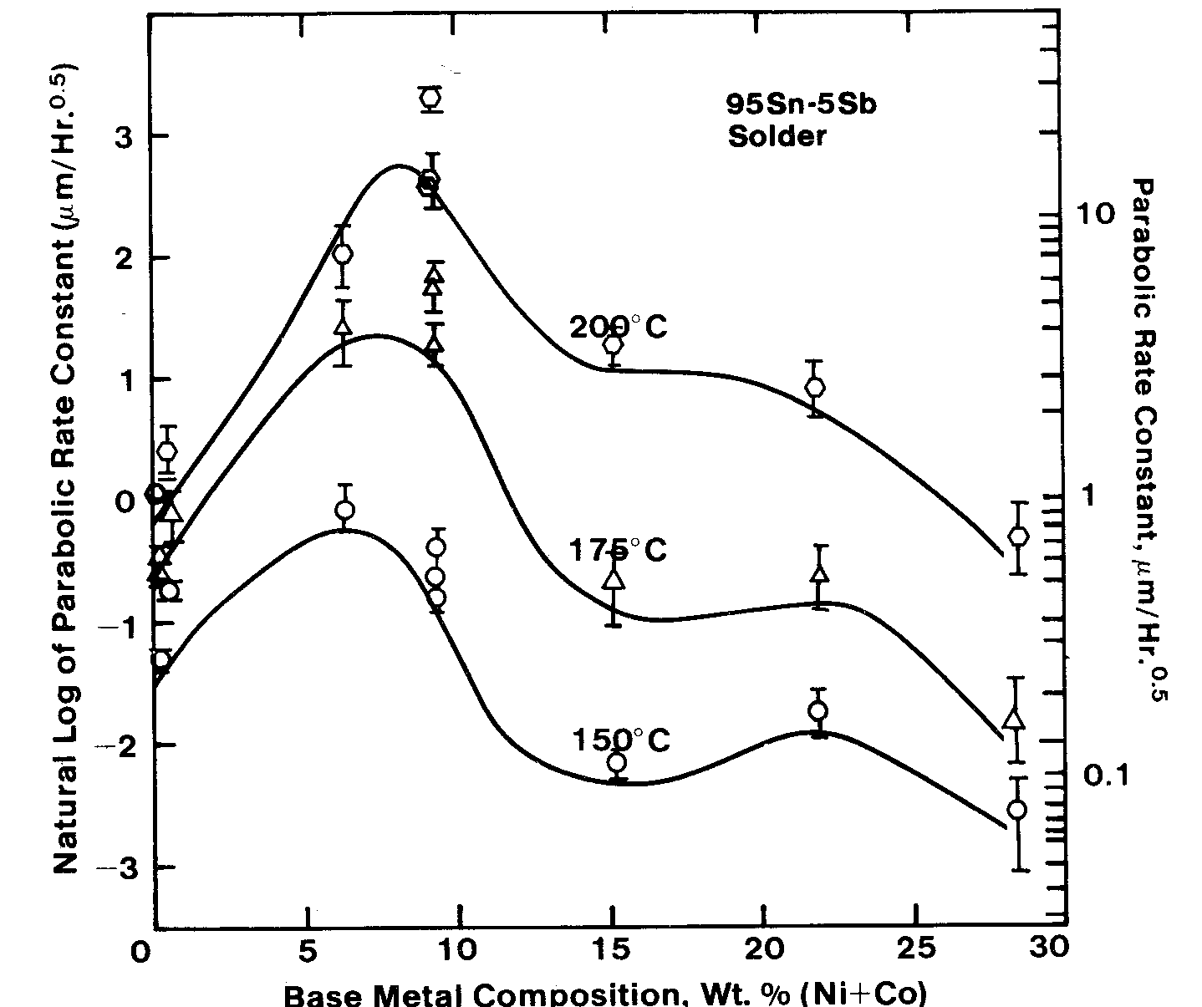
Effect of Nickel Content on Parabolic Growth Rate Constant

Slide 11
Effect of Composition on Kinetics of Layer Growth for High-Tin Solders
Nickel-free alloys have low and nearly uniform activation energy
Alloys with 6 or 9% nickel exhibit high activation energy in the temperature range 150 to 175°C
Alloys with 15% nickel or more exhibit high activation energy in the temperature range 175 to 200°C

Slide 12
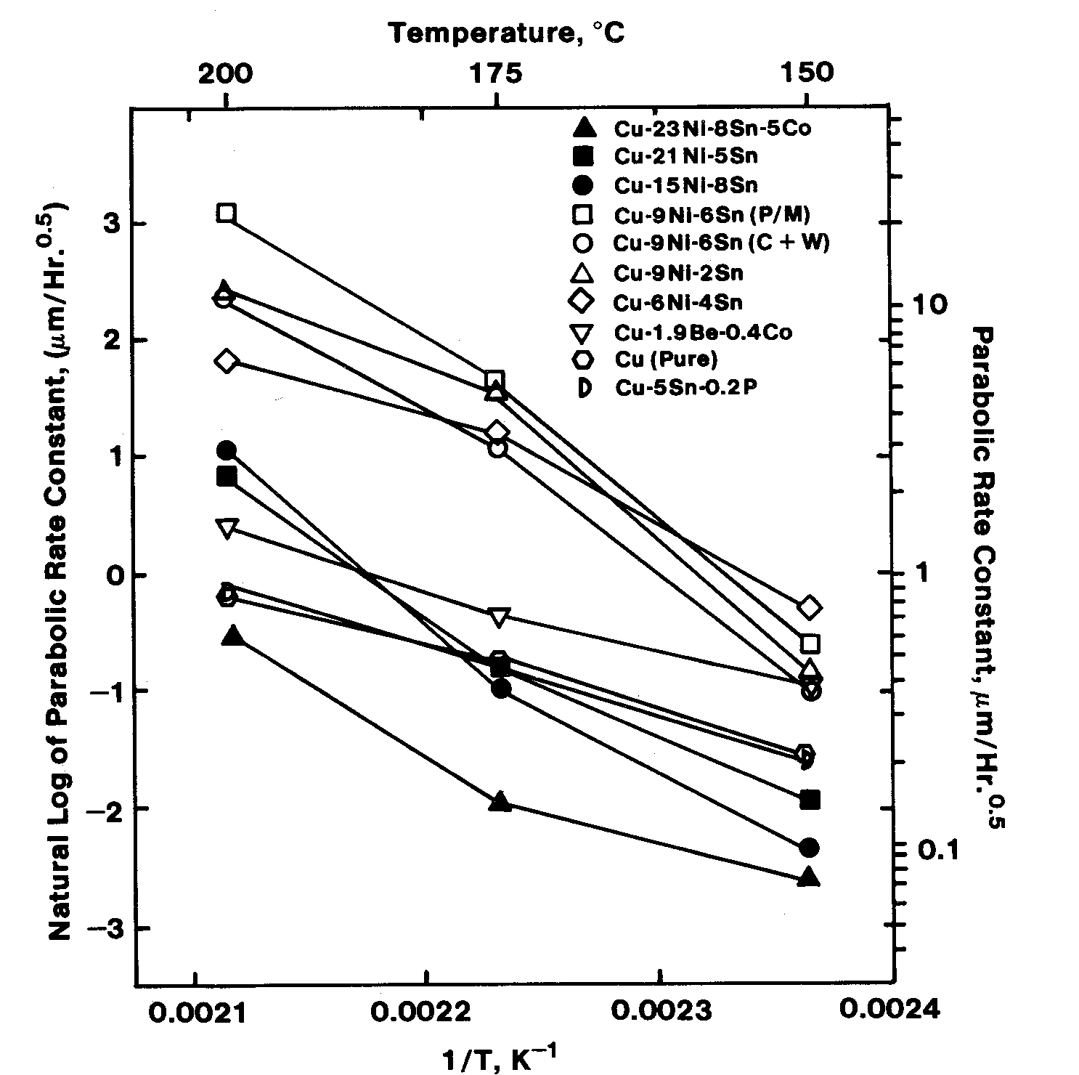
Arrhenius Plots for Layer Growth with 95Sn-5Sb Solder

Slide 13
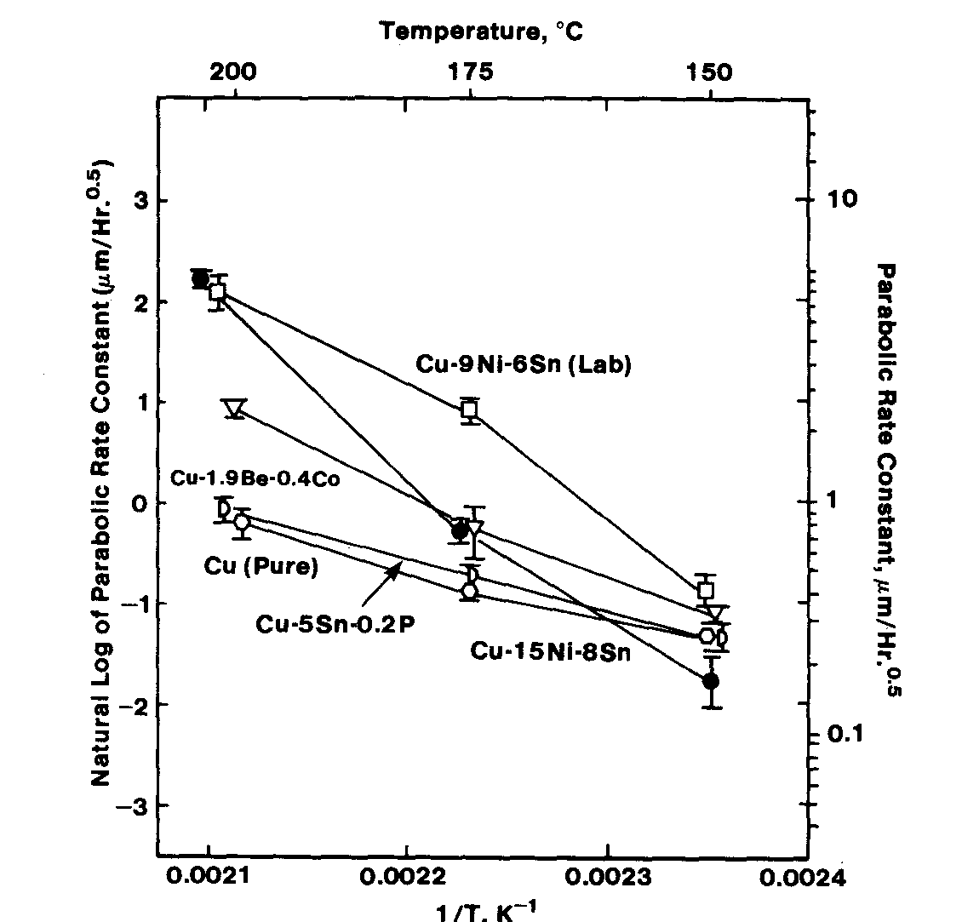
Arrhenius Plots for Layer Growth with 95Sn-5Ag Solder

Slide 14
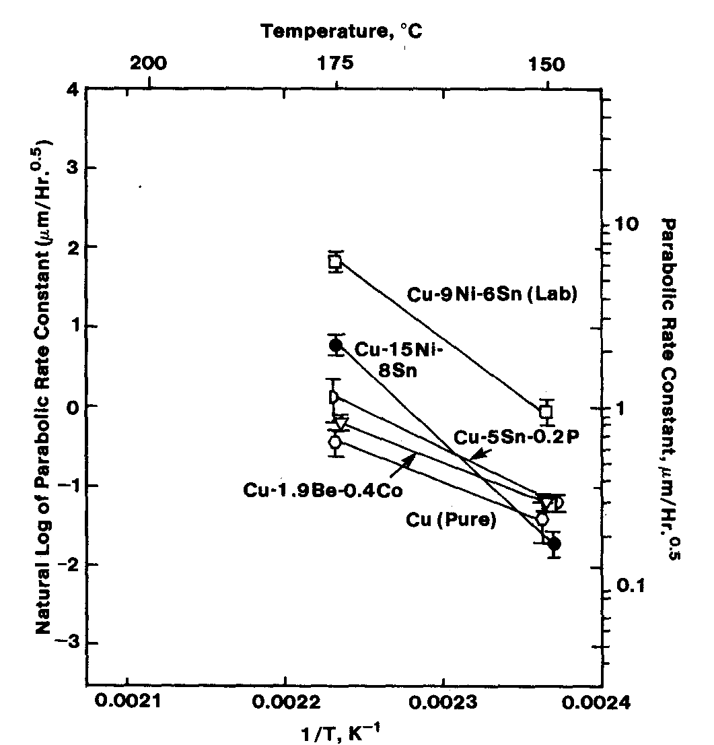
Arrhenius Plots for Layer Growth with 60Sn-40Pb Solder

Slide 15
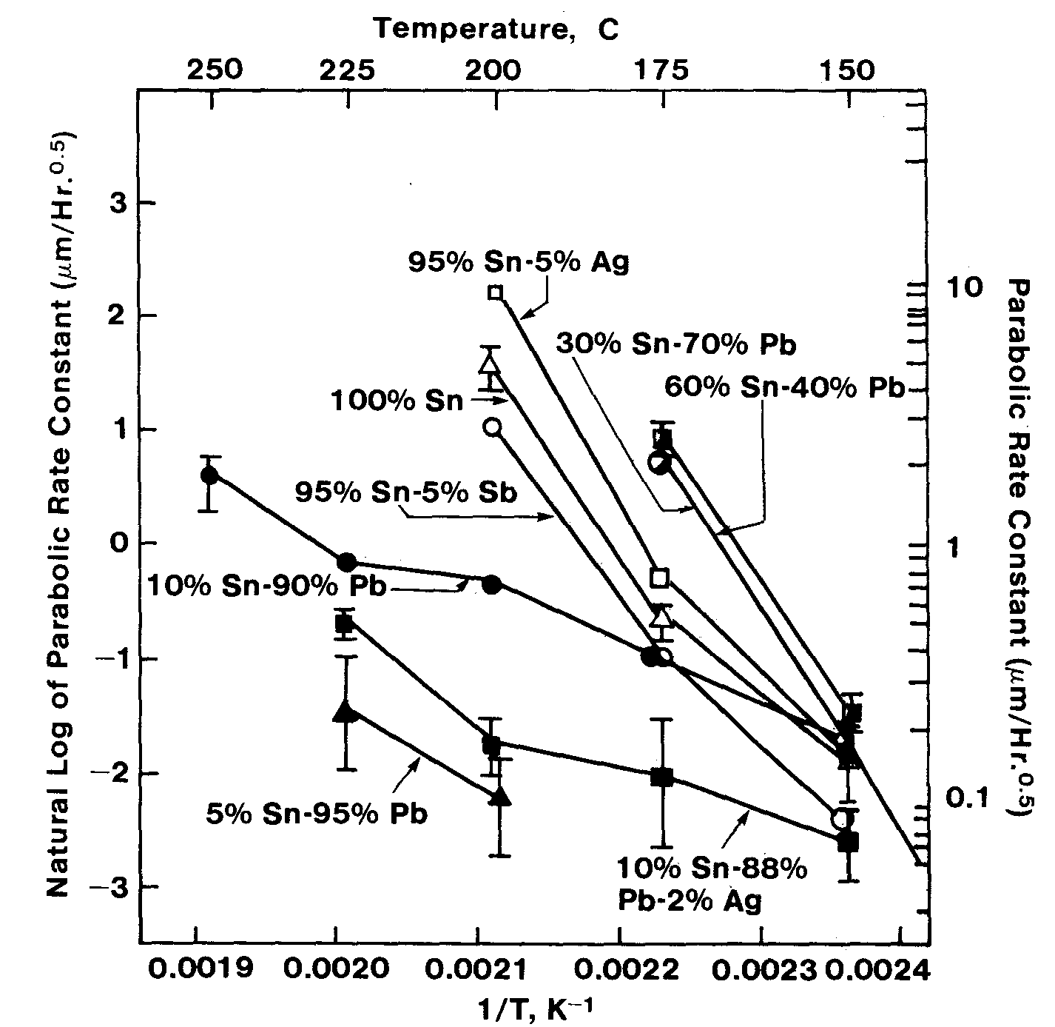
Arrhenius Plots for Layer Growth Cu-15Ni-8Sn with Various Solders

Slide 16
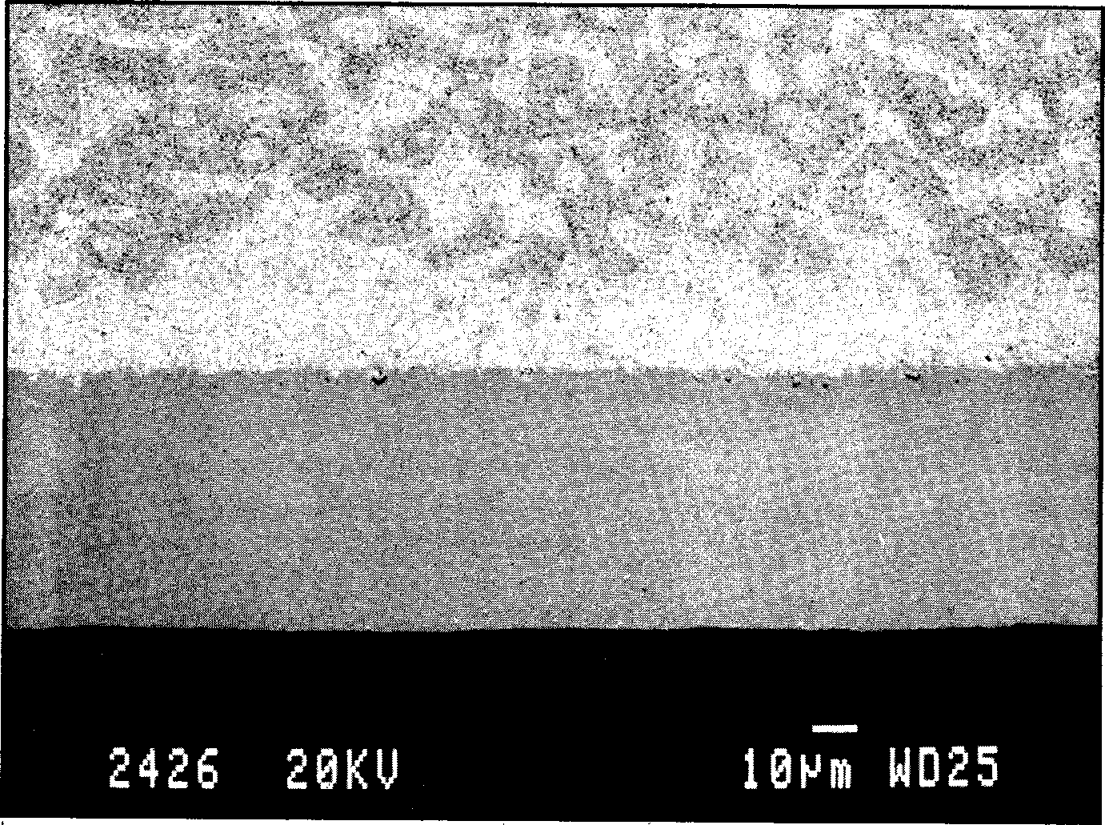
Tin Depletion In 60Sn-40Pb Solder in Region Adjacent to Cu-15Ni-8Sn After 500 hours at 175°C
60Sn-40Pb
Pb-rich
(CuNi)₆Sn₅
Cu-15Ni-8Sn

Slide 17
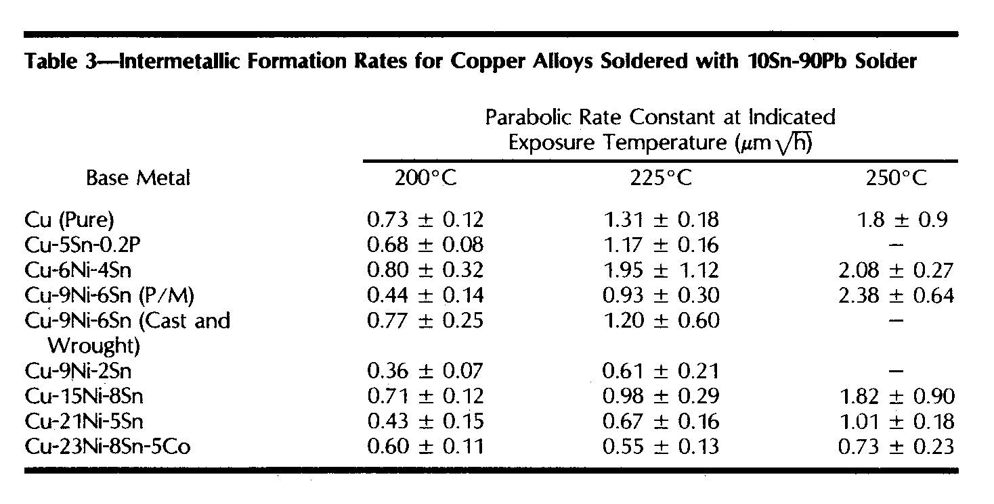
Parabolic Rate Constants for 10Sn-90Pb Solder Vary Little with Base Metal Alloy Composition

Slide 18
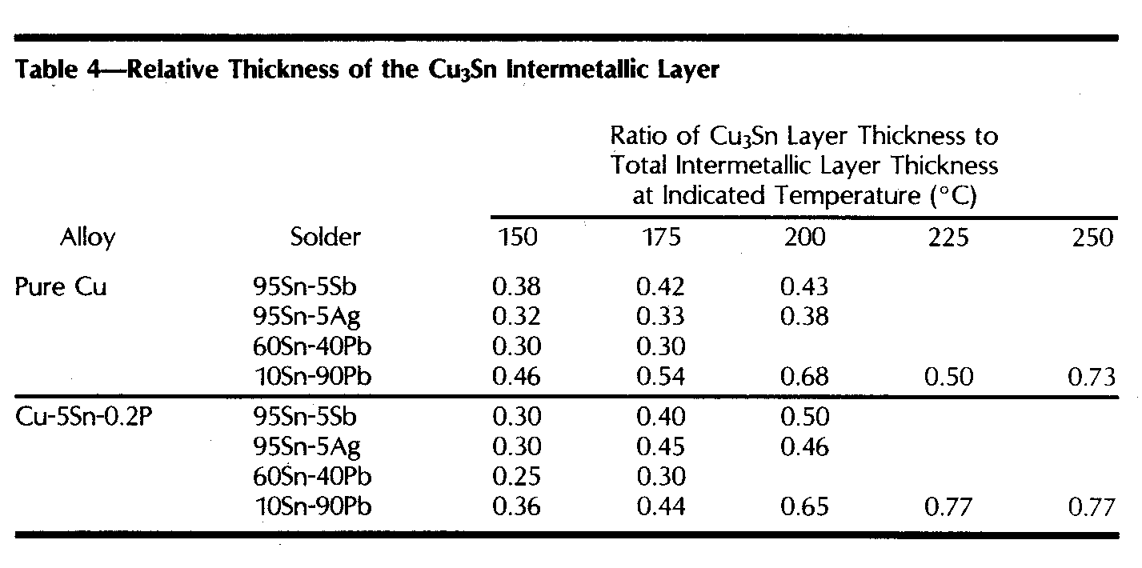
Cu3Sn Observed only in Alloys not Containing Nickel

Slide 19
Structures and Chemistries of Intermetallic Layers With High-tin Solders
Cu₃Sn and Cu₆Sn₅ intermetallic layers in nickel-free alloys
Only (Cu,Ni)₆Sn₅ intermetallic layers in nickel-containing alloys
At temperatures of 150°C and 175°C distinct layers corresponding to approx. (Cu₄Ni₂) Sn₅ adjacent to base metal and (Cu₅Ni) Sn₅ adjacent to the solder

Slide 20
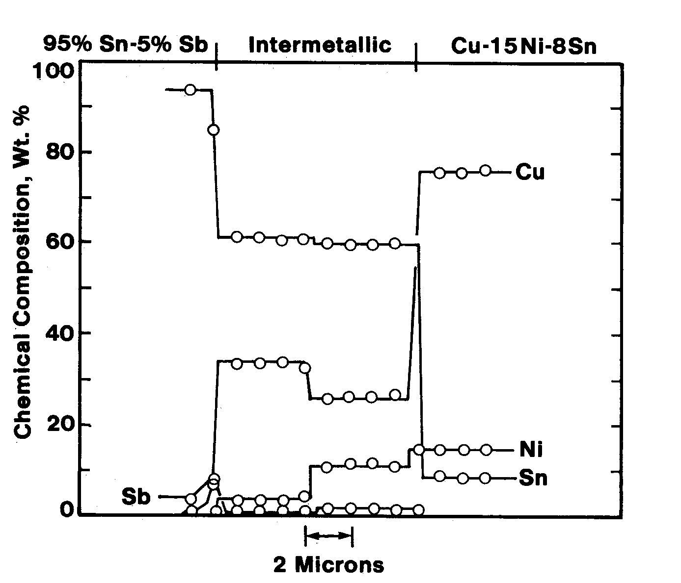
Composition Profile for
Cu-15Ni-8Sn with 95Sn-5Sb Shows Two Regions of (Cu,Ni)₆Sn₅

Slide 21
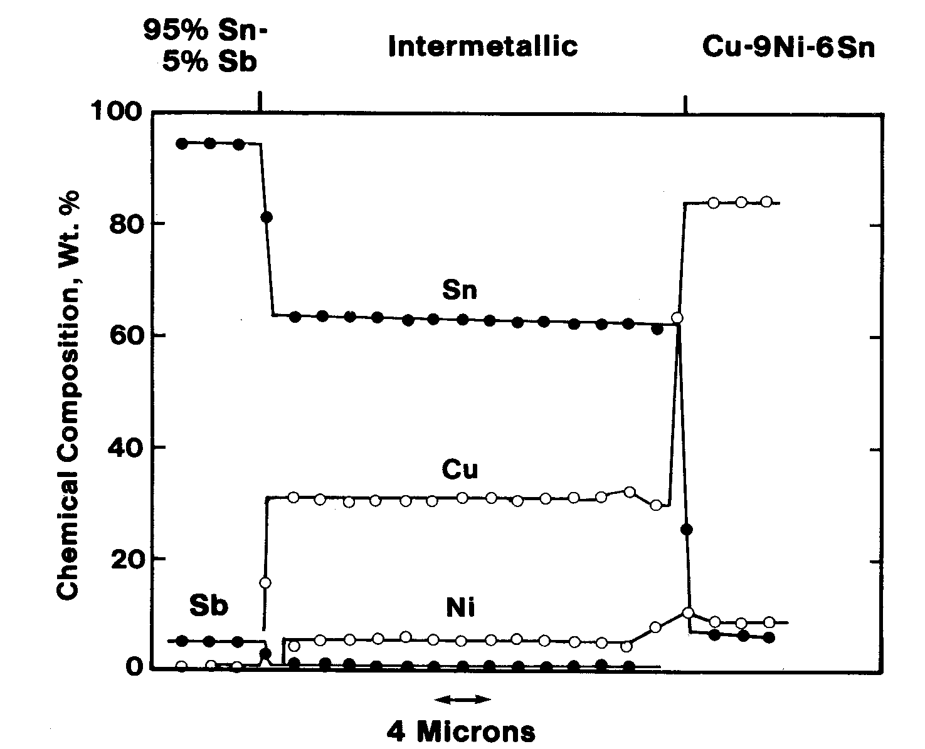
Composition Profile for
Cu-9Ni-6Sn with 95Sn-5Sb Shows Two Regions of (Cu,Ni)₆Sn₅

Slide 22
Compositions of Intermetallic for Cu-15Ni-8 Sn Base Metal (1500 hrs)

Slide 23
Compositions of Intermetallic for 95Sn-5Sb Solder

Slide 24
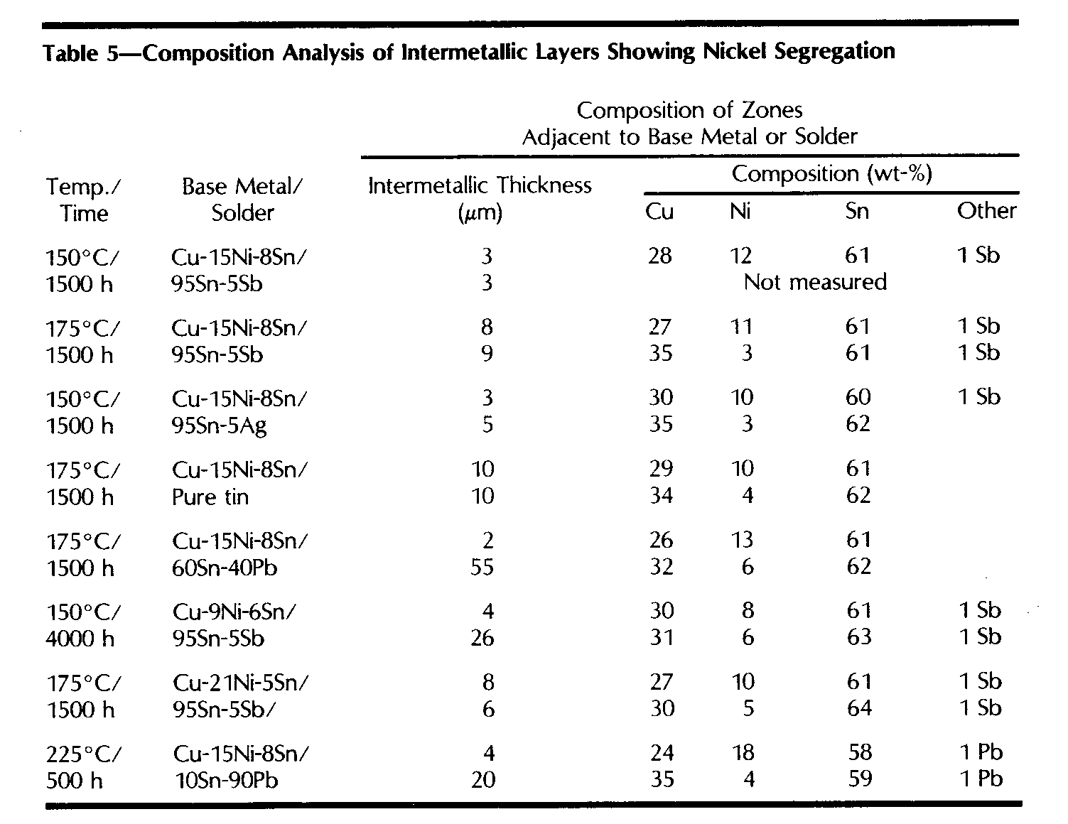
Compositions of Intermetallic Layer

Slide 25
Discussion of Multicomponent Diffusion
At higher temperatures the intermetallic formation can be treated as a pseudo-binary system when there is no segregation of nickel and copper
At temperatures where there are distinct regions on high- and low-nickel content (Cu,Ni)₆Sn₅ the system can only be treated as a ternary

Slide 26
Ternary Effects With Segregation in the Intermetallic (Cu,Ni)₆Sn₅
Kinetics of layer growth are controlled by rate limiting diffusion through nickel-rich intermetallic
In binary diffusion couple kinetics of compound growth in one phase layer does not effect others
Layer growth of the lower-nickel content intermetallic layer is limited by the requirement of mass conservation
Low activation energy in temperature range of 150 to 175° C associated with presence of nickel-rich intermetallic
“Uphill diffusion” of copper

Slide 27
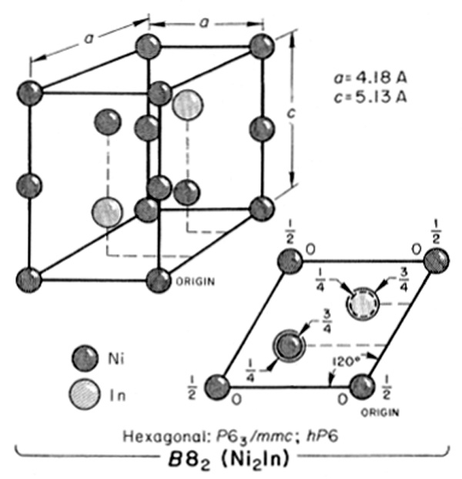
Effects of Crystal Structure
Ni₃Sn₂ has hexagonal
B8₂ structure with
structural vacancies
at nickel sites
Cu₅₅Sn₄₅ analogous
hexagonal B8₁ structure
with copper atoms at
these same sites
Both phases show
ordering at low
temperatures

Slide 28
Discussion of Crystal Structure, Ternary Diffusion, and Layer Growth
Nickel-rich intermetallic has lower tin content which is consistent with lower tin content in the binary Ni-Sn intermetallic as compared to the Cu-Sn intermetallic
Nickel-rich intermetallic is formed adjacent to the base metal consistent with the tin diffusion gradient
Lower diffusion rates in nickel-rich intermetallic are consistent with reduced vacancy content
The initial increase in layer growth rate with small additions of nickel does have a simple explanation on the basis of crystal structure

Slide 29
Discussion of Quarternary Diffusion and Layer Growth
Increased Rate of Layer Growth for Tin-Lead Solders as compared to High-Tin solders
  Low levels (about 0.2) of Pb detected in intermetallics
  formed with high-lead solders at 225°C
  Low levels of Pb not detected but likely present in
  intermetallics formed with tin-lead solders at 175°C
  Low levels of Pb may effect ordering, segregation of nickel and resulting defect structures resulting in the observed increased rate of intermetallic formation in Cu-15Ni-8Sn
Ag and Sb in High-Tin Solders have little effect on layer growth
Observed addition of 2% Ag to 10Sn-90Pb solder reduces intermetallic layer growth in nickel-containing alloys

Slide 30
CONCLUSIONS
Intermetallic layer growth has parabolic kinetics and depends on base metal and solder compositions
For low-tin content solders intermetallic layer growth is controlled by tin diffusion through the solder and is sensitive to solder composition
For high-tin and eutectic solder intermetallic layer growth is very sensitive to nickel content of the copper alloy

Slide 31
CONCLUSIONS (continued)
Intermetallic layer growth for these solders show a maximum growth rate at 6 to 9 % nickel, as much a 35 times greater than other compositions
Reduced layer growth rates are associated with two distinct layers of (CuNi)₆Sn₅ with differing nickel contents
At low nickel contents and/or at increased temperature the layer growth can be treated as a pseudo-binary
Segregation within the (CuNi)₆Sn₅ requires that the layer growth be treated as a ternary diffusion

