Slide 1
Trabalho

Slide 2
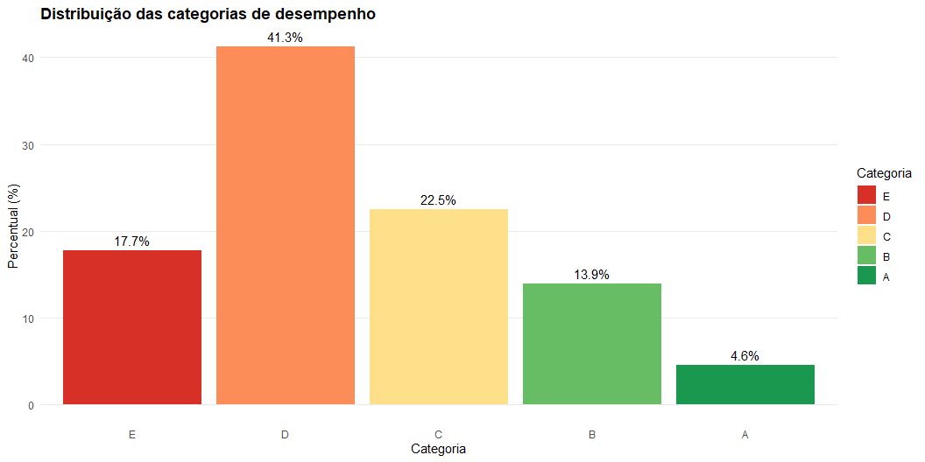
Análise Descritiva
Categóricas

Slide 3
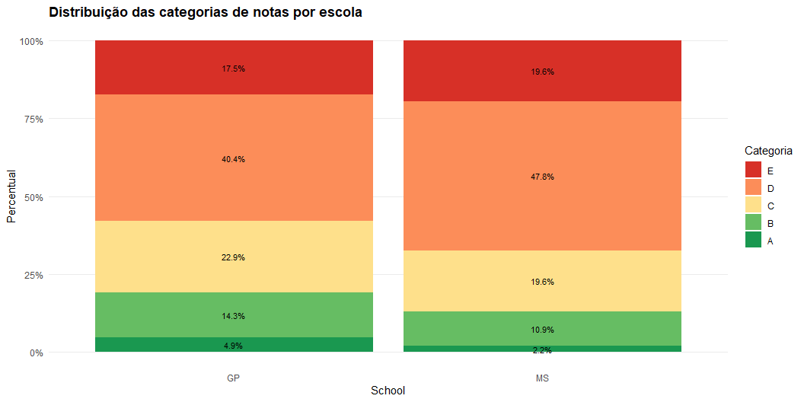

Slide 4
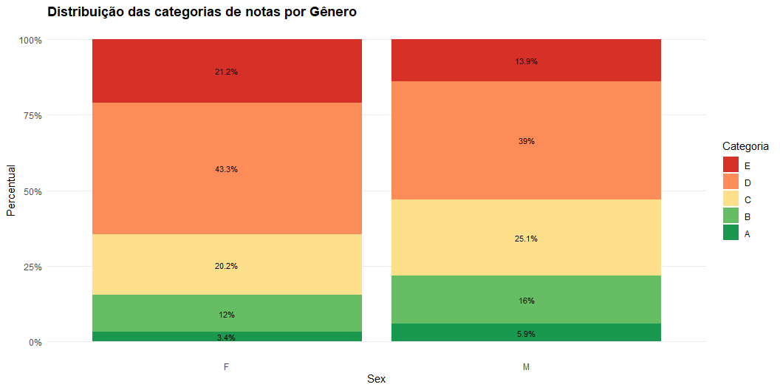

Slide 5
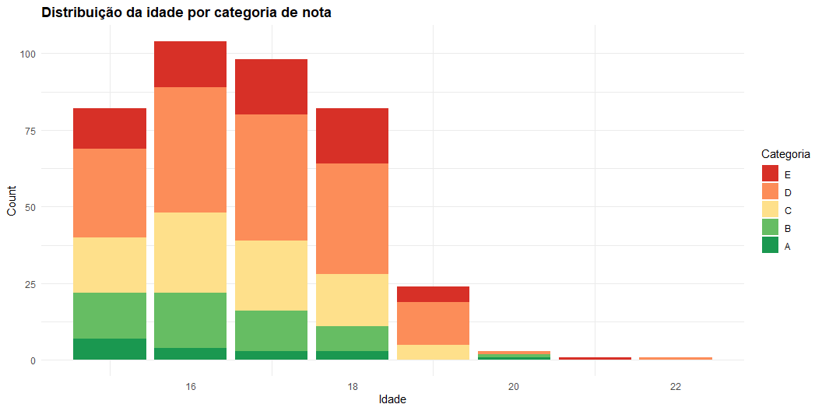

Slide 6
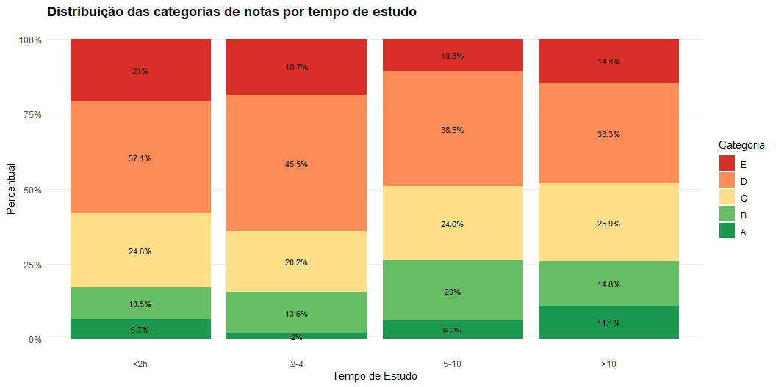

Slide 7
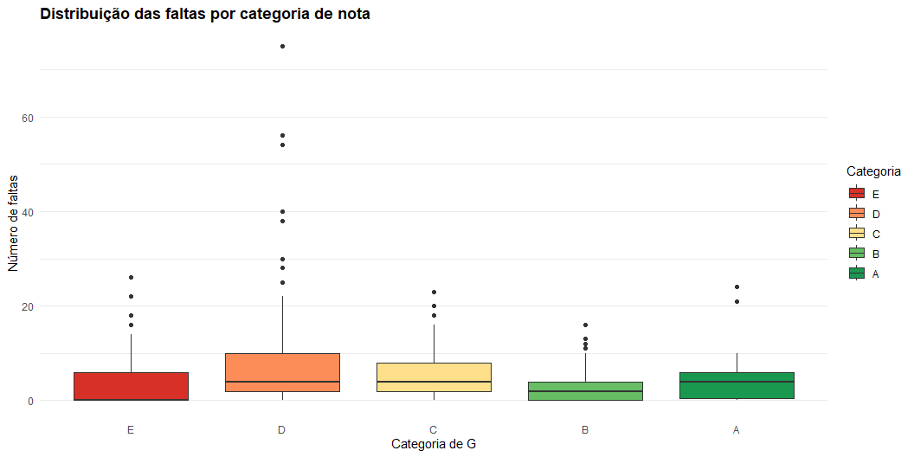

Slide 8
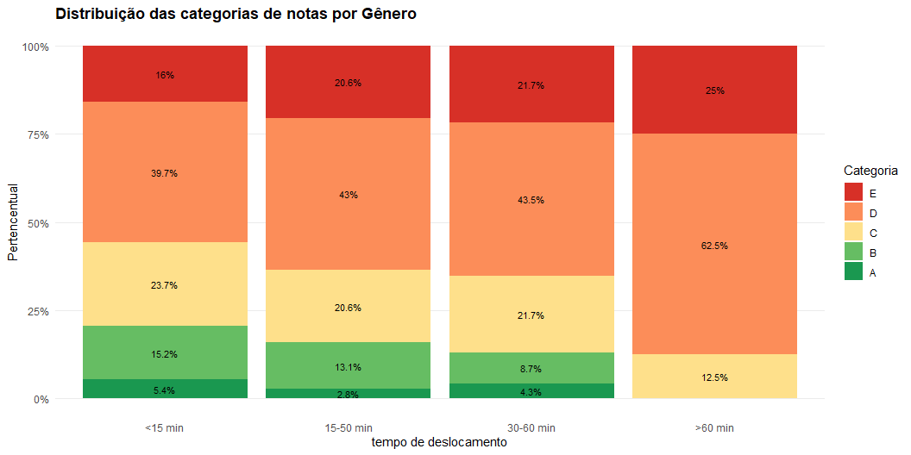

Slide 9
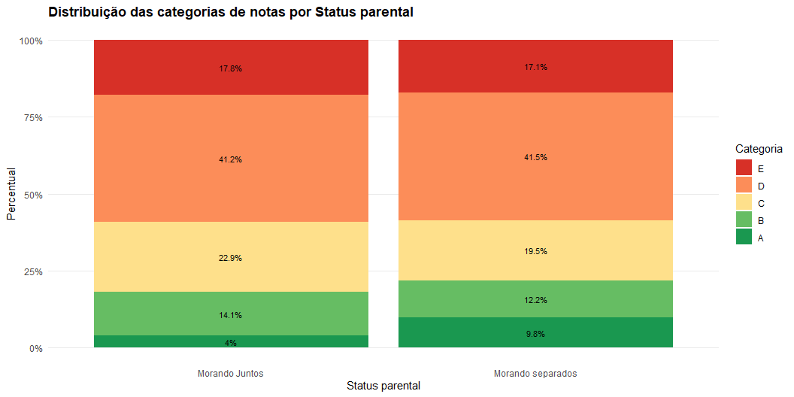

Slide 10
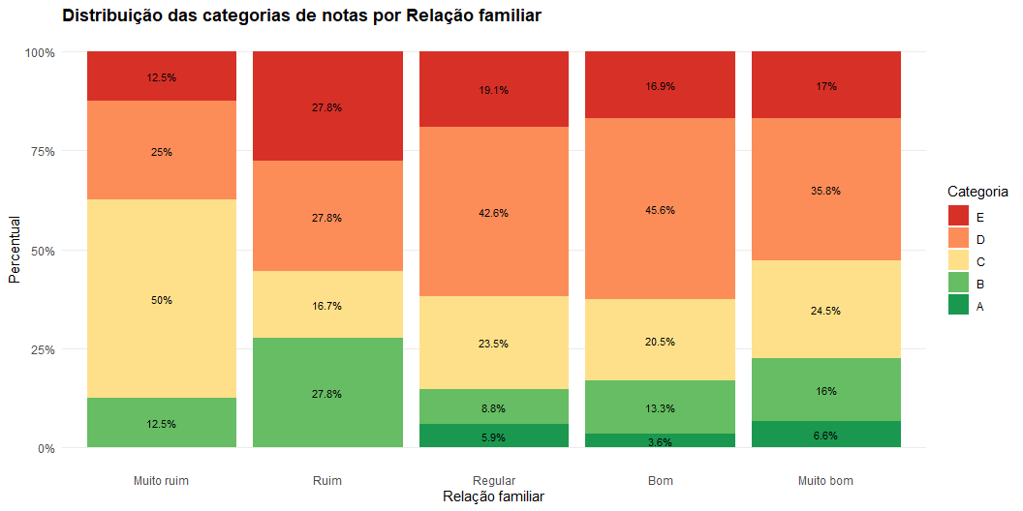

Slide 11
Modelo Inicial
Characteristic | OR | 95% CI | p-value
sex
F | — | —
M | 2.02 | 1.36, 3.00 | <0.001
age | 0.81 | 0.70, 0.94 | 0.005
studytime
<2h | — | —
2-4 | 1.06 | 0.67, 1.68 | 0.8
5-10 | 2.44 | 1.32, 4.53 | 0.005
>10 | 1.87 | 0.82, 4.29 | 0.14
absences | 1.00 | 0.98, 1.02 | >0.9
traveltime
<15 min | — | —
15-50 min | 0.77 | 0.51, 1.17 | 0.2
30-60 min | 0.84 | 0.37, 1.88 | 0.7
>60 min | 0.26 | 0.07, 0.89 | 0.032
Pstatus
Morando Juntos | — | —
Morando separados | 1.19 | 0.65, 2.20 | 0.6
famrel
Muito ruim | — | —
Ruim | 0.67 | 0.15, 3.03 | 0.6
Regular | 0.56 | 0.15, 2.05 | 0.4
Bom | 0.60 | 0.17, 2.09 | 0.4
Muito bom | 0.72 | 0.21, 2.60 | 0.6
Abbreviations: CI = Confidence Interval, OR = Odds Ratio

Slide 12
Stepwise AIC
Characteristic | OR | 95% CI | p-value
sex
F | — | —
M | 1.96 | 1.33, 2.90 | <0.001
age | 0.80 | 0.69, 0.92 | 0.002
studytime
<2h | — | —
2-4 | 1.11 | 0.71, 1.75 | 0.6
5-10 | 2.52 | 1.38, 4.64 | 0.003
>10 | 1.91 | 0.85, 4.31 | 0.12
Abbreviations: CI = Confidence Interval, OR = Odds Ratio

Slide 13
Teste Odds proporcionais
Characteristic | p-value
<none>
sex | >0.9
age
studytime | 0.6
absences | <0.001
traveltime
Pstatus | 0.6
famrel | 0.4

Slide 14
Modelo Odds propocionais parciais
Termo | Beta | OR | IC95% | p-valor
Odds proporcionais
sexM | 0.673 | 1.960 | (1.316 ; 2.918) | 0.0009
age | -0.198 | 0.820 | (0.705 ; 0.954) | 0.0103
studytime2-4 | 0.041 | 1.041 | (0.656 ; 1.653) | 0.8633
studytime5-10 | 0.886 | 2.425 | (1.303 ; 4.511) | 0.0052
studytime>10 | 0.622 | 1.862 | (0.817 ; 4.244) | 0.1392
traveltime15-50 min | -0.274 | 0.760 | (0.498 ; 1.160) | 0.2036
traveltime30-60 min | -0.174 | 0.840 | (0.374 ; 1.885) | 0.6726
traveltime>60 min | -1.332 | 0.264 | (0.077 ; 0.903) | 0.0338
PstatusMorando separados | 0.192 | 1.212 | (0.643 ; 2.285) | 0.5518
famrelRuim | -0.457 | 0.633 | (0.138 ; 2.909) | 0.5567
famrelRegular | -0.697 | 0.498 | (0.135 ; 1.841) | 0.2961
famrelBom | -0.642 | 0.526 | (0.150 ; 1.846) | 0.3160
famrelMuito bom | -0.437 | 0.646 | (0.180 ; 2.317) | 0.5024
Odds não proporcionais
E|D.absences | -0.057 | 0.945 | (0.900 ; 0.993) | 0.0245
D|C.absences | 0.028 | 1.028 | (0.993 ; 1.064) | 0.1157
C|B.absences | 0.068 | 1.070 | (1.011 ; 1.133) | 0.0195
B|A.absences | -0.028 | 0.972 | (0.891 ; 1.061) | 0.5265

Slide 15
Termo | Beta | OR | IC95% | p-valor
Odds proporcionais
sexM | 0.646 | 1.907 | (1.287 ; 2.827) | 0.0013
age | -0.212 | 0.809 | (0.697 ; 0.940) | 0.0055
studytime2-4 | 0.088 | 1.092 | (0.693 ; 1.720) | 0.7040
studytime5-10 | 0.918 | 2.505 | (1.361 ; 4.611) | 0.0032
studytime>10 | 0.653 | 1.921 | (0.857 ; 4.307) | 0.1129
Odds não proporcionais
E|D.absences | -0.058 | 0.943 | (0.898 ; 0.991) | 0.0201
D|C.absences | 0.025 | 1.025 | (0.992 ; 1.060) | 0.1411
C|B.absences | 0.064 | 1.066 | (1.008 ; 1.127) | 0.0242
B|A.absences | -0.030 | 0.970 | (0.890 ; 1.057) | 0.4915

Slide 16
Modelo binario
Characteristic | OR | 95% CI | p-value
sex
F | — | —
M | 1.91 | 1.21, 3.03 | 0.006
age | 0.81 | 0.68, 0.96 | 0.015
studytime
<2h | — | —
2-4 | 0.92 | 0.54, 1.56 | 0.7
5-10 | 2.06 | 1.01, 4.25 | 0.047
>10 | 1.72 | 0.69, 4.36 | 0.2
absences | 0.98 | 0.94, 1.01 | 0.15
traveltime
<15 min | — | —
15-50 min | 0.76 | 0.46, 1.23 | 0.3
30-60 min | 0.79 | 0.30, 1.96 | 0.6
>60 min | 0.09 | 0.00, 0.62 | 0.042
Pstatus
Morando Juntos | — | —
Morando separados | 1.12 | 0.54, 2.27 | 0.8
famrel
Muito ruim | — | —
Ruim | 0.36 | 0.05, 2.11 | 0.3
Regular | 0.25 | 0.04, 1.20 | 0.089
Bom | 0.25 | 0.05, 1.16 | 0.083
Muito bom | 0.34 | 0.06, 1.64 | 0.2
Abbreviations: CI = Confidence Interval, OR = Odds Ratio

Slide 17
Characteristic | OR | 95% CI | p-value
sex
F | — | —
M | 1.89 | 1.21, 2.99 | 0.006
age | 0.81 | 0.68, 0.96 | 0.015
studytime
<2h | — | —
2-4 | 0.91 | 0.54, 1.54 | 0.7
5-10 | 1.99 | 0.99, 4.04 | 0.054
>10 | 1.77 | 0.71, 4.44 | 0.2
absences | 0.98 | 0.94, 1.01 | 0.2
traveltime
<15 min | — | —
15-50 min | 0.74 | 0.45, 1.20 | 0.2
30-60 min | 0.79 | 0.30, 1.96 | 0.6
>60 min | 0.13 | 0.01, 0.77 | 0.061
Abbreviations: CI = Confidence Interval, OR = Odds Ratio

Slide 18
Modelo | AIC | BIC | LogLik
Ordinal | 1,125.01 | 1,196.63 | −544.50
Ordinal Step | 1,114.53 | 1,150.34 | −548.26
Ordinal Parcial | 1,108.99 | 1,192.55 | −533.50
Ordinal Parcial Step | 1,100.78 | 1,152.50 | −537.39
Binário | 529.42 | 589.10 | −249.71
Binário Step | 524.42 | 564.20 | −252.21

