Slide 1
Web Design
Plan the site and its structure
Plan the display and navigation
Design the look
Test

Slide 2
Planning the site
Identify the audience
Determine the site’s purpose
Plan the structure

Slide 3
Planning the site
Identify the audience
Determine the site’s purpose
Plan the structure

Slide 4
Identifying the Audience
What audience are the following sites addressing? Look them up now.
www.yahooligans.com/
http://personal.fidelity.com/products/wealth/
www.NOAA.GOV/
children
adult investors looking for information and advice
wide range, professionals to fishermen

Slide 5
Target Audiences
Organization-centered
web site built from the point of view of the group that is publishing the site.
Structure: reflects organizational chart
Vocabulary: language used by executives
Content: similar to internal documents
Example: hospital site is a table with links to Audiology, Nephrology, podiatry, etc.
Words mean something to the professionals, not the average user.

Slide 6
Target Audiences
technology-centered
Starts with particular set of tools
Site built around the tools
Example:
use Flash, use database, use Active Server Pages with forms
hospital site designed by multimedia experts.
Site would contain interviews with doctors, live video stream from OR, etc.

Slide 7
Target Audiences
user-centered
Starts with target audience
Designer
defines who the visitors will be
studies visitors to figure out what they need and how they work
presents site in terms that the visitor can understand and in a structure that mirrors the way that they think.

Slide 8
Target Audience
Which audience to target?
Depends on purpose of site.
Usually want a user-centered web site.

Slide 9
Ways of defining an audience
age
gender
geographic location
residence: urban, suburban, rural
level of income
level of education
race or ethnicity
interest (why user came to the site)
history (path of web pages user has visited before)

Slide 10
Ways of defining an audience
1-7 called demographics.
Used to define audiences for media advertisements (TV etc)
8 & 9 most important for web sites.
The more characteristics you include, the more precise and useful your definition.

Slide 11
Ways of defining an audience
Example:
yahooiligans. Children between 8 and 12 years old who are looking for information relevant to their school or personal research.
one demographic characteristic (age)
one interest characteristic (looking for info)

Slide 12
Ways of defining an audience
Better example:
Fidelity web site.
Fidelity brokerage customers living in large sities with balances of at least $250,000 who have conducted at least three online strock trades in the last three weeks and who have clicked on the Trade button on the Fidelity home page.
2 demographic characteristics (location, wealth)
2 characteristics on interest and history.

Slide 13
Audience
What demographics are identified in the following description?
The audience for the LeftyStuff Web site is potential purchasers of LeftyStuff products who have responded to one of LeftyStuff’s banner ads and are interested in items designed especially for left-handed people. Most are adults, equally divided among men and women, between the ages of 25 and 50, who live in the US or Canada, are sports-minded, and have family incomes greater than $50,000. Most have never visited the site before.

Slide 14
Steps in defining the audience
Ask your client the following questions about site visitors:
Who are they?
Why are they at the site?
How did they get there?
How old are they? What’s the range of their ages?
Where do they live?
What gender are they? Mostly men/women? why?
How wealthy are they compared to the rest of the population?
What’s their history of dealing with your organization? What have they done before at your web site?
Are there any common characteristics that stand out?

Slide 15
Audience
Exercise
Talk with the people on either side of you and describe the audience for a web site for Mac’s store.

Slide 16
Planning the site
Identify the audience
Determine the site’s purpose
Plan the structure

Slide 17
Determining the Site’s Purpose
What will viewers be using site for
Why will viewers be using the site
Part of the answers come from users’ reason for visiting site (get from audience def)
Part of answers come from organization’s reasons for publishing the site.

Slide 18
Example
The purpose of the LeftyStuff Web site is to increase the direct online sales of high-end tennis racquets by 30% over the next 3 quarters. The site will display six key items from the racquet line, with two types of color photos: the racquets alone and the racquets in use by left-handers on the tennis court. The site will make it easy for customers to find racquets that best meet their needs and will make it easy to purchase the racquet online using a credit card. The site will also communicate the mission of the LeftyStuff Corporation and its special emphasis on the needs of this minority group.

Slide 19
Example (cont)
Definition reflects organization’s needs
market and sell racquets
Definition reflects customer’s interests
find and purchase a specialty racquet
Explains why site is being published
to increase sales
Explains what site will include
product displays, purchasing system, company’s mission

Slide 20
Determining the Site’s Purpose
Key to definition is the verbs used
increase sales
display items
find the racquet
purchase the racquet
communicate the mission

Slide 21
Determining the Site’s Purpose
Statement of purpose must contain both goals and objectives.
Goals state the desired long-term results.
increase the direct online sales of high-end tennis racquets by 30% over the next 3 quarters. (organization-centered)
to provide a wider range of services to online readers of the newspaper. (user-centered)

Slide 22
Determining the Site’s Purpose
Objectives include specific means and methods used on the site to accomplish goals
to provide online readers of the newspaper with hourly updates of key news stories. (user-centered)
display six key items from the racquet line with two types of color photos: the items alone and the racquets in use by left-handers on the tennis court. (user-centered)

Slide 23
Example
The chief purpose of the XYZ web site is to expand and broaden the reach of the program so that it makes a greater impact on American education. A secondary purpose is to create a virtual community of educators interested in XYZ, who can use the Internet to share ideas and promote sound teaching in this field in middle and high schools. A tertiary purpose of this site is to serve as a model or template for other XYZ programs that seek to promote change and improvement in education.
To achieve these broad purposes, the site will comprise three key objectives:
To inform its audiences about XYZ happenings
To educate its audiences about XYZ
To promote intelligent conversation about XYZ among all three audiences.
Goals
Objectives

Slide 24
Purpose
Exercise
Identify possible goals and objectives for a web site for Mac’s store.
Identify which goals and objectives are user-centered and which are organization-centered

Slide 25
Determining the Site’s Purpose
Example of technology-centered goals:
to show the capabilities of ABC-VR software by including four virtual reality panoramas on the site.
to allow users to view video excerpts from the summer institutes in a variety of formats including QuickTime and RealVideo.

Slide 26
Determining the Site’s Purpose
Goals and objectives also allow you to evaluate success after the site has been published for a while.

Slide 27
Determining the Site’s Purpose
Template for goals chart
Goals of the organization
Goals of the user
Objectives for display
Objectives for interactivity
Objectives for communication
Objectives for technology

Slide 28
Goals Chart
Example goals:
Display. These goals would describe how the site would appear. Examples:
“Simple, easy to navigate menus”
“Advertise the X club through pictures”
“Brand the company through logos and colors”

Slide 29
Goals Chart
Example goals:
Interactivity. These goals would describe how the user would interact with the web pages (but not how they would communicate):
“the user will be able to run animations/play movies about X”
“the user may buy products”
“people may upload pictures”
“the user may choose the month of the calendar displayed”
“there will be links to other related pages”
“users will be able to fill out a survey”

Slide 30
Goals Chart
Example goals:
Communciation. These goals would describe how the user would communicate with the organization or with each other.
In this goal information should flow to the organization and then (potentially) back to the user.
“there will be email links to each member of the organization”
“there will be a message board”
“people may request information by submitting a form”

Slide 31
Goals Chart
Example goals:
Technology. These goals would be concerned with how the web page is put together. This includes
any type of data that will be used on the site and
any programs/applications that will be used.
Examples:
“we will display high resolution pictures”
“we will include movies in quicktime and real formats”
“the site will employ server-side scripts to store responces”
“javascript will be used to make the menus dynamic
“animations will be displayed using javascript”

Slide 32
Planning the site
Identify the audience
Determine the site’s purpose
Plan the structure

Slide 33
Planning the Structure of the Site
Structure: the layout and function of each part of the site.
Use a planning chart to organize overall structure and functions
Often use a flow chart to illustrate particular structure.
Create a storyboard to prototype the site.

Slide 34
Planning Chart
Each purpose and objective indicates a structural element (which might have sub-elements)
Each structural element must have one or more functions
Functions should be as concrete and detailed as possible
Functionality usually described in terms of actions taken by users
Viewers go here to read about new ideas
Viewers find many different types of events

Slide 35
Planning Chart Example
Purpose | Structure (what) | Function (how)
To inform its audiences about XYZ happenings | Calendar of Events section: here viewers will find… | Users can search events by date, topic, and location, or browse a list of all events
To educate its audiences about XYZ | Institutes section: this section will display publicity and registration information for summer institutes… | Users can link to teaching resources and video clips that show the nature of the institutes and an online application form
To promote intelligent conversation about XYZ among all three audiences | Forums section: viewers will go here to read about new ideas, … | Users can participate in an asynchronous discussion system as well as synchronous chat discussions.
Get these from the goals chart
Items in this column describe what information/interactivity will be be used to meet the goal.
Items in this column describe how the user will use the items from the structure column.

Slide 36
Planning Chart Example
Purpose | Structure (what) | Function (how)
To expand and broaden the reach of the XYZ program so that it makes a greater impact on American education. | Teaching resources section: This is the largest part of the site, containing materials to help teachers integrate media and democracy topics into the curriculum. It has 3 subsections: Teaching units: developed at the …. Publications: references to print and on-lin publications… Multimedia: video, … media collected by program staff….. | In addition to the functions typically available in a Web site, the XYZ site will require additional functionality to implement the materials described above: Dynamic home page: Program staff need the capability to change the images and text on the home page at least weekly, without reprogramming the page. Database of resources: Viewers need to be able to search and retrieve teaching units from a collection of several hundred. Program staff need to be able to add new units… Database of publications and studies:…. Streaming video: Excerpts from summer institutes and other multimedia material need to be made available in streaming format.

Slide 37
Flow Charts
A flow chart is a graphical shorthand that represents the site’s detailed verbal description.
Rows of rectangles, each one representing a section of the site.
Three levels of flow charts
General. Shows overall structure of site. Each block represents one cell of the structure column of the planning chart.
Detailed. Each flow chart block represents one page
Specified. Add specification block is added to each block in the detailed flow chart.

Slide 38
Flow Charts
Each box must have a number that relates it to the corresponding goal

Slide 39
Example: General Level
the number relates
the F.C. box to a
corresponding goal
1
Home Page
About the
Program
2
3
4
5
6
7
Teaching
Resources
Calendar
of Events
Forums
Faculty
and Staff
Institutes
8
Teaching
Units
Discussion
Topics
Faculty
Pages
11
13
9
Publications
Synchronous
Chat
12
10
Multimedia

Slide 40
Detailed Level
Each box on the detailed flow chart must have a label.
The label must be descriptive enough to indicate exactly what will go on the page
example: a label of forms is not descriptive enough. What type of forms? How many?
You must indicate the types of information (but not their specifics) in the box.

Slide 41
Example: Detailed Level
3
Teaching
Resources
Teaching
Resources menu
14
Teaching
Units
the number relates
the F.C. box to a
corresponding goal
Search Teaching
Units
Search Video
clips
8
15
16
Publications
9
Display Teaching
Resources
Display Video
clips
Multimedia
17
18
10

Slide 42
Flow Charts Specifications
For each detailed block, list all the items that the page will include.
Called “spec’ing out” the flow chart.
Must include:
page’s filename
a brief description of the text
descriptions of the images
descriptions of each sound, video, or animation
a list of any input forms and how the info on them is retrieved
a list of links to other pages
a description of any scripts used on the page
Don’t include visual design, color, “look & feel”

Slide 43
Elements to use in specifications
Text
fastest way to communicate content
text placed on page
text put in PDF file
must determine where will get text from
hypertext to link
to another page in your site
to another site
to a spot elsewhere on your page
link to an image
link to voice, music, or sound clip
link to a video
open a new window, eg, to display a definition

Slide 44
Elements to use in specifications
Images
used to pass information
used to create a “feel”
used for navigation (image maps)
icons
can be animated (animated gifs)

Slide 45
Elements to use in specifications
Multimedia
usually slow to download: consider audience
animation. text or images. Flash most popular format.
sound.
video.
virtual reality. VMR or QTVR.

Slide 46
Elements to use in specifications
CGI
indicate any cgi (server files) that you connect to.
indicate what information will be sent to the cgi script.

Slide 47
Elements to use in specifications
Interactivity
Choose
Animate. Click to see a process in action.
Search and Find. Multidimensional menu, Search engine, etc.
Buy and Sell.
Manipulate. Use mouse to move things around on the screen. Allows complex selections.
Construct. User builds something on screen by making choices, manipulating objects, selecting alternatives.

Slide 48
Elements to use in specifications
More Interactivity
Question and Answer. Answers can be “live” or delivered later via email.
Converse. synchronously (via chat rooms) or asynchronously (via threaded discussions).
Play.

Slide 49
Specifications Example
Display Video
clips
FileName: videosmith.html
Images: logo.gif
Multimedia: videosmith.mov
Text: smith bio; video synopsis
Links: smith home page
(http://www.bu.edu/smith/)
Menu items: search video clips,
teaching resources
CGI scripts: send request form to
(http://www.bu.edu/cgi-bin/req.cgi)

Slide 50
Example Project
Art History Web site, designed Fall 2003.

Slide 51
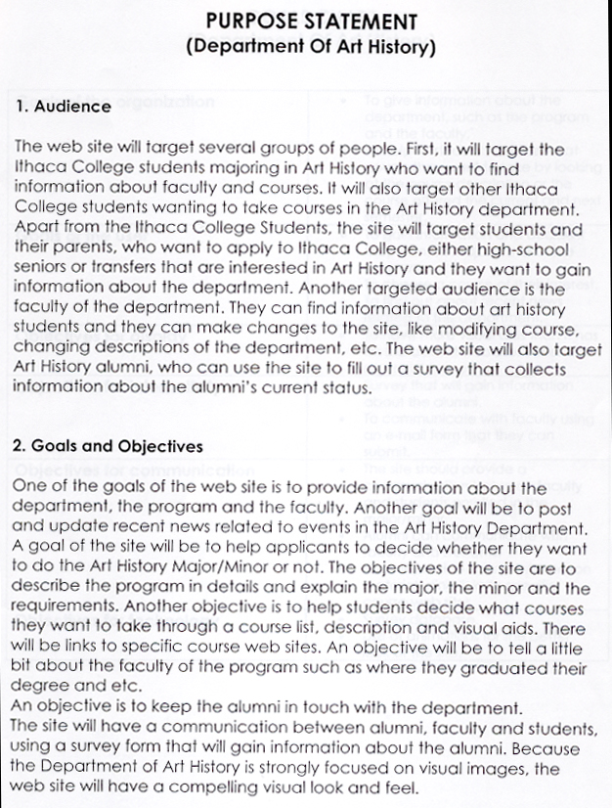
Project

Slide 52
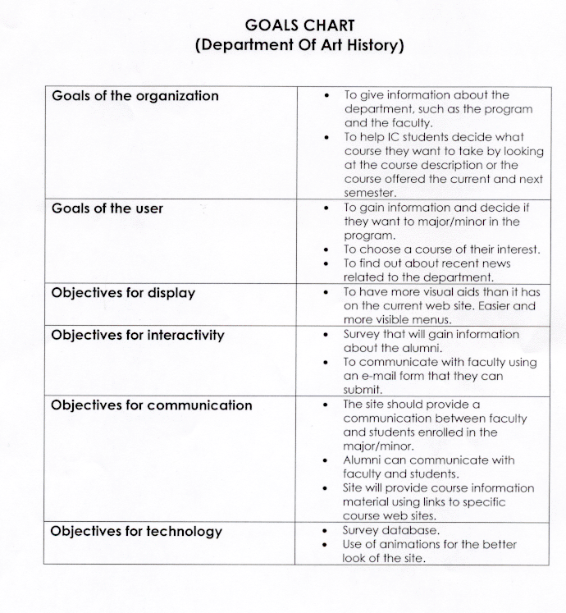
Project

Slide 53
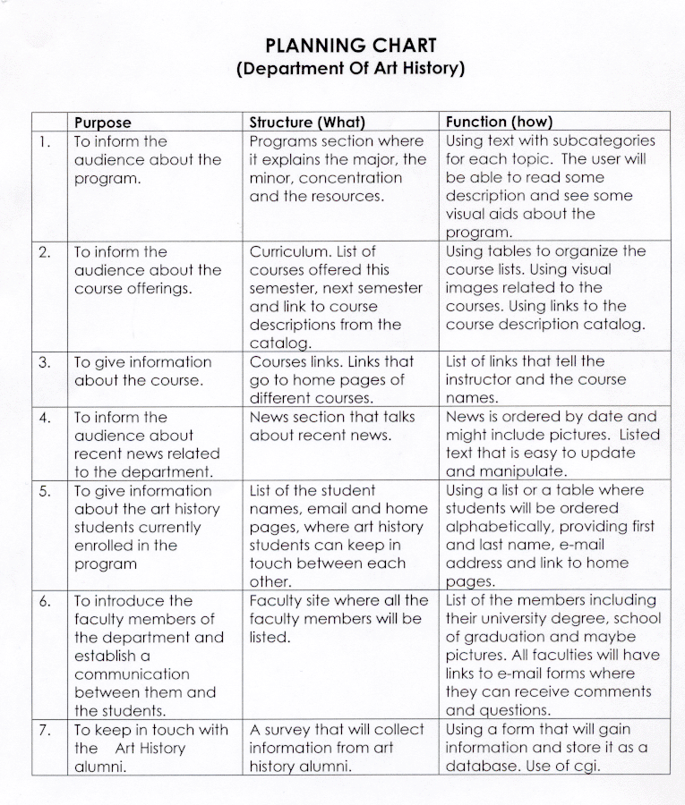
Project
Numbering Scheme to
enable trace to flow charts
and specifications

Slide 54
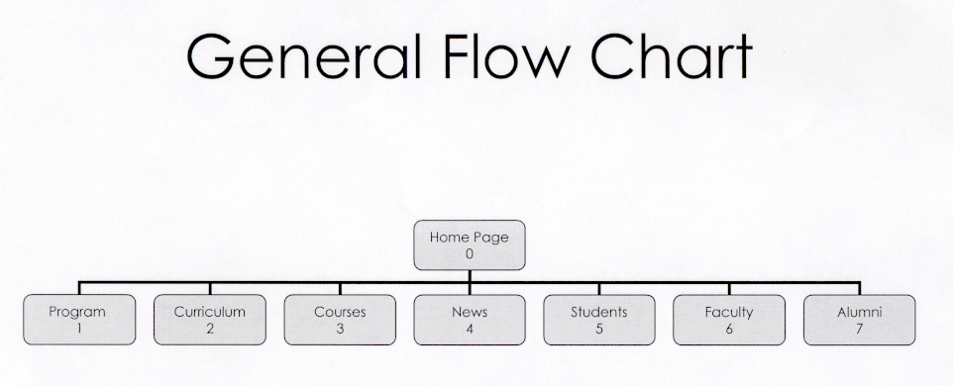
Art History Project
Numbering Scheme
to trace back to goals
and forward to detailed
FC and specs

Slide 55
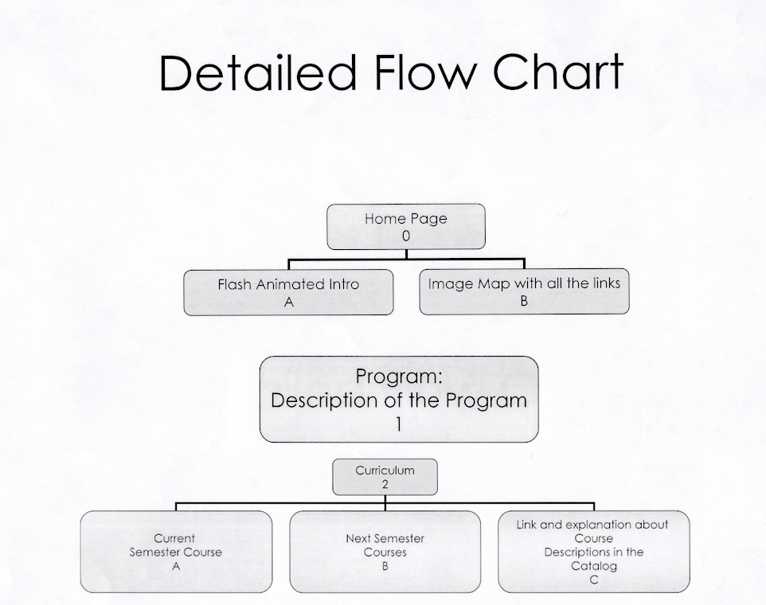
Art History Project
Numbering Scheme
to trace back to goals
and forward to specs

Slide 56
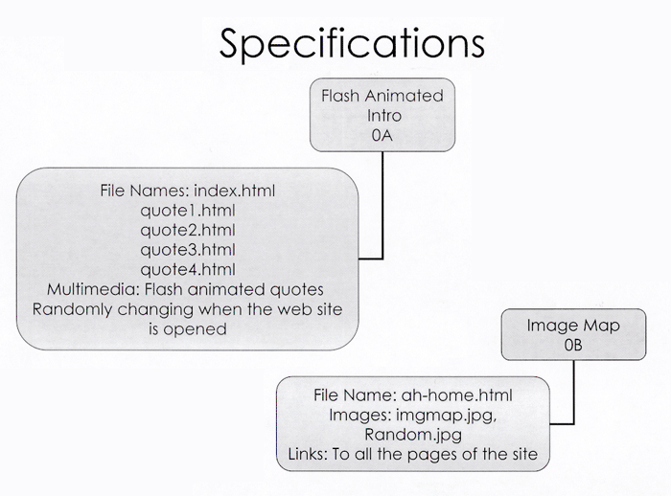
Corresponds to
detailed FC 0A
and 0B

Slide 57
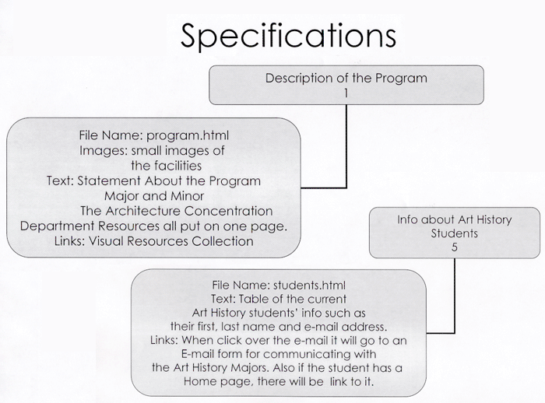
Corresponds to
detailed FC 1
and 5

Slide 58
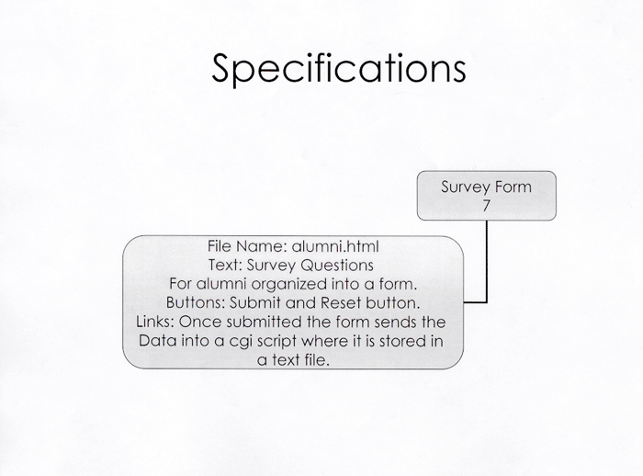
cgi script is specified. Should
give actual name of the script
if known.

Slide 59
Storyboard
gives a graphic example of each major page
used to provide a visual prototype of the web site
size of pages used should mimic display size (especially ratio of width to length)
traditionally used in animation and film creation
should be part of the final design package

Slide 60
Planning process
Goals chart
Planning Table
General Flow Chart
Detailed Flow Chart
Specifications
Storyboard
and sketches
Prototype

