Slide 1
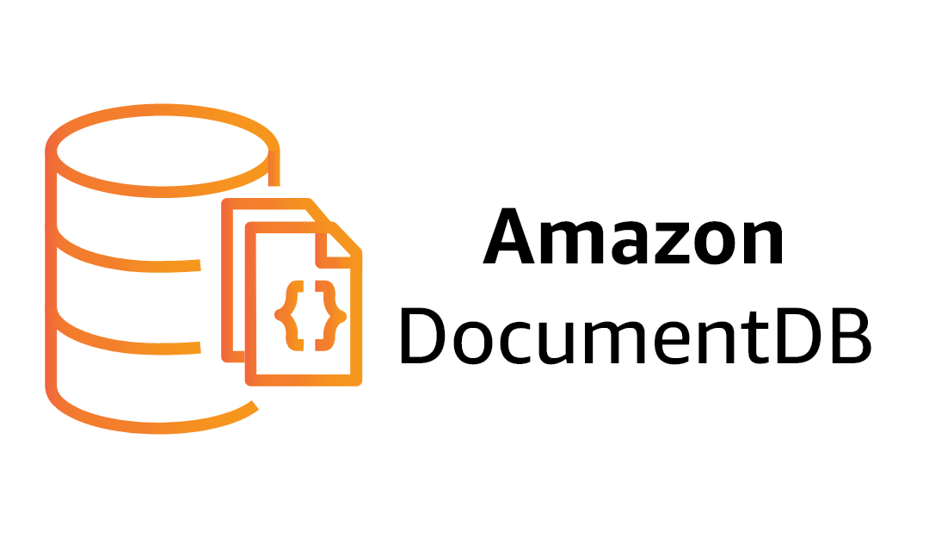

Slide 2
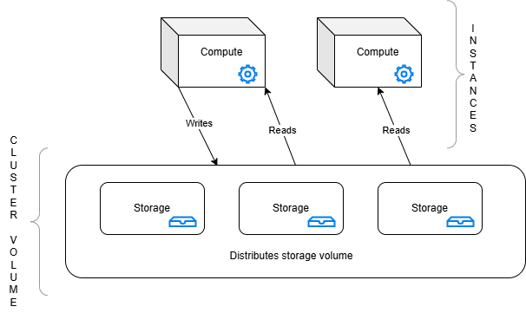
Core Components
Notes:
AWS managed document database service
MongoDB compatible
instances
query processing
caching
APIS - instances type: - primary instance - each AWS DocumentDB cluster has one primary instance - support read and writes - perform all data modifications to cluster volume - replica instance - support only read - each AWS DocumentDB can have up to 15 instances - enables distribute read workload - May enable Multi AZ Availability
cluster volume
manage data to instances
Two flavors: instances and elastic cluster
Use cases
games
IoT devices into Amazon

Slide 3
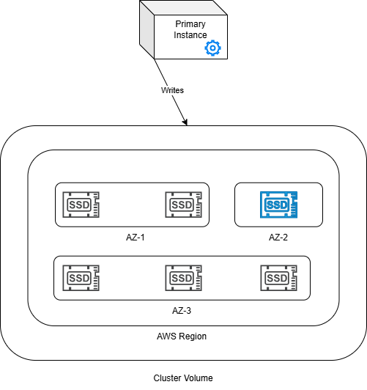
Cluster Volume
Notes:
- data is stored in cluster volume - single, virtual volume that uses SSDs - cluster volume - consists of six copies of your data - data is automatically replicated across multiple Availability Zones (AZ) in single AWS Region - Replication helps ensure high durability, less possibility of data loss, also higher availability during failover because data already exist in other AZ, since these copies could continue to serve data to instances of the AWS DocumentDB
- Replication - Write operation to primary instance, the primary instance executes a durable write to the cluster volume - After the primary instance replicates the state of the write (not the data) to each ACTIVE replica - Read replicas does NOT participate on the write process - downside for read scaling - Reads from Amazon DocumentDB replicas are eventually consistent with minimal replica lag—usually less than 100 milliseconds after the primary instance writes the data - Amazon DocumentDB replicas are also failover targets and are quickly promoted if the primary instance for your Amazon DocumentDB cluster fails.

Slide 4
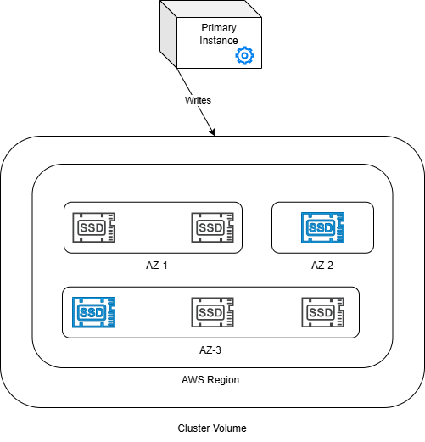
Cluster Volume
Notes:
- data is stored in cluster volume - single, virtual volume that uses SSDs - cluster volume - consists of six copies of your data - data is automatically replicated across multiple Availability Zones (AZ) in single AWS Region - Replication helps ensure high durability, less possibility of data loss, also higher availability during failover because data already exist in other AZ, since these copies could continue to serve data to instances of the AWS DocumentDB
- Replication - Write operation to primary instance, the primary instance executes a durable write to the cluster volume - After the primary instance replicates the state of the write (not the data) to each ACTIVE replica - Read replicas does NOT participate on the write process - downside for read scaling - Reads from Amazon DocumentDB replicas are eventually consistent with minimal replica lag—usually less than 100 milliseconds after the primary instance writes the data - Amazon DocumentDB replicas are also failover targets and are quickly promoted if the primary instance for your Amazon DocumentDB cluster fails.

Slide 5
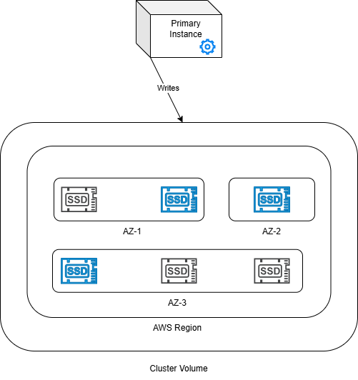
Cluster Volume
Notes:
- data is stored in cluster volume - single, virtual volume that uses SSDs - cluster volume - consists of six copies of your data - data is automatically replicated across multiple Availability Zones (AZ) in single AWS Region - Replication helps ensure high durability, less possibility of data loss, also higher availability during failover because data already exist in other AZ, since these copies could continue to serve data to instances of the AWS DocumentDB
- Replication - Write operation to primary instance, the primary instance executes a durable write to the cluster volume - After the primary instance replicates the state of the write (not the data) to each ACTIVE replica - Read replicas does NOT participate on the write process - downside for read scaling - Reads from Amazon DocumentDB replicas are eventually consistent with minimal replica lag—usually less than 100 milliseconds after the primary instance writes the data - Amazon DocumentDB replicas are also failover targets and are quickly promoted if the primary instance for your Amazon DocumentDB cluster fails.

Slide 6
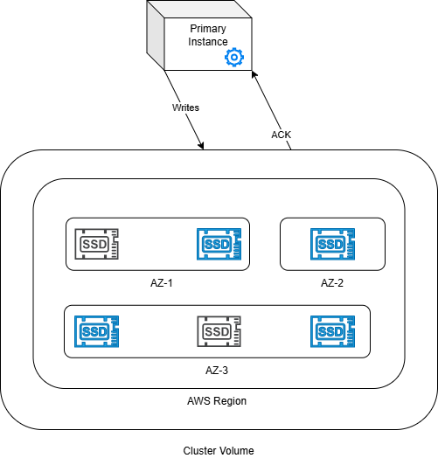
Cluster Volume
Notes:
- data is stored in cluster volume - single, virtual volume that uses SSDs - cluster volume - consists of six copies of your data - data is automatically replicated across multiple Availability Zones (AZ) in single AWS Region - Replication helps ensure high durability, less possibility of data loss, also higher availability during failover because data already exist in other AZ, since these copies could continue to serve data to instances of the AWS DocumentDB
- Replication - Write operation to primary instance, the primary instance executes a durable write to the cluster volume - After the primary instance replicates the state of the write (not the data) to each ACTIVE replica - Read replicas does NOT participate on the write process - downside for read scaling - Reads from Amazon DocumentDB replicas are eventually consistent with minimal replica lag—usually less than 100 milliseconds after the primary instance writes the data - Amazon DocumentDB replicas are also failover targets and are quickly promoted if the primary instance for your Amazon DocumentDB cluster fails.

Slide 7
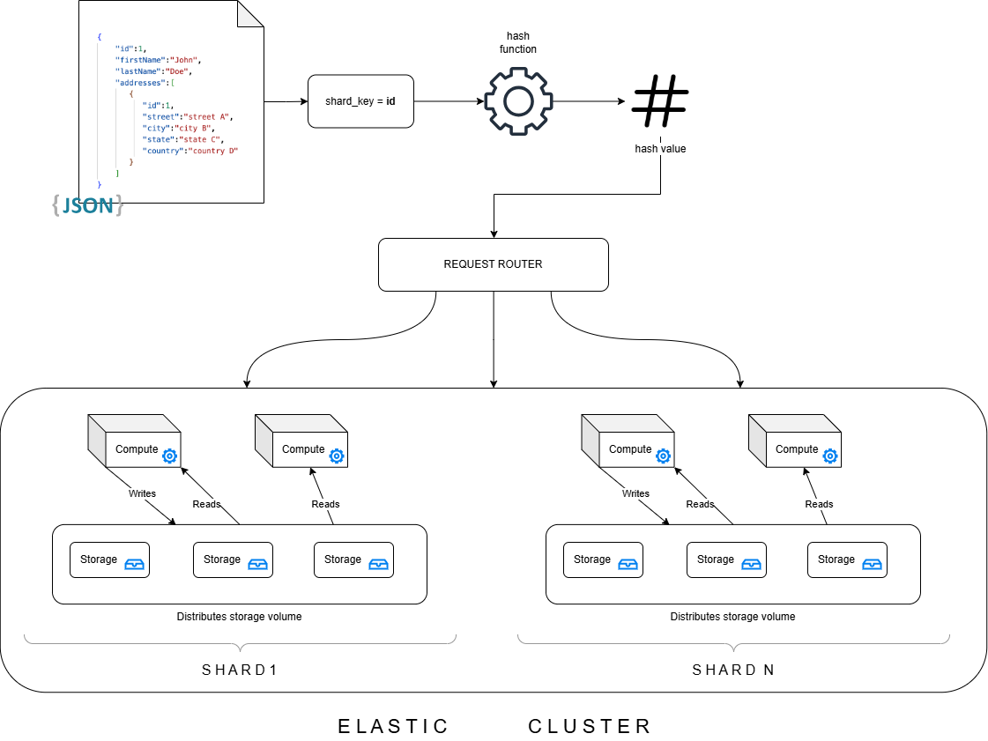
Elastic Cluster Sharding
Notes:
- Amazon DocumentDB elastic clusters use hash-based sharding to partition data across a distributed storage system. - Algorithm: hash function transforms the shard key into hash and uses this hash to partition the data across - Sharding, also known as partitioning, splits large data sets into small data sets across multiple nodes enabling you to scale out your database beyond vertical scaling limits - AWS Document DB decouples compute from storage, allowing scale independently of each other
- each shard has it own writer
- games
- Shard definitions - Shard - A shard provides compute for an elastic cluster. - Single writer instance and 0-15 read replicas - By default, a shard will have two instances: a writer and a single read replica. - Shard Key - Required field on JSON document in shared collections that elastic cluster uses to distribute read and write to matching shard - A good shard key will evenly partition your data across the underlying shards, giving your workload the best throughput and performance. - Sharded collection - Collection whose data is distributed across an elastic cluster in data partitions - Partition - Logical portion of shared data - When shared collection is created, the data is organized into partitions inside each shard basead on the shard key

Slide 8
Pros
🔸 Isolation between compute and storage, providing granular scalability;
🔸 Durability even with single instance

Slide 9
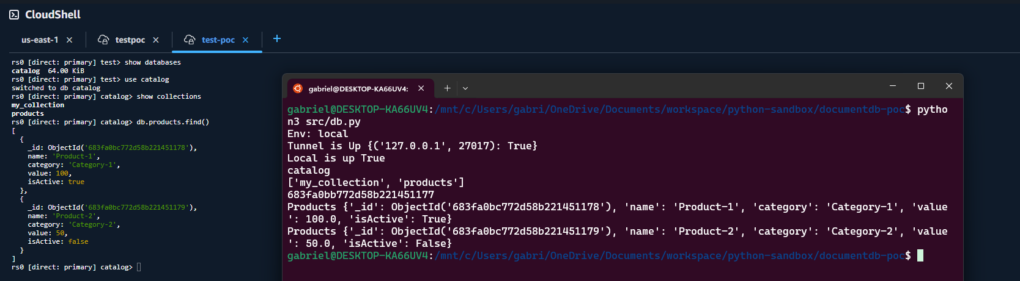


Tests
aws-document-db-poc

