Slide 1
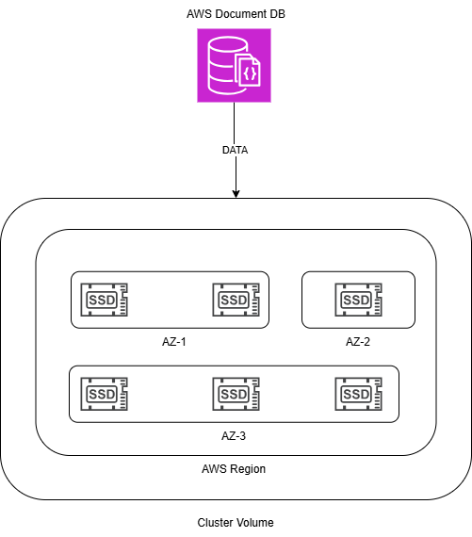
AWS DocumentDB

Slide 2
Core Components
🔸 Two Main Components:
🔸 Cluster Volume: Manages and stores data independently of compute instances
🔸 Instances:
🔸 Primary Instance: supports reads and writes
🔸 Replica Instances: support reads, up to 15 per cluster

Slide 3
Replication Process
🔸 Write to Primary Instance → durable write to Cluster Volume
🔸 State of write is asynchronously replicated to replicas
🔸 Read replicas do NOT participate in writes
🔸 Replication lag typically under 100 ms

Slide 4
Storage Architecture
🔸 Data stored in Cluster Volume:
🔸 Single virtual volume on SSD
🔸 6 copies of data across multiple Availability Zones (AZs)
🔸 Benefits:
🔸 High durability
🔸 Fault tolerance
🔸 High availability

Slide 5
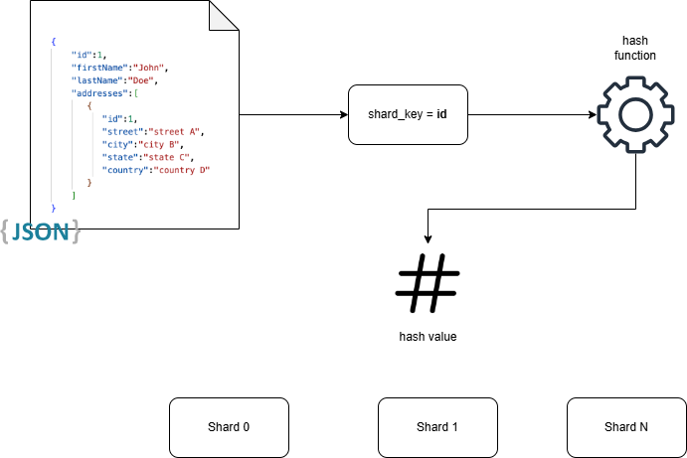
Sharding Overview
🔸 Elastic Cluster Sharding:
🔸 Hash-based partitioning
🔸 Distributes data across multiple shards based on shard key
🔸 Decouples compute from storage

Slide 6
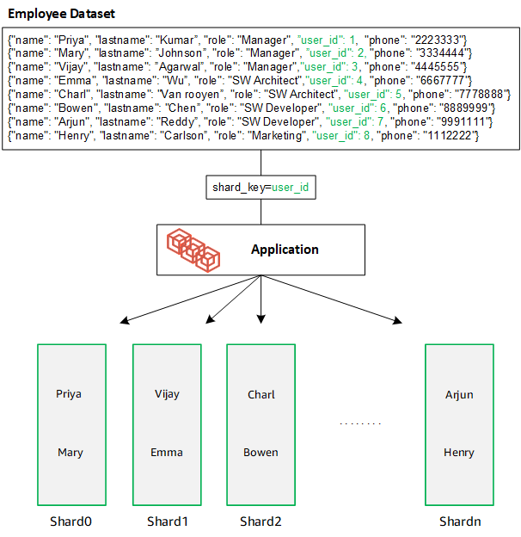
Shard Definitions
🔸 Shard: Compute unit in a cluster with a writer & replicas
🔸 Shard Key: JSON document field used for partitioning
🔸 Sharded Collection: Split collection distributed across shards
🔸 Partition: Logical subset of data within a shard

Slide 7
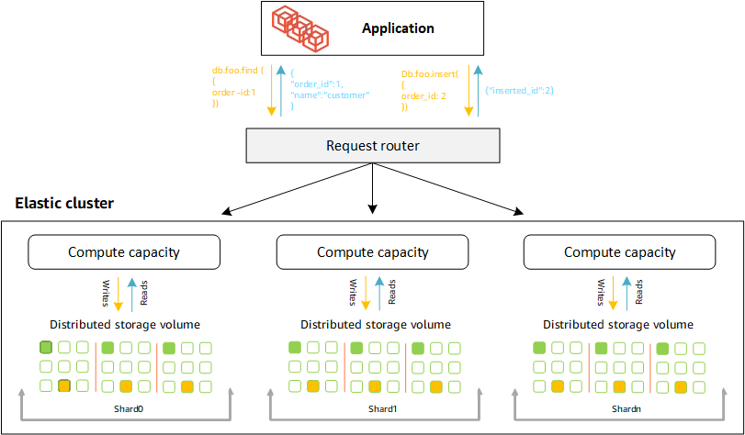
Sharding Example
🔸 Employee Dataset Example:
🔸 Data distributed by user_id using shard key
🔸 Visual example of how employees are distributed across shards

