Slide 1

Deterministic testing for applications with external APIs
Gabriel Passos
HOVERFLY / API SIMULATION FOR TESTING
01

Slide 2
External dependencies make tests unpredictable
Flaky by nature
Hard to reproduce
Limited edge cases
Network outages, rate limits,
latency and changing payloads.
A failure may depend on a third-party
service or a transient condition.
Success paths are easy; timeouts,
errors and unusual responses are harder.
Testing your code should not require the external service to be healthy every time.
Goal: control the dependency while keeping the HTTP interaction realistic.
HOVERFLY / API SIMULATION FOR TESTING
02

Slide 3
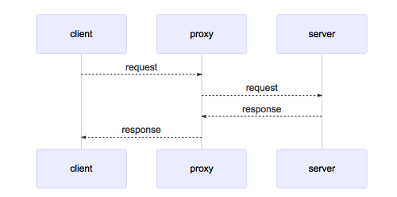
Hoverfly is a service-virtualization proxy
A lightweight, open-source tool for API simulation and HTTP traffic interception.
Test / app
Hoverfly
API
Real or simulated
HTTP client
Proxy + rules
Capture real request/response traffic
Replay saved simulations in tests
Match requests to stored responses
The test client makes ordinary HTTP calls.
Hoverfly is a controllable stand-in for an API dependency.
HOVERFLY / API SIMULATION FOR TESTING
03

Slide 4
Choose the mode for the testing question
CAPTURE
SIMULATE
MODIFY
Record real HTTP interactions into a reusable simulation.
Replay recorded interactions without calling the real API.
Pass traffic through and transform requests and/or responses via middleware.
SPY
SYNTHESIZE
DIFF
Simulate external API only if found a matching request
Create responses dynamically
Compare the real external API response vs the stored simulated and store the diff
HOVERFLY / API SIMULATION FOR TESTING
04

Slide 5
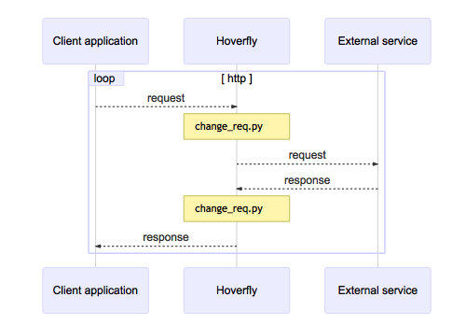
Modify Mode
HOVERFLY / API SIMULATION FOR TESTING
05

Slide 6
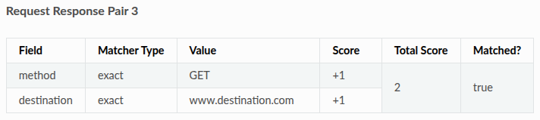
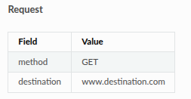
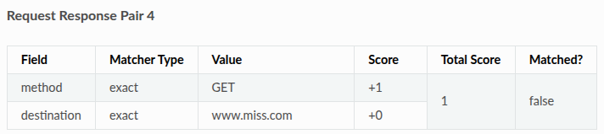
How Hoverfly selects a response
WINNER: PAIR 3
Both configured matchers succeed, giving it the higher score. Hoverfly returns Pair 3’s associated response.
HOVERFLY / API SIMULATION FOR TESTING
06

Slide 7
Where Hoverfly fits
Good fit
Integration or end-to-end tests with HTTP dependencies; repeatable regression cases; controlled failures and response variants.
Not a replacement for
All end-to-end tests use cases, contract test, or unit test where a local mock is sufficient.
HOVERFLY / API SIMULATION FOR TESTING
07

