Slide 1
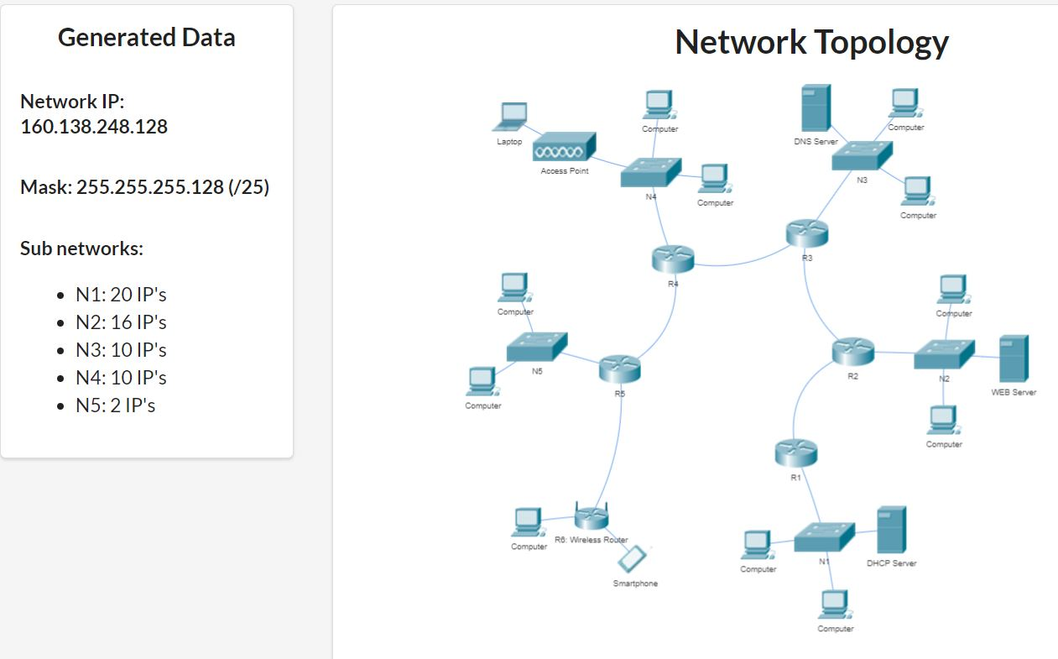

Slide 2
Adresa de retea: 160.138.248.128/25 Netmask: 255.255.255.128 128 IP-uri disponibile Adresa de inceput: 160.138.248.128 Adresa de final: 160.138.248.255
Adrese IP ramase:
160.138.248.228/30 -> Broadcast: 160.138.248.231 (4)
Retea | Nr IP-uri | Dimensiunea retelei | Adresa de retea de inceput | adresa de broadcast
N1 | 20 + 3 (adresa de retea, default gateway, broadcast) = 23 | 32 | 160.138.248.128/27 | 160.138.248.159
N2 | 16 + 3 = 19 | 32 | 160.138.248.160/27 | 160.138.248.191
N3 | 10 + 3 = 13 | 16 | 160.138.248.192/28 | 160.138.248.207
N4 | 10 + 3 = 13 | 16 | 160.138.248.240/28 | 160.138.248.255
N5 | 2 + 3 = 5 | 8 | 160.138.248.232/29 | 160.138.248.239
N12 | 4 (2+2) | 4 | 160.138.248.208/30 | 160.138.248.211
N23 | 4 (2+2) | 4 | 160.138.248.212/30 | 160.138.248.215
N34 | 4 (2+2) | 4 | 160.138.248.216/30 | 160.138.248.219
N45 | 4 (2+2) | 4 | 160.138.248.220/30 | 160.138.248.223
NWifiRouter | 4 | 4 | 160.138.248.224/30 | 160.138.248.227

