Slide 1
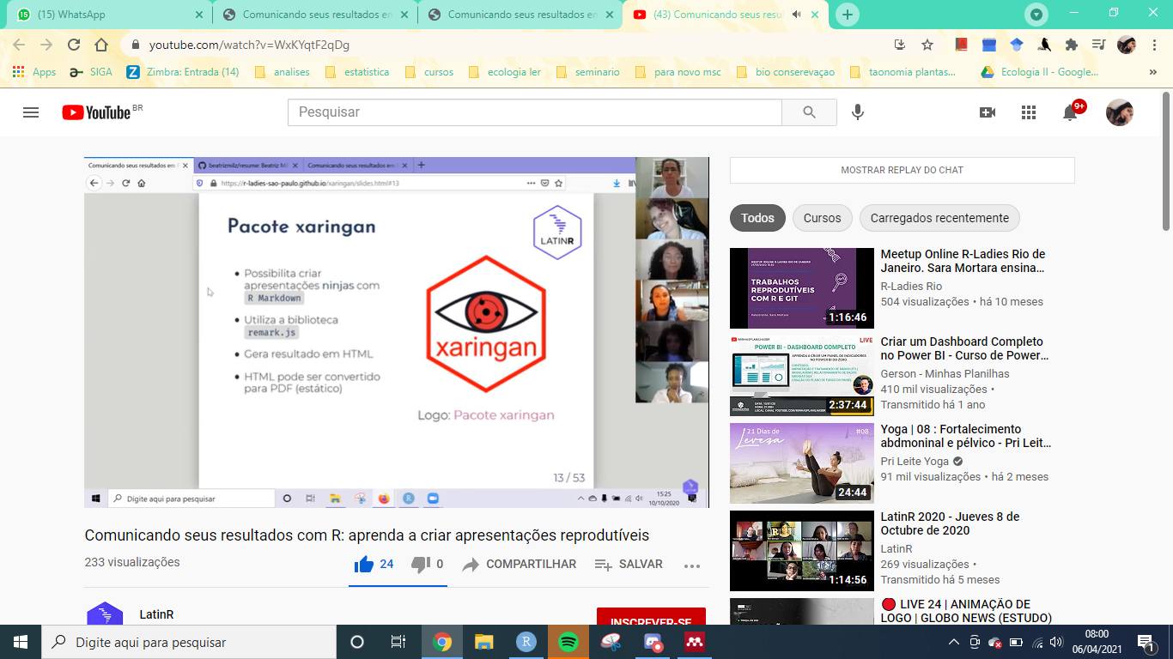

Slide 2
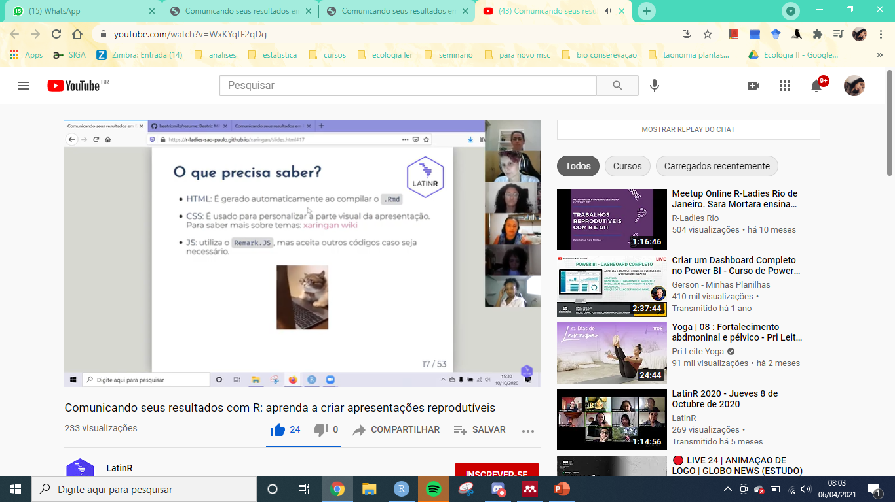

Slide 3
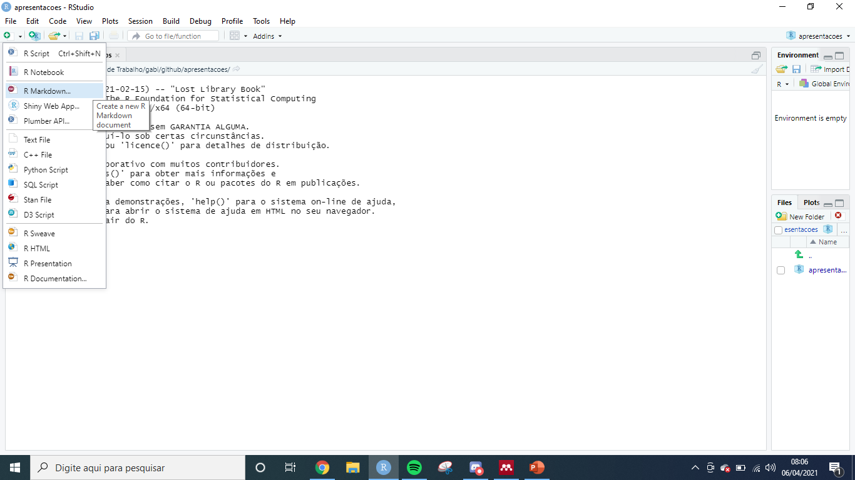

Slide 4
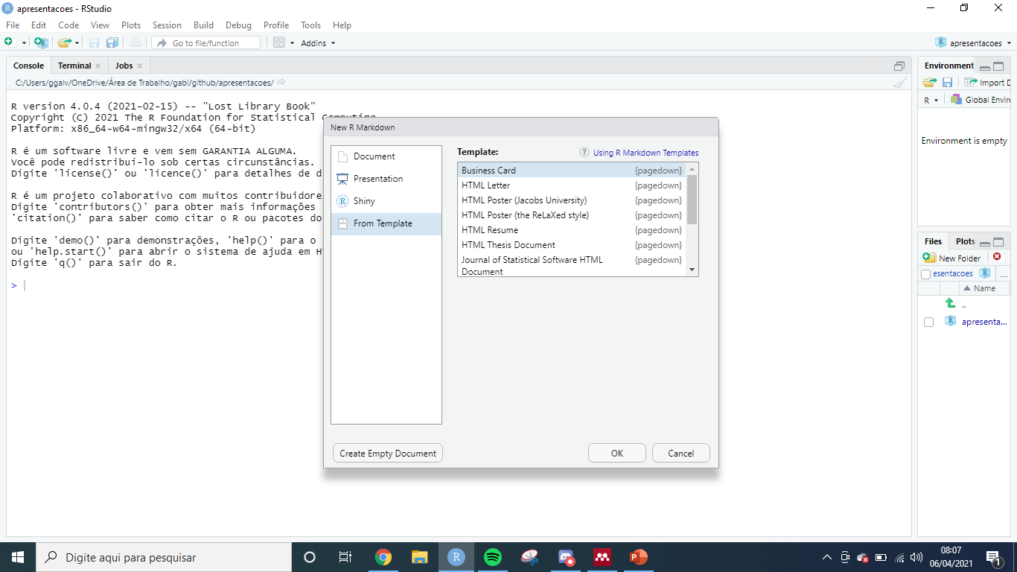

Slide 5
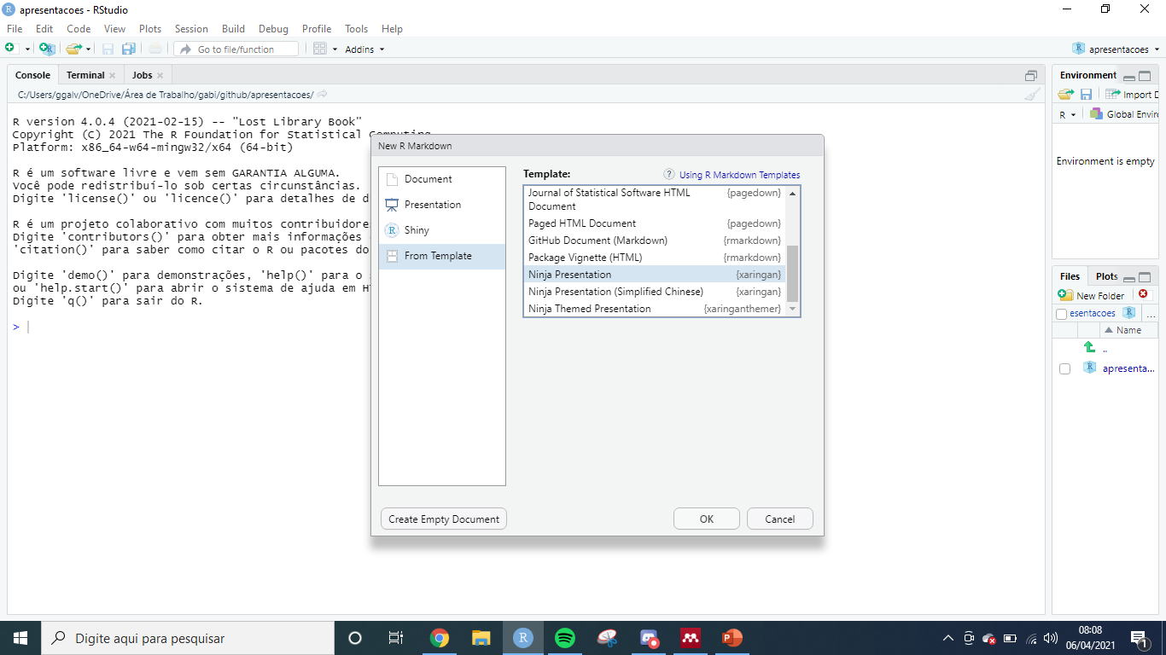

Slide 6
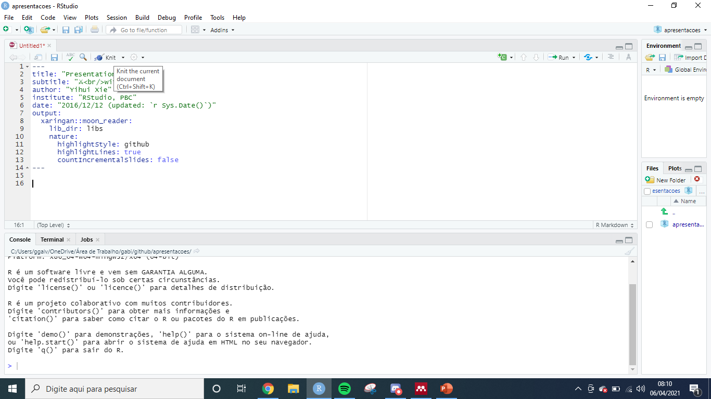

Slide 7
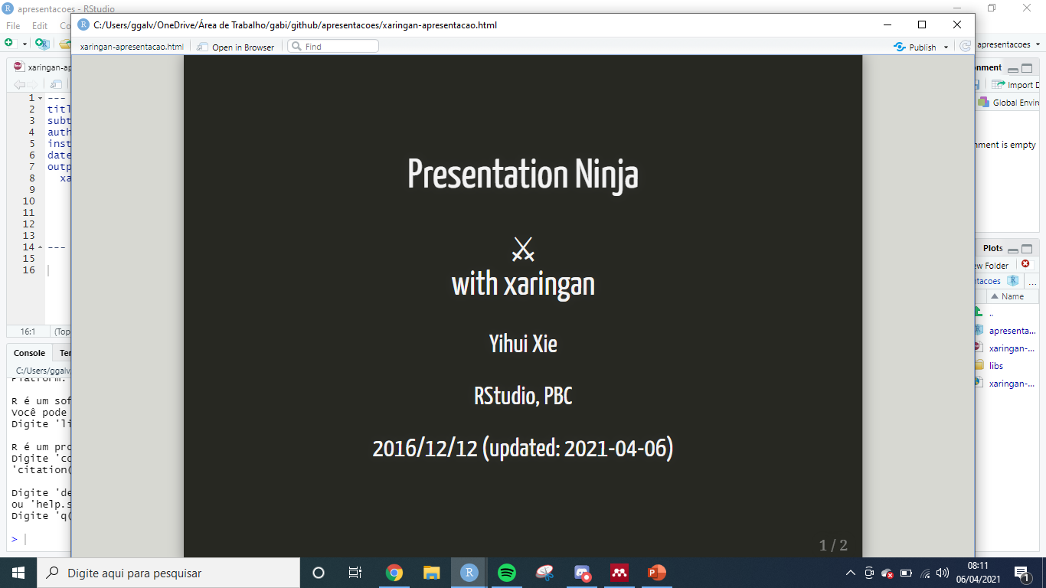

Slide 8
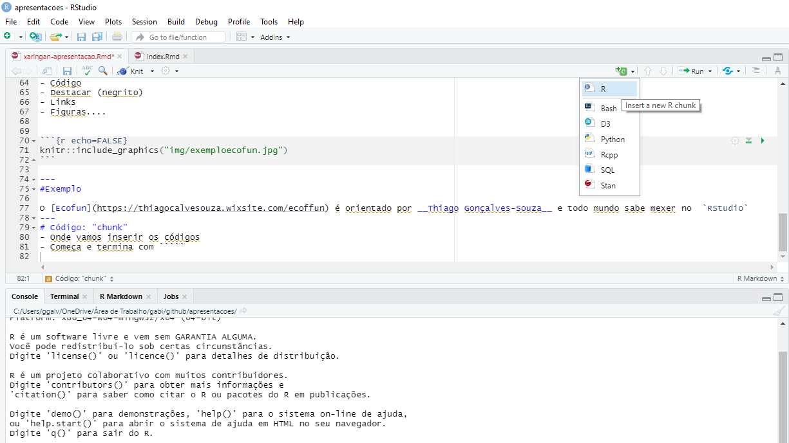

Slide 9
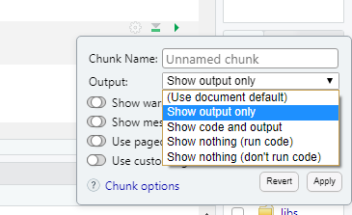

Slide 10
https://static.wixstatic.com/media/c30fdf_e5102b5c82b04745b754ade80ef11640~mv2.jpeg/v1/crop/x_0,y_8,w_581,h_606/fill/w_282,h_294,al_c,q_80,usm_0.66_1.00_0.01/WhatsApp%20Image%202019-10-07%20at%2018_06_08_jp.webp

Slide 11
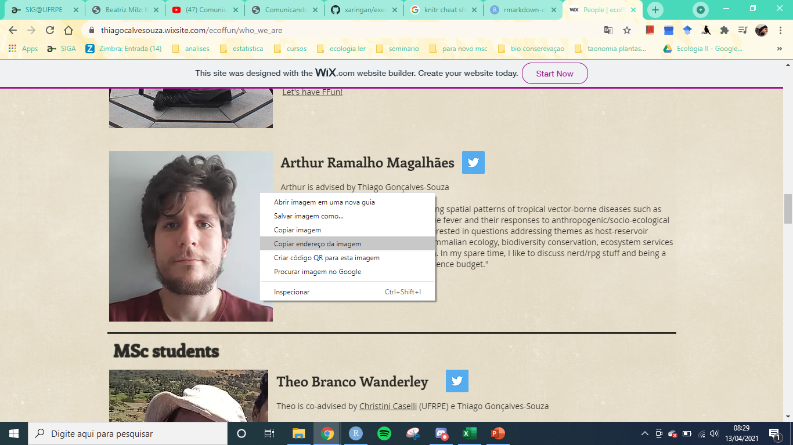

Slide 12
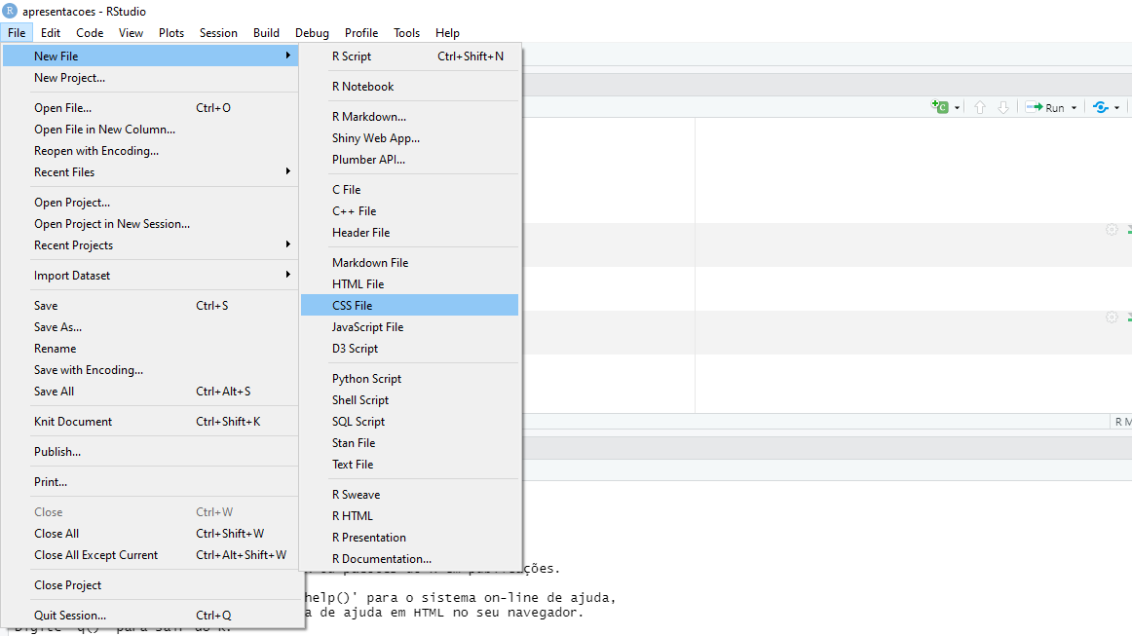

Slide 13
