Slide 1
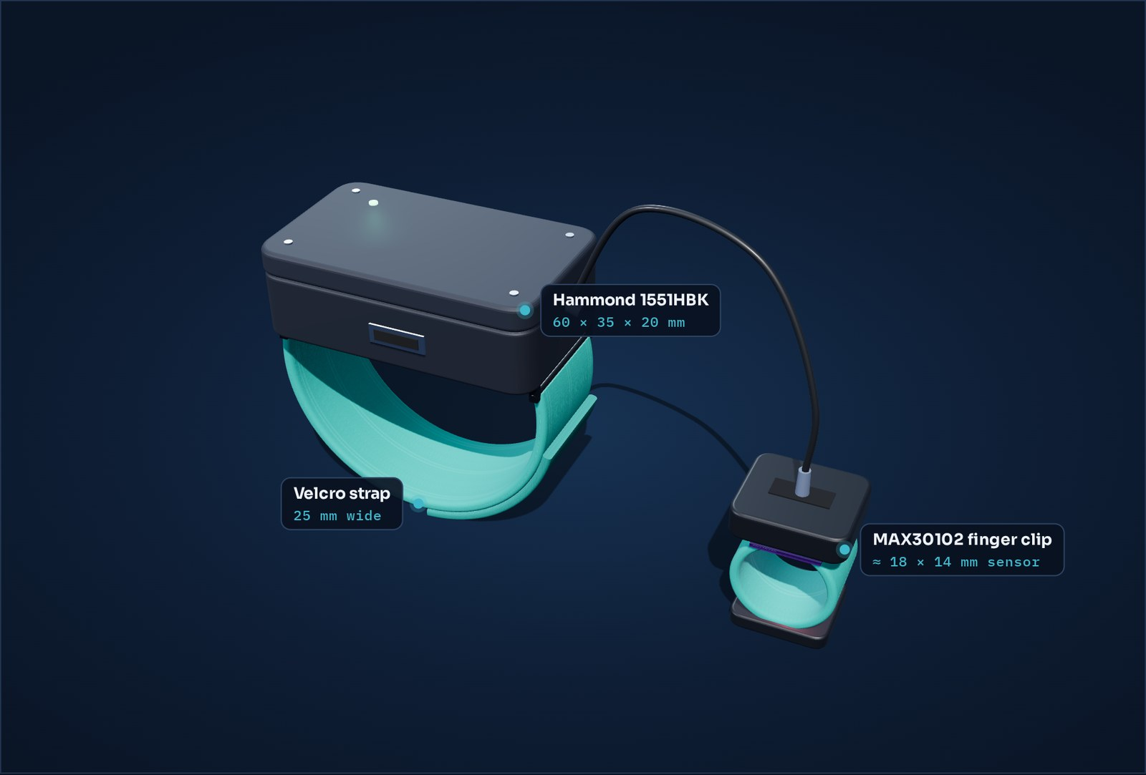
SCIENCE FAIR · HEALTH AND MEDICAL SCIENCES · EXPERIMENTAL PROJECT
Night Signal
A low-cost wearable that detects sleep apnea — and screens the heart and breathing too.
Gabriela Mamane · Grade ___
Educational prototype — not a medical device.
Notes:
[0:15] Hi, I'm Gabriela. My project is Night Signal: a wearable I designed that watches your blood oxygen while you sleep to catch sleep apnea — and it turns out the same sensor can screen the heart and breathing too.

Slide 2
PURPOSE & HYPOTHESIS
Can a ~$65 wearable catch sleep apnea?
Purpose Find out whether a low-cost wearable can detect the oxygen drops caused by sleep apnea accurately enough to estimate how many events happen per hour — the number doctors use (AHI).
Hypothesis If breathing pauses make blood oxygen dip, then a fingertip sensor read once per second will reveal those dips, and software can count them to sort a night into Normal, Mild, Moderate or Severe — because oxygen-rich and oxygen-poor blood absorb red and infrared light differently.
INDEPENDENT VARIABLES
DEPENDENT VARIABLES
CONTROLS
Breath-hold length (10 / 15 / 20 s) and sleeping position
Events detected, AHI score, agreement with a reference oximeter
Same finger, cuff tightness, room, firmware and detection settings
Notes:
[0:40] My question: can a wearable that costs about sixty-five dollars catch sleep apnea? My hypothesis: if each breathing pause makes oxygen dip, a fingertip sensor reading once per second will see the dips, and software can count them per hour — the AHI doctors use. What I change is breath-hold length and sleeping position; what I measure is events, the AHI, and how closely my device agrees with a real oximeter.

Slide 3
SCIENTIFIC BACKGROUND
Sleep apnea: breathing stops, oxygen drops
Obstructive sleep apnea: the airway collapses during sleep and breathing pauses for 10 seconds or more, many times a night.
≈ 936 million
Each pause lowers blood oxygen (a desaturation) and makes the heart speed up and slow down.
adults worldwide have obstructive sleep apnea — most don’t know it (Benjafield et al., 2019).
Pulse oximetry: red (660 nm) and infrared (880 nm) light shine through the fingertip; oxygen-rich blood absorbs them differently, giving SpO₂.
Doctors count events per hour of sleep: the Apnea–Hypopnea Index (AHI). A clinical sleep study costs thousands and needs a lab.
< 5
5–15
15–30
> 30
Normal · events/hour
Mild · events/hour
Moderate · events/hour
Severe · events/hour
Notes:
[0:50] Sleep apnea is when the airway collapses during sleep and breathing stops for ten seconds or more, over and over. About 936 million adults have it, and most don't know. Every pause drops blood oxygen. A pulse oximeter measures that by shining red and infrared light through the fingertip — oxygen-rich blood absorbs the two colours differently. Doctors count the events per hour — the AHI — and grade it from normal to severe. The problem: the standard test is an overnight lab study that costs thousands.

Slide 4
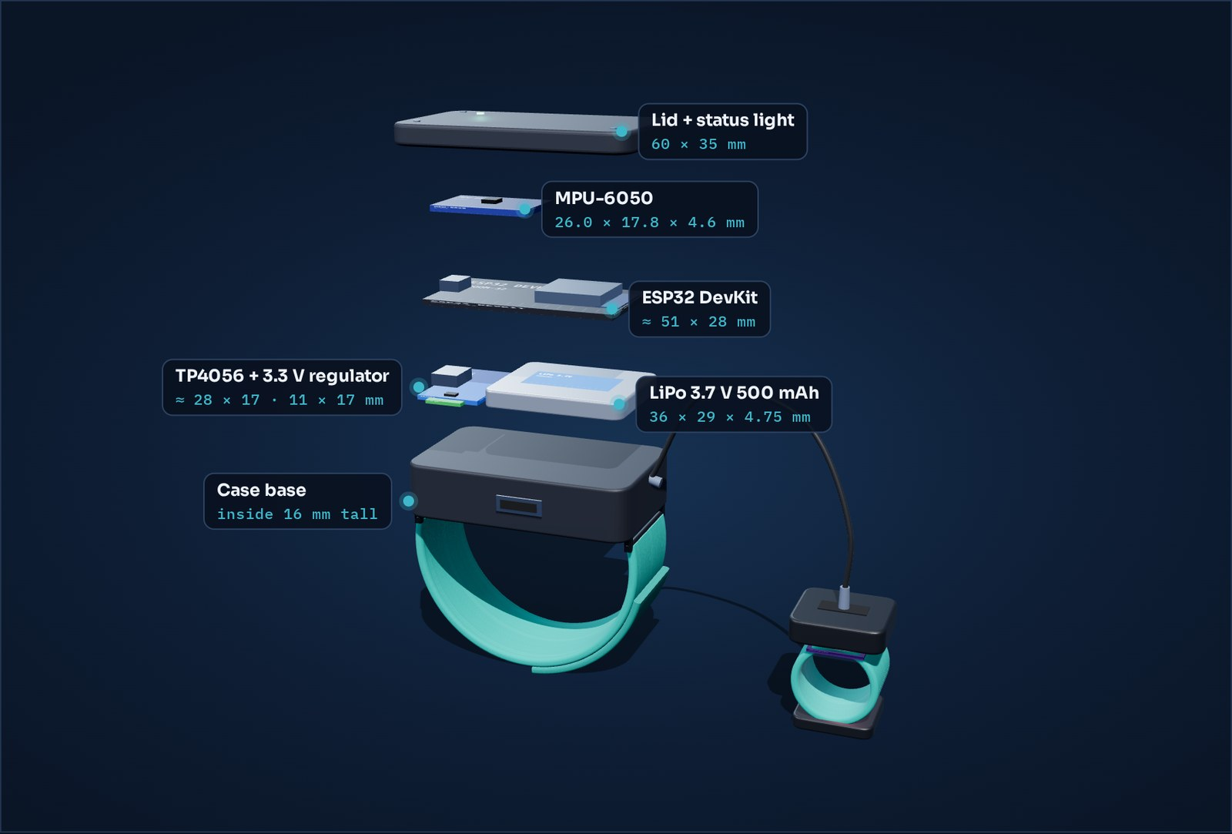

DESIGN PROTOTYPE
The wearable
Assembled — case on a velcro strap, cable to the finger clip
Exploded — every part at its real size
60 × 35 × 20 mm
25 mm
18 × 14 mm
1 / second
Interactive 3D →
sensor case
velcro strap
finger sensor
readings
Notes:
[0:40] Here's the design. A small case — a 60 by 35 millimetre Hammond box — rides on a velcro strap and holds the ESP32 processor, battery, charger and a motion sensor. A cable runs to a velcro finger clip with the MAX30102 oxygen sensor. On the right is the exploded view with every part at its real size; you can spin the interactive version with this QR code.

Slide 5
DESIGN PROTOTYPE · HOW IT WORKS
From fingertip to sleep report
Finger sensor
›
ESP32 in the case
›
Bluetooth / USB
›
App + analysis
MAX30102 · red + infrared light
computes SpO₂ + pulse, reads position
one line of data every second
events, AHI, heart, breathing
Built-in self-test — proves it’s working before every recording
$ python check_device.py --port COM5
[PASS] Data arriving 1 reading/s
[PASS] Self-test oxygen OK · motion OK
[PASS] Finger on sensor 100%
[PASS] Believable values SpO2 97–98%, HR 60–64
[PASS] Motion sensor 100% near 1 g
RESULT: READY — sending real data
Firmware re-checks both sensors every 30 s and reports it.
No finger → readings are marked invalid, never trusted.
The app shows the same checks live, every second.
A broken sensor is caught: “NOT READY”.
Notes:
[0:35] The data path: the finger sensor's light readings go to the ESP32, which calculates oxygen and pulse and reads body position, then sends one line per second over Bluetooth or USB to my app and analysis code. To make sure it's really working, I built a self-test: every recording starts with a device check that has to say READY — and when I tested with a broken motion sensor, it correctly said NOT READY.

Slide 6
EXPERIMENTAL PROTOCOL · KEY MANIPULATIONS
How I test it
1
Device check every session must pass check_device.py
SAFETY
Breath-holds only while awake and supervised — never asleep
2
Accuracy test awake, side-by-side with a store-bought oximeter every 2 min for 30 min
Stop at any dizziness
3
Detection test supervised, awake breath-holds of 10, 15 and 20 s — known events
Parent/guardian consent
Ethics committee form (human subject) submitted
4
Battery runtime test full charge → stream until it stops, 3 times
5
Recorded nights ≥ 5 nights; case on upper arm, clip on index finger
Notes:
[0:45] My key manipulations: one, a device check before every session. Two, an accuracy test — I wear my device and a store-bought oximeter at the same time and compare. Three, a detection test: supervised, awake breath-holds of 10, 15 and 20 seconds — I know exactly when they happened, so I can score my software. Four, a battery runtime test. Five, full recorded nights. Safety first: breath-holds only while awake and supervised, with consent and ethics approval.

Slide 7
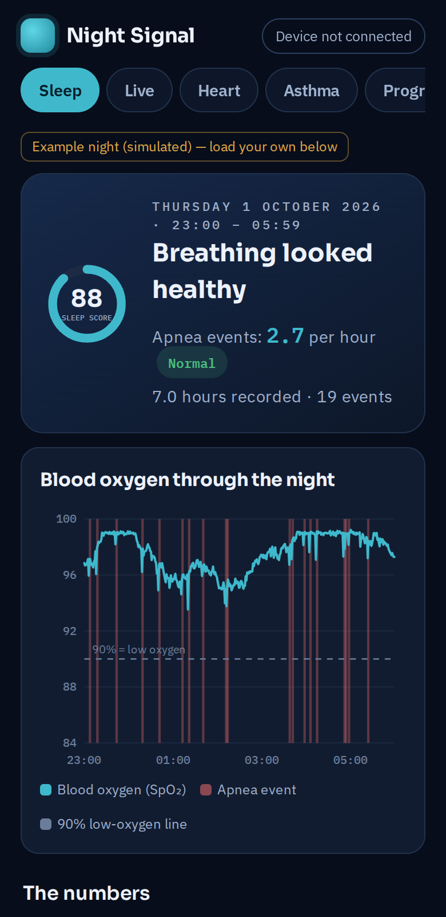
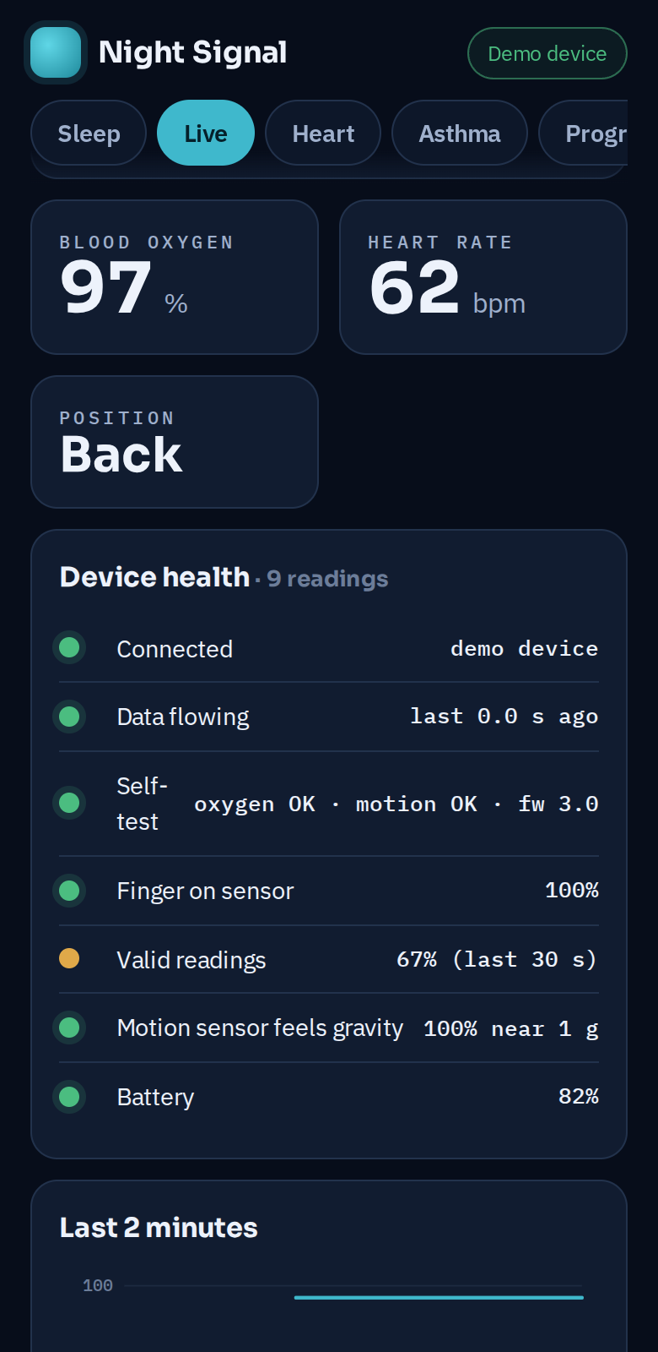

DESIGN PROTOTYPE · THE APP
The companion app measures real data
Live tab connects straight to the wearable (USB or Bluetooth) and shows oxygen, heart rate and position every second.
Device health checks run continuously — data flowing, self-test, finger on, battery.
Save a session → the same CSV the analysis uses, so every number is traceable.
Heart, Asthma and Progress tabs for the spin-offs and my build log.
Open the app →
Scan to try it (demo device built in).
Sleep report
Live + device health
Notes:
[0:35] This is my companion app. On the Live tab it connects directly to the wearable and shows oxygen, heart rate and position every second, with health checks running the whole time. Saving a session gives the exact CSV my analysis uses, so every number is traceable. Scan the code to try it — there's a demo device built in.

Slide 8
RESULTS · SUMMARY
EXAMPLE DATA
What one night showed
Measure | Result | Meaning
Recording | 7.0 h · 25,200 readings | a full night captured
Apnea events | 19 → AHI 2.7 / hour | Normal range (< 5)
Blood oxygen (avg / lowest) | 97.5 % / 84 % | lowest point during an event
Accuracy vs reference | ± 0.56 % (r = 0.88) | 210 paired readings
Events caught: rule / ML | 63 % / 63 % | precision 1.00 / 0.92
Sleep position | back 3.8 / h vs sides 1.1–1.3 / h | ≈ 3 × more events on the back
Spin-offs | 3 heart episodes · breathing 13 → 22 / min | patterns flagged correctly
Example data from my simulator — replaced with my own recorded nights before the final submission.
Notes:
[0:40] Here's the summary. Over a seven-hour night, the software found 19 events — an AHI of 2.7, which is in the normal range. Oxygen averaged 97.5% and dropped to 84% at the lowest. Against a reference oximeter, my device was within about half a percent. The detector caught 63% of known events with zero false alarms. And events were about three times more frequent on the back than on the sides.

Slide 9
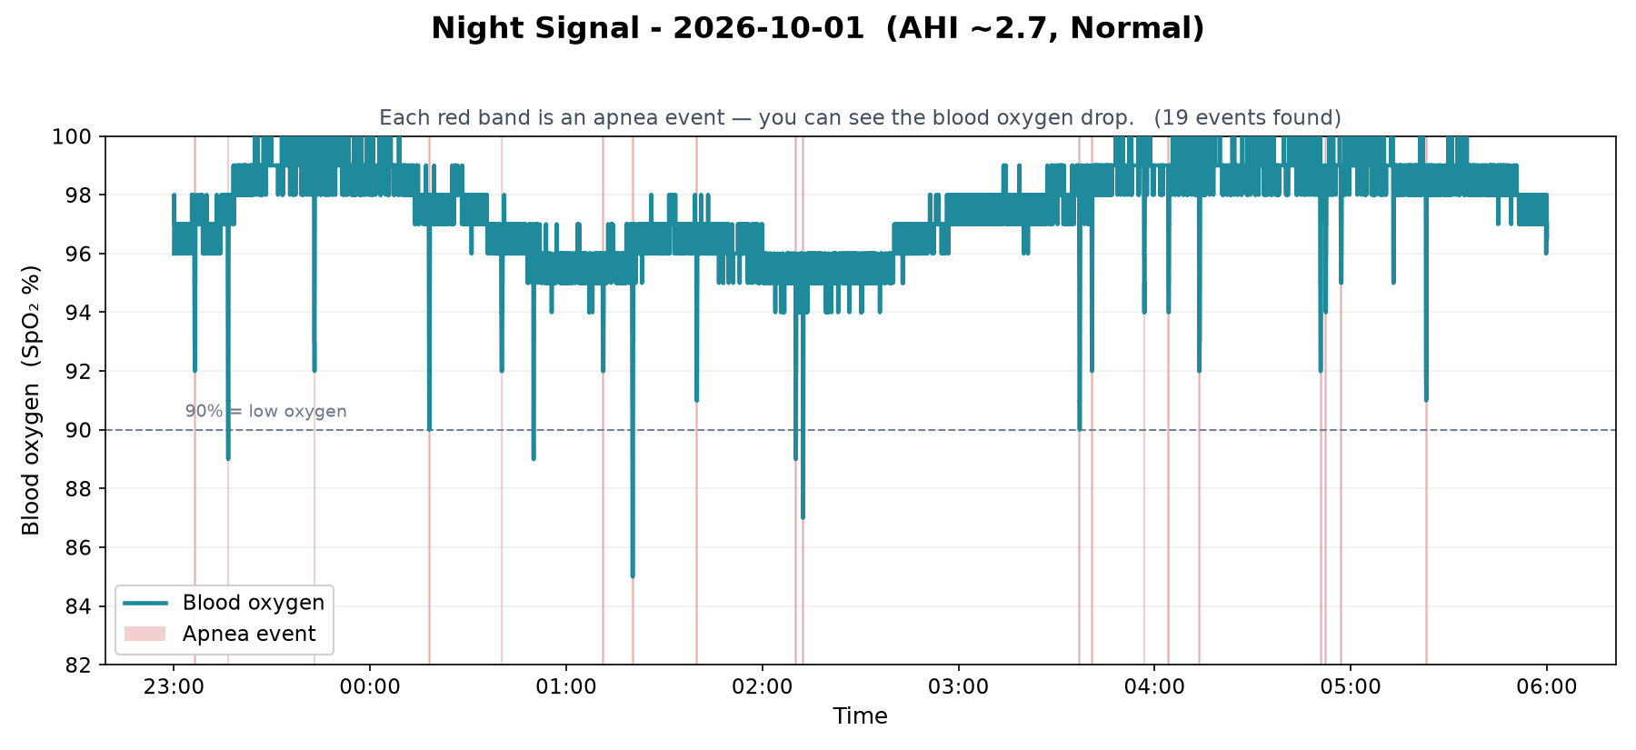
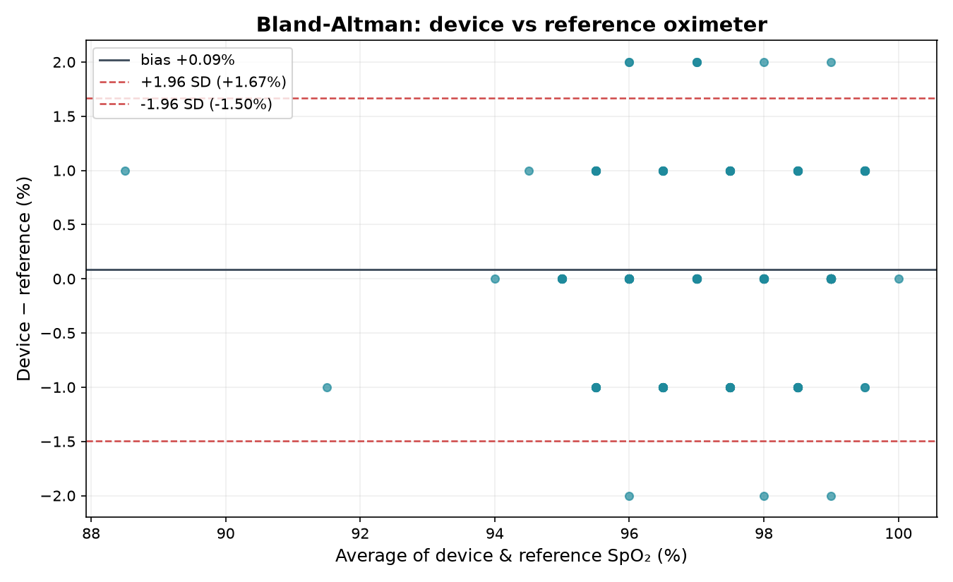
RESULTS · DETECTION AND ACCURACY
EXAMPLE DATA
Every dip found, and the readings agree
Bland–Altman: 95% of readings within −1.5 to +1.7 %
One night: each red band is an apnea event found automatically
Notes:
[0:35] On the left, a whole night of oxygen — every red band is an event my code found on its own. On the right is a Bland–Altman plot, the standard way medical papers compare two devices: the average difference is almost zero, and 95% of my readings fall within about one and a half percent of the reference.

Slide 10
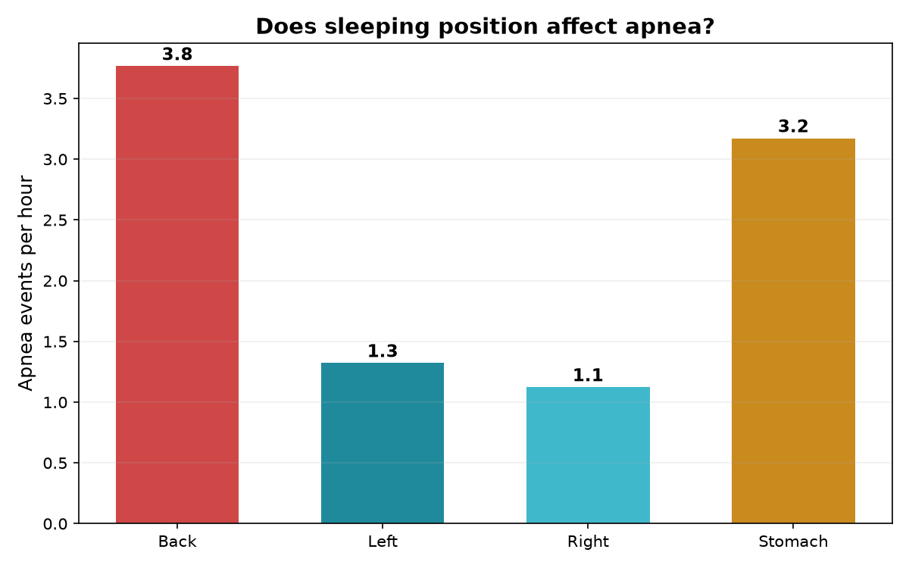
RESULTS · SLEEP POSITION AND MACHINE LEARNING
EXAMPLE DATA
Back-sleeping and two detectors
Apnea events per hour by position
Notes:
[0:30] Two more results. Events happened most on the back — 3.8 per hour versus about 1 on the sides. And I compared my simple rule with a machine-learning model: on new data, both caught the same share of events, but the rule had no false alarms, so for now the simpler method wins.

Slide 11
MAIN ANALYSIS · INTERPRETATION
What the results mean
Accurate enough to trust
Cautious, not over-eager
Agreement within about ±1.6 % is in line with commercial fingertip oximeters (about ±2–3 %), so the drops it sees are real, not sensor noise.
Perfect precision but 63 % recall means it misses shallow events — so my AHI is probably an under-estimate, the safe direction for a screening tool.
Position matters
More data beats fancier code
Three times more events on the back matches “positional” sleep apnea in the literature — a simple, free change (side-sleeping) could help.
Machine learning only tied the rule because it trained on one night; it needs many labeled nights to learn more than a rule.
Notes:
[0:45] What does it mean? First, accuracy within about one and a half percent is in the same range as store-bought oximeters, so the dips are real. Second, the detector is cautious — no false alarms but it misses shallow events, so my AHI is probably an underestimate, which is the safer mistake for a screening tool. Third, the back-sleeping result matches what doctors call positional sleep apnea. And fourth, machine learning didn't win yet because it only had one night to learn from — more data matters more than fancier code.

Slide 12
MAIN ANALYSIS · SOURCES OF ERROR
What could make it wrong
Measurement
Method
Finger movement, pressure and cold hands distort the light signal
Awake breath-holds aren’t the same as real obstructive apnea
Oxygen only — no airflow or brain-wave sensors like a lab study
4-second averaging window smooths very short dips
The reference oximeter itself is only ±2 %
One person, few nights: can’t generalize yet
Arm angle approximates body position
Results so far use simulated example data
Engineering finding: Bluetooth draws about 100 mA, so the 500 mAh battery lasts roughly 4–5 hours — not a full night. I added a battery runtime test, and full nights use a small USB power bank.
Notes:
[0:35] Sources of error: movement, finger pressure and cold hands can distort the light signal; the four-second averaging can blur very short dips; even the reference oximeter is only plus or minus two percent. On the method side, awake breath-holds aren't identical to real apnea, I only measure oxygen — not airflow or brain waves like a sleep lab — and one person isn't enough to generalize. I also caught an engineering problem: the battery only lasts four to five hours with Bluetooth, so I added a runtime test and use a power bank for full nights.

Slide 13
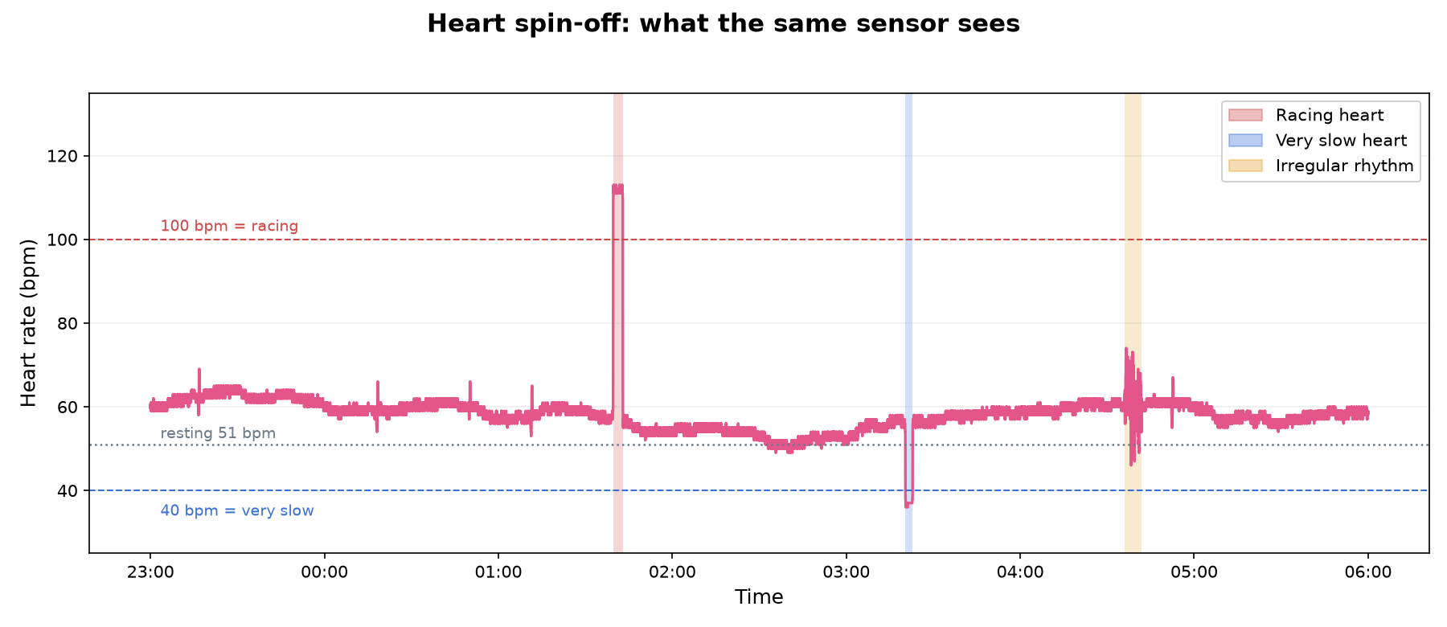
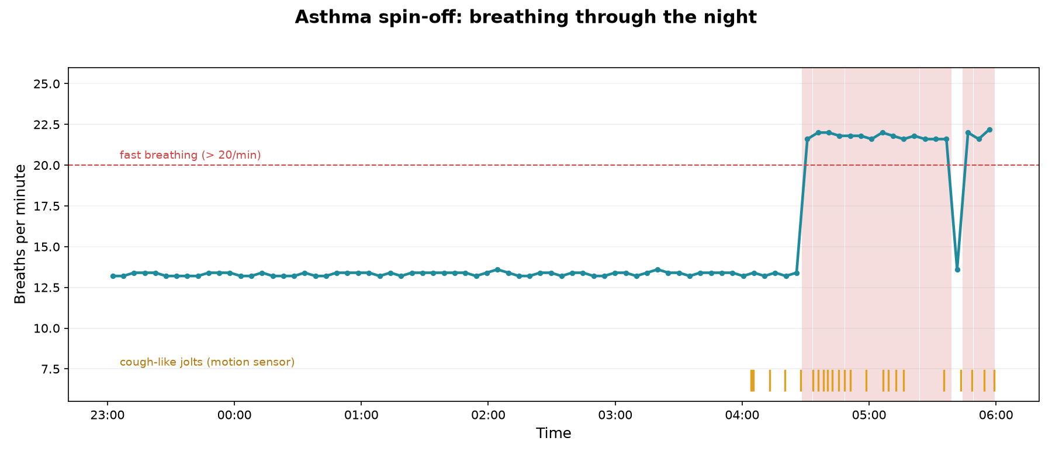
FURTHER CONSIDERATIONS · SPIN-OFFS
EXAMPLE DATA
Same sensor, two more uses
Heart flags racing (>100 bpm), very slow (<40 bpm) and irregular-rhythm episodes, plus resting heart rate and HRV.
Asthma tracks breathing rate from the heart’s rhythm and coughs from the motion sensor — catching early-morning worsening (13 → 22 breaths/min).
Screening ideas only — confirming an arrhythmia or asthma needs a doctor.
Notes:
[0:40] The same hardware opened two spin-offs. Heart: it flags racing, very slow and irregular-rhythm episodes. Asthma: night-time asthma often gets worse around 4 a.m., and my code tracks breathing rate from the heart's rhythm plus coughs from sudden jolts of the motion sensor — here it caught breathing climbing from 13 to 22 breaths a minute. These are screening ideas, not diagnoses.

Slide 14
CONCLUSION
Back to the hypothesis
Supported (so far). A low-cost wearable measured blood oxygen within about half a percent of a reference, found apnea events on its own, scored the night’s severity, and showed back-sleeping triples events.
Improvements
Record more people and many more nights
Add a nasal airflow sensor to separate apnea from hypopnea
Bigger battery or Bluetooth Low Energy for full nights
App
3D model
Shrink it into a finger-ring and compare with a real sleep lab
Thank you — questions?
Notes:
[0:35] Back to my hypothesis: so far it's supported — a low-cost wearable measured oxygen within about half a percent of a reference, found apnea events by itself, scored the night, and showed back-sleeping triples events. Next I'd test more people and nights, add an airflow sensor, fix the battery life, and shrink it into a ring to compare against a real sleep lab. Thank you — I'm happy to take questions.

Slide 15
APPENDIX A · MATERIALS
APPENDIX · NOT PRESENTED
Parts, exact sizes and where to buy
Part | Size | Purpose | Where | ≈ CAD
ESP32 DevKit (ESP-WROOM-32) | ≈ 51 × 28 mm | Processor + Bluetooth | Canada Robotix | $10
MAX30102 oxygen sensor | ≈ 18 × 14 mm | SpO₂ + pulse | X2 Robotics | ≈ $10
MPU-6050 (Adafruit 3886) | 26.0 × 17.8 × 4.6 mm | Position + coughs | Adafruit | ≈ $10
LiPo 3.7 V 500 mAh (Adafruit 1578) | 36 × 29 × 4.75 mm | Battery (≈ 4–5 h) | Adafruit | ≈ $12
TP4056 USB-C charger | ≈ 28 × 17 mm | Charges battery | Amazon.ca | ≈ $3
Pololu 3.3 V regulator S7V8F3 | 11 × 17 × 3 mm | Steady 3.3 V | Pololu | ≈ $8
Hammond 1551HBK case | 60 × 35 × 20 mm | Holds the boards | Hammond | ≈ $6
Velcro one-wrap strap | 25 mm × ≈ 250 mm | Arm strap + finger cuff | Amazon.ca | ≈ $5
2 × 100 kΩ resistors, wire | — | Battery level | Amazon.ca | ≈ $5
Fingertip pulse oximeter | — | Accuracy reference | Amazon.ca | ≈ $25
Total ≈ $65 for the wearable + ≈ $25 reference oximeter. Board sizes vary about ±2 mm between sellers — measure before assembling.
Notes:
[0:00] Appendix — not presented. Full parts list with exact dimensions, links and prices.

Slide 16
APPENDIX B · FULL PROTOCOL
APPENDIX · NOT PRESENTED
Full experimental protocol
1
Build: wire MAX30102 and MPU-6050 to the ESP32 (SDA→21, SCL→22, 3V3, GND); battery → TP4056 → 3.3 V regulator → ESP32 3V3; battery divider to GPIO 34. Flash firmware v3.
2
Device check: run check_device.py; record the result. Do not continue unless it says READY.
3
Battery runtime test: charge fully, stream with a finger on the sensor, record the time until data stops. Repeat 3 times; report the average.
4
Accuracy test: seated, awake, 30 min. Every 2 min write down the reference oximeter value with the time. Analyse with validate.py (Bland–Altman, r).
5
Detection test: supervised, awake; 5 breath-holds each of 10, 15 and 20 s, 2 min apart; log start/end times as ground-truth labels. Score with train_model.py.
6
Recorded nights: ≥ 5 nights; case on the upper arm, finger clip on the index finger; record.py logs all night; note bedtime and wake time.
7
Analysis: analyze.py, signals.py, position.py, heart.py, asthma.py on each night; rebuild the app and slides with build_app.py and build_deck.js.
8
Controls: same finger, cuff tightness, room temperature, firmware v3 and detection settings (3 % drop, 10 s, 120 s baseline).
Notes:
[0:00] Appendix — not presented. Step-by-step protocol including controls.

Slide 17
APPENDIX C · DESIGN PLANS
APPENDIX · NOT PRESENTED
Wiring and case layout
From | To (ESP32) | Notes
MAX30102 VIN / GND | 3V3 / GND | never 5 V
MAX30102 SDA / SCL | GPIO 21 / 22 | shared I²C bus
MPU-6050 VCC / GND | 3V3 / GND | address 0x68
MPU-6050 SDA / SCL | GPIO 21 / 22 | wired in parallel
Battery + / − | TP4056 B+ / B− | 500 mAh LiPo
TP4056 OUT+ / OUT− | Regulator VIN / GND | Pololu S7V8F3
Regulator VOUT | 3V3 | steady 3.3 V
Battery divider (2 × 100 kΩ) | GPIO 34 | battery %
Status LED | GPIO 2 | blinks each reading
Stack inside the 16 mm-tall case
Layer heights: battery 4.75 mm + ESP32 (no header pins) ≈ 5 mm + MPU-6050 4.6 mm ≈ 15 mm ≤ 16 mm inside height. With header pins soldered, use a case at least 30 mm deep.
Notes:
[0:00] Appendix — not presented. Wiring table and the internal layout with layer heights.

Slide 18
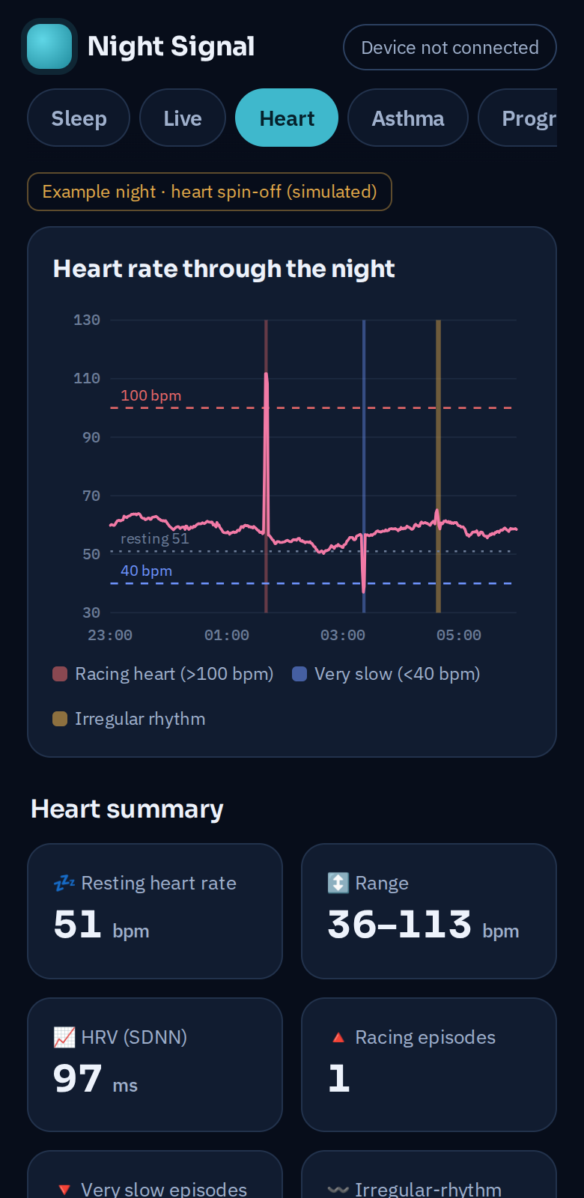
APPENDIX D · DATA AND ADDITIONAL PICTURES
APPENDIX · NOT PRESENTED
More data and pictures
Analysis | Result (example data)
Breathing rate (signals.py) | 13.5 breaths/min
HRV (SDNN / RMSSD) | 69 / 50 ms
Lowest heart rate | 46 bpm
Heart spin-off | racing 3.3 min (106–118 bpm) · slow 2.5 min (34–39) · irregular 5.9 min
Asthma spin-off | normal 13.4 → early morning 21.6 /min · 85 min fast · 24 cough-like jolts
ML model relies on | heart-rate swing and jitter, then oxygen swing
Device check (simulated device) | healthy → READY · broken motion sensor → NOT READY
All code, data tools and raw CSV format on GitHub →
Arduino setup guide →
App · heart tab
Notes:
[0:00] Appendix — not presented. Remaining numbers, app screenshot and links to all data and code.

Slide 19
BIBLIOGRAPHY · APA
APPENDIX · NOT PRESENTED
References
American Academy of Sleep Medicine. (2014). International classification of sleep disorders (3rd ed.).
Benjafield, A. V., et al. (2019). Estimation of the global prevalence and burden of obstructive sleep apnoea: A literature-based analysis. The Lancet Respiratory Medicine, 7(8), 687–698.
Berry, R. B., et al. (2012). Rules for scoring respiratory events in sleep. Journal of Clinical Sleep Medicine, 8(5), 597–619.
Bland, J. M., & Altman, D. G. (1986). Statistical methods for assessing agreement between two methods of clinical measurement. The Lancet, 327(8476), 307–310.
Global Initiative for Asthma. (2024). Global strategy for asthma management and prevention.
Jubran, A. (2015). Pulse oximetry. Critical Care, 19, 272.
Maxim Integrated. (2020). MAX30102 high-sensitivity pulse oximeter and heart-rate sensor [Datasheet].
Task Force of the European Society of Cardiology and NASPE. (1996). Heart rate variability: Standards of measurement, physiological interpretation, and clinical use. Circulation, 93(5), 1043–1065.
Notes:
[0:00] Appendix — not presented. References in APA style.

