Slide 1
NIGHT SIGNAL · SCIENCE FAIR PROJECT
A $35 wearable that catches sleep apnea.
It records blood oxygen, heart rate and body position all night — then finds the moments when breathing stops.
Fingertip sensors
›
ESP32
›
Your laptop
MAX30102 + MPU-6050
streams over Bluetooth
records + analyzes
Educational prototype — not a medical device.
Notes:
Night Signal is a low-cost wearable that detects sleep apnea. Sensors on the fingertip feed an ESP32, which streams the data over Bluetooth to a laptop that records and analyzes it.

Slide 2
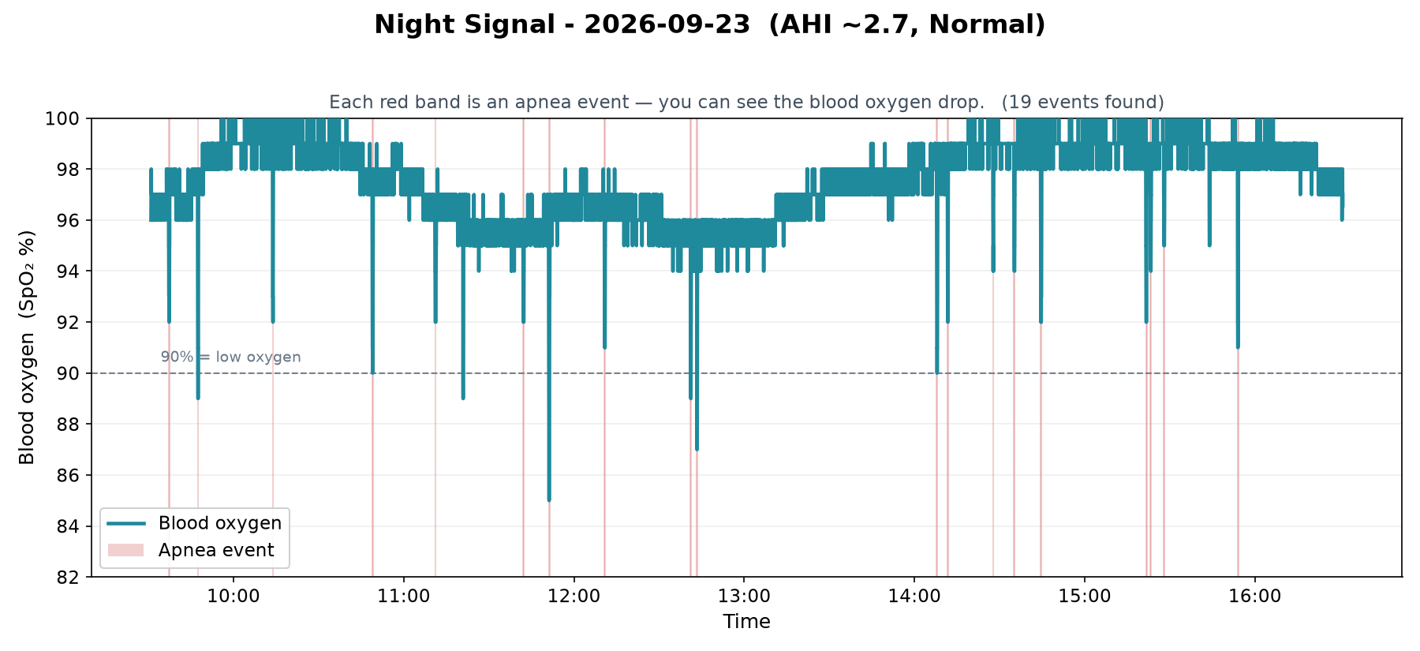
HOW IT WORKS
Apnea makes oxygen drop — we catch every drop.
1
Breathing pauses
During apnea the airway closes and breathing stops for 10+ seconds.
2
Blood oxygen dips
Each pause starves the blood of oxygen — a “desaturation.”
3
Software scores it
It counts the dips per hour (an AHI score) and rates severity.
Each red band is an apnea event the software caught automatically.
Notes:
Apnea pauses breathing, which drops blood oxygen. Our software finds each drop, counts them per hour to get an AHI score, and rates severity. The red bands on the chart are the events it flagged.

Slide 3
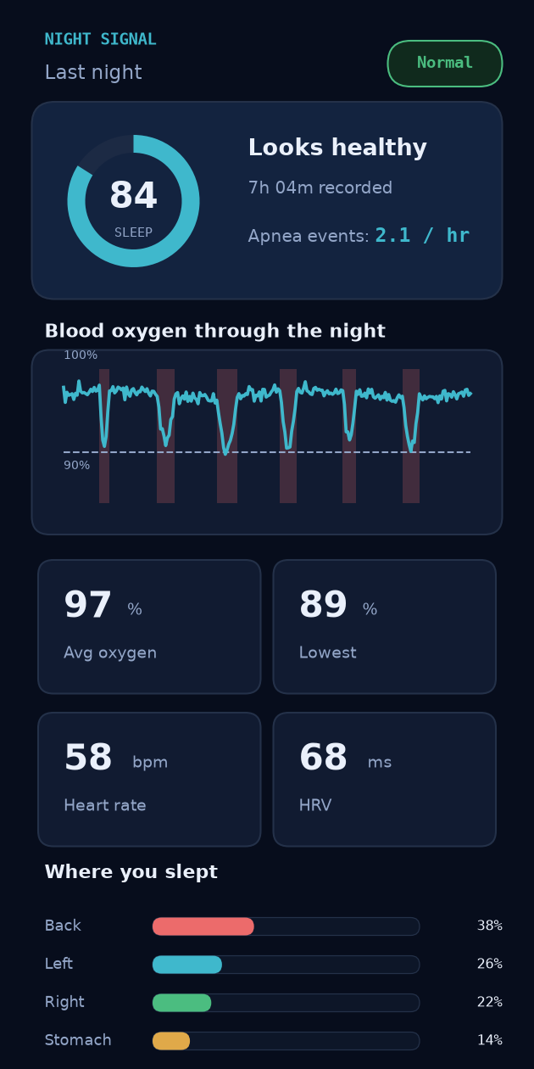
THE COMPANION APP
Your whole night, in your pocket.
Sleep score at a glance
One number sums up how the night went.
Oxygen + apnea events
The full night's SpO₂, with every event in red.
Heart rate, breathing, position
All the signals the wearable captured, in plain cards.
Record overnight → open the app in the morning → see your sleep report.
Notes:
The companion app turns the raw data into a friendly sleep report: a sleep score, the night's oxygen graph with apnea events marked, and cards for heart rate, breathing and sleep position. Record overnight, open the app in the morning.

Slide 4
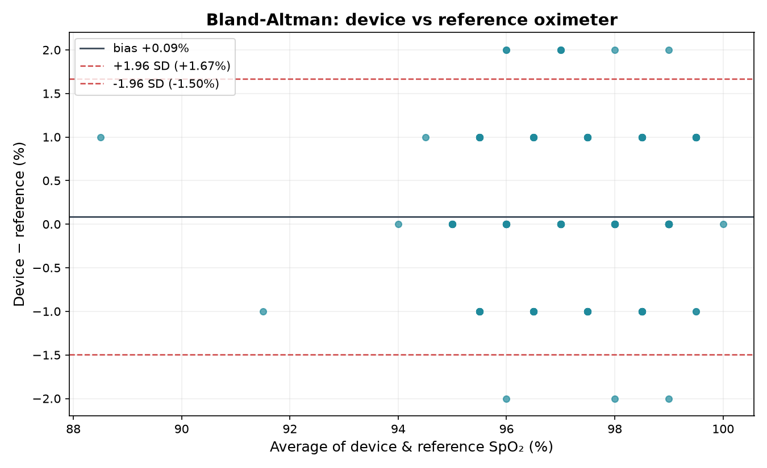
TESTED IN CODE
We proved it works.
±0.5%
r = 0.89
accuracy vs a medical
reference oximeter
the two devices rise
and fall together
82%
4
of events caught by our
machine-learning model
analyses, all tested
end-to-end in code
Low-cost. Validated. Ready to screen for sleep apnea.
Notes:
We validated the device against a reference oximeter (within about half a percent, correlation 0.89), built a machine-learning detector that catches 82% of events, and tested all four analyses in code. The Bland-Altman plot is the standard medical way to show two devices agree.

