Slide 1


Geo Cinema
Presented by:
Alex Monteiro
Gabriela Menocal
Jamel Phillips
Jon Campbell

Slide 2


Motivation
Finding out which country any given movie was made in and giving a brief description of that movie, along with the poster so you know that its the exact same movie, as there are many duplicate titles that are only slightly different. For example there’s a movie “Matrix” which is not at all the same a “The Matrix”.

Slide 3

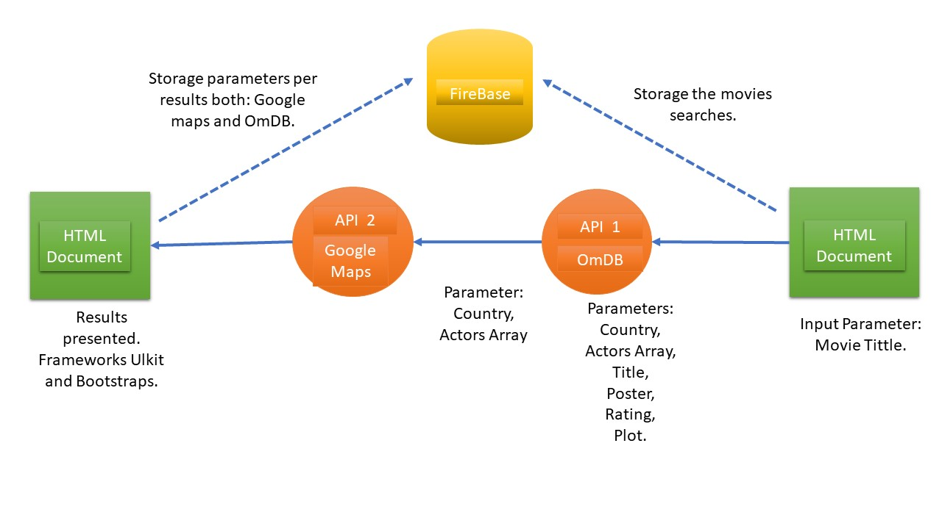
Geo Cinema is a movie search web application which return information about the movie and will let the user identify where the movie was made.
The parameters to be returned are:
The searched movies Poster.
Country it was made.
Year of release.
Plot summary.
Country’s Map.
Pre-Design

Slide 4




Technologies and Implementation
User’s Input
HTML
Country
Error Message2
Year of release
No
Yes
Is there map info?
Movie Exist?
Movie’s poster
Yes
No
Plot Summary
Country’s Coordinates
Error Message1
Movie’s Title
HTML

Slide 5

Individual Responsibilities.
Front End
Jameel
(HTML & CSS)
Jon
(HTML & API)
Back End
Gaby
(Google’s API & API’s coding merged)
Alex
(Firebase)

Slide 6


Geo Cinema:
https://gabrielamenocal.github.io/GeoCoding/
Firebase:
https://console.firebase.google.com/u/0/project/group-project-cinema/database/group-project-cinema/data

Slide 7



Merging branches and dealing with conflicts in the code.
Getting variables from the API's and storing them in firebase.
Locating cities in countries.
Looking for the co-ordinates for the google maps API.

Slide 8

Front End | Back End
Add Favorites. | Store favorites in FireBase.
Search by Country and Actors. | Add API or create one (if there’s any) to get Country’s coordinate and passing them to Google Maps’s API.
Create the favorite Section in HTM by category (e.g actors, movie and countries) | Support searches for more than one language.
Ad the fields in order to shown the information storage within the database. | Return the Storaged information in the HTML in the fields created for.

Slide 9


