Slide 1
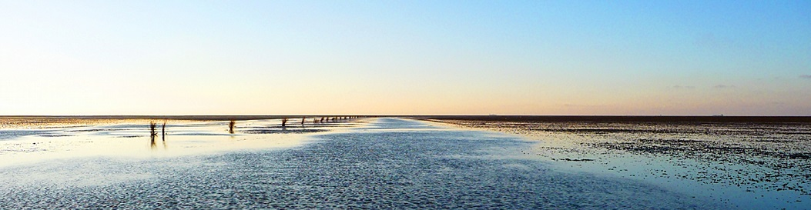
Imaging Changes in Sea Surface Temperature
1993-2010
Θ Gabriela Maldonado Θ Iris Bontekoe Θ

Slide 2

Climate change
Goal
Human induced warming of the world's oceans since the mid-1800's.
Fate of the energy trapped by greenhouse gas emissions from human activities
Human activities are releasing nearly 10 Gegatons of Carbon
Water has a high heat capacity
The ocean is deep
The ocean is dynamic
The Shell
Results

Slide 3
Indicator: Sea Surface Temperature
Goal
→The average temperature of water at the surface of the ocean
→Key factor of ocean’s health
Oceans absorb more heat from the warming atmosphere
sea surface temperatures will increase
ocean circulation patterns that transport water around the globe will change
The Shell
Results

Slide 4
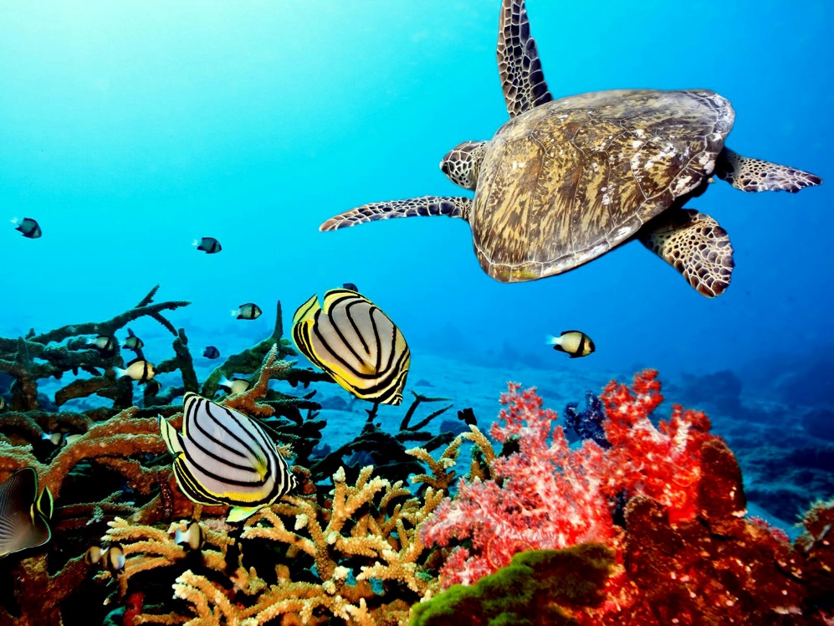
Effects of high SST
Goal
Increase in destructive potential of tropical cyclones and hurricanes
Alteration of Marine life
Loss of habitat
Temperature stress
Changes in host pathogen associations
Coastlines
The Shell
Results

Slide 5
How has SST changed over the years?
Goal
SDS
The Shell
Results

Slide 6
Pipeline & Workflow
Goal
https://github.com/gabrielamg24/SST
R
Python
Image
Magick
The Shell
The Shell
Results

Slide 7
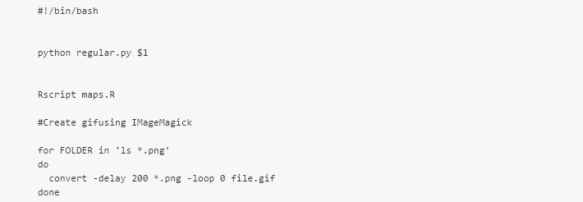
The Shell
Goal
The Shell
Results

Slide 8
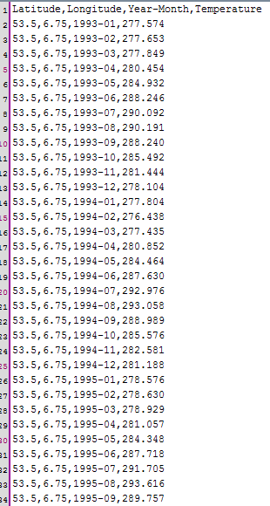
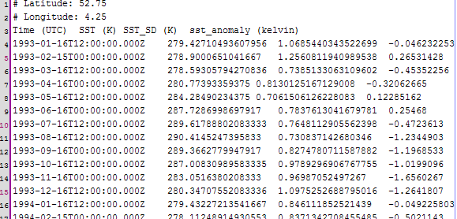
Data Set
Goal
70 files and >15,000 data points
The Shell
Results

Slide 9
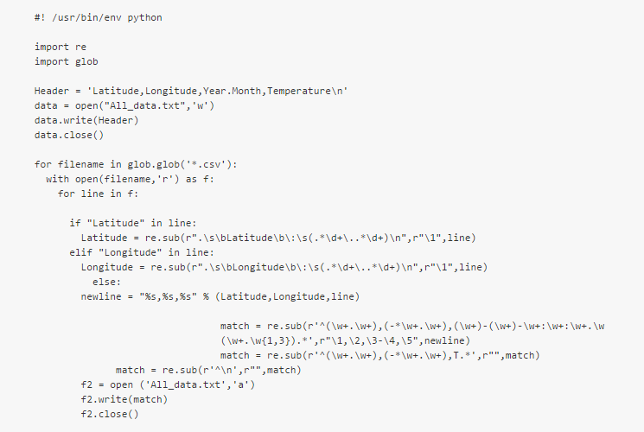
Python
Goal
The Shell
Results

Slide 10
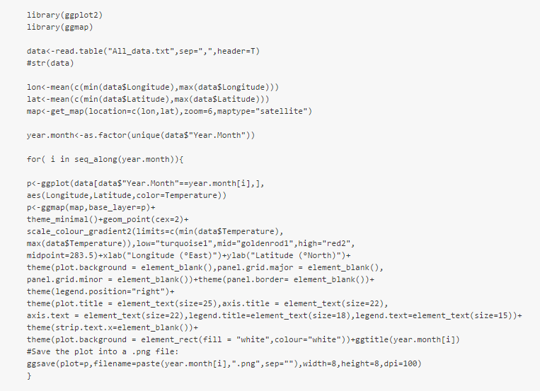
R
Goal
The Shell
Results

Slide 11
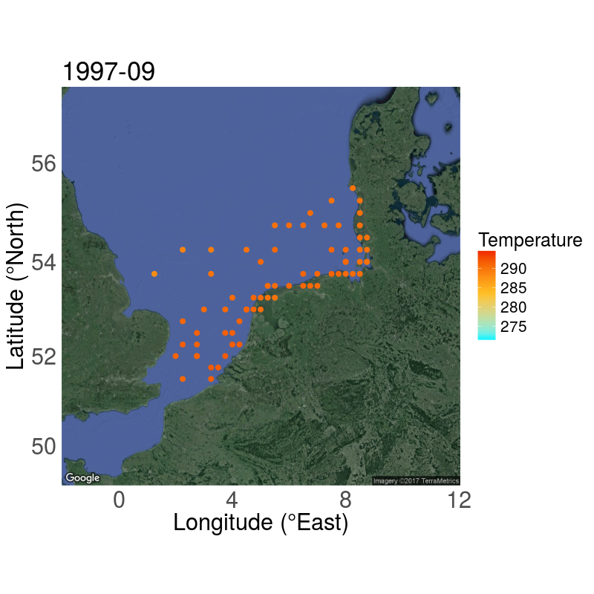
Maps
Goal
The Shell
Results

Slide 12
Discussion & Conclusion
Goal
Clear differences seen across maps
Within years
Powerful tool to analyze big data sets
Coordinates
Parameter
Dates
The Shell
Results

