Slide 1
Changes in sea surface temperature in the Wadden Sea
Iris Bontekoe S2361558
Gabriela Maldonado García S3168190

Slide 2
Workflow
Retrieving data from ESA
Arrange data
Writing R script
Extend Python program
Results + README
Saturday
Sunday
Monday
Tuesday
Wednesday

Slide 3
Retrieving data from ESA
Write a program on Python/Shell that goes into the website and extracts the data files
Per year
Per coordinates (← find a way to automatically generate the list of coordinates within a range)
Join files together and use a text editor to create the regular expressions to put information in a useful format
In Jedit/Gedit
In Python
Arrange data

Slide 4
Writing R script
From the data file creating a map with temperature based colors
Run the program
Call the R script and the file
Get the maps + a .gif
Analysis of Results + CODE + README + comments
Extend Python program
Results + README

Slide 5
Timetable
Saturday | Sunday | Monday | Tuesday | Wednesday
Acquire data (SST throughout the years ) | Arrange data Gedit/Jedit | Write R script for analysis of data (MARMAP/maps) | Extending python program for data analysis using R script | Analyse results from graphs
Writing a program to extract data from ESA website | Transferring the regular expressions to Python | Try running some data | Run it in the files | Arrange code, README and comments
 |  |  |  | Create presentation

Slide 6
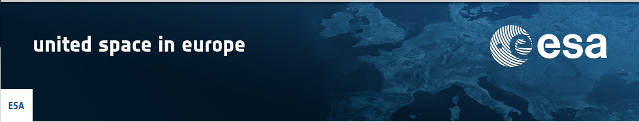
Data Set
→ Centre for Environmental Data Archival
→ Sea Surface Temperature Climate Change Initiative (ESA SST CCI)
→dataset accurately maps the surface temperature of the global oceans over the period 1991 to 2010, using observations from many satellites
→quality suitable for climate research

Slide 7
Ideas…
Let user decide year range
Create gif
Time left
Graphs
Red color if species die above certain temperature

Slide 8
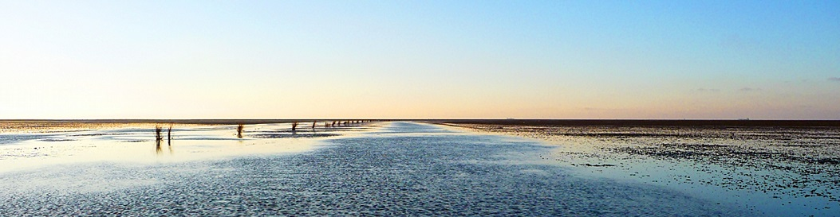
Changes in Sea Surface Temperature in the Wadden Sea
1993-2010
Θ Gabriela Maldonado Θ Iris Bontekoe Θ

