Slide 1

Pens and Printers
Sales Analysis
Practical Exam DA601P
Presented by: Gabriel Angelo
Date: 16/10/2024

Slide 2
OBJECTIVES
1
2
3
Evaluate sales
methods
efficiency
Define a metric
for the business
to monitor
Recommend
data-driven
strategies
Business goals: The business should aim to identify the sales strategy that yields the highest revenue with the least amount of effort from the team. This ensures that resources are allocated efficiently, avoiding excessive time spent on strategies with low returns.

Slide 3
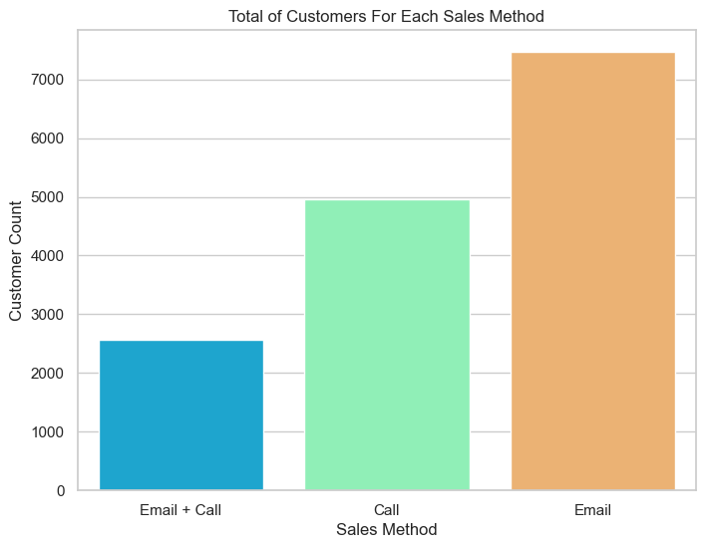
Sales Methods
Email: 7465 customers, 50% of the total
Call: 4961 customers, 33% of the total
Email + Call: 2572 customers, 17% of the total

Slide 4
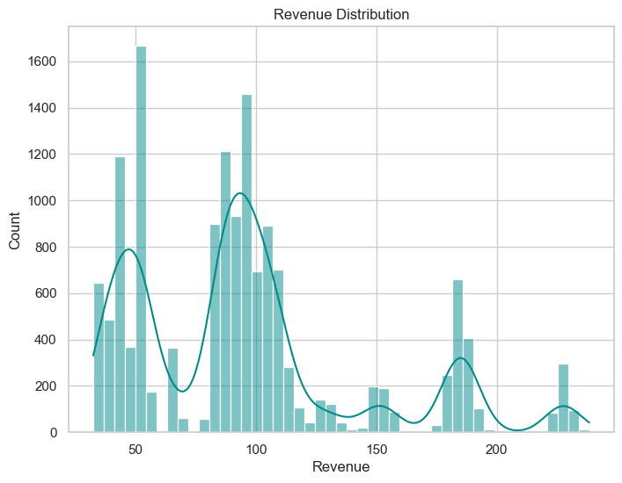
Revenue Spread
Most sales are concentrated between 52 and 107 of revenue
Distribution: Right-skewed
Range : 32.54 to 238.32
Mean: 95.56
Median: 90.95

Slide 5
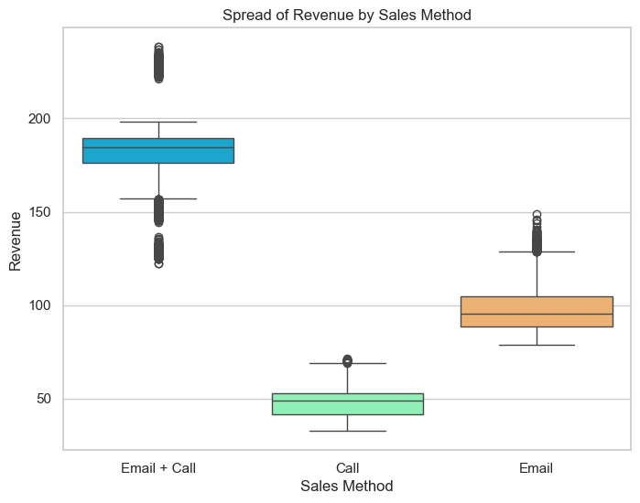
Revenue Spread(cont..)
Email: ranges from 78 to 148, concentrated between 88 and 104
Call: ranges from 32 to 71, concentrated between 41 and 52
Email + Call: ranges from 122 to 238, concentrated between 176 and 189

Slide 6
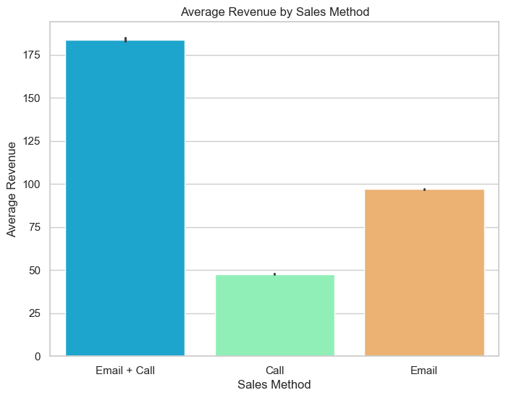
Average Revenue
Email: Average of 97
Total revenue: 724216
Call: Average of 47
Total revenue: 236391
Email + Call: Average of 183
Total revenue: 472730
Email is the method with the most customers and the highest total revenue, however, the Email + Call method has the highest average revenue. Meanwhile, the Call method has the lowest average and total revenue of all.

Slide 7
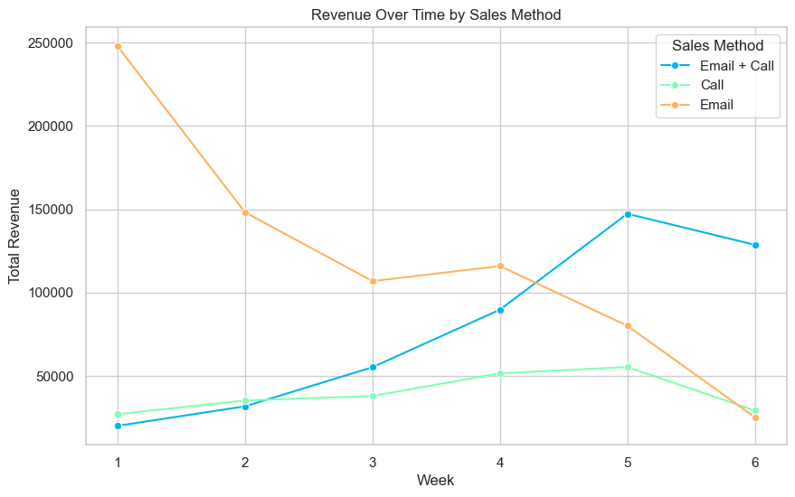
Revenue Trend Over Time
Email: had an average decrease
in growth of 31.8%
Call: had an average increase in growth of 6.8%
Email + Call: average increase in growth of 49.3%
The Email + Call method had the highest growth of all methods throughout the 6 weeks.

Slide 8
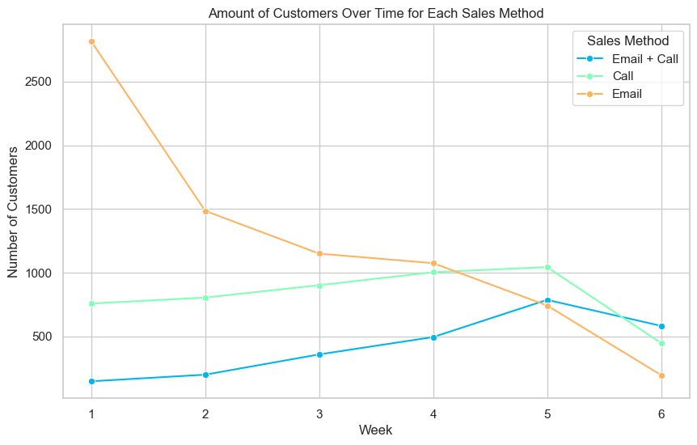
Customers Trend Over Time
Email: average decrease in growth of 36.1%
Call: average decrease in
growth of 4.7%
Email + Call: average increase
in growth of 37.1%

Slide 9
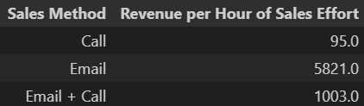
Metric to Monitor
Revenue per hour of sales effort:
This metric accounts for the time spent on each sales approach (Email, Call, Email + Call) and relates it to the revenue generated, computing the revenue per hour by dividing the total revenue by the total sales effort time spent in hours.
By tracking this metric, the business can evaluate the efficiency of each method and optimize resource allocation based on the return generated from time spent by the team.

Slide 10
Summary and Recommendations
Summary: The email method has gathered the most customers and the most revenue so far, the email + call method had the best growth and highest average revenue, and the call method had the second highest number of customers but the lowest revenue of all methods.
Based on the revenue per hour of sales effort metric, the most appropriate recomendation would be to keep the focus on the Email method which is the most time efficient and has generated the most revenue so far, while keeping track of increases in efficiency of the Email + Call method and diverting the efforts from the Call method to Email + Call, as the Call method compares very poorly to the other methods, demanding way too much time and not as much revenue in result.
How does this help solve the problem? By comparing the performance of different sales methods (Email, Call, Email + Call), this project helps the business pinpoint which strategies generate the highest revenue per effort, enabling smarter allocation of resources.
Recommendations:
• Keep the focus on the Email method while keeping track of increases in efficiency of the Email + Call method
• Divert the efforts from the Call method to Email + Call
• Explore new methods of reaching out to new customers
• Gather more information about the period of time of the sale.
• Gather more information about the client, such as demographics and preferences.
• Implement a strategy to improve data collection, such as correcting inconsitent values and identifying the causes of missing values
• Create standardized templates of emails to be sent and include the types into a column on the dataset, so we could take a look at what template of email is the most efficient by A/B testing and other methods.

